Slide 1
User Experience Design Assessment 2
Group Member 1
Group Member 2
Group Member 3
Niall Corbishley – L39596869

Slide 2
Product Overview – D&D Beyond
D&D Beyond is the self-described home of the official digital toolset for fifth edition Dungeons & Dragons (D&D) used for creating characters and running games (Dndbeyond.com. 2024).
The functions that are promoted are the ability to create and manage characters and campaigns; the ability to use the virtual tabletop and share it among the group live; The ability to buy books and content digitally; and as the ability to make your own content digitally and share it among friends and publicly.
Notes:
D&D Beyond is the self-described home of the official digital toolset for fifth edition Dungeons & Dragons (D&D) used for creating characters and running games (Dndbeyond.com. 2024).
The functions that are promoted are the ability to create and manage characters and campaigns; the ability to use the virtual tabletop and share it among the group live; The ability to buy books and content digitally; and as the ability to make your own content digitally and share it among friends and publicly.

Slide 3
Strategic Context
The Product is attempting to capitalise on the recent success of Actual Plays and shows being the core reason for people’s engagement ( Sidhu, P. and Carter, M., 2020)
Success can be measured in the form of:
  consistent traffic to the website.
  it can also be measured by subscription up take and people maintaining their subscription, measured as subscribers per month.
Notes:
The Product is attempting to capitalise on the recent success of Actual Plays like Critical Role and shows like Stranger Things being the core reason for people engagement ( Sidhu, P. and Carter, M., 2020) by providing tools that make the game more accessible to the growing audience. Success can be measured in the form of consistent traffic to the website, not only new traffic, but users returning to the website regularly, measured as users per week, it can also be measured by subscription up take and people maintaining their subscription, measured as subscribers per month.

Slide 4
Design & User Experience
The design of the QuickBuilder specifically built to “spark creativity and reduce cognitive load” allowing users to move from concept to playable character "in just a few steps” by automating the complex calculations that would otherwise overwhelm newcomers to the 5e and 5.5e ruleset (DND Staff, 2026).
D&D beyond hinders through cluster of information that event experienced users struggle with handling, and low processing machines cannot handle its complexity.
Mobile app limits users to single resource open at once (Bubak, 2024) through this limited version of D&D Beyond, which violates the (Jakob Nielsen, 1995) heuristic of user control and freedom.
Notes:
D&D Beyond’s core design and functionality are built around its character creator builder and digital character sheets, showcasing a great effort to reduce the cognitive load on new players and users of D&D Beyond. The platform QuickBuilder is specifically “designed to spark creativity and reduce cognitive load", allowing users to move from concept to playable character "in just a few steps” by automating the complex calculations that would otherwise overwhelm newcomers to the 5e and 5.5e ruleset (DND Staff, 2026). Applying Cognitive Load Theory (Sweller, Ayres and Kalyuga, 2011), the builder effectively eliminates extraneous cognitive load so that the mental effort spent on tasks is irrelevant to the core goal of D&D Beyond's design. However, the design of D&D Beyond hinders experienced and new user experiences through its design and cluster of information that requires innovative knowledge of D&D to be able to navigate the information displayed on their screen. Following this, users with low-processing machines such as a Chromebook will have difficulty handling the complexity of D&D Beyond. Additionally, whereas browsers allow for multiple tabs to be open for resources, the app restricts the user in many ways, such as restricting users to "a single resource open at once" (Bubak, 2024) through this limited version of D&D Beyond, which violates the (Jakob Nielsen, 1995) heuristic of user control and freedom.

Slide 5
Behavioural Design & Persuasion
Artificial scarcity – Non-premium users are limited to 6 character slots so are encouraged to upgrade
Exclusivity – Premium users gain early access to content
Sunk-cost fallacy – Users invest a lot of time into using D&D Beyond and so are reluctant to leave
Choice manipulation – The most expensive subscription is presented as “best value”, so users are nudged into paying more
Notes:
D&D Beyond uses several persuasive design techniques, cognitive biases and behavioural nudges like scarcity and exclusivity. Premium users gain either 1 week or 2 weeks early access to new books depending on their subscription. Limited character slots encourage users to upgrade. Loss aversion is also used as users invest time building characters and campaigns so they may feel reluctant to leave. D&D Beyond also displays the more expensive subscription tier as the "Best Value" nudging users towards it. Ethically the platform make D&D more accessible however it uses exclusivity tactics to pressure users into upgrading, long term investment into characters and content can create dependency on the platform by creating the perception of a sunk-cost falalcy

Slide 6
Inclusivity
Pros
Cons
Complete lack of localisation or internationalisation, reducing its global reach [Jiménez-Crespo, M.A., 2013]
Dungeons & Dragons has the legacy of the “Satanic Panic” of the 1980s [Wilson, A., 2019], which may alienate Christian users
Web based application – accessible from any device with a JavaScript capable web browser, which all modern web browsers support [Mitropoulos, D. et al. (2019) ]
Supports payments in multiple currencies

Slide 7
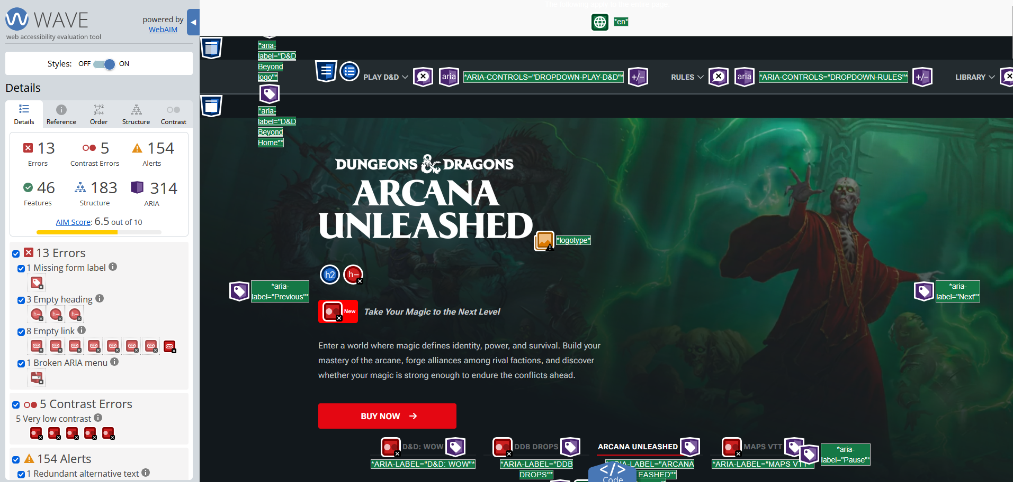
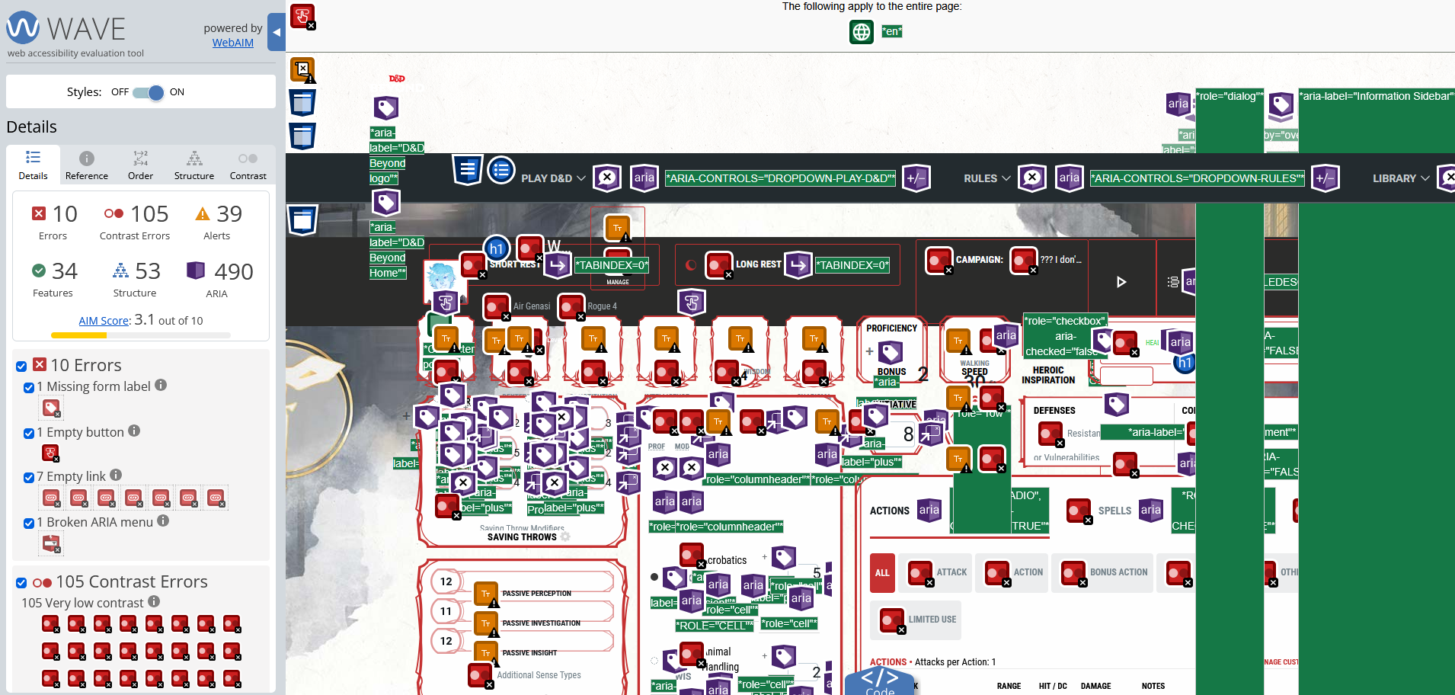
Accessibility
Average of 3.7 on the Web Accessibility Evaluation Tool
Structure is not built to support screen reader technologies [Lazar, J., Allen, A., Kleinman, J. and Malarkey, C., 2007]
Presents large amount of complex information, contributing to cognitive load [Van Merrienboer, J.J. and Sweller, J., 2005]
Notes:
D&D Beyond has relatively poor accessibility
The homepage scores a 6.5 out of 10 on the Web Accessibility Evaluation Tool
The character sheet page (where users spend the most time) scores at a 3.1 out of 10 , falling to a 1.6 with the dark mode theme turned on
Overall, from testing on various pages across the site, D&D Beyond scores a 3.7 on average
Further investigation found that the website’s structure is not built to support screen reader technologies, often missing information or reading off screen text [Lazar, J., Allen, A., Kleinman, J. and Malarkey, C., 2007]
The website uses complex language and does not offer information in more understandable “Easy Read” formats [Lazar, J., Allen, A., Kleinman, J. and Malarkey, C., 2007]

Slide 8
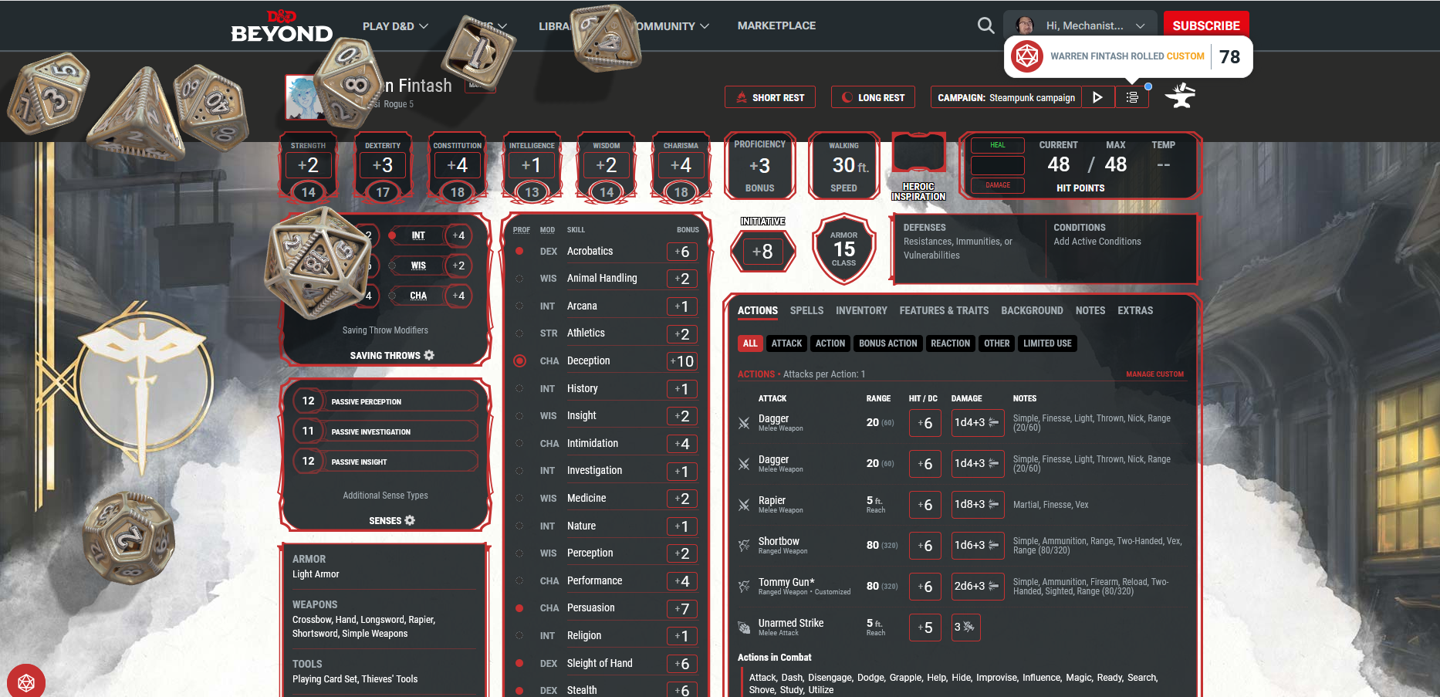
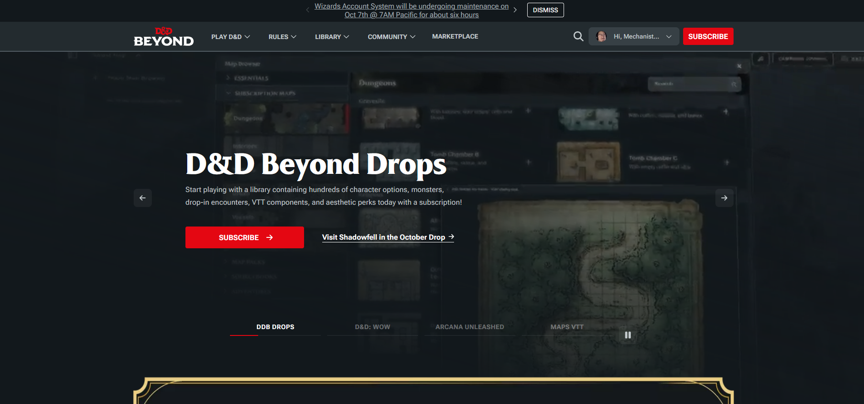
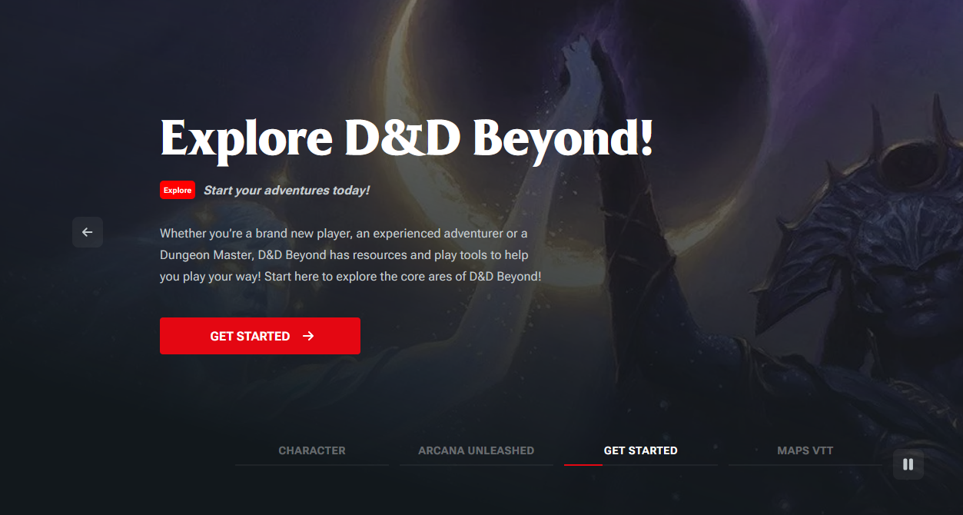
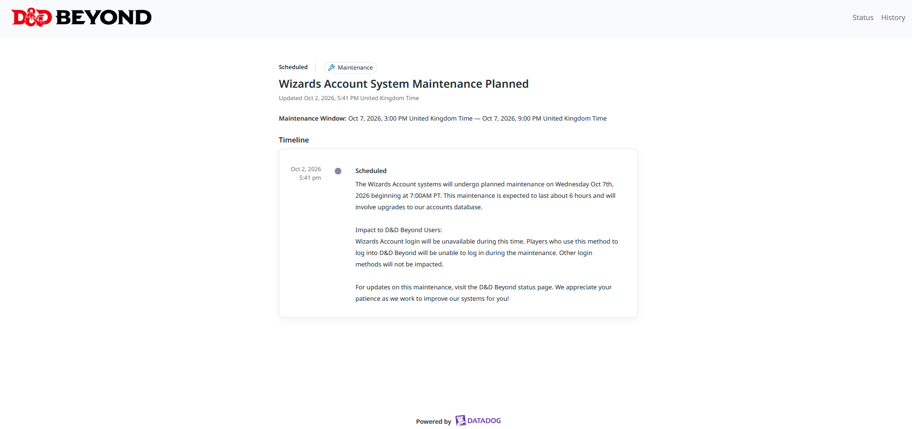
Communication & Feedback – Positives
The landing page of the website immediately offers a guide to new users guides that them through use of the website in simple terms
Users are informed of expected downtime with a banner on the homepage, with a link to more information
Active feedback – virtual dice rolling, highlighting areas, calculated totals
Notes:
Most actions taken on a character sheet have immediate feedback – highlighting areas, virtual dice rolling on the sheet and calculated totals

Slide 9
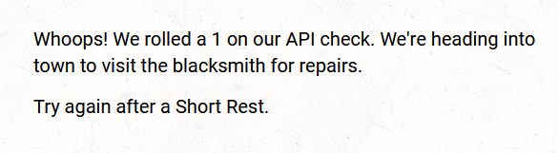
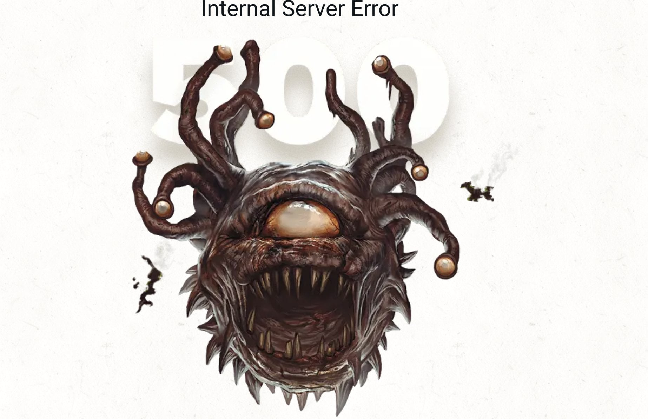
Communication & Feedback – Negatives
Little user feedback for errors, more of a focus on playful theming
Very little guidance for users beyond new-user guides
Information locked behind paid content
Notes:
When an error occurs, the user gets very little feedback, with the website opting to use thematic error codes in lieu of any useful information on how to resolve the error
Beyond the aforementioned new user guide, there is little-to-no guidance for users after that point, leaving users to navigate overwhelming amounts of information by themselves, with much of that information being locked behind paid content

Slide 10
Critical Recommendations
Propose strategic UX or design improvements on the analysis
Improve accessibility of the rules by introducing better search functions
Introduce Dynamic lights to the virtual tabletop and the ability to upload images as tokens and stickers
Simplify and give more control to the creation of homebrew
Implement Interactivity between tokens on virtual tabletops
Improve overall structure of the webpage for screen reader compatibility
Add internationalisation according to i18n standards [Couto, M., et al, 2026]

Slide 11
References
Sidhu, P. and Carter, M., 2020, January. The critical role of media representations, reduced stigma and increased access in D&D’s resurgence. In Proceedings of DiGRA 2020 Conference: Play Everywhere.
Dndbeyond.com. (2024). Blocked Page. [online] Available at: https://www.dndbeyond.com/resources/1793-what-is-d-d-beyond [Accessed 10 Oct. 2026].
Mitropoulos, D. et al. (2019) “Time Present and Time Past: Analyzing the Evolution of JavaScript Code in the Wild.” 2019 IEEE/ACM 16th International Conference on Mining Software Repositories (MSR), pp. 126–137. Available at: https://doi.org/10.1109/MSR.2019.00029.
Jiménez-Crespo, M.A., 2013. Translation and web localization. Routledge.
Wilson, A., 2019. Demons & Devils: The Moral Panic Surrounding Dungeons & Dragons, 1979-1991 (Doctoral dissertation, Department of History, University of Kansas).
Van Merrienboer, J.J. and Sweller, J., 2005. Cognitive load theory and complex learning: Recent developments and future directions. Educational psychology review, 17(2), pp.147-177.
Lazar, J., Allen, A., Kleinman, J. and Malarkey, C., 2007. What frustrates screen reader users on the web: A study of 100 blind users. International Journal of human-computer interaction, 22(3), pp.247-269.
Couto, M., Miranda, B. and Cartaxo, B., 2026. A systematic mapping study on Localization (l10n) and Internationalization (i18n) testing. Information and Software Technology, p.108258.
bubak (2024). D&D beyond - ratings & reviews - app store. [online] App Store. Available at: https://apps.apple.com/cz/app/d-d-beyond/id1501810129 [Accessed 20 Oct. 2026].
Jakob Nielsen (1995). Usability inspection methods. Geneva] Ifip, Internat. Federation For Information Processing.
Sweller, J., Ayres, P. and Kalyuga, S. (2011). Cognitive load theory. [online] New York, Ny: Springer New York. Available at: http://ndl.ethernet.edu.et/bitstream/123456789/54490/1/23.pdf [Accessed 20 Oct. 2026].
DND Staff (2026). Behind the screen: The new quickbuilder and future character builder concepts. [online] D&D Beyond. Available at: https://www.dndbeyond.com/posts/2135-behind-the-screen-the-new-quickbuilder-and-future [Accessed 20 Oct. 2026].

