Slide 1
NHS England A&E Winter performance
Niall McSharry

Slide 2
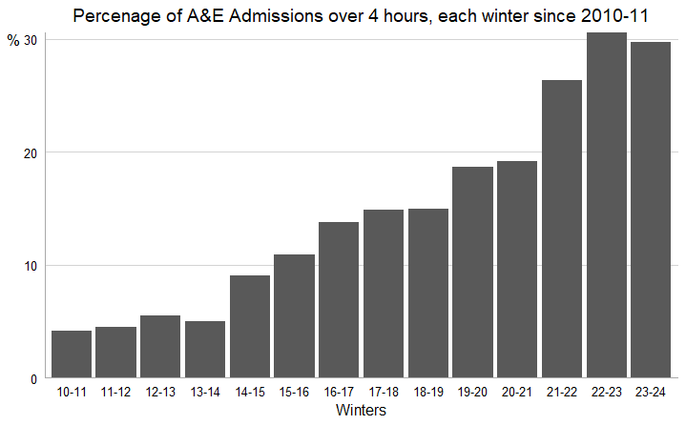
How is performance measured in A&E?
The target waiting time from attendance to admission/transfer/discharge is less than 4hrs
In Winter 2023-24: nearly 30% of attendances were over 4 hours. The 2nd worst performing winter on record

Slide 3
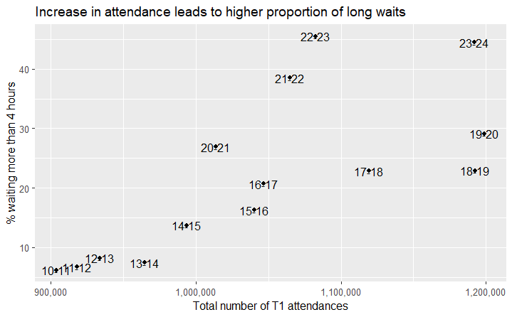
What impacts performance?
Pre-Covid, a 100,000 increase in T1 attendances represented a 7.2pp increase in waiting times exceeding 4 hours
Post-Covid (Excluding 2020-21), there are significantly higher waiting times, and due to the size of the sample it is difficult to create a similar metric.

Slide 4
Predicting performance
More time permitting, I would recommend creating a model which looks at A&E attendances compared with some external factors such as weather, prevalence of flu
With these estimates for attendance, it would be possible to get an improved estimate for performance, based on the assumption discussed previously that increases in attendance lead to increases in delay

Slide 5
Outline of analysis
Data used is public data on NHS A&E wait times from 2010 onwards
Winter was defined as Dec, Jan, Feb
Data was available up to Winter 2023-24

