Slide 1


CS 314 Operating Systems
Chapter 1 (PART 1)
Introduction to OS (concept, evolution, some keywords)
Department of Computer Science
Southern Illinois University Edwardsville
Spring, 2018
Dr. Hiroshi Fujinoki
E-mail: hfujino@siue.edu
Chapter_One/001

Slide 2
CS 314 Operating Systems
Two Primary Roles of Operating Systems
We discussed this subject in the previous PPT slides, but we go
deeper into the technical details.
(1) A middleman between you (as a user) and computer hardware
Operating systems as extended machine
Keyword #1
(2) The government in your computer (the agent that allocate resources)
Operating systems as resource manager
Keyword #2
Chapter_One/002

Slide 3
CS 314 Operating Systems
Operating systems as extended machine
①
②
High-level commands
(e.g., “READ” call)
Low-level commands
(e.g., “OUT 06 1A FE”)
Computer
Hardware
OS
User(s)
High-level outputs
(e.g., “Hello”)
Raw output
(“41 4B 5C 20”)
④
③
Chapter_One/003

Slide 4
CS 314 Operating Systems
Concept of Extended Machine
High-level
commands
Computer System
Computer
Hardware
OS
User
Low-level
Commands
A human user can manipulate computer
Hardware through operating system
Chapter_One/004

Slide 5
CS 314 Operating Systems
Concept of Extended Machine
High-level
commands
Extended Machine
Computer
Hardware
Hardware
Computer
OS
User(s)
“Extended machine” is an imaginary hardware computer
that can be manipulated directly by high-level commands
Chapter_One/005

Slide 6
CS 314 Operating Systems
Definition
Extended Machine =
=
An imaginary computer (as a hardware computer) that can be
manipulated directly by high-level user commands by abstraction
offered by an operating system
(this is for your quiz #1 in the next week)
Chapter_One/006

Slide 7
CS 314 Operating Systems
Operating systems as resource manager
A computer System
Program A
Program B
Request resources
Request resources
Resources
CPU
Network
Memory
Disk
Keyboard
Etc.
Request resources
Request resources
Program D
Program C
Chapter_One/007

Slide 8
CS 314 Operating Systems
Operating systems as resource manager (continued)
Important Fact
Any physical computer resources (CPU, memory, keyboard, disk, etc)
can not be assigned to multiple programs at a given time.
Example
CPU
CPU
A physical CPU
can not be assigned
to more than one
program at a time
Program A
Program B
Memory
Chapter_One/008

Slide 9
CS 314 Operating Systems
Operating systems as resource manager (continued)
CPU
A physical CPU
can not be assigned
to more than one
program at a time
Program A
Program B
Memory
Question
We know that we can run multiple application programs in Windows XP
at the same time. How is this possible, then?
Chapter_One/009

Slide 10
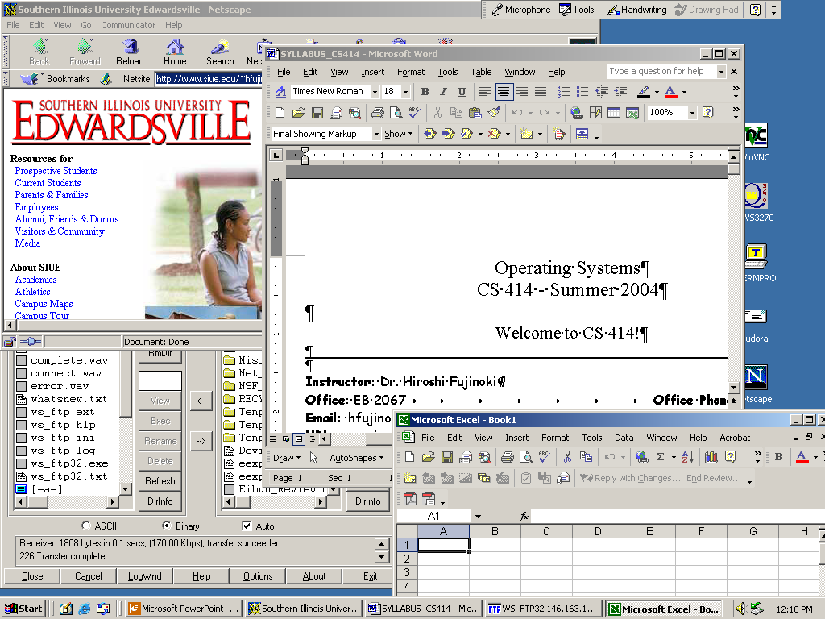
CS 314 Operating Systems
Operating systems as resource manager (continued)
Multi-tasking
Chapter_One/010

Slide 11
CS 314 Operating Systems
Operating systems as resource manager (continued)
Question
We know that we can run multiple application programs in Windows OS
at the same time. How is this possible, then?
Answer
By resource management, called “context switching”.
Context
Switching
Context
Switching
Context
Switching
Program A
Program B
Context
Switching
Program C
Context
Switching
Context
Switching
Context
Switching
Context
Switching
Time
Chapter_One/011

Slide 12
CS 314 Operating Systems
Operating systems as resource manager (continued)
Program A
Program B
Program C
Looks like all
three running
At the same time
Program A
Program B
Program C
Chapter_One/012
Time

Slide 13
CS 314 Operating Systems
Operating systems as resource manager (continued)
Program A
Program B
Program C
Time
Switching the processor from a program to another
It is called “context switching”
(A part of OS process management)
Chapter_One/013

Slide 14
CS 314 Operating Systems
Operating systems as resource manager (continued)
In the previous example, we discussed process management
as an example of resource management, similar (but different)
resource management is performed for every and each resource
available in a computer system
Examples
Memory management (how much for which program?
Printer spooling (= assign the order of printer use)
Deadlock avoidance for other I/O devices
- Everyone got a little I/O resource but not enough
- Everyone waits for other forever
We will discuss all these topics.
Chapter_One/014

Slide 15
CS 314 Operating Systems
Evolution of operating systems
(1) What is the oldest operating system?
(2) Why we do not use the oldest operating system any more?
(3) How operating systems evolved?
(4) How is our Windows XP different from those classical OS?
We will see the answers for these questions!
(and you can answer these questions in Quiz #1 next week ☺)
Chapter_One/015

Slide 16
CS 314 Operating Systems
Evolution of operating systems (continued)
① Pre-Operating Systems
(no OS)
Computer System
CPU
Process it
(run the program)
User Program
Outputs
User Program
User(s)
Memory
Chapter_One/016

Slide 17
CS 314 Operating Systems
① Pre-Operating Systems
(no OS)
Major Properties
No process manager
Only one user application program at a time
No resource manager
We don’t need it.
No automatic program loader/starter
You are the one who does this.
Advantages
(Yes, you did read this correctly, there are some advantages)
Hardware resources are all yours
No one can disturb you (= extremely fast!)
Memory space for OS is not needed
Chapter_One/017

Slide 18
CS 314 Operating Systems
① Pre-Operating Systems
(no OS)
Disadvantages
(There are many, but what was the most serious one?)
A user can not leave the computer room and relax in his/her office
Price of computer hardware was extremely expensive
- Once your program is finished, you have to save the
outputs and cleanup the computer system immediately.
Basically you work as a slave for the
computer system (not as a user) ☹
Solution is “batch system”
Chapter_One/018

Slide 19
CS 314 Operating Systems
② Batch Systems
User Programs
A
Computer System
B
CPU
C
Process it
(run the program)
D
Outputs
E
User Program
User(s)
Program Loader
Memory
Chapter_One/019

Slide 20
CS 314 Operating Systems
② Batch Systems
Major Properties
The program loader monitors progress of program execution
As soon as a program is completed, the program loader loads the next
As long as programs (“jobs”) exists, a computer keeps running
Advantages
A computer system continues to execute programs, one at a time
(you no longer have to manually load programs)
Disadvantages
What if your program has a bug?
Computer does not fix it for you
CPU utilization could be low
Chapter_One/020

Slide 21
CS 314 Operating Systems
③ Multitasking and Timesharing OS
Multitasking
User Programs
A
Computer System
B
CPU
C
D
Outputs
E
D
C
B
A
User(s)
Program Loader
Memory
Chapter_One/021

Slide 22
CS 314 Operating Systems
③ Multitasking and Timesharing OS
Multitasking & Timesharing
User Programs
A
Computer System
B
CPU
C
D
E
D
C
B
A
Program Loader
Memory
Chapter_One/022
user
user
user
user

Slide 23
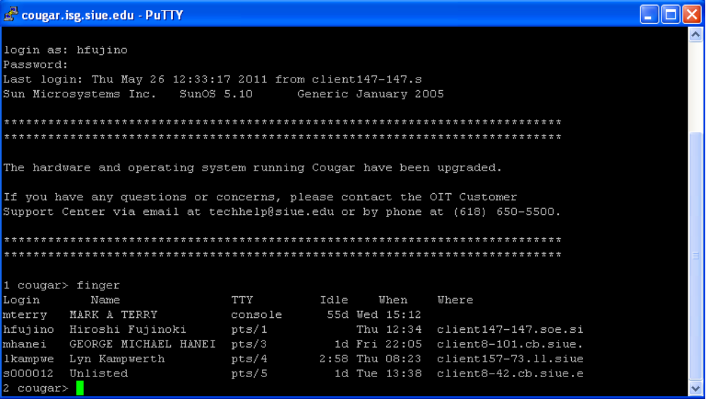
CS 314 Operating Systems
③ Multitasking and Timesharing OS
Chapter_One/022

Slide 24
CS 314 Operating Systems
③ Multitasking and Timesharing OS
Multitasking
Multiple programs can be in memory at the same time
While a program does not need the CPU, CPU can be assigned
to another program
CPU utilization will be improved
Advantage
A small program that was submitted after big ones could finish
before the big ones
Average waiting time will be improved
Advantage
It’s not “interactive”
Disadvantage
Chapter_One/023

Slide 25
CS 314 Operating Systems
③ Multitasking and Timesharing OS
Multitasking
User Programs
A
Computer System
B
B stops and it
leaves the system
CPU
B is placed at
the end of queue
C
D
E
D
C
B
A
Program Loader
Memory
If B has a bug
Chapter_One/024

Slide 26
CS 314 Operating Systems
③ Multitasking and Timesharing OS
Multitasking & Timesharing
Multiple programs can be in memory at the same time
While a program does not need the CPU, CPU can be assigned
to another program
CPU utilization will be improved
Advantage
A small program that was submitted after big ones could finish
before the big ones
Average waiting time will be improved
Advantage
It’s “interactive”
Advantage
Chapter_One/025

Slide 27
CS 314 Operating Systems
③ Multiprogramming (= “multitasking”) and Timesharing OS
Multitasking & Timesharing
User Programs
A
Computer System
B can be restarted
(in an interactive way)
B
CPU
C
D
E
D
C
B
A
Program Loader
Memory
interact
user
user
user
user
Chapter_One/026

Slide 28
CS 314 Operating Systems
Summary of this presentation
In this presentation, we have covered the following key concepts in OS:
① Two primary roles of OS
Extended machine and resource manager
② Context switching
Provide users with pseudo-parallelism
③ Batch system
The most primitive operating system
④ Multiprogramming
Improve CPU utilization and execution time
⑤ Time sharing
Allows users interactive operations
Chapter_One/027

