Slide 1


CS 314 Operating Systems
Chapter 1 (PART 2)
Operating System Concepts
Department of Computer Science
Southern Illinois University Edwardsville
Spring, 2018
Dr. Hiroshi Fujinoki
E-mail: hfujino@siue.edu
Chapter_One_2/001

Slide 2
CS 314 Operating Systems
Operating System Concepts
This PPT presentation covers Section 1.5 of the textbook.
(1) Process
(2) Deadlock avoidance in I/O resource management
(3) Files and file descriptor
(4) Special Files
Chapter_One/002

Slide 3
CS 314 Operating Systems
Subjects covered about “process”
What is “process”?
How is it different from “program”?
What we can do by “processes”?
Solutions
Q: What is “process”?
A: “Process” is a program in execution.
program
“program” is an executable
file stored in a disk
Stored as a file
HDD
Chapter_One/003

Slide 4
CS 314 Operating Systems
Then how a “program” can become “process”?
A program becomes a process
when one is loaded into the memory for execution by CPU
CPU
program
Load
Stored as a file
HDD
Memory
Chapter_One/004

Slide 5
CS 314 Operating Systems
Things needed for a program to be executed in memory
CPU
PCB is a data structure for the CPU
to keep track of each process
PCB-Z
PCB-A
PCB-X
Program Z
① Stack Memory
② Program Code
Address
Space
Program
③ Heap Memory
HDD
Program X
PCB = Process Control Block
Process
Memory
Chapter_One/005

Slide 6
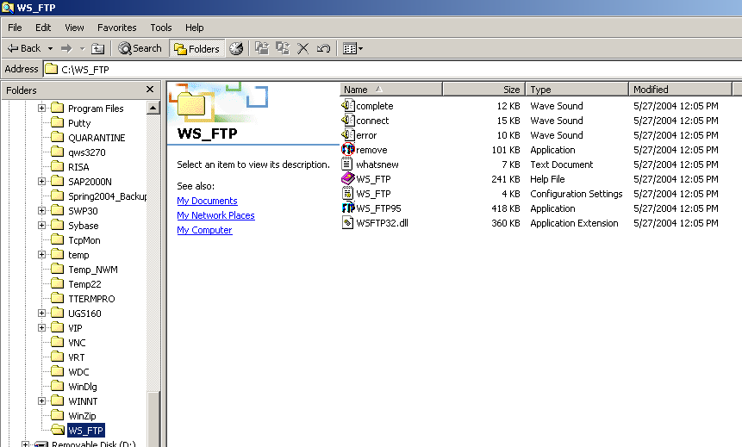
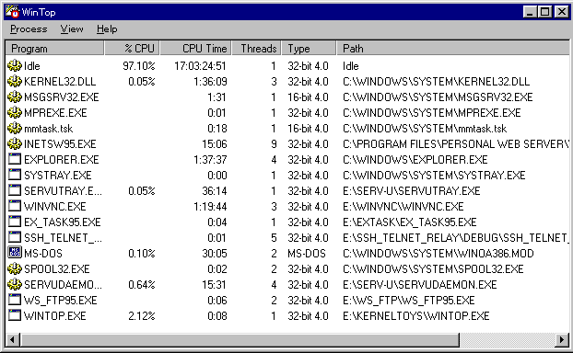
CS 314 Operating Systems
Example of “program” and “process”
Program
Static object, usually exists as an executable file
Process
Program in execution
This is a program
This is a process (program in execution)
Chapter_One/006

Slide 7
CS 314 Operating Systems
Intermediate summary of “process”
It is a program in execution
A process consists of the contents in process address space and PCB
Process address space consists of:
① Program Code
Collection of assembly instructions CPU runs
② Stack Memory Space
Stack data structure for sub-routine calls
③ Heap Memory Space
Other data structure (local/global variables)
Questions
① Where are PCBs located?
② What information does PCB hold?
Chapter_One/007

Slide 8
CS 314 Operating Systems
Things needed for a program to be executed in memory
① Where are PCBs located?
CPU
In the operating system
PCB-Z
PCB-A
PCB-X
Program Z
Program Y
Program X
OS
Memory
Chapter_One/008

Slide 9
CS 314 Operating Systems
Operating System Structure
This PPT presentation covers Section 1.7 of the textbook.
① Monolithic Structure
② VM (Virtual Machine)
Windows uses these concepts
③ Micro-Kernel
Chapter_One/009

Slide 10
CS 314 Operating Systems
Monolithic Structure OS
Operating systems are essentially a collection of procedures.
Monolithic Structure OS
No structure in a collection of procedures
(Any procedure or a user application can call any other procedure)
Program
OS Procedures
user
Big mess
Memory Mgmt.
Disk I/O
But fast
(no overhead)
Printer Spooler
Process Mgmt.
IPC
KB I/O
Chapter_One/010

Slide 11
CS 314 Operating Systems
How is a Monolithic-Structured OS implemented?
Operating system as
an executable program
OS Procedures
Memory Mgmt.
Disk I/O
OS
Printer Spooler
Process Mgmt.
IPC
KB I/O
Compile
Disk I/O
Memory Mgmt.
Source code
modules
Process Mgmt.
Concatenate into
one source code file
IPC
KB I/O
Printer Spooler
Chapter_One/011

Slide 12
CS 314 Operating Systems
How is a Monolithic-Structured OS implemented?
External Commands
“OS” in a broader definition
Disk I/O
Operating system as
an executable program
Memory Mgmt.
awk
Process Mgmt.
IPC
OS
grep
KB I/O
sort
Printer Spooler
exec ();
System calls
execute
“OS Kernel”
Program
user
Chapter_One/012

Slide 13
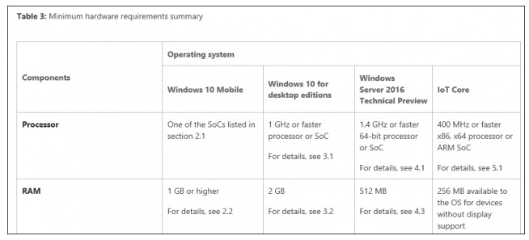
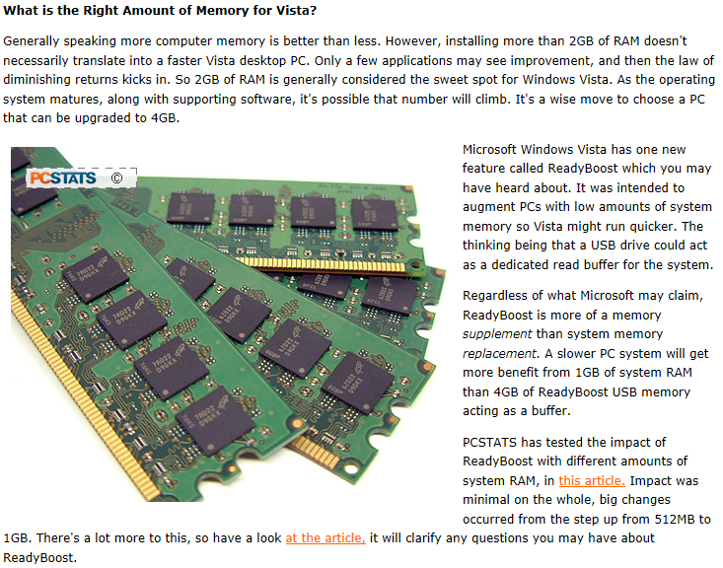
CS 314 Operating Systems
Ever-increasing minimum memory footprint
Chapter_One/009

Slide 14
CS 314 Operating Systems
Virtual Machine (VM)
user
Without VM
App1
• • •
App N
Operating System
Hardware
Application programs
A virtual machine
With VM
• • •
• • •
• • •
Extra layer on
top of hardware
OS₁
OS₂
OS₃
Virtual Machine Support
Windows 2000
UNIX
MS-DOS
Hardware
Chapter_One/013

Slide 15
CS 314 Operating Systems
Concept of VM
• • •
• • •
• • •
OS₁
OS₂
OS₃
Virtual Machine Support
Hardware
For each application program,
it looks like they are being
executed by the dedicated
hardware
• • •
• • •
• • •
OS₁
OS₂
OS₃
Hardware₁
Hardware₂
Hardware₃
Chapter_One/014

Slide 16
CS 314 Operating Systems
Implementation of of VM
With VM
Without VM
Process X
VM₁
Process Y
Process
Manage
OS₁
Process X
Process M
Process Z
VM₂
Process N
Process
Manage
OS₃
Process Y
Process A
VM₃
Process B
Process
Manage
OS₂
OS
VMS
Process
Manage
VM
Manage
Memory
Memory
Chapter_One/015

Slide 17
CS 314 Operating Systems
Summary of Virtual Machine (VM)
VM
A virtual computer where computer hardware is software-emulated
by VMS (Virtual Machine Support)
Provide virtual dedicated machine (= hardware) to each OS
- For flexibility
Multiple operating systems (and its applications) at once
(Q: What’s the difference from “multiple boot”?)
- For robustness
One VM crashes, others still survive
(EG: Windows-NT)
Chapter_One/016

Slide 18
CS 314 Operating Systems
Micro-Kernel Architecture
External Commands
“OS” in a broader definition
Disk I/O
Memory Mgmt.
awk
Process Mgmt.
IPC
OS
grep
KB I/O
sort
Printer Spooler
“OS Kernel”
Chapter_One/017

Slide 19
CS 314 Operating Systems
Micro-Kernel Architecture (continued)
External Commands
“OS” in a broader definition
Disk I/O
Memory Mgmt.
awk
Memory Mgmt.
Process Mgmt.
OS
Process Mgmt.
IPC
grep
KB I/O
Printer Spooler
sort
Printer Spooler
“OS Kernel”
Chapter_One/018

Slide 20
CS 314 Operating Systems
Micro-Kernel Architecture (continued)
In ordinary OS (not Micro-Kernel OS), OS has to provide
all the user services in Kernel-mode services
User-Mode
System Call
User Program
Operating System
Kernel-Mode
Computer Hardware
OS Procedure (in the OS kernel)
OS kernel tends to be huge
Chapter_One/019

Slide 21
CS 314 Operating Systems
Micro-Kernel Architecture (continued)
Micro-kernel Architecture
Make the OS kernel as small as possible
Client
Server
User-Mode
User Program
Spooler
Operating System
Kernel-Mode
Computer Hardware
Micro-Kernel Architecture is based on Client-Server Model
Operating System becomes a service broker
Chapter_One/020

Slide 22
CS 314 Operating Systems
Micro-Kernel Architecture (continued)
What is it good for?
(1) Each OS function becomes a module
A bug in OS can be fixed by replacing a module
(what we should do if “monolithic structure kernel”?)
MS Windows uses micro-kernel architecture for this reason
(2) Better robustness
OS functions may be executed in user-mode
(a bug in a module will not crash the kernel)
Chapter_One/021

Slide 23
CS 314 Operating Systems
Deadlock avoidance in I/O resource management
What is “deadlock”?
More than one process wait for resource for each other for forever
Example
Assume that there are two processes
Each of the two processes requires printer and HDD at the same time
Without the printer and HDD, neither can finish its tasks
Resources
Process B
Process A
wait
Deadlock
Assigned
Printer
(Circular-wait)
HDD
Assigned
wait
Chapter_One/022

Slide 24
CS 314 Operating Systems
Concept of files and file descriptor
What is a file?
Logical data storages in computer systems
What is “file descriptor”?
Logical identification for each file being used
in a computer system.
① open
④ use
② read
file
⑤ close
③ load
user
OS
HDD
Chapter_One/023

Slide 25
CS 314 Operating Systems
Concept of files and file descriptor (continued)
Open “A.txt”
A
Find/Access
Y
Load
B
File Descriptor
X
User
OS
File Names
HDD
File Allocation Table
Location
on disk
“A.txt”
File Names
Sector Locations
Read (FD)
Write (FD)
Append (FD)
A.txt
1E→23→CD→×
Sectors
Track
Platters
Chapter_One/024

Slide 26
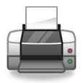
CS 314 Operating Systems
Concept of Special Files
Ordinary File
OS
file
user
HDD
Special Files
Can not be seen
by human user
Users can I/O to
many devices as if they
were a file
HDD
Request
Request
Request (1)
Modem
Network
Internet
OS
Internet
Response (4)
user
Keyboard
Chapter_One/025
Special Files
printer

Slide 27
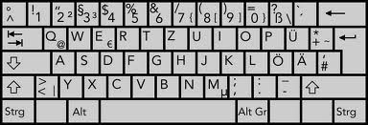
CS 314 Operating Systems
Concept of Special Files
file
Can not be seen
by human user
fd = open (my_text, READ_WRITE);
write (fd, out_buffer);
read (fd, in_buffer);
HDD
close (fd);
file
OS
user
Keyboard (KB)
fd = open (LPT, WRITE);
write (fd, out_buffer);
close (fd);
file
fd = open (KB, READ);
read (fd, in_buffer);
close (fd);
Printer (LPT)
Chapter_One/026

Slide 28
CS 314 Operating Systems
Special Files
A concept in OS where a user can handle many different I/O devices
using the same interface (APIs) that is used for actual files.
When you open (reserve) a resource, OS gives you “descriptor”
Some special files are read-only and some others may be write-only
Read/Write
Read-Only
Write-Only
- Disks
- Keyboard
- Printer
- Network
- Mouse
- CRT Monitor
CRT Monitor
(with touch-pen support)
- CD-ROM
Chapter_One/027

