Slide 1


CS 314 Operating Systems
TWO Processor Modes
USER and KERNEL modes
Department of Computer Science
Southern Illinois University Edwardsville
Spring, 2018
Dr. Hiroshi Fujinoki
E-mail: hfujino@siue.edu
Two_Processor_Modes/001

Slide 2
CS 314 Operating Systems
What are the two processor modes?
* Intel calls it “protected mode”
① KERNEL (“SYSEM”) mode*
The mode of a processor in which a processor can execute
any instruction (no restriction on the type of instructions)
② USER mode
The mode of a processor in which there are restrictions on
the type of instructions (listed below) a processor can executes
Send a command to an I/O device (printers, hard drives, and etc.)
Access (both “read” and “write”) to any memory address in a computer system
Activate/disable “hardware interrupts” (“interrupt” discussed in CS286)
Kill currently existing processes
Many others
Two_Processor_Modes/002

Slide 3
CS 314 Operating Systems
What are the two processor modes?
① KERNEL (“SYSEM”) mode
The mode of a processor in which a processor can execute
any instruction (no restriction on the type of instructions)
② USER mode
The mode of a processor in which there are restrictions on
the type of instructions (listed below) a processor can executes
Mode Flag
1 – KERNEL mode
0 – USER mode
Processor
Two_Processor_Modes/003

Slide 4

CS 314 Operating Systems
How is the processor mode used?
• When a processor is executing an operating system, the processor
should be in KERNEL (“SYSEM”) mode
• When a processor is executing any user process, the processor
should be in USER mode
OS performs the requested
task in KERNEL mode
KERNEL
MODE
OS
OS
OS
OS
OS
USER
MODE
context
switching
user process
user process
user process
user process
time
You power-on
your PC
Your process
calls “wait”
for a semaphore
Your process
requests more
memory space
Your process
creates a new
file in HDD
You start
a user process
Your process
has data to
a printer
Two_Processor_Modes/004

Slide 5
CS 314 Operating Systems
How is the processor mode changed?
USER→KERNEL
This jump address
can be setup only
in the KERNEL mode
Hardware
Interrupter
① USER→KERNEL
KERNEL→USER
Jump to a specific
memory address (OS)
It’s easy to do!
Processor
Processor
① Mode Change
OS
OS
1
0
1
0
Any system call
automatically lets (“forces”)
a processor jump
to the hardware interrupter
② Context-switch to
the user process
system
calls
Processor
User App.
Process
Processor
User App.
Process
0
0
Two_Processor_Modes/005

Slide 6
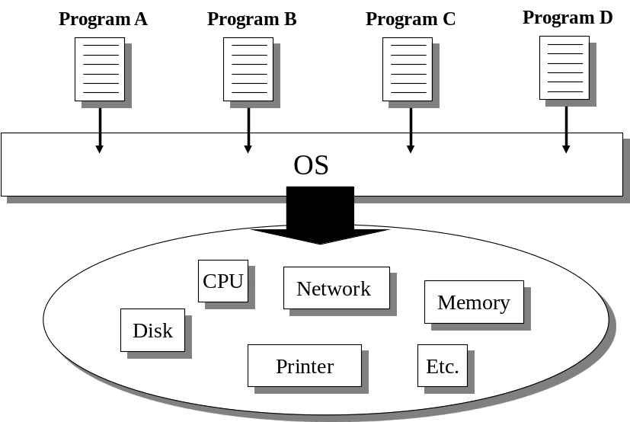
CS 314 Operating Systems
Conclusions
① The USRE mode in a processor prohibits user processes from directly
accessing hardware resources.
Forcing user processes (those running in USER mode) to call the OS
(system calls) when user processes need hardware resources.
After all, USER/KERNEL
modes are the key to keep
the OS as the government.
Two_Processor_Modes/006

