Slide 1


CS 314 Operating Systems
Process Synchronization
Race Condition, Mutual Exclusion and Semaphores
Department of Computer Science
Southern Illinois University Edwardsville
Spring, 2018
Dr. Hiroshi Fujinoki
E-mail: hfujino@siue.edu
ProcessSynch/000

Slide 2
CS 314 Operating Systems
Race Condition & Mutual Exclusion
Race Condition
= a situation in which the final results on a shared resource depends on
unpredictable context-switching for the processes that share the resource
Initially A = 0
Only each instruction
is “atomic”
Shared Memory
Process
Process
A := A + 8
P₁
A
P₂
A := A - 3
LOAD R1, (A)
LOAD R3, (A)
ADD R1, R1, 8
ADD R3, R3, -3
STORE (A), R1
Processor
STORE (A), R3
A = 5
ProcessSynch/001

Slide 3
CS 314 Operating Systems
Race Condition & Mutual Exclusion
Race Condition
= a situation in which the final results on a shared resource depends on
unpredictable context-switching for the processes that share the resource
Context-Switching
by OS happens here
Shared Memory
Process
Process
A := A + 8
P₁
A
P₂
A := A - 3
LOAD R1, (A)
LOAD R3, (A)
ADD R1, R1, 8
ADD R3, R3, -3
STORE (A), R1
Processor
STORE (A), R3
A = 8
ProcessSynch/002

Slide 4
CS 314 Operating Systems
Race Condition & Mutual Exclusion
Race Condition
= a situation in which the final results on a shared resource depends on
unpredictable context-switching for the processes that share the resource
Context-Switching
by OS happens here
Context-Switching
by OS happens here
Shared Memory
Process
Process
A := A + 8
P₁
A
P₂
A := A - 3
LOAD R1, (A)
LOAD R3, (A)
ADD R1, R1, 8
ADD R3, R3, -3
STORE (A), R1
Processor
STORE (A), R3
A = -3
ProcessSynch/003

Slide 5
CS 314 Operating Systems
Critical Section is a section in
a program where at most one
process can exist at any given time
Mutual Exclusion
Mutual Exclusion (A.K.A. “Mutex”) is a solution for race condition
Wait
Signal
If S > 0, do S = S - 1 then proceed
If S = 0, wait on this semaphore
Shared Memory
If no one waiting on S, set S = 1
If some one waiting on S, let the first
proceed to CS and leave S = 0
Process
Process
A
P₂
A := A + 2
P₁
A := A - 9
• • •
• • •
• • •
• • •
P₂ blocks here
• • •
• • •
Wait(S)
Wait(S)
LOAD R1, (A)
LOAD R1, (A)
Critical
Section
Processor
Critical
Section
ADD R1, R1, 2
ADD R1, R1, 2
STORE (A), R1
STORE (A), R1
Signal(S)
Signal(S)
• • •
• • •
• • •
1
• • •
0
• • •
• • •
Semaphore
(Binary Semaphore)
ProcessSynch/004

Slide 6
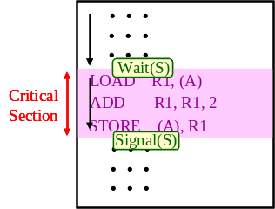
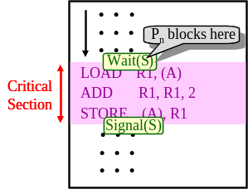
CS 314 Operating Systems
Counting Semaphores
The semaphores that are initialized by an integer larger than 1
A
Process
Process
P₃
3
P₄
2
0
1
Process
Semaphore
(Binary Semaphore)
Process
P₁
P₂
ProcessSynch/008

Slide 7





CS 314 Operating Systems
Where are semaphores?
A situation in which some processes suffer from waiting for their execution
Process
Process
P₃
0
P₄
Process
Semaphore
(Binary Semaphore)
Process
P₁
P₂
1
OS
A host computer
ProcessSynch/009

Slide 8
CS 314 Operating Systems
Starvation
A situation in which some processes suffer from waiting for their execution
Process
Process
P₅
P₆
A
Process
Process
P₃
0
P₄
Process
Semaphore
(Binary Semaphore)
Process
P₁
P₂
Process
Process
P₇
P₈
1
ProcessSynch/007

Slide 9
CS 314 Operating Systems
Starvation
A situation in which some processes suffer from waiting for their execution
A
Process
Process
P₃
0
P₄
Process
Semaphore
(Binary Semaphore)
Process
P₁
P₂
1
ProcessSynch/005

Slide 10
CS 314 Operating Systems
Starvation
A situation in which some processes suffer from waiting for their execution
Process
Process
P₅
P₆
A
Process
Process
P₃
0
P₄
Process
Semaphore
(Binary Semaphore)
Process
P₁
P₂
1
ProcessSynch/006

