Slide 1
introduction to graphs
CS340

Slide 2
Graphs
G = (V, E)
A graph consists of a set of vertices, and a set of edges representing some kind of connection between specific vertices.
Edges and vertices are abstractions that can represent virtually anything

Slide 3
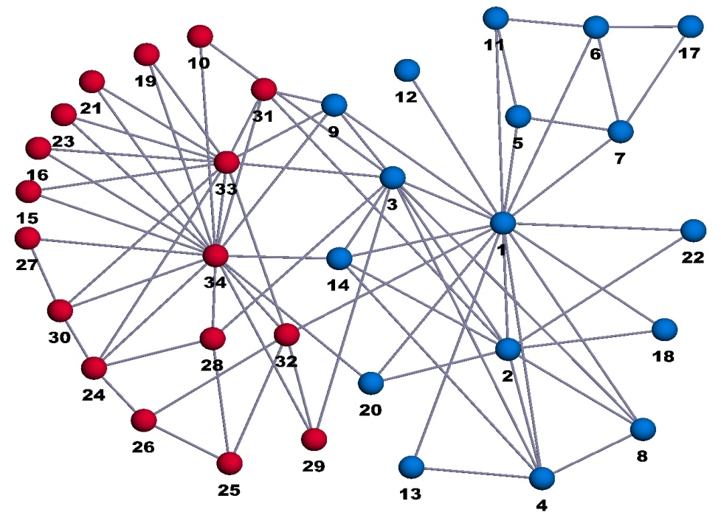
Graphs can represent…
Computer networks
Design of computer chips
Communications networks
Water flow
Streets and traffic
Airline routes
The structure of the internet
Linguistic models
Chemical reactions
Protein interactions
Molecular interactions
Coloring problems
Social interactions
Rumor spreading
Epidemiology
Covert crime networks
Acquaintanceships
Friendships
Matchmaking
Collaborations
Economic transactions

Slide 4
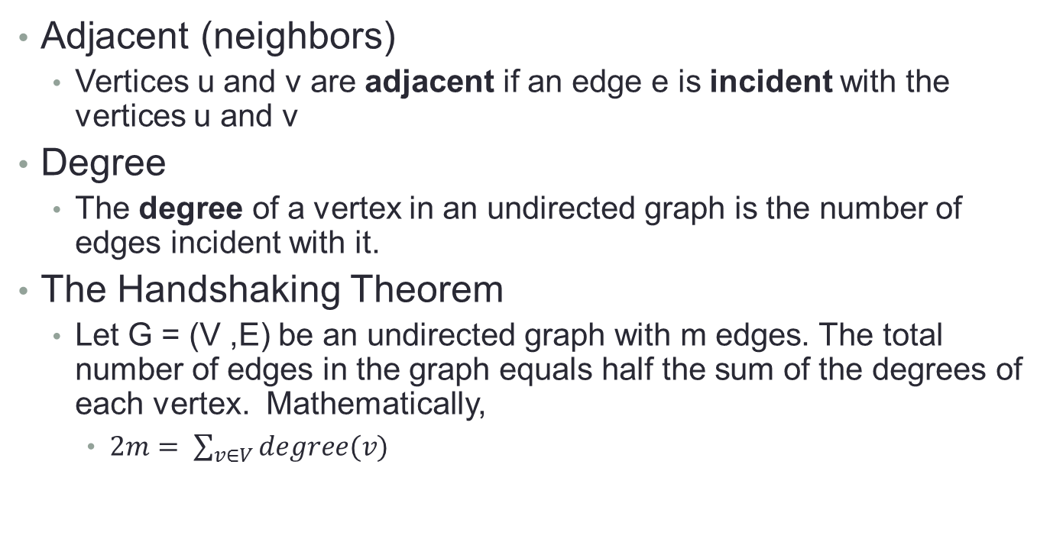
Terminology
Adjacent (neighbors)
Vertices u and v are adjacent if an edge e is incident with the vertices u and v
Degree
The degree of a vertex in an undirected graph is the number of edges incident with it.
The Handshaking Theorem
Let G = (V ,E) be an undirected graph with m edges. The total number of edges in the graph equals half the sum of the degrees of each vertex. Mathematically,
$2m= \sum_{v∈V}{degree(v)}$

Slide 5
Terminology
Complete
A graph that has all possible edges.
Bipartite
A graph that can be partitioned into two disjoint sets V1 and V2 such that every edge in the graph connects a vertex in V1 and a vertex in V2.
Directed/Undirected
A directed edge is directed from one vertex to another. It flows in one direction.
Weighted
Edges of a graph have associated weights.

Slide 6
Terminology
Sparse graph
The size of the set of edges |E| is much less than the square of the size of the set of vertices |V|². Counter-concept is a dense graph.
Cycle
Traversal of a graph that starts and ends at the same vertex but otherwise has no repeated vertices or edges.
Acyclic
Containing no cycles
Tree
An acyclic graph

Slide 7
Interview Questions
Why is the total number of edges only half the sum of the degrees of the vertices?
How many edges does a complete graph with n vertices have?
What might edge weights represent?

Slide 8
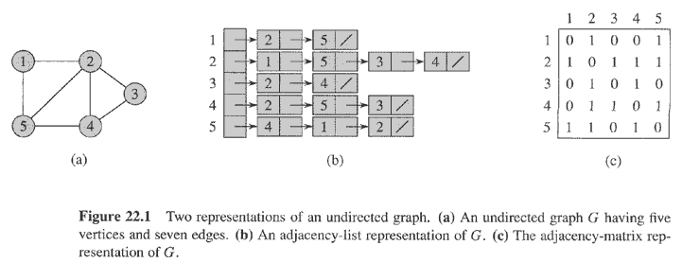
Representation of graphs
Graph is undirected, so adjacency matrix is symmetric along the diagonal.
Adjacency list
Adjacency matrix

Slide 9
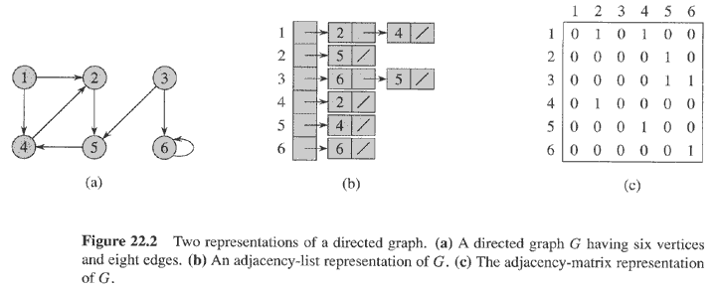
Representation of a directed graph

Slide 10
Representation of graphs
Adjacency list
Array Adj of |V| lists, one per vertex.
Preferred for sparse graphs (why?)
Weights and other info can be stored with each vertex
Time: to list all vertices adjacent to u: Θ(degree(u))
Time: to determine whether (u, v) ∈ E: O(degree(u))
Adjacency matrix
1 or weight in matrix represents an edge
Preferred for dense graphs
Preferred if we need to determine quickly if an edge exists (why?)
Time: to list all vertices adjacent to u: Θ(V)
Time: to determine whether (u, v) ∈ E: Θ(1)

Slide 11
Interview Questions
Given an adjacency-list representation of a directed graph, how long does it take to compute the out-degree of every vertex? How long does it take to compute the in-degrees?
For the questions above, how long does it take with an adjacency-matrix representation?
Give an adjacency-list representation for a complete binary tree on 7 vertices. Give an equivalent adjacency-matrix representation. Assume that vertices are numbered from 1 to 7 as in a binary heap.

Slide 12
Interview Questions
Suppose that instead of a linked list, each array entry Adj[u] is a hash table containing the vertices v for which (u,v) ∈ E. If all edge lookups are equally likely, what is the expected time to determine whether an edge is in the graph?
What disadvantages does this scheme have? Suggest an alternate data structure for each edge list that solves these problems.
Does your alternative have disadvantages compared to the hash table?

Slide 13
Breadth First Search
Input: A graph and a source vertex, s
Send a wave out from s.
First hits all vertices 1 edge from s.
From there, hits all vertices 2 edges from s.
Etc.
Use FIFO queue Q to maintain wavefront.
v∈Q if and only if wave has hit but has not come out of yet.

Slide 14
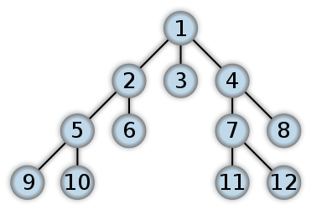
The "wave" of BFS
← 1 edge from s
← 2 edges from s
← 3 edges from s

Slide 15
Breadth-First Search
Discovers every vertex that is reachable from the source
Computes distance (in edges) from source to each reachable vertex
Can construct a breadth-first tree of reachable vertices
BFS may not reach all vertices

Slide 16
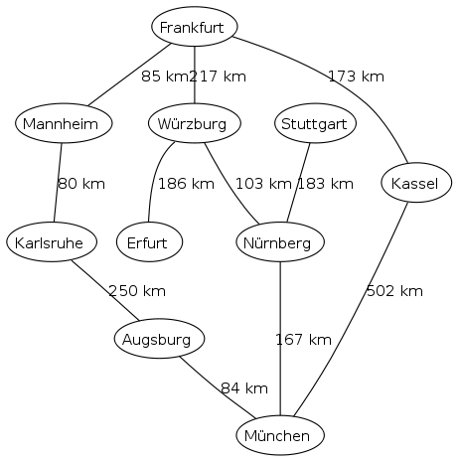
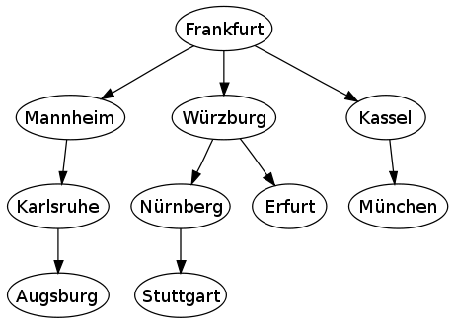
Breadth-First Search starting at Frankfort

Slide 17
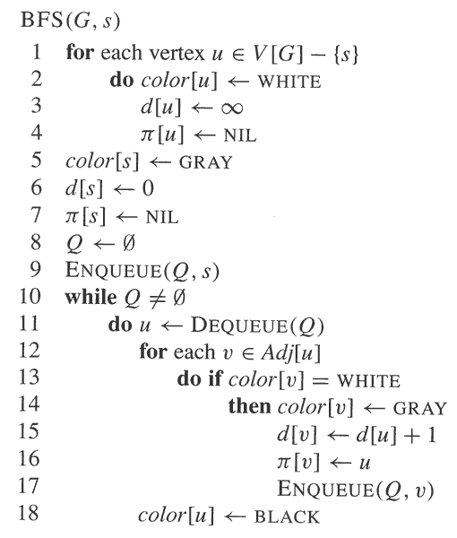
BFS
All edges start out white
When an edge is discovered (and put into the queue) it is colored gray. Gray vertices have not yet had their adjacency lists fully examined.
When an edge is removed from the queue it is colored black
The queue consists only of gray nodes

Slide 18
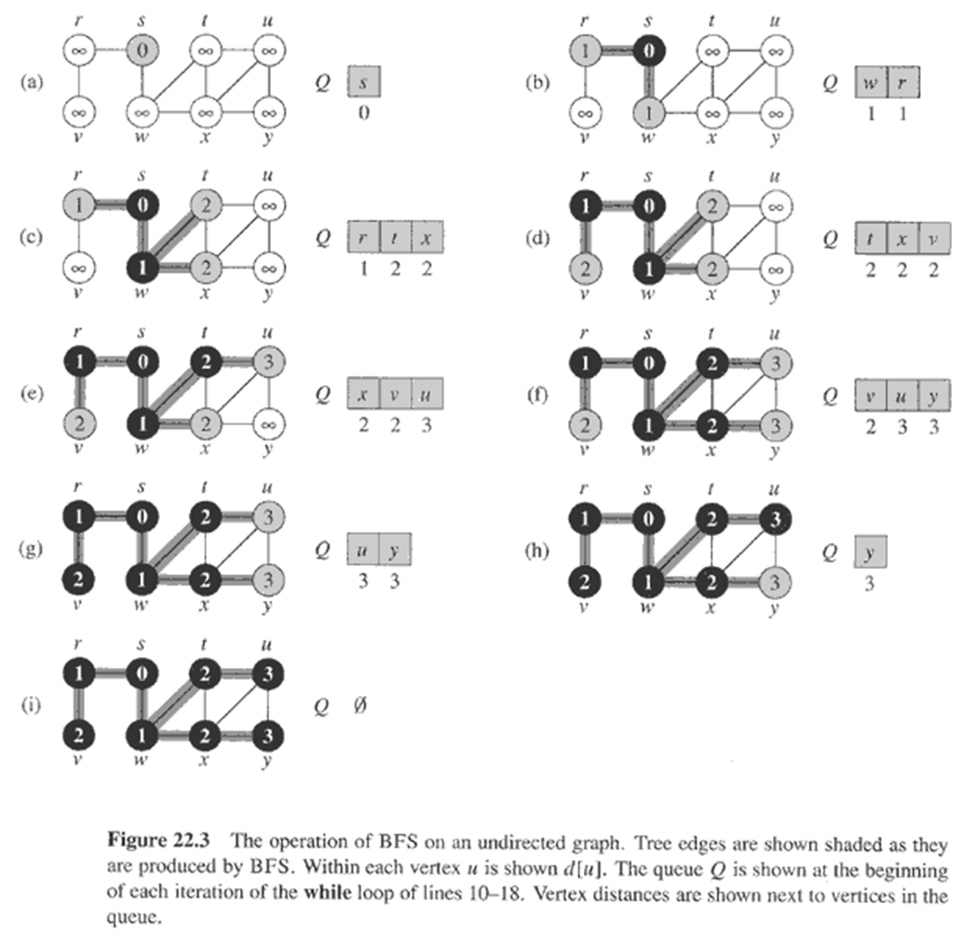
BFS

Slide 19
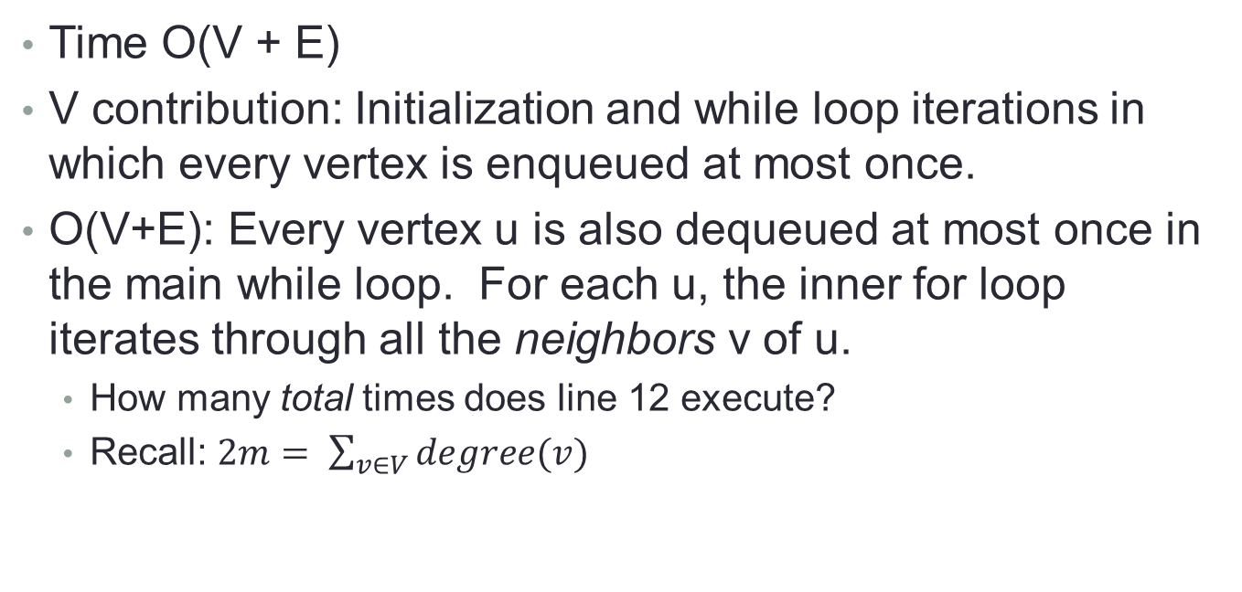
Running time
Time O(V + E)
V contribution: Initialization and while loop iterations in which every vertex is enqueued at most once.
O(V+E): Every vertex u is also dequeued at most once in the main while loop. For each u, the inner for loop iterates through all the neighbors v of u.
How many total times does line 12 execute?
Recall: $2m= \sum_{v∈V}{degree(v)}$

Slide 20
Shortest Path ideas
For any edge (u, v) → distance(s,v) ≤ distance (s,u) + 1
PROOF: If u is reachable from s, then so is v. In this case, the shortest path from s to v cannot be longer than the shortest path from s to u followed by the edge (u, v)

Slide 21
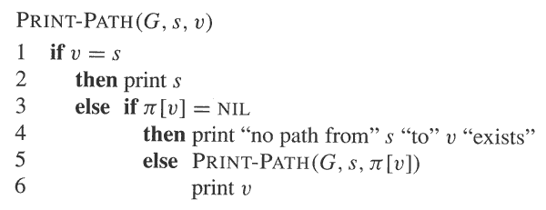
Print-Path
Assumes shortest-paths tree has been computed
Running time: linear in number of vertices in the path

Slide 22
Interview Questions
Show the d and π values that result from running breadth-first search on figure a, using vertex 3 as the source.
Show the d and π values that result from running breadth-first search on figure a, using vertex u as the source.

Slide 23
Interview Questions
Show that using a single bit to store each vertex color suffices by arguing that the BFS procedure would produce the same result if lines 5 and 14 were removed.
What is the running time of BFS if we represent its input graph by an adjacency matrix and modify the algorithm to handle this form of input?
Describe how you can find your way out of a maze if you are given a large supply of pennies.

