Slide 1
Disjoint Set data structures
CS340

Slide 2
Disjoint-set data structures
Also known as “union find.”
Disjoint = "no elements in common"
Maintain collection S = {S₁,…,S_{k}} of disjoint dynamic (changing over time) sets.
Each set is identified by a representative, which is some member of the set.
Doesn’t matter which member is the representative, as long as if we ask for the representative twice without modifying the set, we get the same answer both times.

Slide 3
Operations supported
MAKE-SET(x)
Makes a new set whose only member (and representative) is x.
UNION(x,y)
Unites the dynamic sets that contain x and y, say S_{x} and S_{y}, into a new set that is the union of these two sets. The representative is any member of S_{x} ∪ S_{y.}
FIND-SET(x)
Returns a pointer to the representative of the (unique) set containing x.

Slide 4
Running Times
Analyzed in terms of:
n, the number of MAKE-SET operations,
m, the total number of MAKE-SET, UNION, and FIND-SET operations.
Each UNION(x) reduces the number of sets by 1.
max number of UNION operations is n-1

Slide 5
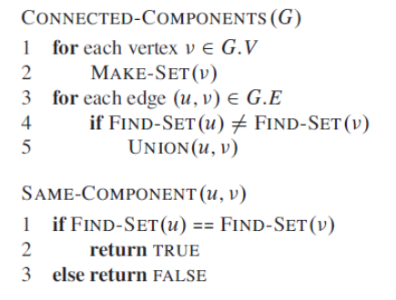
Determining Connected Components
Why not use DFS?

Slide 6
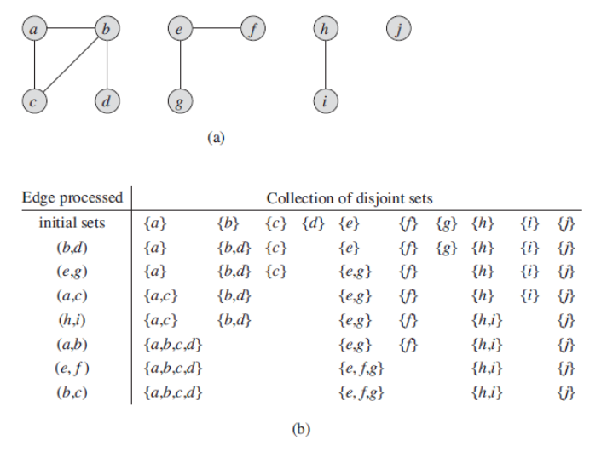
Connected Components

Slide 7
Interview Questions
During the execution of CONNECTED-COMPONENTS on an undirected graph with k connected components,
How many times is MAKE-SET called?
How many times is FIND-SET called?
How many times is UNION called?
Express your answers in terms of |V|, |E|, and k.

Slide 8
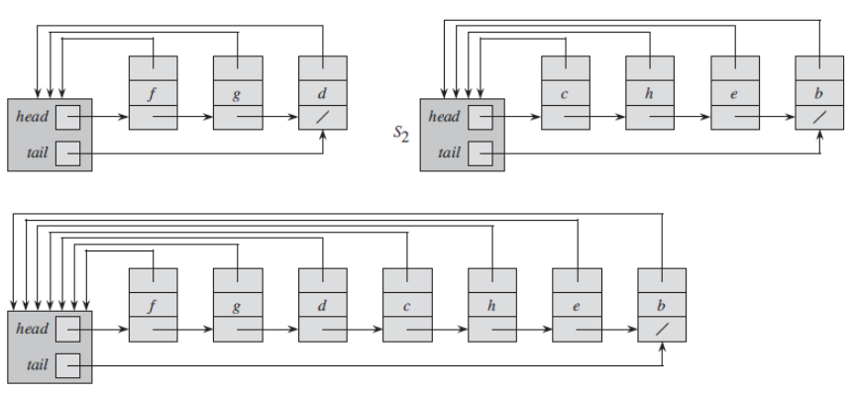
Linked List Representation

Slide 9
Linked-List Representation
MAKE-SET
Create a singleton list (time complexity?)
FIND-SET
Follow the pointer back to the list object, and then follow the head pointer to the representative. (time complexity?)
UNION
A couple of ways to do it.

Slide 10
Linked list representation
UNION
Append y’s list onto end of x’s list. Use x’s tail pointer to find the end.
Need to update the pointer back to the set object for every node on y’s list.
If appending a large list onto a small list, it can take a while.
In the worst case, this requires an average of Θ(n) time per call because we may be appending a longer list onto a shorter list
Notes:
Θ(n) time per call, there are n-1 calls, so the whole thing is O(n2)

Slide 11
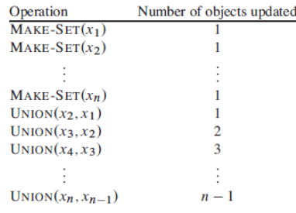
Amortized Time Complexity
Take the time complexity for the complete set of operations, and divide by the number of operations.
For a disjoint set problem, total time to do 2n-1 operations = Θ(n²)
Amortized time per operation = Θ(n)

Slide 12
Linked list representation
Weighted-union heuristic
Keep track of the length of each list
Always append the smaller list to the larger list. (Break ties arbitrarily.)
A single union can still take Ω(n) time, e.g., if both sets have n=2 members.
With weighted union, a sequence of m operations on n elements takes O(m + n lg n) time.

Slide 13
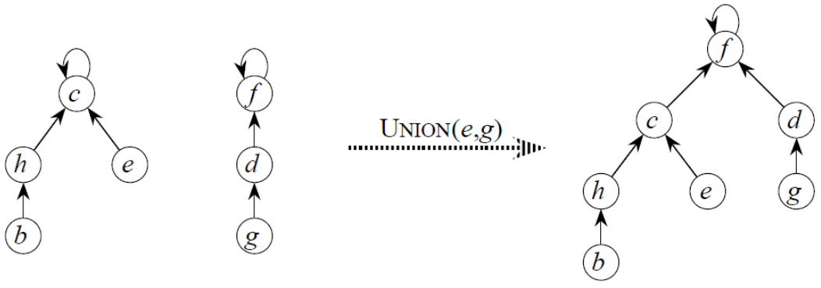
Disjoint Set Forest
Create a forest of trees.
1 tree per set. Root is representative.
Each node points only to its parent.

Slide 14
Disjoint set forest
MAKE-SET
make a single-node tree.
UNION
make one root a child of the other.
FIND-SET
follow pointers to the root.
Sounds good, but if our trees end up looking like linked lists, we haven't gained anything.

Slide 15
Forest heuristics
Union by rank
Make the root with the smaller rank into a child of the root with the larger rank.
Rank is an upper bound on the height of a node.
Size (number of nodes) of the trees is irrelevant.

Slide 16
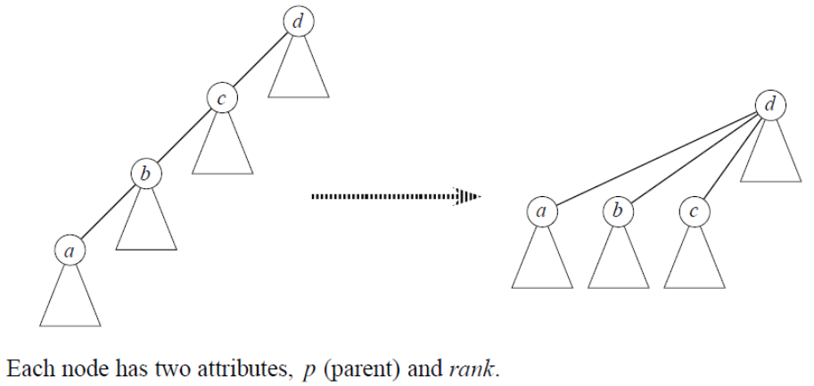
Forest Heuristics
Path compression
Find path = nodes visited during FIND-SET on the trip to the root.
Make all nodes on the find path direct children of root.
We want the tree to be as short and bushy as possible.

Slide 17
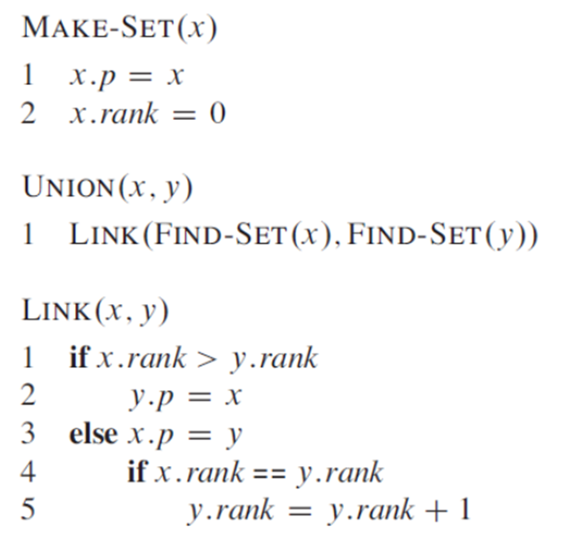
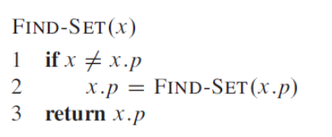
Forest implementation with heuristics
notice how cleverly
x.p=FIND-SET(x.p)
accomplishes path
compression!
FIND-SET makes a pass up to find the root, and a pass down as recursion unwinds
to update each node on find path to point directly to root.

Slide 18
Running times
If use both union by rank and path compression, O(m α(n)).
α is a very-slow growing function
Running time is just barely superlinear

Slide 19
Interview Questions
Write a nonrecursive version of FIND-SET with path compression

