Slide 1
Karvis
NLP Project
flammekueche d’aujourd’hui

Slide 2
Team Presentation
My Lan ARAGON 50181568
Myriam CHOLET 50181567
Quentin RENAUD 50181560
Anthony JOUVEL 50181592
Thomas VIGIER 50181555
Julie BODART 50181578

Slide 3


What is Karvis ?
Karvis is a chatbot on messenger
It helps you find good restaurants in Seoul

Slide 4
Demonstration

Slide 5





Technologies

Slide 6
Project Structure
Node.JS
Server
Keywords
SQL Query
Wit.AI
Amazon RDS
User message
SQL Query
Facebook Messenger
MariaDB

Slide 7





How does WIT.AI work ?
Intent
Location
Date/time
Restaurant Types

Slide 8
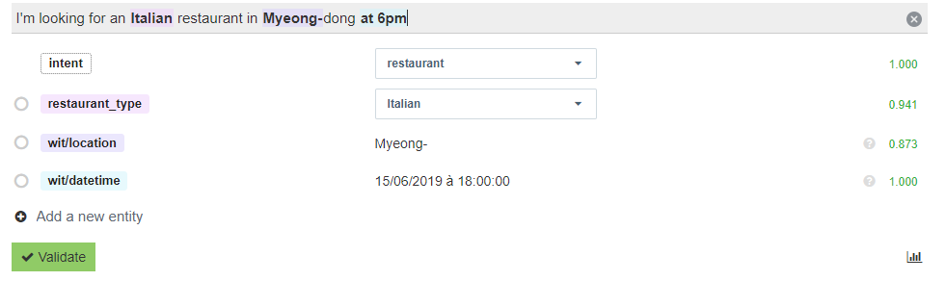
How does WIT.AI work ?

Slide 9
Node.JS server
“Where do you want
to eat ?”
“When do you want
to eat ?”
User 1
Server
“What do you think of … ?”
User 2
Not enough info from user 1 and 3
“What type of food
do you want to eat ?”
User 3
Stockage
-user1: korean restaurant, undefined, undefined
-user2: mexican restaurant, Hongdae, diner
-user3: undefined, Itaewon, diner

Slide 10
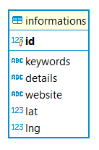
Database Structure
Tags list
Answer
Link
Latitude
Longitude

Slide 11
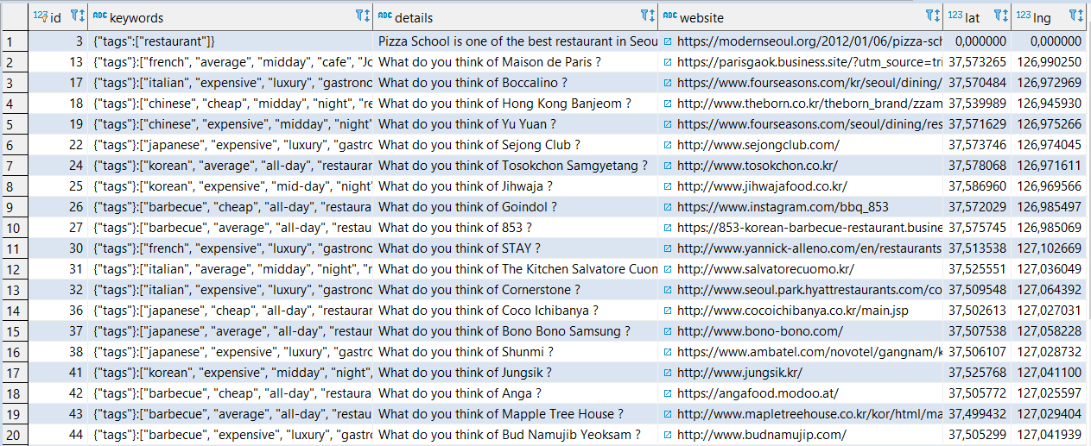
Database Structure

Slide 12
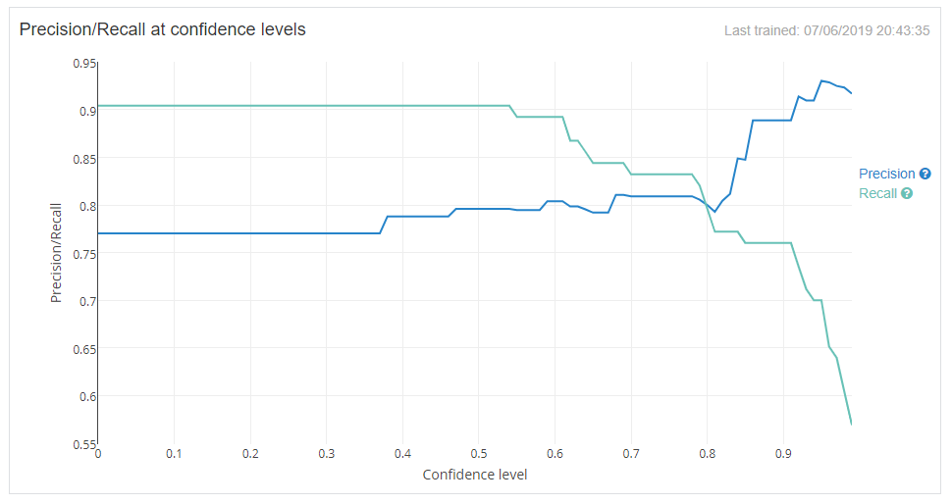
Evaluation
Wit.ai model evaluation
Users feedback
Future improvement

Slide 13
Thank you !
Do you have any questions ?

