Slide 1
Proposal:
Mutual information in the hippocampus and neocortex during memory processes

Slide 2
Hippocampus during memory encoding and retrieval
Spikes (single cell)
Spikes (population)
LFP
Rate model
Standardized
Firing rate
Theta
Phase coding
(theta)
Synchronous
firing
Theta-Gamma PAC
Spike time model
Synergy
through
silence
First-spike time
Sync-desync framework
Alpha/beta NC
Theta/gamma HC
Complex
temporal code

Slide 3
Hippocampus during memory encoding and retrieval
Spike-Field coupling
Spikes (single cell)
Spikes (population)
LFP
Spike field coupling
Rate model
Standardized
Firing rate
Theta
Phase coding
(theta)
Synchronous
firing
Theta-Gamma PAC
Spike time model
Synergy
through
silence
First-spike time
Sync-desync framework
Alpha/beta NC
Theta/gamma HC
Complex
temporal code

Slide 4
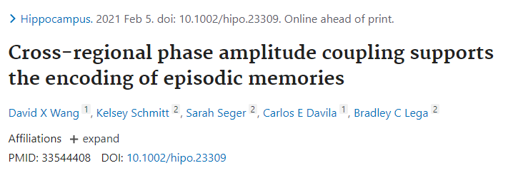
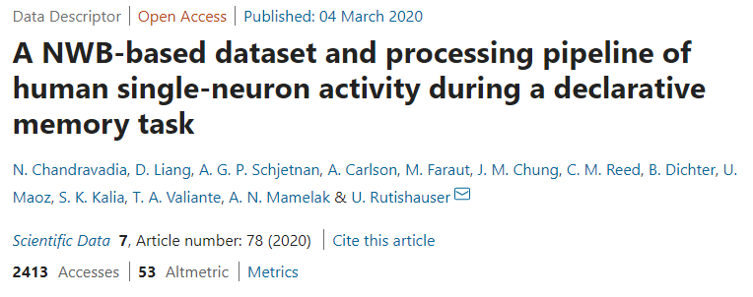
Proposal
1.
Birmingham data (face-place task)
Hippocampus micro
Neocortex macro
Associative
memory task
2.
One or more intracranial dataset with:
- Encoding and retrieval paradigm
- Behavioural measure
- Micro wires in hippocampus
- Macro wires in neocortex
- (Micro wires in neocortex)
Hippocampus and
Neocortex
Free recall of 12
nouns sets from lists
3.
Hippocampus only
Recognition task
Novel or old images
4.
Pretty sure I can find many more

Slide 5

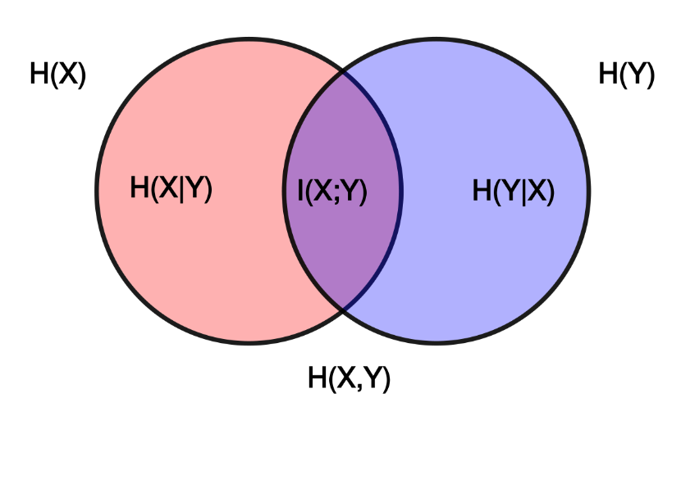
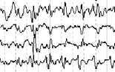
Proposal
Mutual information without classifier
For each encoding (or retrieval) trial, apply model and get estimate
Calculate mutual information between each trial’s model estimate and retrieval success
Take n models
Standardized
Firing rate
Synchronous
firing
Theta
Model n
Model n+1
Phase coding
(theta)
Synergy
through
silence
Theta-Gamma PAC
First-spike time
Complex
temporal code
Sync-desync framework

Slide 6
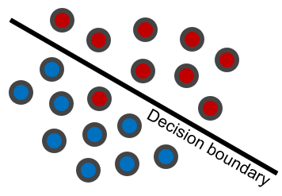

Proposal
Mutual information with classifier
Calculate mutual information between each model’s predicted and true performance (retrieved or not)
For each encoding (or retrieval) trial, destroy everything except model structure
Apply classifier
to each model’s data
Take n models
Standardized
Firing rate
Synchronous
firing
Theta
Retrieved
Not retrieved
Model n
Model n+1
Phase coding
(theta)
Synergy
through
silence
Theta-Gamma PAC
First-spike time
Complex
temporal code
Sync-desync framework

