Slide 2
GOLDEN MEAN warping
Warping to each participant’s (alpha * golden mean) [1.618 Hz]

Slide 3
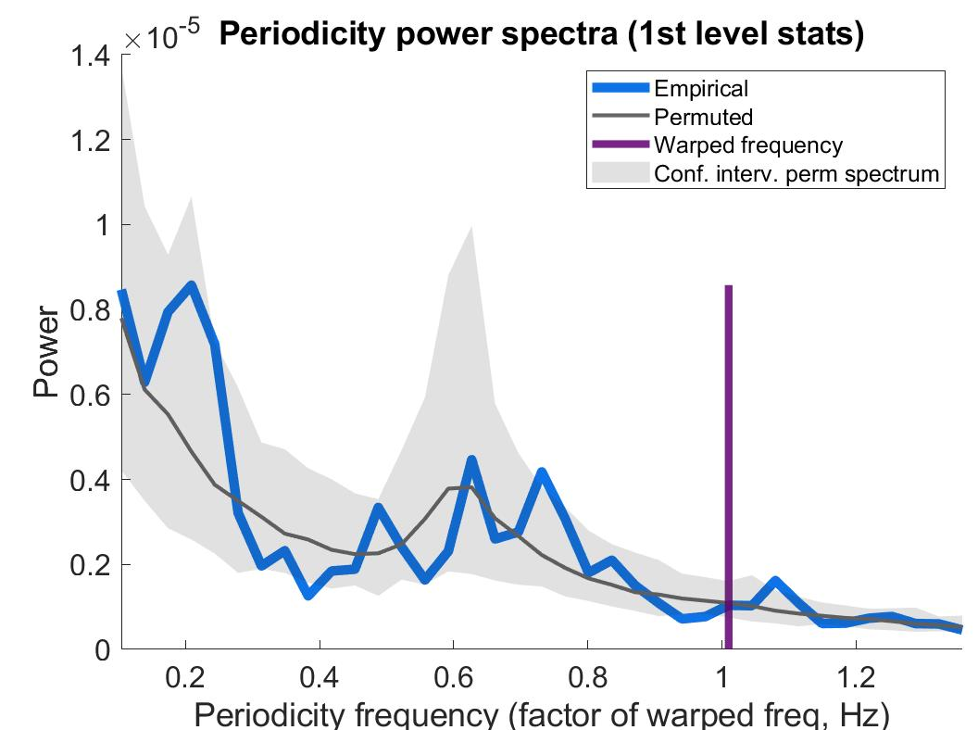
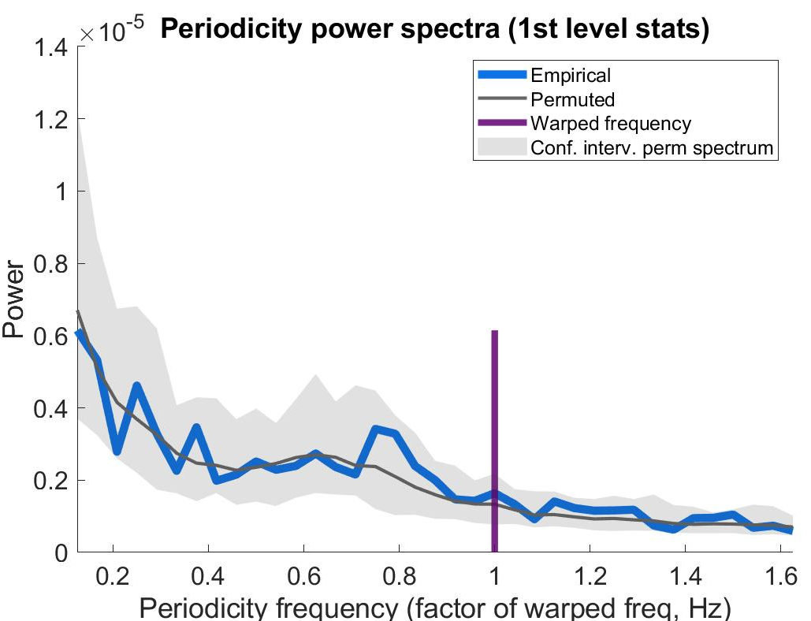
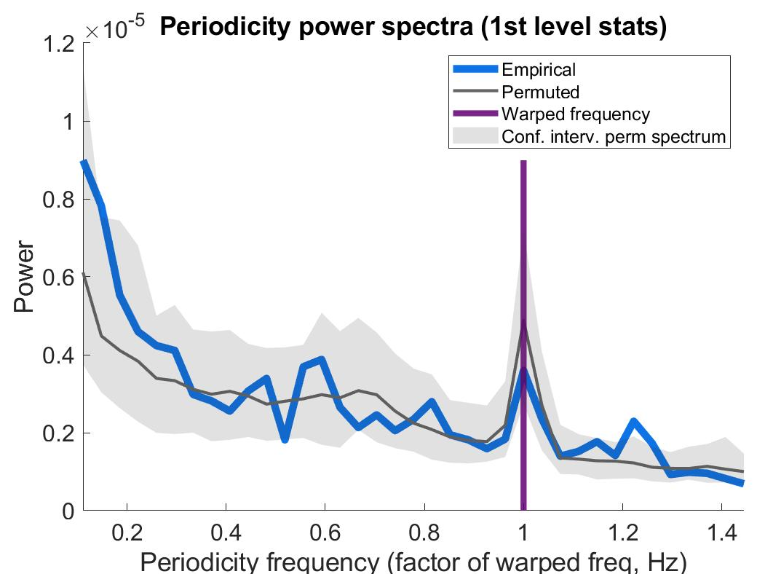
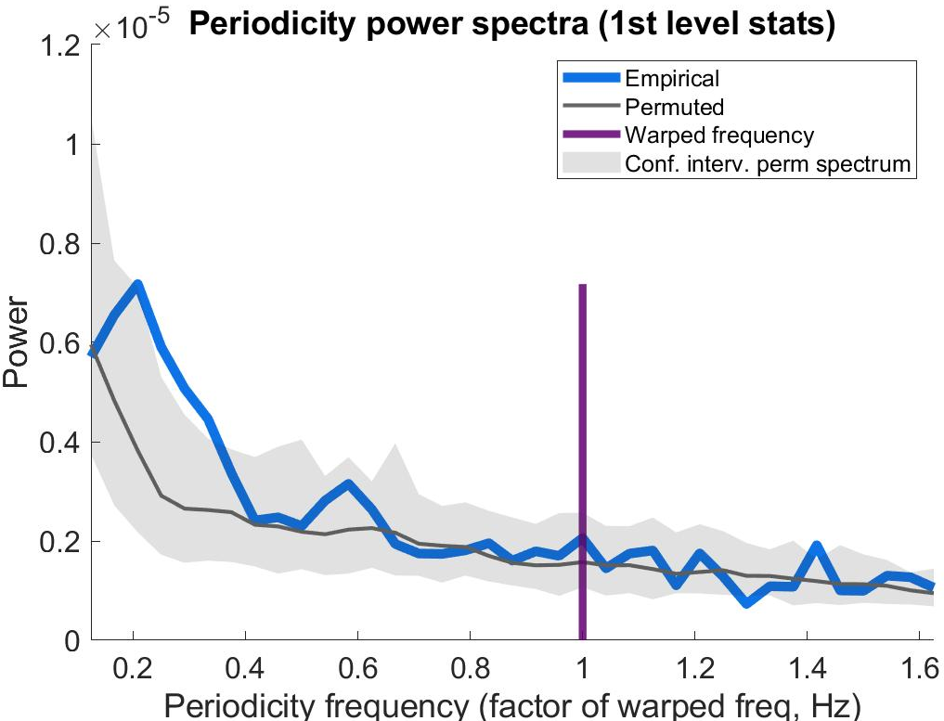
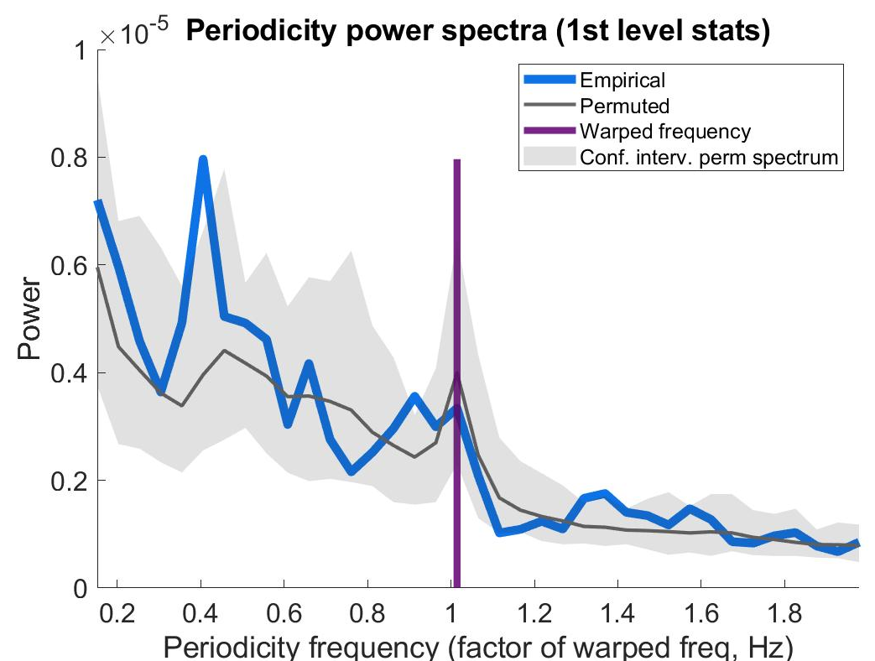
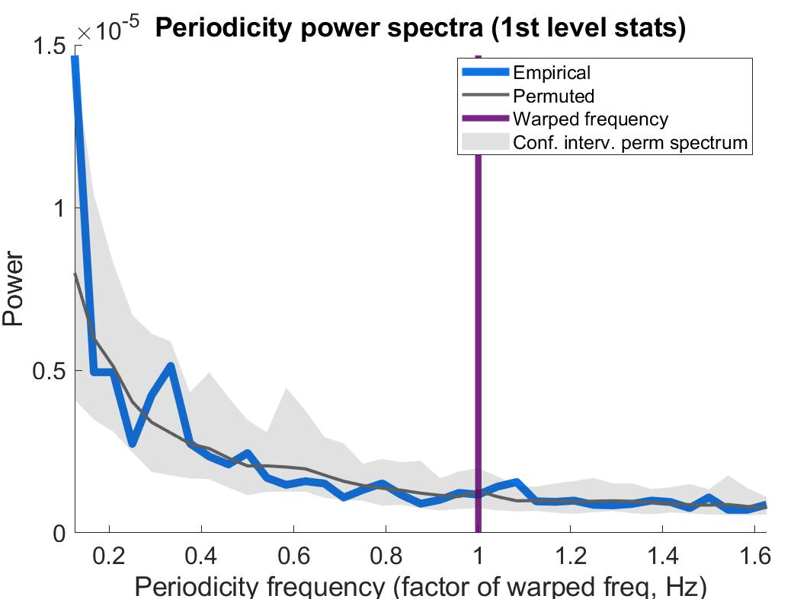
GOLDEN MEAN warping

Slide 4
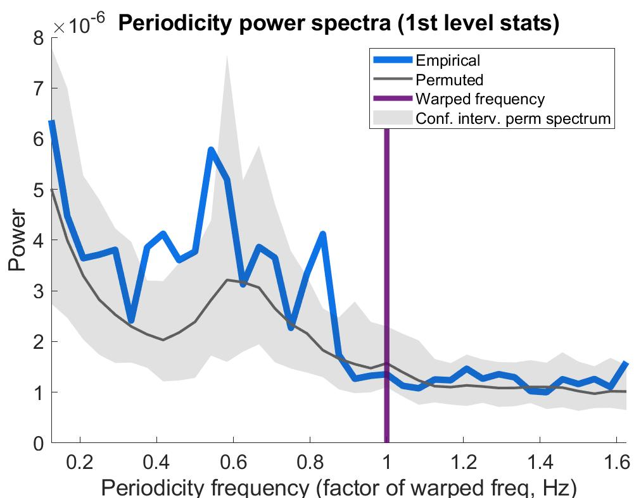
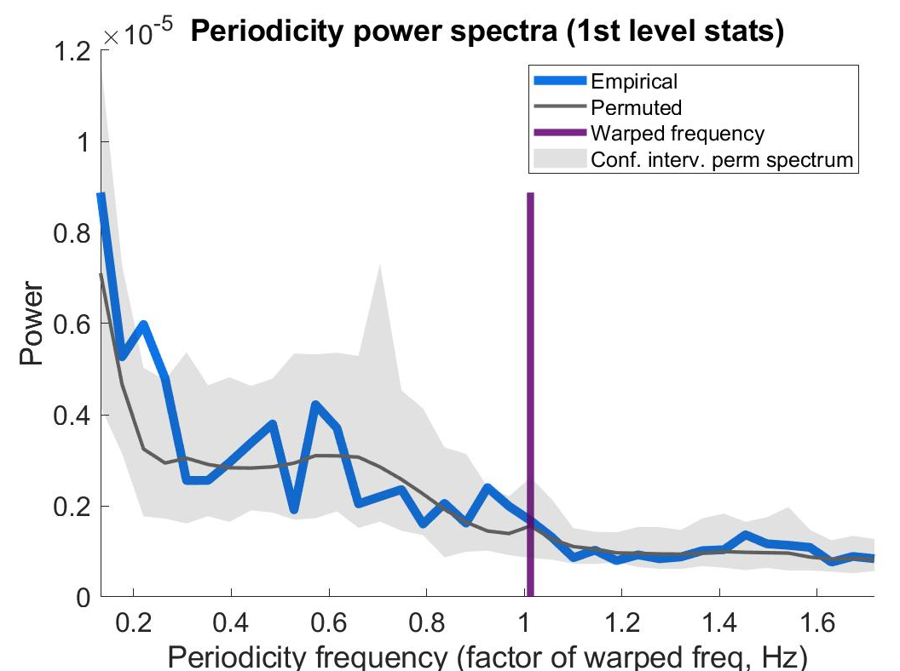
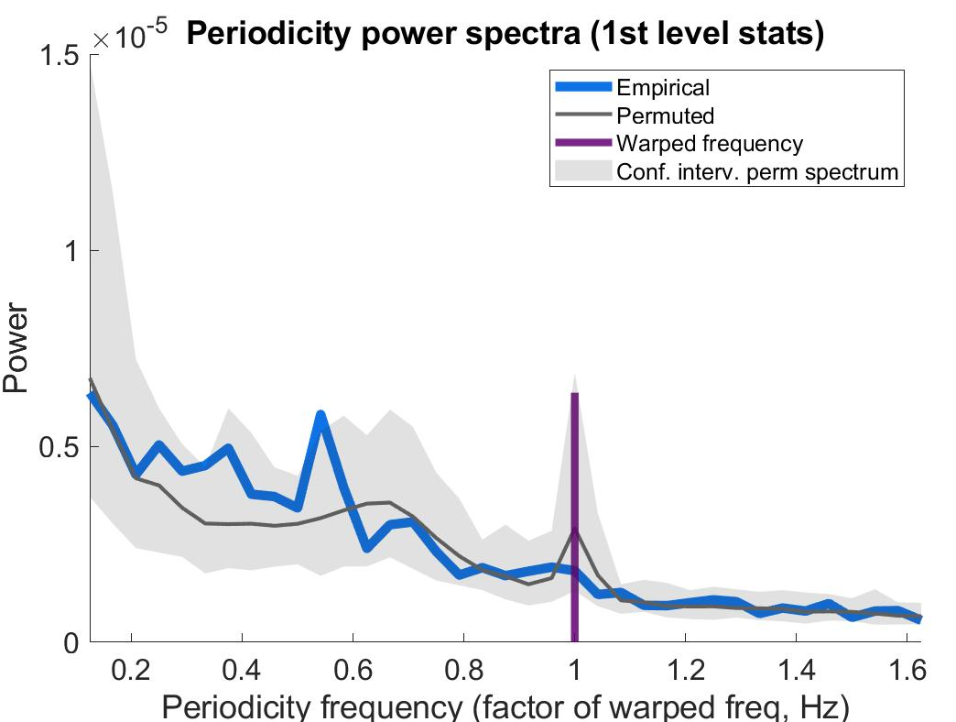
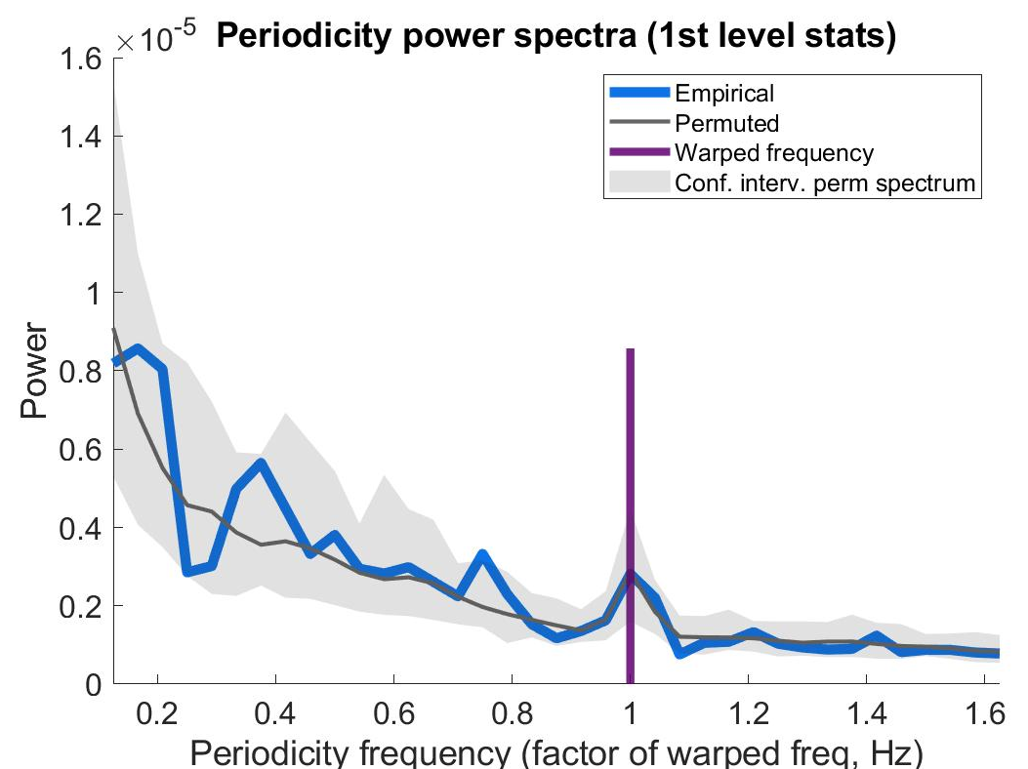
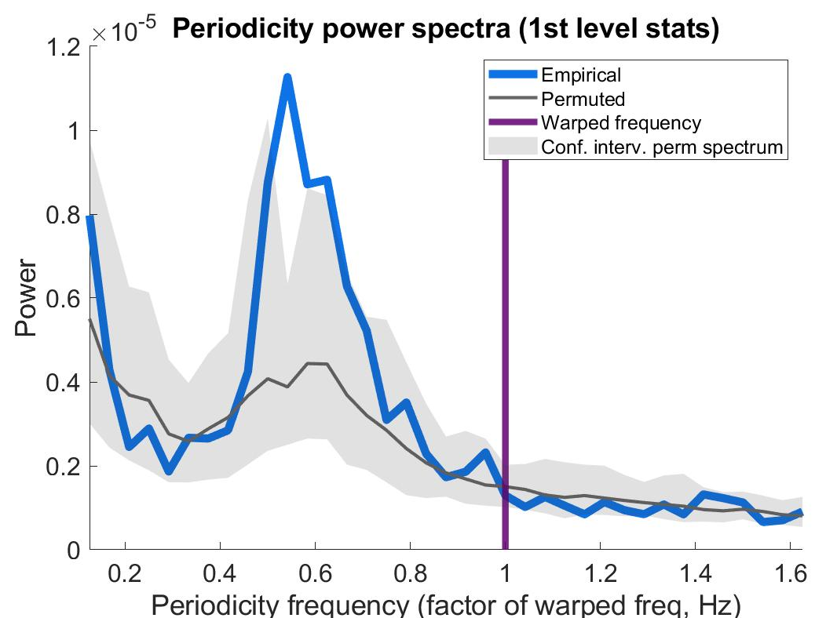
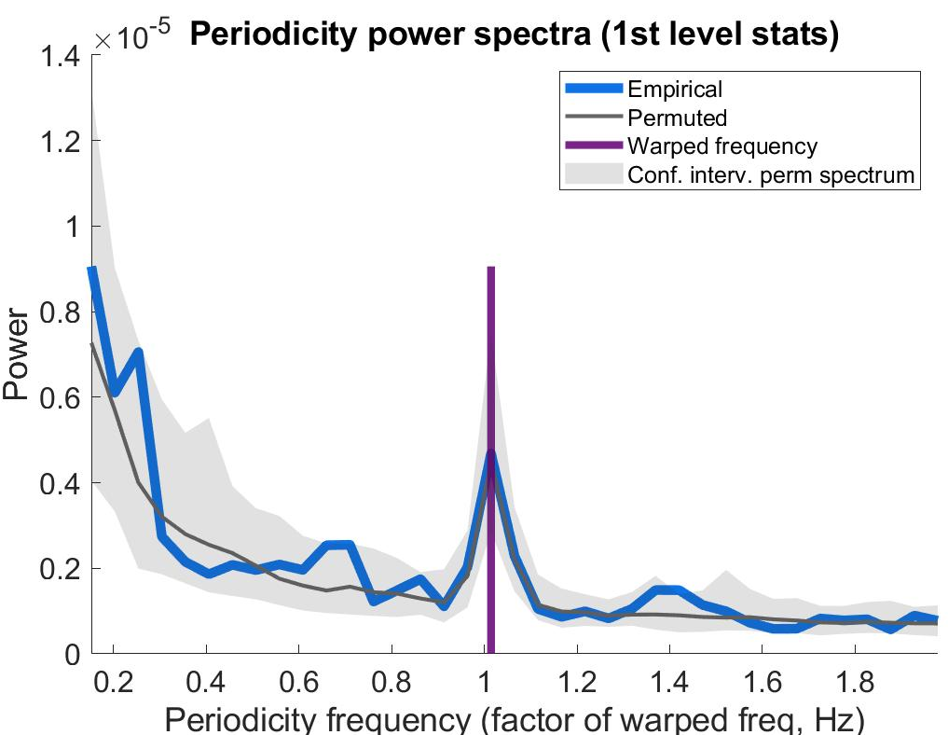
GOLDEN MEAN warping

Slide 5
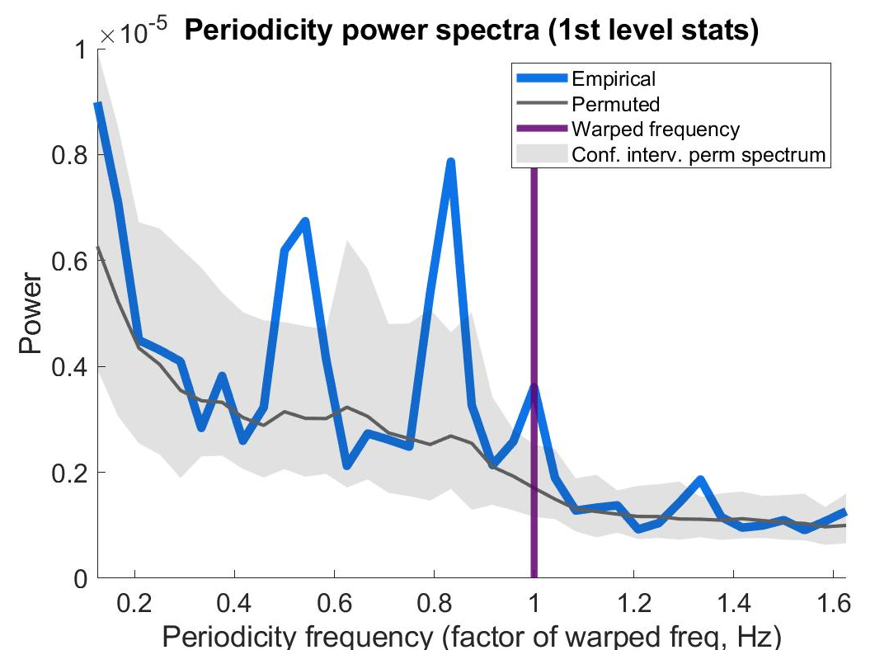
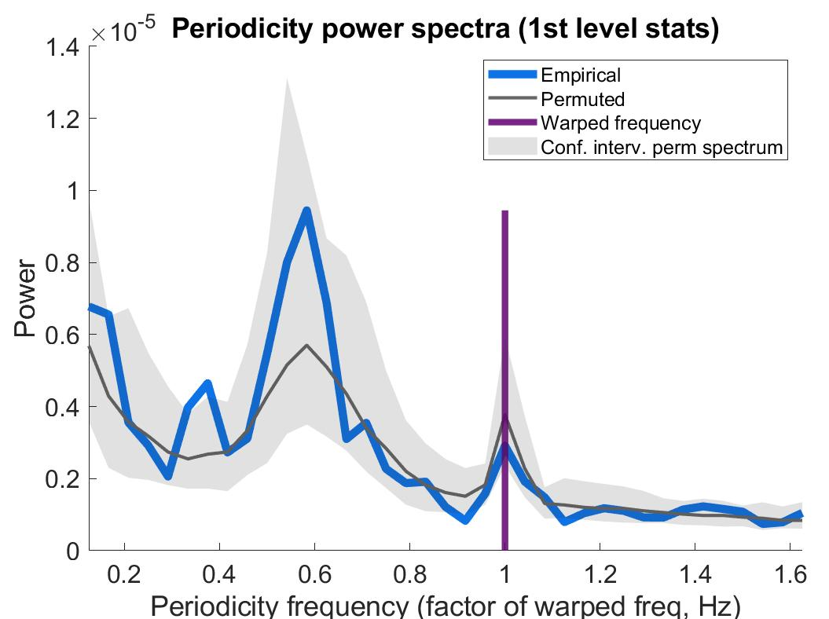
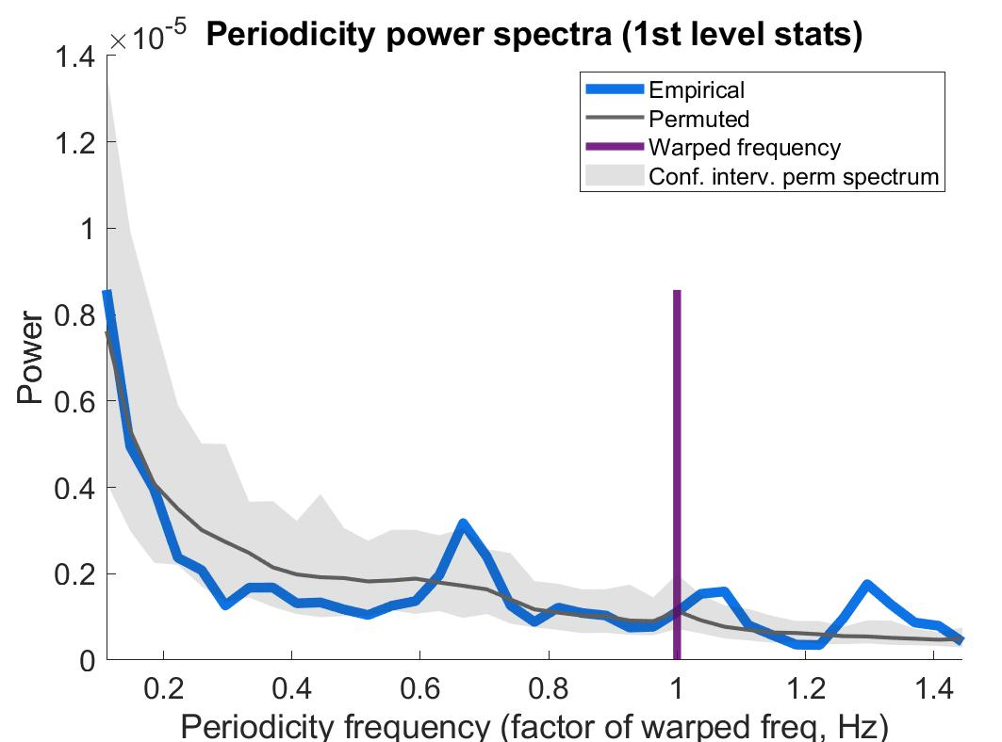
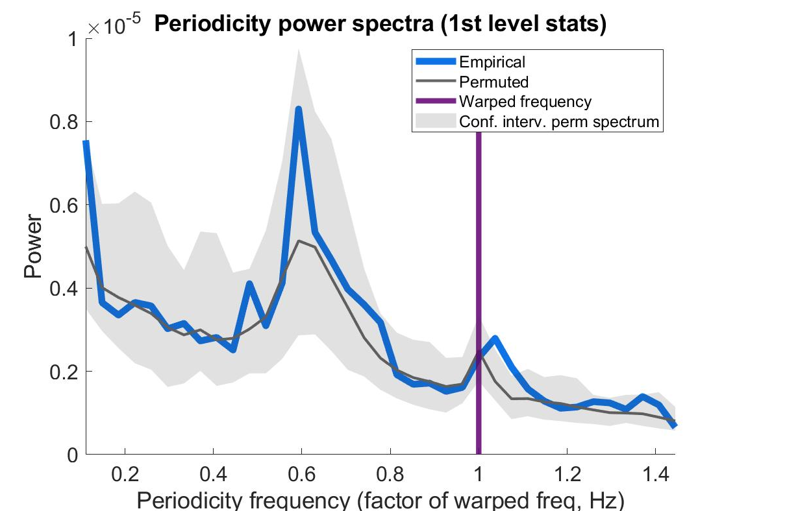
GOLDEN MEAN warping

Slide 6
GOLDEN MEAN warp
CLOCK TIME 2nd level
BRAIN TIME 2nd level

Slide 7
ALPHA warp
BRAIN TIME 2nd level
Golden mean = 1.62 Hz
Alpha = 1 Hz
GOLDEN MEAN warp
BRAIN TIME 2nd level
Golden mean = 1 Hz
Alpha = 0.62 Hz

