Slide 1





blinkit
India’s Last Minute App
Blink it
Anaylsis
https://github.com/Nian2024/blinkit_analysis

Slide 2

STEPS IN PROJECT
01
02
03
04
05
06
Data Collection
Data Cleaning
Data Modeling
Calculations
Dashboard Lay outing
Dashboard/Report

Slide 3
Calculations
TOTAL SALES:The overall revenue generated from all items sold.
Average Sales:The average revenue per sale.
Number of Items:The total count of different items sold.
Average Rating:The average customer rating for items sold.

Slide 4


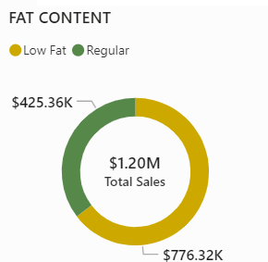
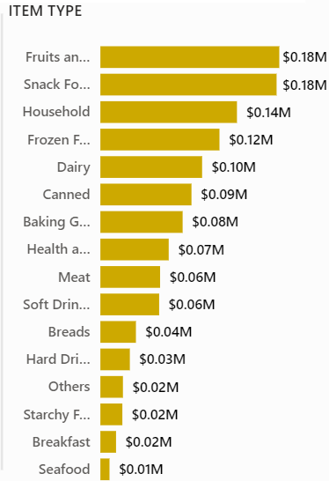
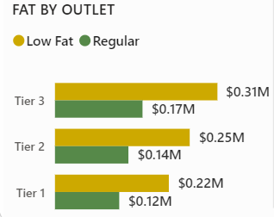
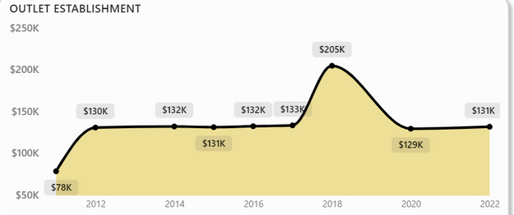
Chart’s Requirement
Total Sales by Fat Content
Total Sales by Item Type
Fat Content by Outlet
Total Sales by Outlet

Slide 5
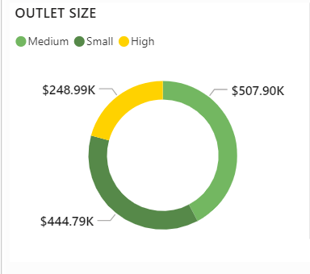
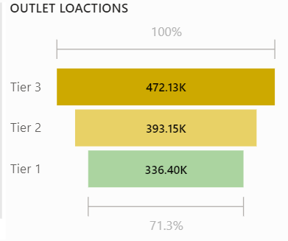
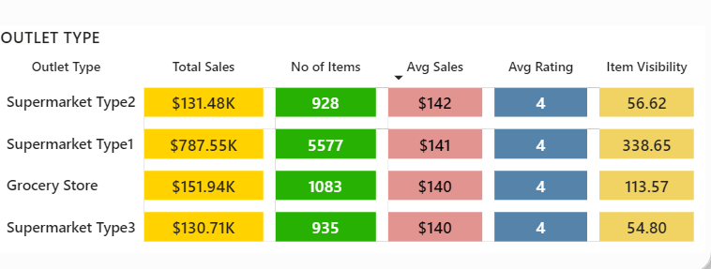
Chart’s Requirement
Sales by Outlet Size
Sales by Outlet Location
All Metrics by Outlet Type

Slide 6
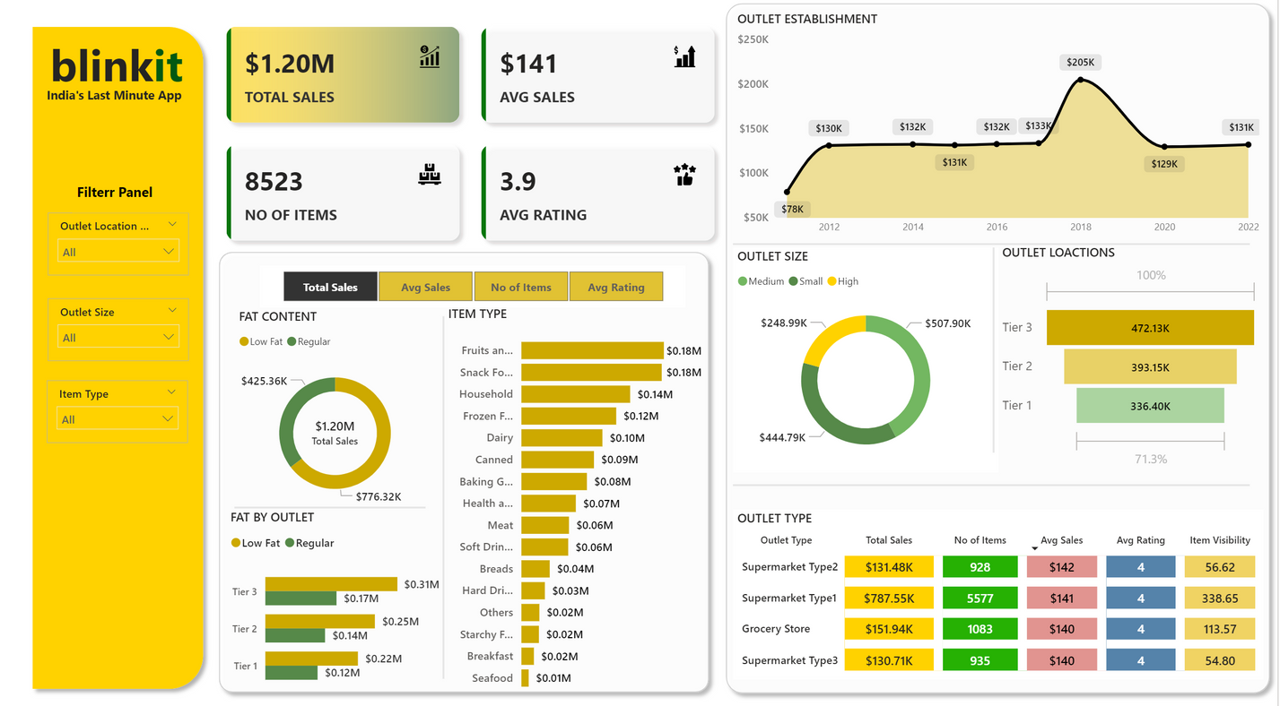
Dashboard

Slide 7
Thankyou

