Slide 1





blinkit
India’s Last Minute App
Blink it
Anaylsis
https://github.com/Nian2024/blinkit_analysis

Slide 2
ABSTRACT
This project, "Blinkit Fat Content Analysis," aims to evaluate the fat content across various food items listed on the Blinkit platform. Given the increasing consumer focus on health and nutrition, understanding the fat composition of popular products can help users make informed dietary choices. The analysis leverages data sourced from Blinkit’s food listings, focusing on nutritional labels to extract and quantify fat content metrics across different product categories. Using data analysis techniques, this study identifies patterns in fat content across categories like snacks, dairy products, and beverages. The findings provide insights into which product types contain higher fat levels and offer recommendations for users interested in maintaining a balanced diet. This research guides health-conscious consumers and supports Blinkit's commitment to transparency in nutritional information.

Slide 3
INTRODUCTION
In today's health-conscious world, consumers are increasingly aware of the nutritional content of their foods. Fat content, in particular, has gained significant attention due to its impact on health, contributing to conditions like obesity, cardiovascular diseases, and other lifestyle-related disorders. With online grocery platforms like Blinkit providing easy access to a wide range of food products, there is a unique opportunity to analyze and understand the fat content in these items to promote informed decision-making for consumers.
This project, "Blinkit Fat Content Analysis," examines the fat levels across various food categories listed on the Blinkit platform. By collecting and analyzing nutritional information, this study seeks to identify patterns in fat content among product types such as snacks, dairy products, beverages, and oils. The goal is to offer insights that can help health-conscious users choose lower-fat options where possible, while also highlighting categories that typically contain higher fat levels.
Through this project, we hope to support Blinkit’s commitment to nutritional transparency and contribute valuable information for consumers who prioritize health in their purchasing decisions.

Slide 4

STEPS IN PROJECT
01
02
03
04
05
06
Data Collection
Data Cleaning
Data Modeling
Calculations
Dashboard Lay outing
Dashboard/Report

Slide 5
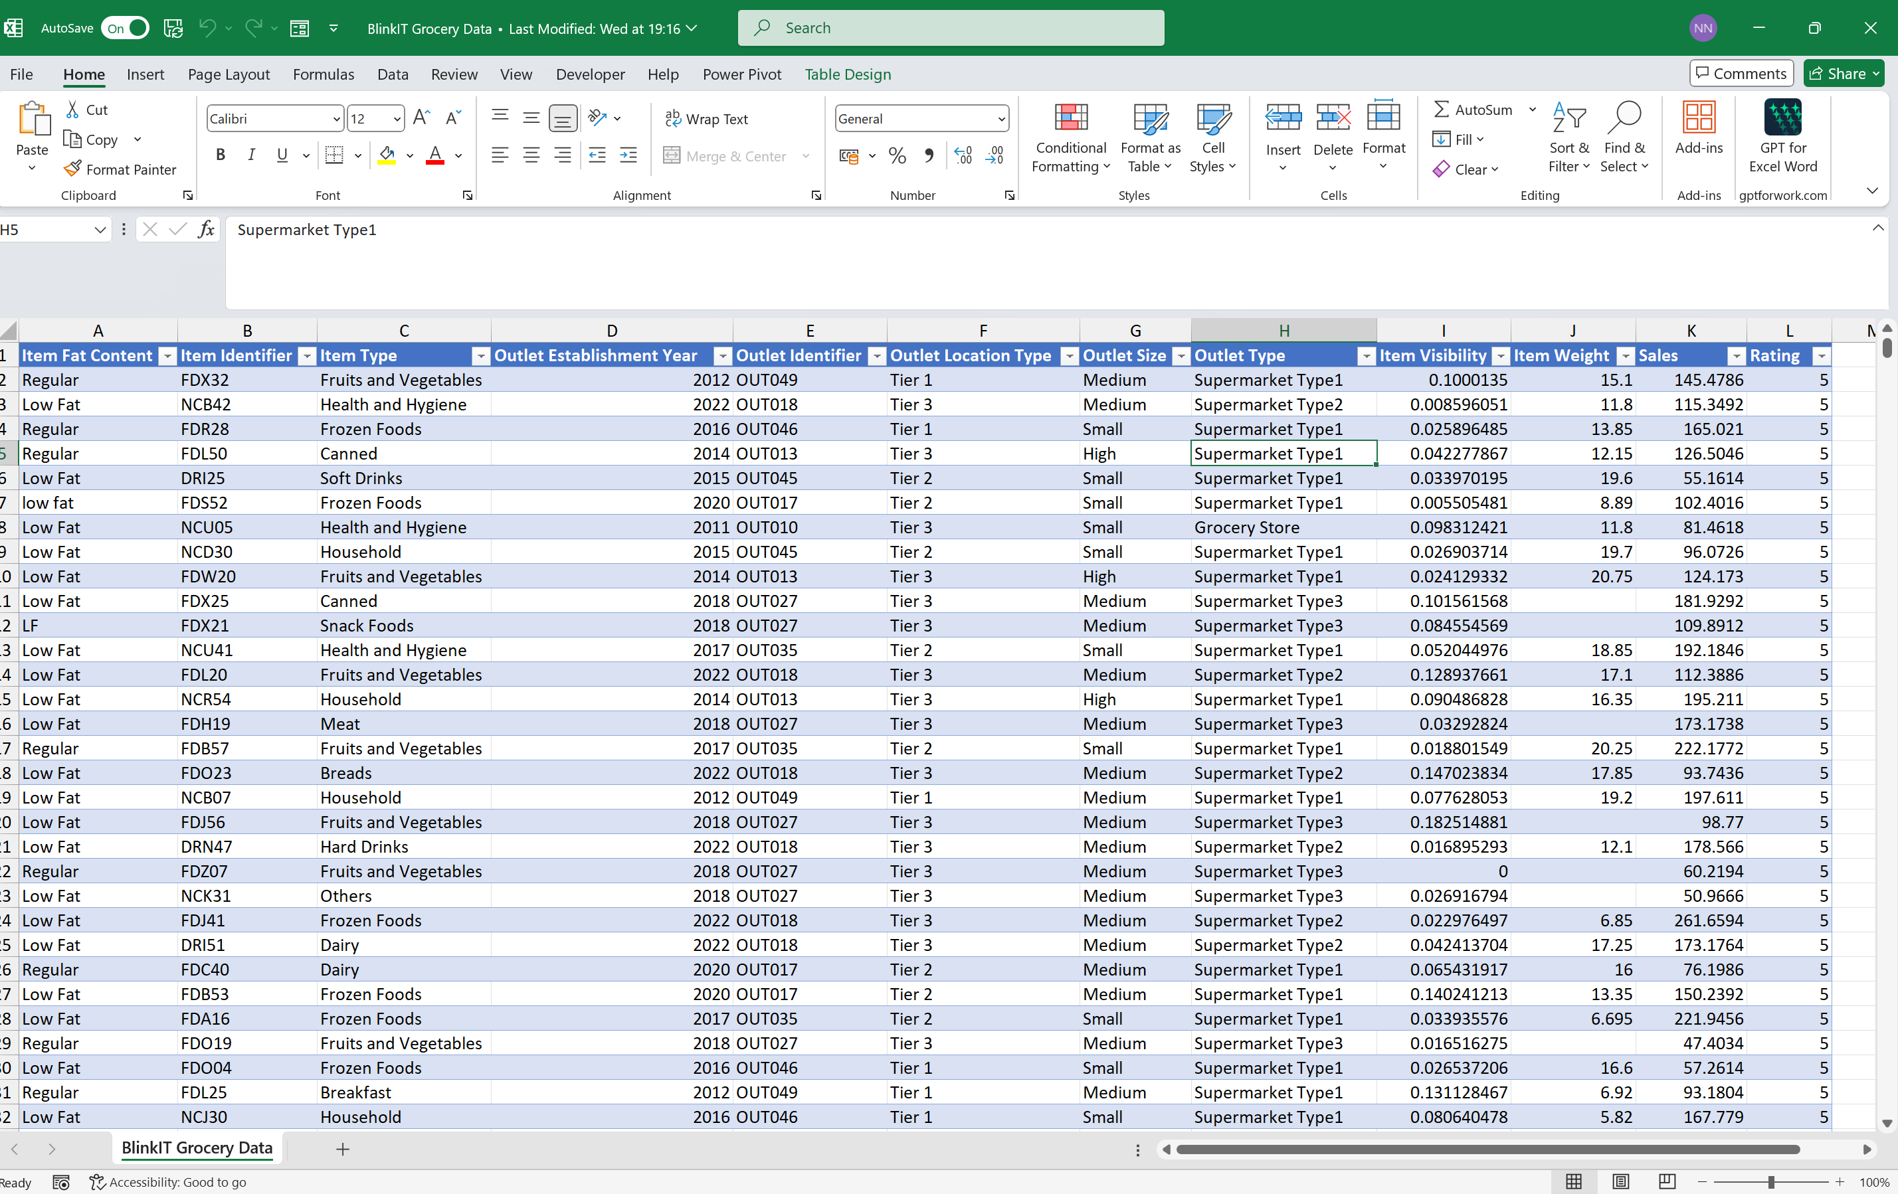
DATA COLLECTION

Slide 6
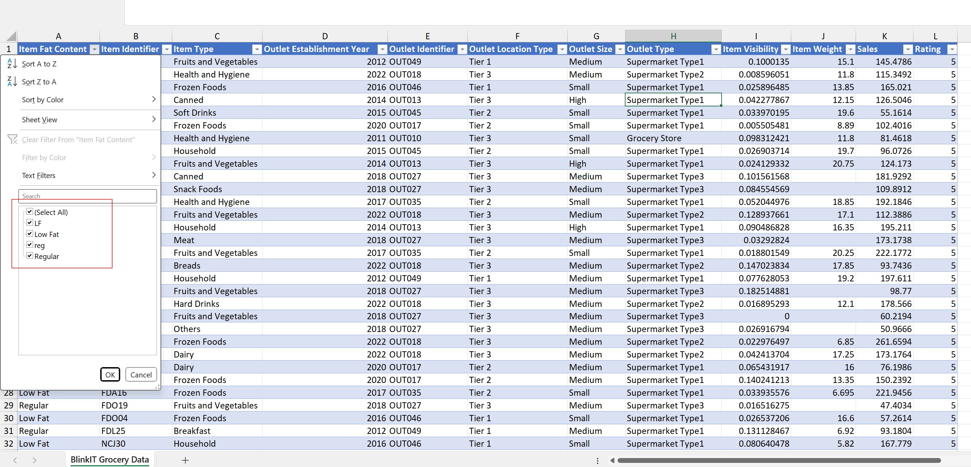
DATA CLEANING
We have Low Fat as Lf &Low Fat, replacing it as Low Fat
Regular Fat as Reg &Regular, replacing them as Regular

Slide 7
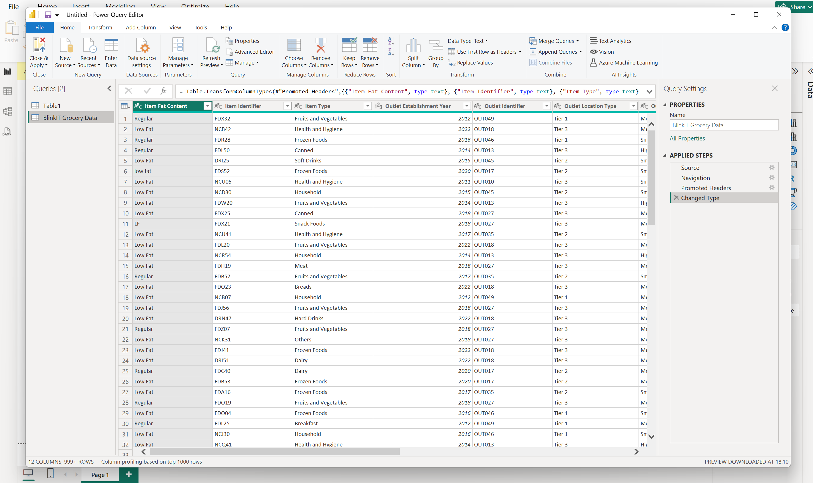
DATA MODELING

Slide 8
Calculations
TOTAL SALES:The overall revenue generated from all items sold.
Average Sales:The average revenue per sale.
Number of Items:The total count of different items sold.
Average Rating:The average customer rating for items sold.

Slide 9


CHART REQUIREMENT’S
Total
Total sales by Fat content:
Objective:Analyze the impact of fat content on total sales.
Additional Metrics:Assess how other (Average Sales,Number of items,Average Rating)vary with fat content.
Chart Type:Donut Chart.
Total Sales by item Type:
Objective:Identify the performance of different item types in terms of total sales.
Additional Metrics:Assess how other(Average Sales,Number of items,Average Rating) vary with fat content.
Chart Type: Bar Chart.
Fat Content by Outlet for Total Sales:
Objective:Compare total sales across different outlets segmented by fat content.
Additional Metrics:Assess how other(Average Sales,Number of items,Average Rating) vary with fat content.
Chart Type: Stacked Column Chart.
Total Sales by Outlet Establishment:
Objective :Evalute how the age of type of outlet establishment total sales.
Chart Type:Line Chart.

Slide 10
CHART REQUIREMENT’S
Total
Sales by Outlet Size:
Objective:Analyze the correlation between outlet size and total sales.
Chart Type:Donut /Pie Chart.
Sales by Outlet Location:
Objective:Assess the geographic distribution of sales across different locations.
Chart Type:Funnel Map.
All Metrics by Outlet Type:
Objective:Provide a comprehensive view of all key metrics(Total Sales,Average Sales,Number of Items,Average Rating) broken down by different outlet types.
Chart Type:Matrix Card.

Slide 11
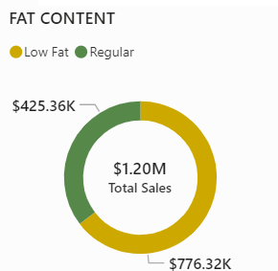
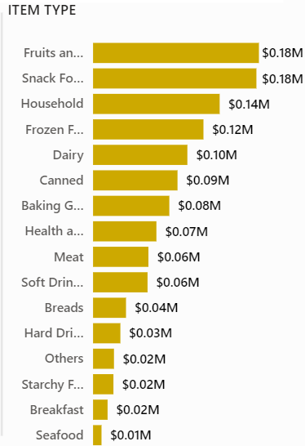
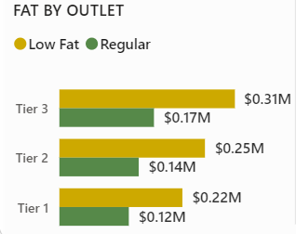
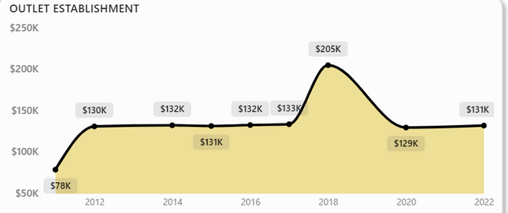
DASHBOARD LAYOUT’S
Total Sales by Fat Content
Total Sales by Item Type
Fat Content by Outlet
Total Sales by Outlet

Slide 12
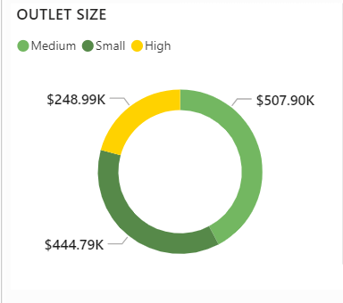
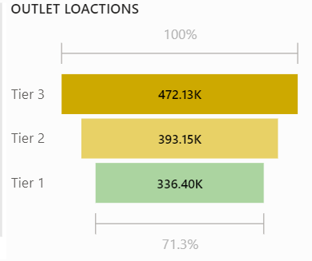
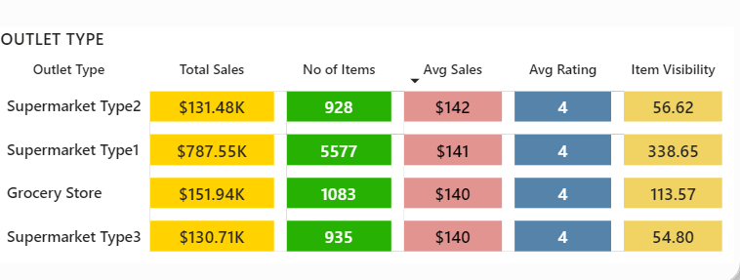
Chart’s Requirement
Sales by Outlet Size
Sales by Outlet Location
All Metrics by Outlet Type

Slide 13
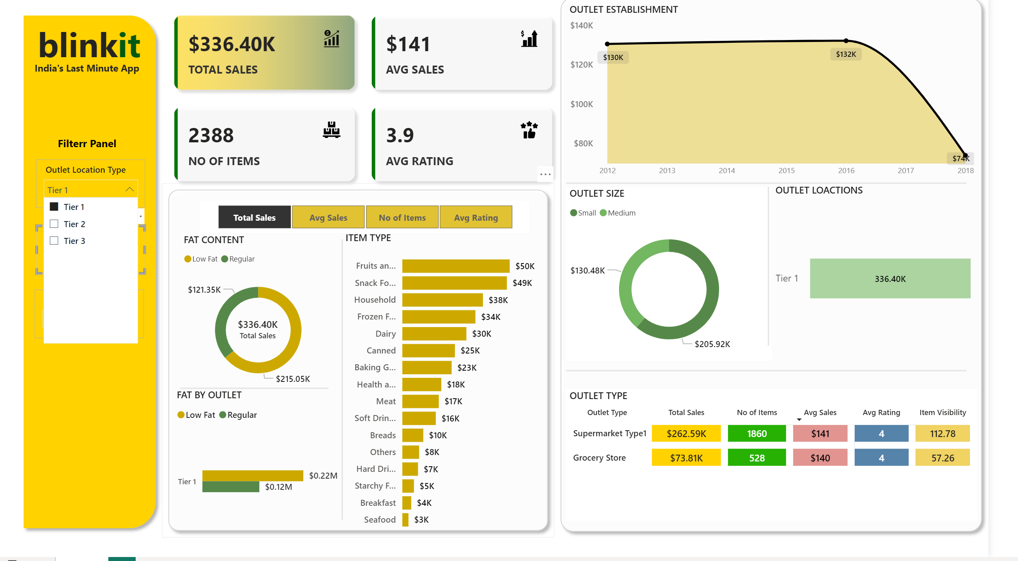
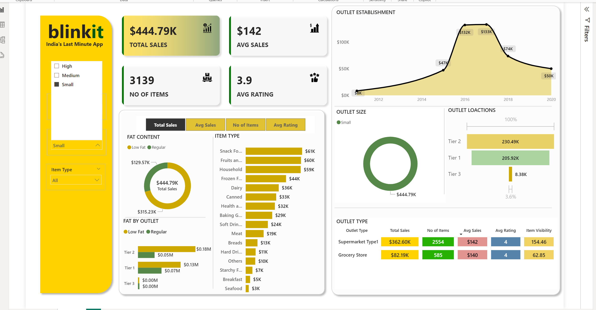
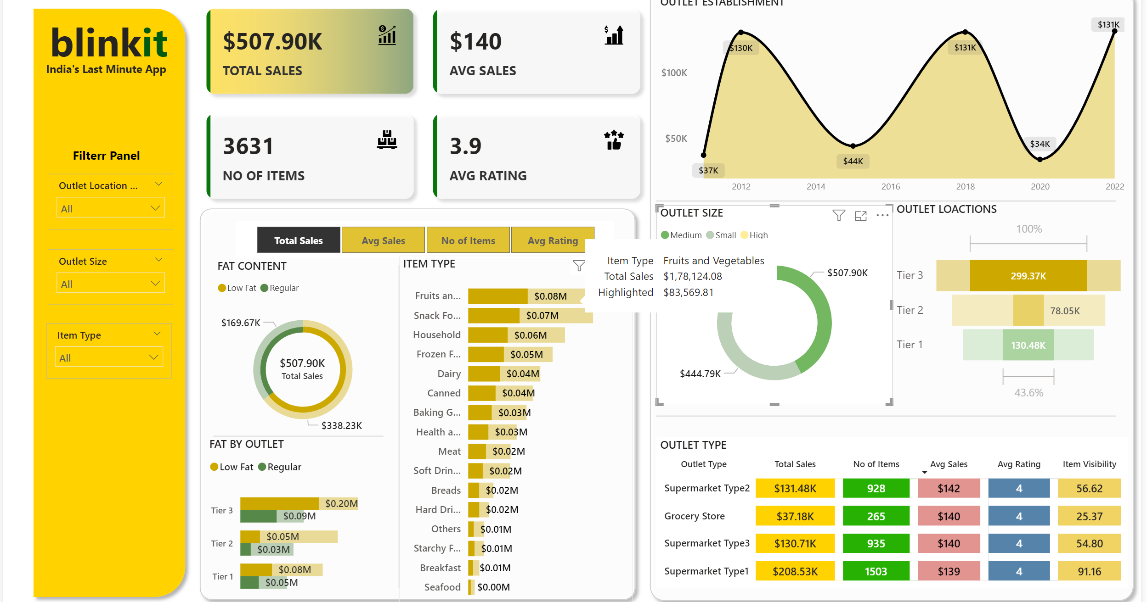
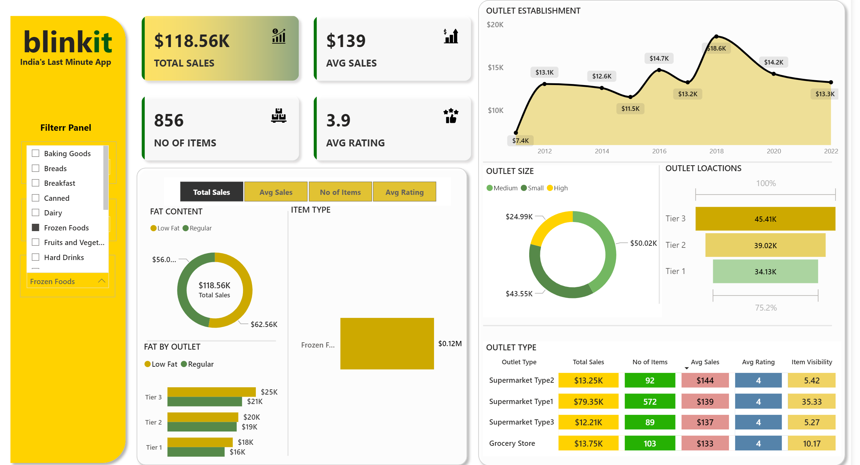
Dashboard Filter PANEL

Slide 14
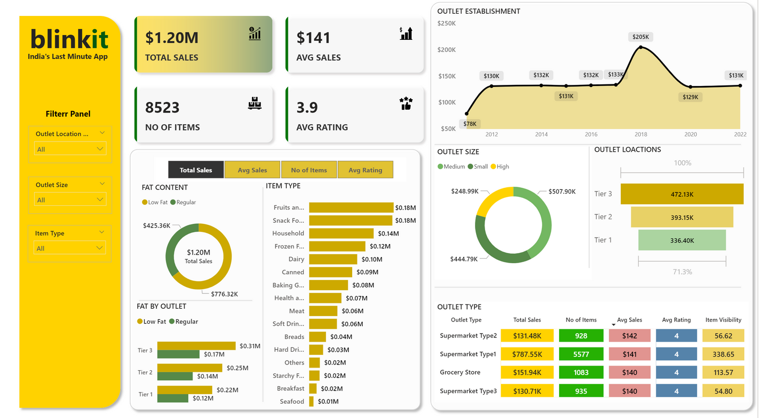
Dashboard

Slide 15
Thankyou

