Slide 1

Heating Load Model for Buildings
By Anny Cui

Slide 2
What determines the amount of energy needed to keep a house warm?
Building a multiple linear regression model

Slide 3

Overview
1 | Data Information
2 | Scope of Inference
3 | Data Exploration
4 | Model Selection
5 | Summary

Slide 4
Data Source
Kaggle: Energy Efficiency Dataset (2012) https://www.kaggle.com/datasets/elikplim/eergy-efficiency-dataset
https://archive.ics.uci.edu/ml/datasets/Energy+efficiency
Created by Angeliki Xifara (Civil/Structural Engineer).
Processed by Athanasios Tsanas (Oxford Centre for Industrial and Applied Mathematics, University of Oxford, UK).
Energy analysis using 12 different building shapes simulated in Ecotect.
768 samples and 8 features.

Slide 5
Variable Information
Name | Meaning | Description
RC | Relative Compactness (ratio) | Dividing the sum of all surfaces by its total heated volume (a ratio).
SA | Surface Area (m^2) | Measure of surface area of a sample (squared meters)
WA | Wall Area (m^2) | Measure of total wall areas of a sample (squared meters)
RA | Roof Area (m^2) | Measure of roof area of a sample (squared meters)
OH | Overall Height (m) | Measure of a sample height (meter)
O | Orientation (number) | Sun’s paths (number)
GA | Glazing Area (percentage) | Percentages of the floor area (0%, 10%, 25%, 40%)
GAD | Glazing Area Distribution (number) | Different distribution scenarios for each glazing area (types)
HL | Heating Load (kW) | The amount of heating a building needs to maintain the interior temperature at a given level (kilowatts)

Slide 6
Scope of Inference
Simulated buildings with eight building parameters
Quantitative
Relatively random
Correlation
Estimate Heat load (heating energy analysis)

Slide 7
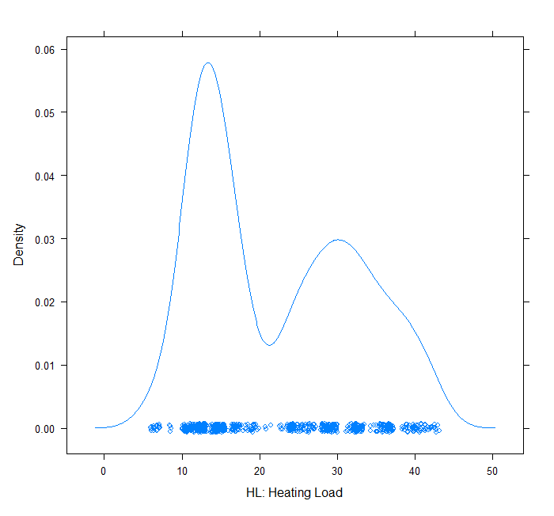
Data Exploration Response Variable
HL
Heating Load

Slide 8
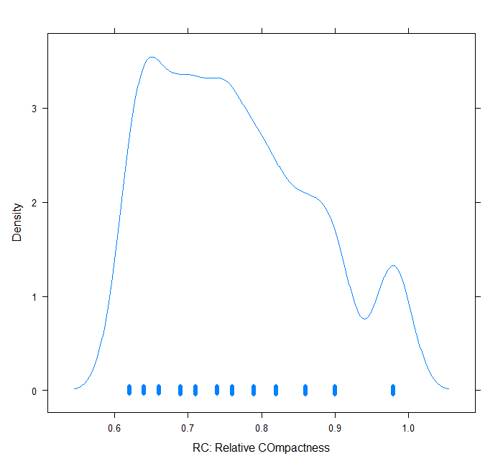
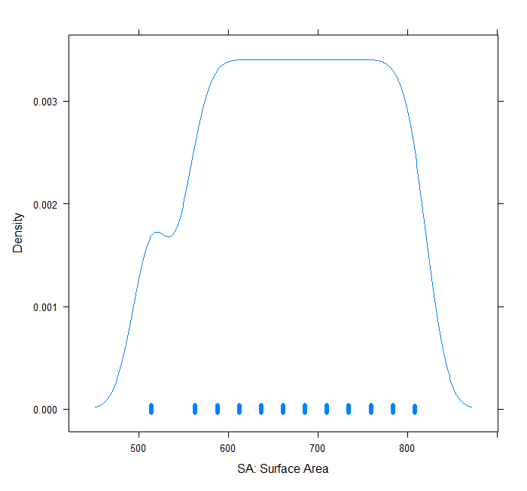
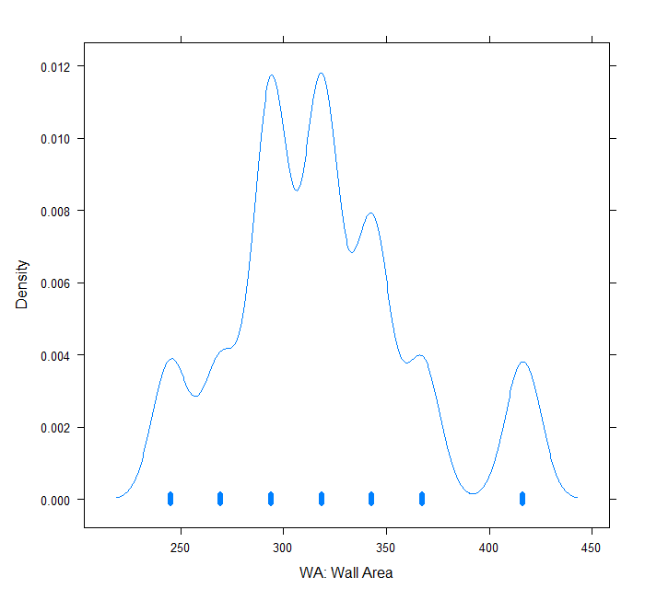
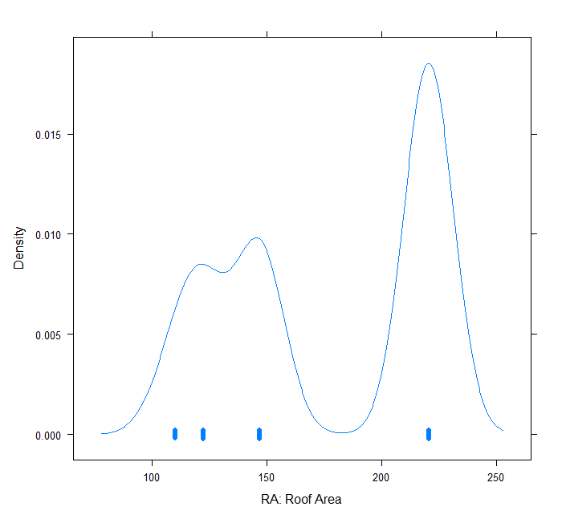
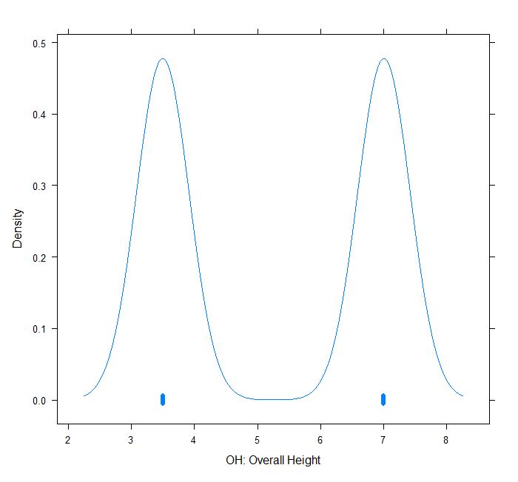
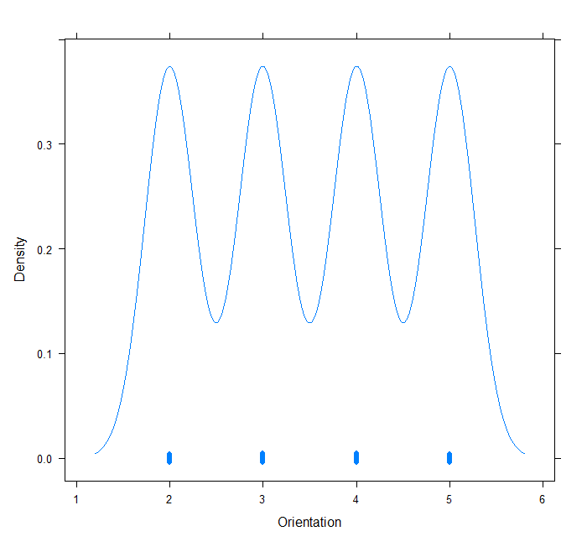
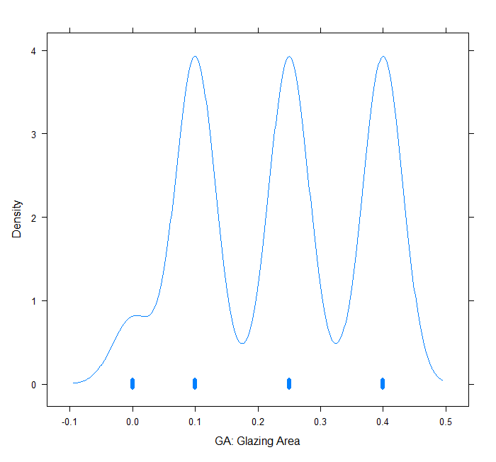
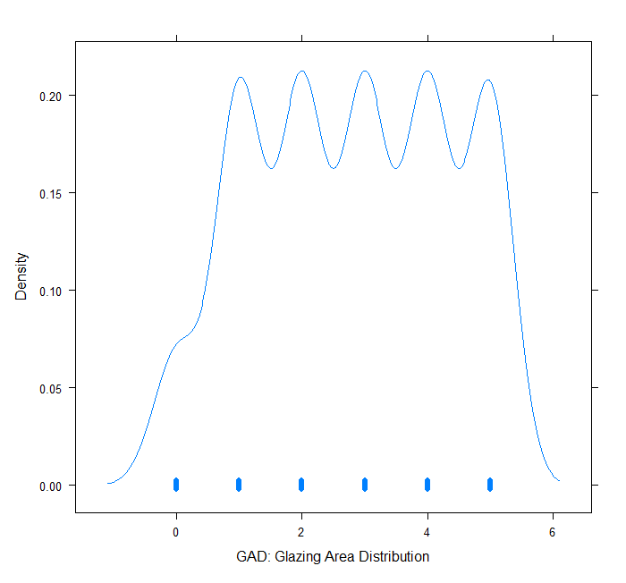
Data Exploration Explanatory Variables
RC
SA
WA
Ra
Relative Compactness
Surface Area
Wall Area
Roof Area
oh
o
Ga
GAD
Overall Height
Orientation
Glazing Area
Glazing Area Distribution

Slide 9
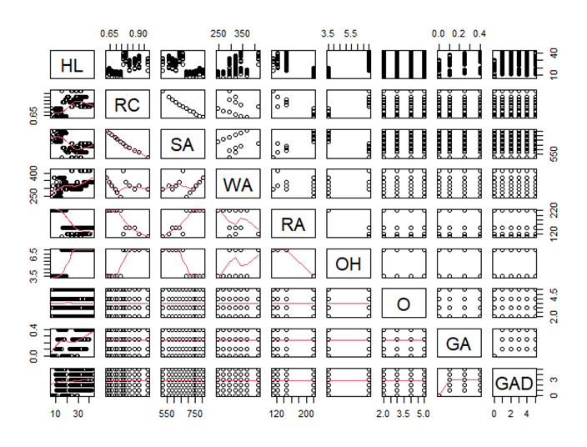
Correlation Plot

Slide 10
Model Selection
Model | Explanatory Variables | AIC
Model1 | RC, WA, O, GA, GAD | 4447.289
Model2 | WA, OH, O, GA, GAD | 3886.792
Model3 | WA, OH, GA, GAD | 3884.850
Model4 | SA, WA, GA | 4223.834
model5 | WA, OH, GA | 3890.872
 | Variance Inflation Factor
Model2 | WA OH O GA GAD 1.085714 1.085714 1.000000 1.047508 1.047508
model3 | WA OH GA GAD 1.085714 1.085714 1.047508 1.047508

Slide 11
Model Selection
R^2 = 0.9108
F-statistic: 1556 on 5 and 762 DF
p-value: < 2.2e-16
Model2
R^2 = 0.9108
F-statistic: 1948 on 4 and 763 DF
p-value: < 2.2e-16
Winner with smaller AIC and ANOVA shows p-value = 0.8111
95% confidence interval for a new data frame
WA=318, OH=7, GA=0, GAD=0
[24.79152, 25.95303]
Fitted = 25.37227
Model3
(Reduced form)

Slide 12
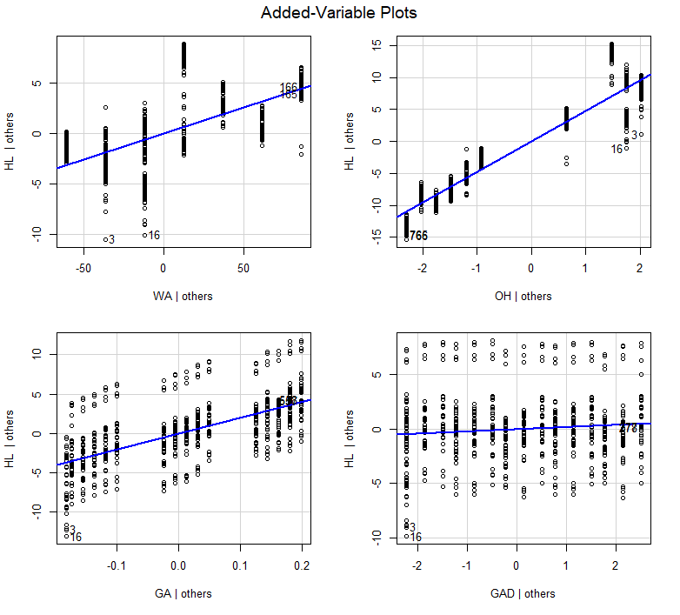

Slide 13
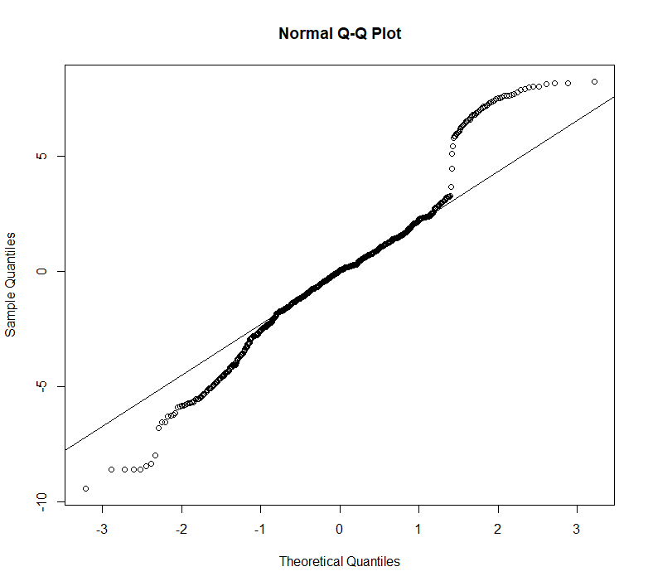
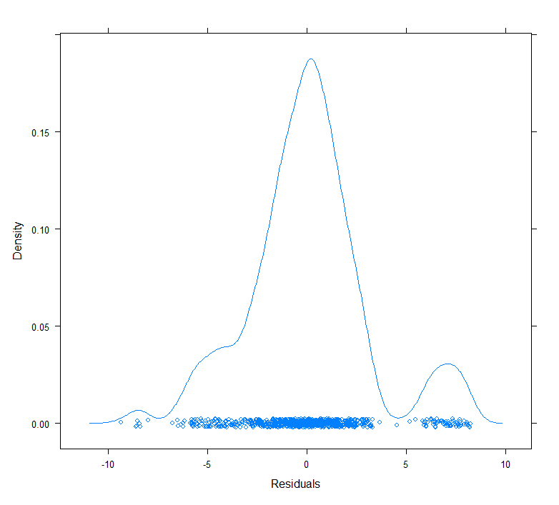
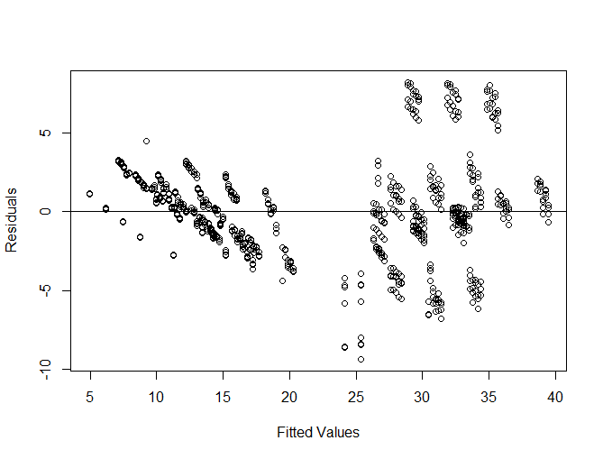
Access Model3

Slide 14
Strengths and Weaknesses
12 different building shapes (construct 768 with 8 features) simulated in Ecotect.
Same volume of 771.75 m^3.
Infer the energy required for heating.

Slide 15
Reference
Tsanas, A. Xifara: 'Accurate quantitative estimation of energy performance of residential buildings using statistical machine learning tools', Energy and Buildings, Vol. 49, pp. 560-567, 2012
https://www.kaggle.com/datasets/elikplim/eergy-efficiency-dataset
https://archive.ics.uci.edu/ml/datasets/Energy+efficiency

