Slide 1
Week 11: PHP wrap-up
INFO/CS 1300: Fall 2016

Slide 2
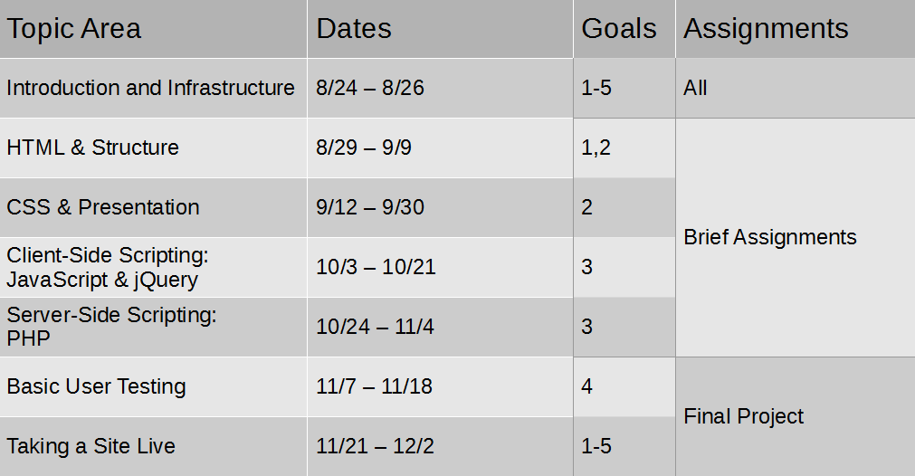
Course Map

Slide 3
Agenda
PHP exercise with associative arrays.
Open time to work on Assignment 9.

