Slide 1
Extensions to Policy Gradient
Reinforcement Learning
School of Data Science
University of Virginia
Last updated: October 26, 2026

Slide 2
Agenda
> Recap of REINFORCE
> Actor-Critic Methods
> Trust Region Methods
> Offline Learning, TD3+BC
> Deep Deterministic Policy Gradient (DDPG)

Slide 3
Recap of REINFORCE

Slide 4
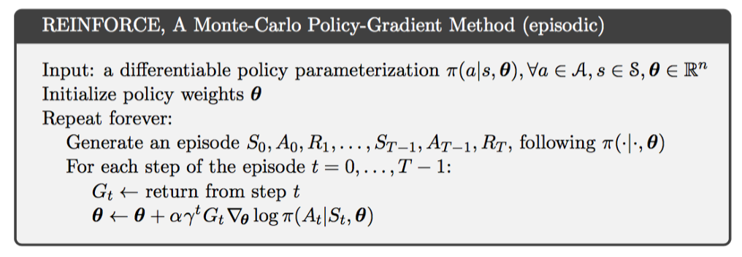
REINFORCE
This was our first policy gradient (PG) method
All PG methods are on-policy algorithms
REINFORCE is a Monte Carlo Gradient algorithm (uses full trajectories)
It works by:
1) simulating paths
2) calculating returns G from each path (evaluate)
3) taking update steps based on return and gradient of policy (improve)

Slide 5
REINFORCE Intuition
As we generate sample paths, we calculate return G over the paths.
The update step will increase parameter vector in direction of:
- greater return
- greater increase of probability repeating action At on future visits to state St

Slide 6

REINFORCE Limitations
REINFORCE can have high variance and converge slowly
From any sampled (s,a) there may be many very different return estimates
We are estimating the gradient of the performance measure
Can be noisy due to factors including:
> Noise in environment
> Sparse rewards
> Length of sample trajectories can vary

Slide 7
REINFORCE with Baseline
REINFORCE can have high variance and converge slowly
We want to take positive gradient steps in direction of parameters that lead to high-reward trajectories
We want to take negative steps for low-reward trajectories
Rather than working w rewards, we can work with relative rewards

Slide 8
REINFORCE with Baseline, contd.
Positive gradient steps in direction of parameters that lead to high relative reward trajectories
Negative steps for low relative reward trajectories
Q: What makes sense for relative reward?
One solution: subtract the average trajectory reward
This is actually the state value function V(s)
By subtracting off a baseline, it reduces variance
We will still have an unbiased estimate for gradient

Slide 9
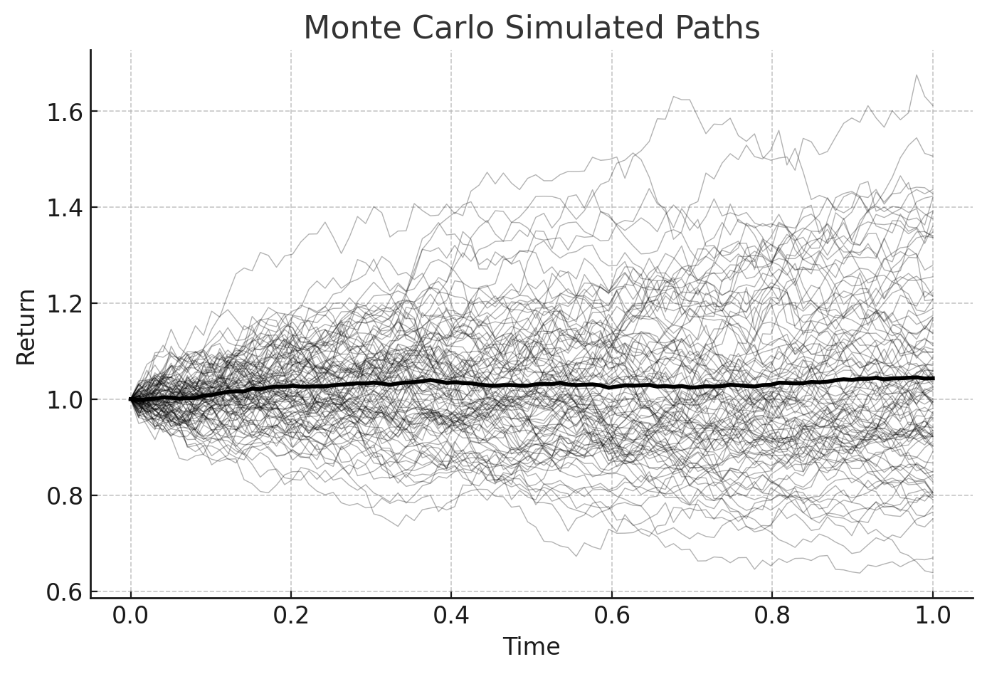
REINFORCE with Baseline, contd.
Plot showing many simulated paths. A gain can be computed for each path.
The dark curve shows average trajectory values. The gain can be computed and it represents V(s).
This can be treated as baseline.

Slide 10
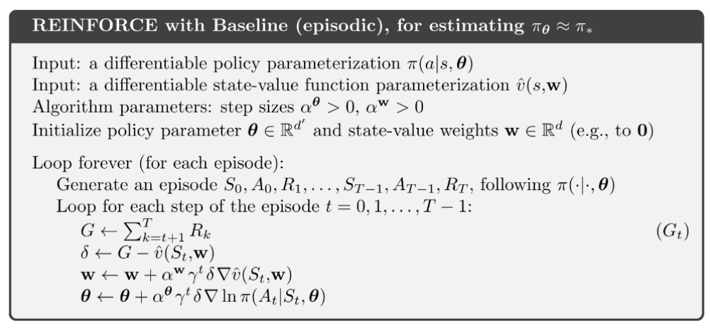
REINFORCE with Baseline Algorithm
REINFORCE can have high variance and converge slowly
One solution: subtract baseline, which can be state value function
Value function as baseline

Slide 11
Actor-Critic Methods

Slide 12


Introducing the Critic
The state value function estimate is based on first state of each transition (time t)
Another option is to use state value estimates from multiple time steps
Given two time steps, we can estimate a one-step return:
State value one step into future, discounted to present value
State value at current time

Slide 13
Introducing the Critic
The state value function estimate is based on first state of each transition (time t)
Another option is to use state value estimates from multiple time steps
Given two time steps, we can estimate a one-step return:
We can collect many trajectories, calculate the returns, and train a neural network
By using this model, it reduces the variance from the samples
It can be used to evaluate the policy, and is called the critic

Slide 14
The Actor
The policy network is called the actor
It guides the behavior of the agent
The actor uses a separate set of parameters

Slide 15
Actor-Critic
We now have two different parametrized functions:
> Policy function (actor)
> State-value function (critic). Evaluates the policy.
For each function the params are updated on each pass
Can use neural networks for the functions, given sufficient training data
The actor and critic work together for policy improvement

Slide 16
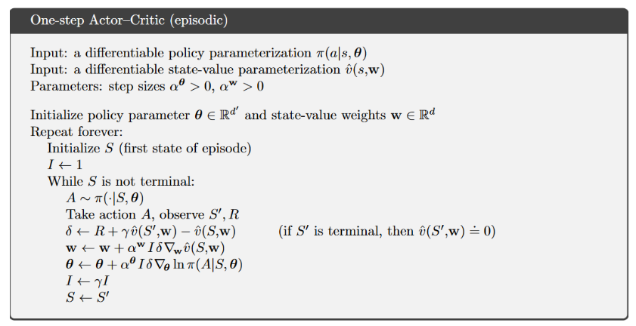
Actor-Critic Algorithm
There are two parametrized functions: one for policy (actor), one for state value (critic)
For each function the params are updated on each pass
Estimate of one-step return
handles discounting
handles discounting
stochastic
update critic
update policy

Slide 17
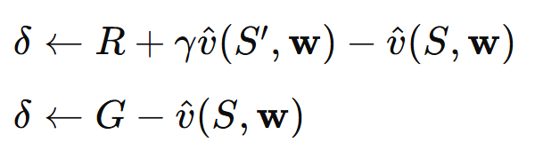
Actor-Critic vs REINFORCE w Baseline
To summarize the difference:
Actor critic:
REINFORCE with baseline:
> The purpose of both is to reduce variance
> Actor critic is a refinement that uses two time points

Slide 18

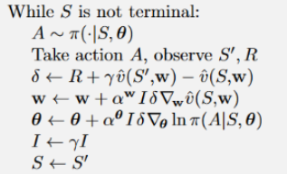
Reappearance of the Advantage Function
Recall the advantage function which measures the benefit of a particular action:
This appears in the critic term (line 4 circled at right)
The Q-value estimate can be calculated from single step transitions.
We have done this with TD learning.
When estimating the advantage this way, the approach is sometimes called
Advantage Actor Critic or A2C

Slide 19
Actor-Critic Summary
Roles:
- Actor learns the policy which drives actions
- Critic estimates value function V(s) or action-value function Q(s,a)
Updating:
- Actor updates policy based on critic feedback
- Critic updates value estimates based on TD error
Advantages:
- Stability and Efficiency: Critic reduces variance in actor policy updates
- Continuous Action Spaces: AC methods handle continuous action spaces

Slide 20
Trust Region Methods

Slide 21
Trust Region Policy Optimization (TRPO)
In policy gradient, a single bad update to policy parameters can have large differences in performance
TRPO methods control step size to avoid bad updates
Source: OpenAI Spinning Up

Slide 22
Trust Region Policy Optimization (TRPO)
In policy gradient, a single bad update to policy parameters can have large differences in performance
TRPO methods control step size to avoid bad updates
They are an enhancement of the basic actor critic method
TRPO updates policies by taking largest possible step to improve performance
However, there is a constraint: new policy must not differ “too much” from old policy
Constraint is formalized using KL-divergence: distance between prob distributions
Source: OpenAI Spinning Up

Slide 23

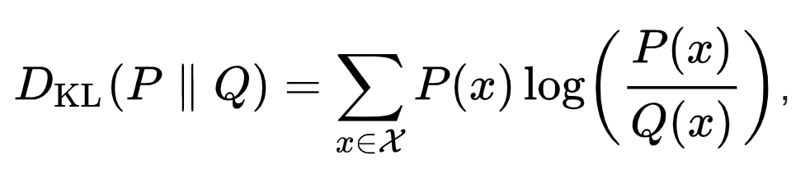

K-L Divergence Definition
Given probability distributions P and Q defined on sample space
KL divergence measures log-difference between P and Q,
where expectation is measured relative to P
Discrete case:
Continuous case:
See here for details and a nice example

Slide 24
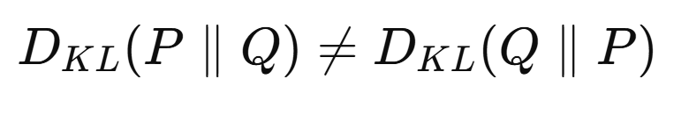
K-L Divergence Facts
KL divergence also called relative entropy
Interpreted as average difference of number of bits required for encoding samples of P using a code optimized for Q
Value is zero when distributions P and Q are identical
When P and Q are not identical, KL divergence is not symmetric:
The triangle inequality also does not hold
Thus, KL divergence is not a metric

Slide 25
TRPO in Practice
TRPO is relatively hard to implement in practice.
Proximal Policy Optimization (PPO) is easier to implement
Thus, we see a quick overview of TRPO

Slide 26



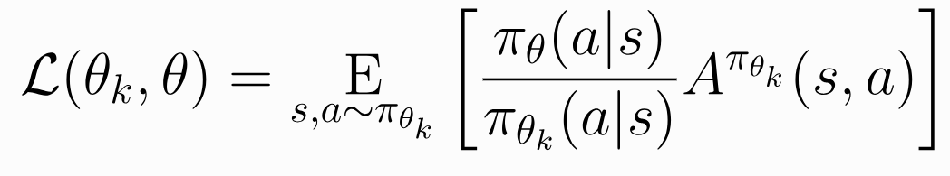
Relative Policy Performance
Define surrogate advantage which measures relative performance of policies
New policy
Old policy
Surrogate advantage of new policy over old policy
Expectation is taken under new policy
As usual, we estimate expectation by sampling

Slide 27
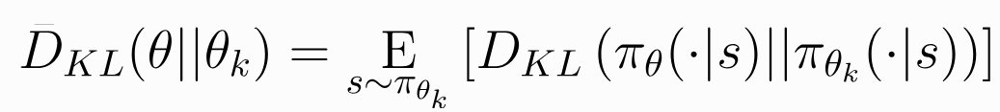

Relative Policy Performance: Constraint
Now we introduce KL divergence:
And we constrain it:

Slide 28
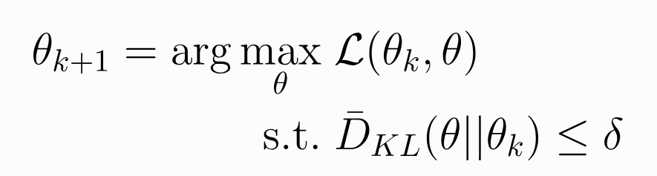
Relative Policy Performance: Key Equations
An update step is subject to these key equations:
(objective)
(constraint)

Slide 29
Relative Policy Performance: Key Equations
An update step is subject to these key equations:
Objective: maximize surrogate advantage
Constraint: limit KL divergence
(objective)
(constraint)

Slide 30
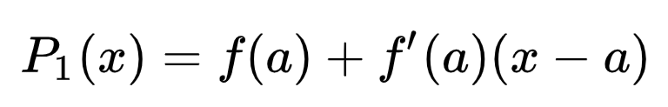
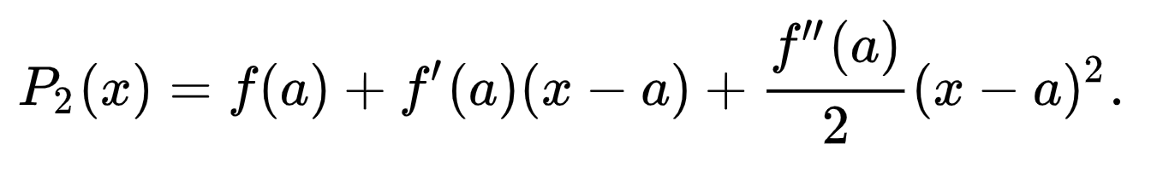
Taylor Approximation
TRPO uses first-order Taylor expansion for easier solution
Recall:
For function f(x) differentiable at point x = a, can consider approximations:
(First order)
(Second order)

Slide 31
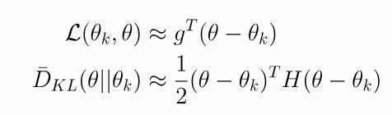
Taylor Approximation, contd.
TRPO uses Taylor expansions of objective, constraint for easier solution
Approximation has this form:
where g is gradient and H is Hessian (2nd order derivative) of surrogate
This can be useful where parameters are sufficiently close

Slide 32
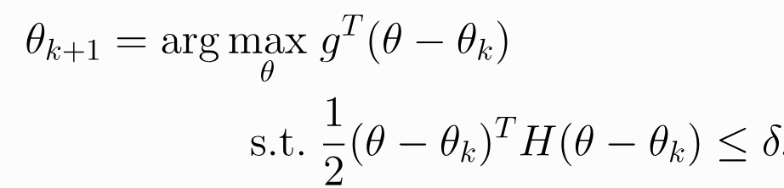
Optimization Problem
Framing as an optimization problem we have:

Slide 33

Optimization Problem
Framing as an optimization problem we have:
The objective of TRPO is to maximize the gradient of surrogate advantage function
This is equivalent to policy gradient method, which moves in direction of gradient
Recall our objective to maximize this quantity from PG:

Slide 34
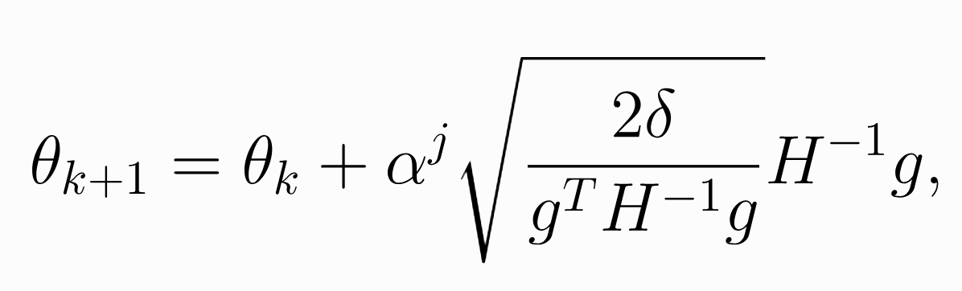
Solving the Optimization Problem
Framing as an optimization problem we have:
Can be solved with this update rule:
Hessian H needs to be inverted

Slide 35
TRPO Challenges
Several challenges make this hard to implement (see Bilgin p249 for list)
Includes:
> Taylor approximation may be violated
> For policy network with massive number of parameters,
- Inverting Hessian H may be hard
- May be hard to store H⁻¹

Slide 36
Proximal Policy Optimization (PPO)
Same approach as TRPO:
> Take policy improvement steps
> Limit distance between old and new policy to retain good performance
TRPO used second-order Taylor expansion
PPO uses first-order methods and tricks
Easier to implement, competitive performance

Slide 37
PPO Variants
PPO-Penality : penalize KL-divergence in objective function
PPO-Clip : No KL-divergence term. Specialized clipping of objective fcn.
OpenAI uses PPO-Clip
Objective function from earlier:
We will limit policy changes based on ratio

Slide 38
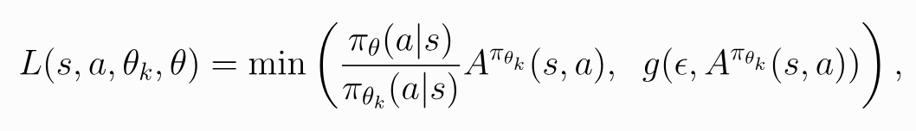
PPO-Clip
Clipped form of objective function L has form below:
This can be computed based on sample trajectories
The min() operator will serve to limit changes based on ratio of new and old policies

Slide 39

PPO-Clip : Example of Positive Case
If advantage for a state-action pair is positive, the contribution to objective reduces to
Any benefit of changing the policy beyond clipped limit is removed
This acts as a regularizer

Slide 40
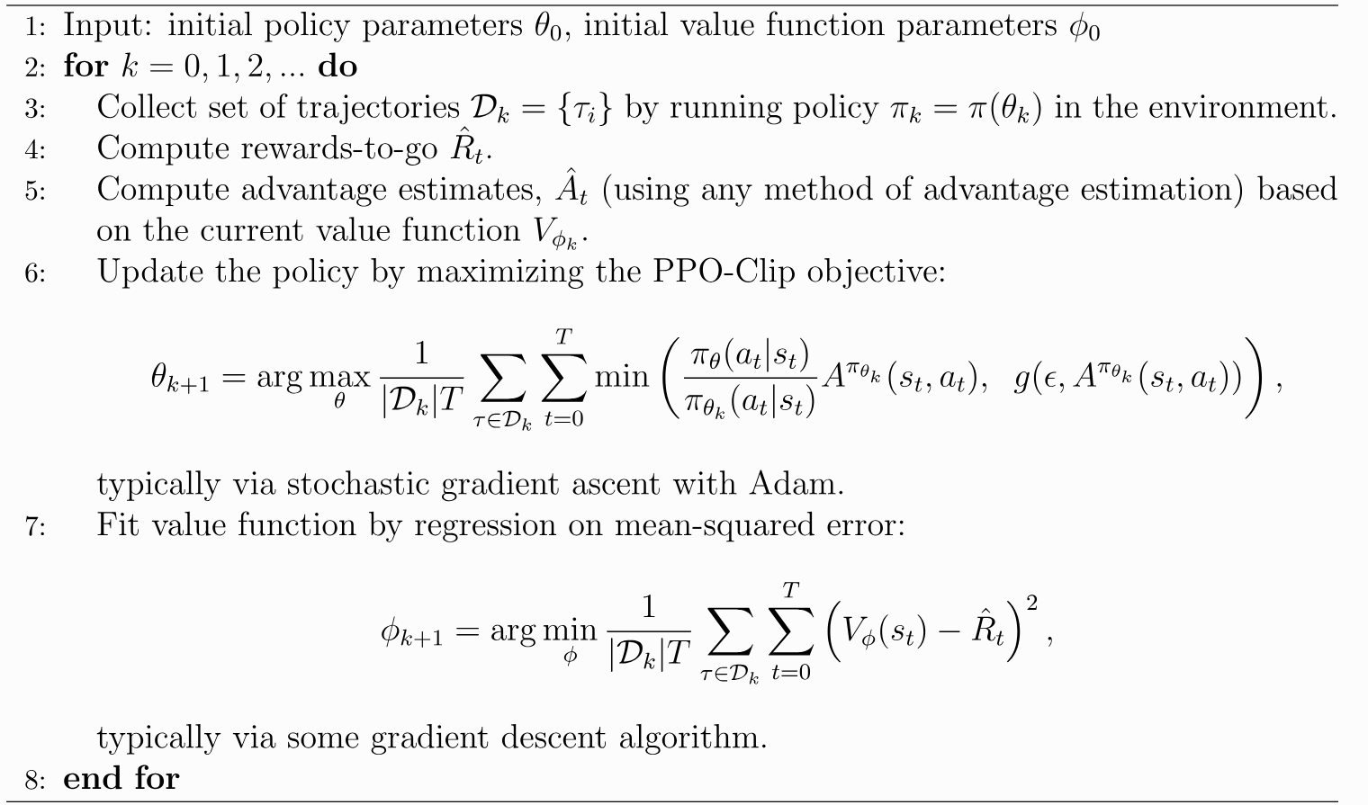
PPO-Clip Algorithm

Slide 41
Offline Learning and TD3+BC
Learn offline for model safety
Policy improvement while encouraging observed actions

Slide 42
Offline Learning Introduction
In some domains, we cannot run RL in real time as it would be dangerous
We can learn offline from a collected dataset
Collected data is regarded as coming from a behavioral policy (e.g., patient treatment in a clinic)
A new policy might recommend an action from a state that was never taken or is poorly represented
This is called out of distribution (OOD), and it can present a safety issue

Slide 43


OOD and Behavioral Cloning
How to handle possibility that policy recommends OOD action?
1 | Prevent it with guardrails / action constraints to restrict the policy to safe actions
2 | Discourage the policy from selecting the action.
Regularize the policy toward actions observed in the dataset.
Behavioral Cloning (BC) takes the second approach
Given collected data
learn the behavior policy through supervised learning

Slide 44
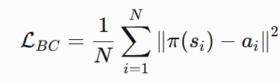
Behavioral Cloning, contd.
The objective function can encourage the policy to remain close to the observed action:
Important point: While BC encourages the policy to stay close to the observed action,
it is not a guarantee

Slide 45


Twin Delayed Deep Deterministic Policy Gradient (TD3)
TD3 is an off-policy, deterministic actor–critic algorithm for continuous-action RL
Uses many ideas we’ve learned already
Actor–critic architecture
> Actor maps to continuous actions
> Critic estimates Q-values
> Replay buffer collects experiences to train the networks
Innovations
> Twin critics to minimize overestimation
> Delayed policy updates: actor updated less frequently than critics for training stability
> Target policy smoothing: clipped noise added to target actions

Slide 46


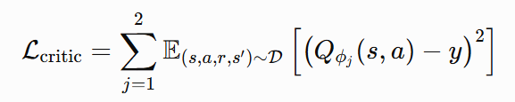

TD3 Essential Components
Critic target:
Notice the min() for conservatism
Target action with clipped noise:
Critic loss:
TD3 actor objective:

Slide 47
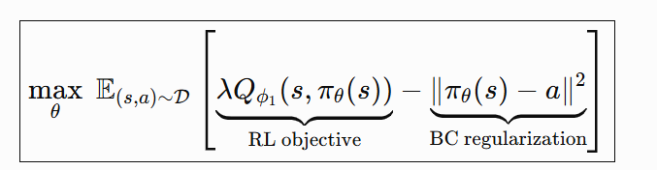
TD3+BC
Finally, we combine TD3 with BC
BC encourages actor’s actions to match the observed actions in dataset
RL objective encourages actions with high estimated return, to potentially improve policy
Regularization parameter controls relative weight in objective function, accounting for relative scales

Slide 48
Deep Deterministic Policy Gradient (DDPG)
Brings together ideas from DQN and Policy Gradients for continuous action space

Slide 49

DDPG - Motivation
We studied a lot of approaches using Q-function
For discrete / low cardinality action space, this makes sense:
For continuous / high cardinality action space, the max is too costly
Instead, a function approximator is used in DDPG
This is the same idea that we used for state spaces with DQN

Slide 50



DDPG - Parametrization
The idea is to use:
for policy
This assumes the policy function is differentiable wrt action
The policy is now deterministic
Uses some of the same features as DQN:
- Replay buffer for stored experiences (making the algorithm off-policy)
- Target network with soft updates (Polyak averaging):

Slide 51
DDPG - Training
The policy is deterministic
If the agent explores on-policy, it may not try enough actions
The trick for better exploration is to add noise to the actions during training

Slide 52
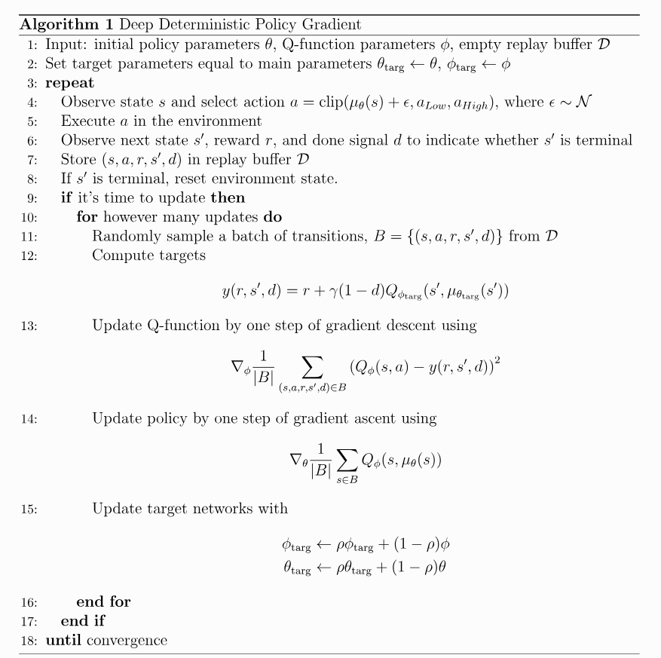
DDPG - Algorithm
Add noise for more exploration
Critic
Actor
Soft updates
Source: https://spinningup.openai.com/en/latest/algorithms/ddpg.html

