Slide 1
Welcome to Presentation
Course code: 0317
Course Title: Software Engineering
Presented By:
Niaz Ahmed Nayeem
ID. UG02-49-18-003
Batch: 49
Department of CSE
State University of Bangladesh

Slide 2
Survey on Smart Software Limited

Slide 3
Introduction:
Smart Software Limited is a Software, Website, e-commerce, and Mobile Application Development service provider company in Bangladesh Not just a software company but they have gained the faith of customers and positioned as one of the best software development company in Bangladesh since 2014.

Slide 4
Works For:
Software Development
Website Development
Human Resource Management
Garments ERP
Hospital Management Software
School Management Software
Account Management System
Production Costing Software
Point of Sale Software
Website Development Service
E-Commerce Website Development
Mobile App Development
Classified Website Development
Hotel Booking Website Development
Garments Accessories Manufacturer ERP
Customer Relationship Management

Slide 5
Main Objective
Development and services
100% client satisfaction
Cost-effectively
Ranking among the top

Slide 6
Departments and Clients Area:
Design
Development
Software Development
Web Development
Mobile Application
E-Commerce
Digital Marketing

Slide 7
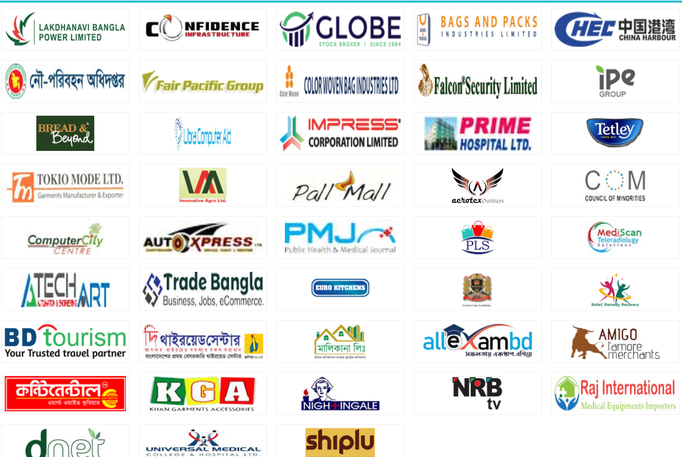
Clients:

Slide 8
Requirements:
Obtain a degree in computer science
Skills in Programming languages
Leadership and communication skills
Develop programming
Business courses
Human resource management

Slide 9
Advantages:
Their mission is 100% client satisfaction.
They develop software cost-effectively.
They have an excellent team of experts who are highly skilled in software.
Take care of their customers even more than their bigger competitors.

Slide 10
Disadvantages:
There are not available all kinds of Software.

Slide 11
Thank You…!

