Slide 1

LSA · LINUX SYSTEM ADMINISTRATION
Linux Basics and the File System
Muhammad Abdullah Niazi
Email: m.niazi@dmuk.edu.kz
Week 1 · Lecture 1

Slide 2
Learning Outcomes
01
Explain what Linux is and describe its layered architecture.
02
Compare popular distributions and distinguish Linux from Unix.
03
Describe the Filesystem Hierarchy Standard and Linux file types.
04
Navigate the file system confidently using absolute and relative paths.
LSA · Linux System Administration
Week 1
02

Slide 3
Session Outline
Introduction to Linux
Installing Linux
Linux distributions
Linux architecture
Linux vs Unix
The Linux file system and file types
File Hierarchy Structure
Directory structure
File system navigation commands
Absolute and relative pathnames
LSA · Linux System Administration
Week 1
03

Slide 4
PART ONE
Understanding Linux Basics
What Linux is, where it runs, and how it is built

Slide 5
What is Linux?
A free, open-source OS
Kernel + GNU tools
Created by Linus Torvalds in 1991 and released under the GNU GPL, so anyone can study, change and share it.
Strictly, “Linux” is the kernel. A full system adds GNU utilities, a shell, libraries and applications.
Multi-user, multitasking
Runs almost everywhere
Many users and processes run at once, each isolated by permissions and the kernel scheduler.
Web servers, cloud VMs, Android phones, routers, cars and every one of the world’s top 500 supercomputers.
LSA · Linux System Administration
Week 1
05

Slide 6
Linux Architecture
Applications & Utilities
Browsers, editors, ls, cp, web servers
User space
Applications and the shell run with limited privileges and must ask the kernel for resources.
System calls
The bridge between user space and the kernel: open(), read(), fork(), execve().
Kernel space
Runs with full hardware access. Device drivers live here as built-in code or loadable modules.
Shell
Interprets your commands (bash, zsh)
Kernel
Process, memory, file and device management
Hardware
CPU, RAM, disks, network cards
LSA · Linux System Administration
Week 1
06

Slide 7
Linux Distributions
A distribution (distro) bundles the Linux kernel with tools, a package manager and defaults.
Distribution | Family | Package tool | Typical use
Ubuntu | Debian | apt | Desktops, cloud servers, beginners
Debian | Debian | apt / dpkg | Stable servers, base for many distros
Fedora | Red Hat | dnf | Latest features, developer desktops
RHEL / Rocky / AlmaLinux | Red Hat | dnf (yum on older) | Enterprise servers with long support
CentOS Stream | Red Hat | dnf | Upstream preview of the next RHEL
Arch Linux | Independent | pacman | Rolling release, do-it-yourself setup
Kali Linux | Debian | apt | Penetration testing and security labs
LSA · Linux System Administration
Week 1
07

Slide 8
Installing Linux
01
Choose a method: virtual machine (VirtualBox/VMware), dual boot, WSL on Windows, or a cloud VM.
02
Download the ISO from the official site, e.g. ubuntu.com, and verify its SHA256 checksum.
03
Create boot media: write the ISO to a USB drive with Rufus or balenaEtcher, or attach it to a VM.
04
Boot and install: choose language, keyboard, disk partitioning, time zone, then create your user.
05
First steps: reboot, then run sudo apt update && sudo apt upgrade to install the latest updates.
LSA · Linux System Administration
Week 1
08

Slide 9
Linux vs Unix
Linux is Unix-like: it follows Unix design ideas and POSIX standards but shares no original Unix code.
Aspect | Linux | Unix
Origin | Linus Torvalds, 1991 | AT&T Bell Labs, 1969
Licence | Free and open source (GPL) | Mostly proprietary (AIX, HP-UX, Solaris)
Cost | Free to download and use | Usually licensed with vendor hardware
Hardware | Runs on almost any CPU architecture | Tied to specific vendor hardware
Shell | bash by default (zsh, fish available) | sh, ksh or csh by default
Examples | Ubuntu, Fedora, Debian, RHEL | AIX, HP-UX, Solaris; macOS is Unix-certified
LSA · Linux System Administration
Week 1
09

Slide 10
“
In Linux, everything is a file — documents, directories, devices and even running processes.
Core Unix design principle inherited by Linux

Slide 11
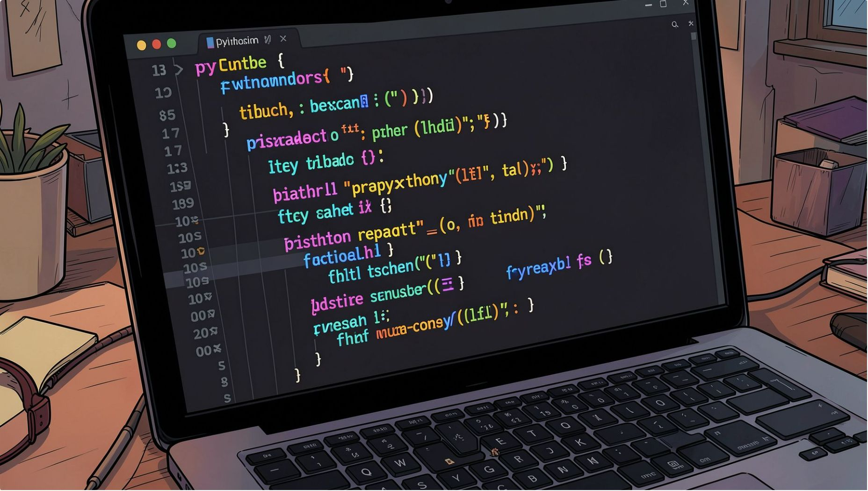
PART TWO
The Linux File System
Structure, file types, paths and navigation

Slide 12
File System and File Types
Linux has one tree starting at /. Common disk formats are ext4, XFS and Btrfs. The first character of ls -l shows the file type.
Symbol | File type | Example
- | Regular file (text, binary, image) | /etc/hostname, /usr/bin/ls
d | Directory | /home, /var/log
l | Symbolic link (shortcut) | /bin → usr/bin on modern distros
c | Character device (byte stream) | /dev/tty, /dev/null
b | Block device (storage) | /dev/sda, /dev/nvme0n1
s | Socket (process communication) | /run/systemd/notify
p | Named pipe (FIFO) | created with mkfifo mypipe
LSA · Linux System Administration
Week 1
12

Slide 13
File Hierarchy Structure (1/2)
The Filesystem Hierarchy Standard (FHS) defines where things live, so every distro feels familiar.
/
/bin · /sbin
/etc
Root of the whole tree. Every file and device sits below it.
Essential user commands (ls, cp) and system binaries (fdisk, reboot).
System-wide configuration files such as /etc/passwd and /etc/hosts.
/home
/root
/boot
Personal directories for each user, e.g. /home/ali.
Home directory of the root (administrator) user.
Kernel images, initramfs and the GRUB bootloader files.
LSA · Linux System Administration
Week 1
13

Slide 14
File Hierarchy Structure (2/2)
/var
/tmp
/usr
Variable data that grows: logs in /var/log, mail, caches, databases.
Temporary files, often cleared at reboot. Writable by every user.
Installed software, libraries and documentation (/usr/bin, /usr/lib).
/opt
/dev · /proc
/mnt · /media
Optional third-party software packages, e.g. /opt/google.
Device files, and a virtual view of running processes and kernel data.
Mount points for temporary filesystems and removable media like USB drives.
LSA · Linux System Administration
Week 1
14

Slide 15
Directory Structure
See the tree
tree draws directories as a tree. Install it with sudo apt install tree.
Limit the depth
Use -L to stay readable, and -d to show directories only.
Check disk layout
lsblk shows disks and partitions; df -h shows where each one is mounted.
TERMINAL
$ tree -L 1 /
/
├── bin -> usr/bin
├── boot
├── dev
├── etc
├── home
├── var
└── usr
$ tree -d -L 2 /home
$ lsblk
$ df -h /
LSA · Linux System Administration
Week 1
15

Slide 16
File System Navigation Commands
Where am I?
pwd prints the current working directory.
What is here?
ls lists contents. Add -l for details, -a for hidden dot-files, -h for readable sizes.
Move around
cd changes directory. ~ is your home, .. the parent, - the previous directory.
TERMINAL
$ pwd
/home/student
$ ls -lah
$ cd /var/log # go to an absolute path
$ cd .. # up one level to /var
$ cd - # back to /var/log
$ cd ~ # home directory
$ cd # also goes home
$ file /etc/hostname # detect type
LSA · Linux System Administration
Week 1
16

Slide 17
Absolute and Relative Pathnames
Rule of thumb: if a path begins with /, it is absolute. Use absolute paths in scripts; use relative paths to save typing.
Absolute path
Relative path
Starts at the root / and works from anywhere. Example: /home/student/docs/notes.txt
Starts from your current directory. From /home/student: docs/notes.txt
. and ..
~ shortcut
. means the current directory and .. means the parent. Example: ../shared/report.txt
~ expands to your home directory, so ~/docs equals /home/student/docs.
LSA · Linux System Administration
Week 1
17

Slide 18
ACTIVITY
1
Run pwd, then ls -la ~ and identify every hidden file.
File System Explorer
2
Visit /etc, /var/log, /dev and /proc. Note one interesting file in each.
3
Use ls -l /dev | head and name three file types from the first character.
4
Run cat /proc/cpuinfo | head and uname -r. Record your CPU model and kernel version.
5
Deliverable: a short table of 6 directories, their purpose, and one file found in each.
20
minutes · individual
LSA · Linux System Administration
Week 1
18

Slide 19
ACTIVITY
1
Create a practice tree: mkdir -p ~/lab1/{docs,code/python,backup}
Path Challenge
2
From ~/lab1/code/python, reach ~/lab1/docs using a relative path only.
3
Repeat the move using an absolute path. Check where you are with pwd.
4
Use cd - and cd ~ and explain what each one did.
5
Run tree ~/lab1 and screenshot the result for your lab log.
15
minutes · pairs
LSA · Linux System Administration
Week 1
19

Slide 20
Session Summary
Linux is a layered OS
Distros share one kernel
Hardware, kernel, shell and applications, linked by system calls.
They differ in package manager, release cycle and target use.
One tree from /
Paths and navigation
The FHS gives every directory a defined job: /etc, /var, /home and more.
Absolute paths start at /; relative paths start where you are.
LSA · Linux System Administration
Week 1
20

Slide 21
Reading and References
Shotts, W. (2019) The Linux Command Line, 2nd edn. San Francisco, CA: No Starch Press. Free edition: https://linuxcommand.org/tlcl.php
Nemeth, E. et al. (2017) UNIX and Linux System Administration Handbook, 5th edn. Boston, MA: Addison-Wesley.
Ward, B. (2021) How Linux Works, 3rd edn. San Francisco, CA: No Starch Press.
Linux Foundation (2015) Filesystem Hierarchy Standard 3.0. Available at: https://refspecs.linuxfoundation.org/fhs.shtml
Ubuntu (2024) Install Ubuntu Desktop tutorial. Available at: https://ubuntu.com/tutorials/install-ubuntu-desktop
LSA · Linux System Administration
Week 1
21

Slide 22
Questions
Week 1 · Linux Basics and the File System
Muhammad Abdullah Niazi · m.niazi@dmuk.edu.kz

