Slide 1

LSA · LINUX SYSTEM ADMINISTRATION
Linux Commands, File Management and Permissions
Muhammad Abdullah Niazi
Email: m.niazi@dmuk.edu.kz
Week 2 · Lecture 2

Slide 2
Review
01
What are the four layers of the Linux architecture?
02
Name two distribution families and the package tool each one uses.
03
Which directory holds system configuration files, and which holds logs?
04
What is the difference between /home/student/docs and docs?
05
What does the first character d mean in the output of ls -l?
LSA · Linux System Administration
Week 2
02

Slide 3
Learning Outcomes
01
Use essential terminal commands to navigate, inspect and search the system.
02
Create, copy, move and delete files and directories safely.
03
Read Linux permission strings and calculate octal permission values.
04
Change permissions with chmod and ownership with chown.
LSA · Linux System Administration
Week 2
03

Slide 4
Session Outline
Anatomy of a command
Basic commands
Complete command reference
Pipes and redirection
File management
Directory management
Permissions
Changing permissions using chmod
Changing ownership using chown
LSA · Linux System Administration
Week 2
04

Slide 5
PART ONE
Linux Commands
Essential terminal commands for everyday administration

Slide 6
Anatomy of a Command
Structure
command -options arguments — e.g. ls -l /etc runs ls, with long format, on /etc.
Get help
man ls opens the manual. ls --help gives a quick summary. Press q to quit.
Work faster
Press Tab to auto-complete, ↑ to recall history, Ctrl+C to stop a command.
TERMINAL
$ ls -l /etc
$ man ls # full manual
$ ls --help # quick help
$ whatis cp # one-line summary
$ history | tail -5
$ !! # repeat last command
$ clear # or Ctrl+L
LSA · Linux System Administration
Week 2
06

Slide 7
Basic Commands
Command | Purpose | Example
echo | Print text or a variable | echo "Hello $USER"
cat · less | Show a file / scroll through it | less /var/log/syslog
head · tail | First or last lines of a file | tail -f /var/log/syslog
touch | Create an empty file or update its time | touch notes.txt
cp · mv · rm | Copy, move/rename, remove | cp a.txt b.txt
mkdir · rmdir | Make / remove a directory | mkdir projects
whoami · date | Current user / date and time | date +%F
uname | Kernel and system information | uname -a
LSA · Linux System Administration
Week 2
07

Slide 8
Complete Commands: A Reference Map
You do not memorise every command — you learn the families and use man for the details.
Files & directories
Viewing text
Searching
ls · cd · pwd · cp · mv · rm · mkdir · touch · ln · stat
cat · less · head · tail · wc · sort · uniq · cut · diff
find · locate · grep · which · whereis
System information
Processes & users
Network & help
uname · hostname · uptime · free · df · du · lscpu · lsblk
ps · top · kill · who · id · sudo · su
ip · ping · ssh · curl · wget · man · --help · tldr
LSA · Linux System Administration
Week 2
08

Slide 9
Pipes and Redirection
Pipe |
Sends the output of one command into the next, like a production line.
Redirect > and >>
> writes output to a file (overwrites); >> appends to it.
Errors 2>
Sends error messages elsewhere, e.g. 2>/dev/null discards them.
TERMINAL
$ ls /etc | wc -l # count entries
$ grep -i error /var/log/syslog
$ ps aux | grep ssh
$ cat /etc/passwd | cut -d: -f1 | sort
$ ls -l > list.txt # overwrite
$ date >> list.txt # append
$ find / -name '*.conf' 2>/dev/null
LSA · Linux System Administration
Week 2
09

Slide 10
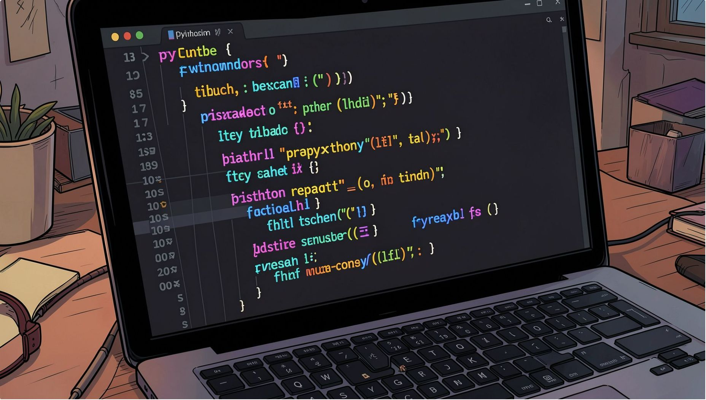
PART TWO
File Management and Permissions
Working safely with files, directories and access rights

Slide 11
File Management
Create and copy
touch creates files. cp -r copies directories, and cp -i asks before overwriting.
Move and rename
mv both moves and renames — there is no separate rename command.
Delete with care
rm has no recycle bin. Use rm -i while learning.
Find files
find searches by name, size, type or time.
TERMINAL
$ touch report.txt
$ cp report.txt report.bak
$ mv report.txt final.txt # rename
$ mv final.txt ~/docs/ # move
$ rm -i report.bak
$ ln -s /var/log/syslog sys.log
$ stat final.txt # size, times
$ find ~ -name '*.txt' -size +1k
LSA · Linux System Administration
Week 2
11

Slide 12
Directory Management
Create
mkdir -p builds a whole path at once and does not complain if it exists.
Remove
rmdir only removes empty directories. rm -r removes a directory and everything inside.
Measure
du -sh shows how much space a directory uses.
TERMINAL
$ mkdir projects
$ mkdir -p web/{css,js,img}
$ cp -r web web_backup
$ mv web_backup archive
$ rmdir emptydir
$ rm -r archive # careful!
$ du -sh ~/projects
$ tree web
LSA · Linux System Administration
Week 2
12

Slide 13
Permissions: Reading -rwxr-x---
Every file has an owner, a group and three permission sets. See them with ls -l.
Position | Characters | Applies to | Meaning
1 | - | File type | - regular file, d directory, l link
2–4 | rwx | Owner (u) | Owner can read, write and execute
5–7 | r-x | Group (g) | Group members can read and execute
8–10 | --- | Others (o) | Everyone else has no access
LSA · Linux System Administration
Week 2
13

Slide 14
Permission Values
Add the values for each set: rwx = 4+2+1 = 7, r-x = 4+0+1 = 5, r-- = 4. So rwxr-xr-- = 754.
Permission | Letter | Value | On a file | On a directory
Read | r | 4 | View the contents | List the files inside
Write | w | 2 | Change the contents | Create or delete files inside
Execute | x | 1 | Run it as a program | Enter it with cd
None | - | 0 | No access | No access
LSA · Linux System Administration
Week 2
14

Slide 15
Changing Permissions using chmod
Numeric mode
Three digits for owner, group and others: chmod 755 script.sh.
Symbolic mode
Who (u g o a), action (+ - =), permission (r w x).
Common values
755 scripts and folders · 644 normal files · 600 private keys.
TERMINAL
$ chmod 755 deploy.sh
$ chmod 644 index.html
$ chmod 600 ~/.ssh/id_ed25519
$ chmod u+x run.sh # owner can run
$ chmod go-w notes.txt # remove write
$ chmod a=r readme.txt # read-only
$ chmod -R 750 /srv/project
$ ls -l deploy.sh
-rwxr-xr-x 1 ali dev 210 deploy.sh
LSA · Linux System Administration
Week 2
15

Slide 16
Changing Ownership using chown
chown
Changes the owner, and optionally the group, of a file. Usually needs sudo.
chgrp
Changes only the group.
Recursive
-R applies the change to a directory and everything inside it.
TERMINAL
$ sudo chown ali report.txt
$ sudo chown ali:developers app.py
$ sudo chown :developers app.py
$ sudo chgrp www-data /var/www/site
$ sudo chown -R www-data:www-data \
/var/www/html
$ ls -l app.py
-rw-r--r-- 1 ali developers app.py
LSA · Linux System Administration
Week 2
16

Slide 17
ACTIVITY
1
Count the lines in /etc/passwd using wc -l.
Command Scavenger Hunt
2
Show only the usernames: cut -d: -f1 /etc/passwd | sort.
3
Find every .conf file in /etc and save the list to confs.txt.
4
Use grep to find which line of /etc/passwd mentions your username.
5
Show the last 5 lines of /var/log/syslog (or journalctl -n 5).
20
minutes · pairs
LSA · Linux System Administration
Week 2
17

Slide 18
ACTIVITY
1
Create ~/lab2/{public,private,scripts} and a file in each.
Permissions Lab
2
Make private accessible only to you: chmod 700 ~/lab2/private.
3
Create hello.sh with echo Hello, then try ./hello.sh — note the error.
4
Fix it with chmod u+x hello.sh and run it again.
5
Set public/info.txt to 644 and explain who can read and write it.
6
Deliverable: ls -lR ~/lab2 output with every permission string explained.
25
minutes · individual
LSA · Linux System Administration
Week 2
18

Slide 19
Session Summary
Commands follow one pattern
Pipes build tools
command, options, arguments. Use man and --help for details.
Chain small commands with | and save output with > or >>.
Manage files safely
Permissions protect data
cp, mv, rm -i, mkdir -p and find cover daily work.
rwx for owner, group and others; set with chmod, own with chown.
LSA · Linux System Administration
Week 2
19

Slide 20
Reading and References
Shotts, W. (2019) The Linux Command Line, 2nd edn. San Francisco, CA: No Starch Press. Free edition: https://linuxcommand.org/tlcl.php
Nemeth, E. et al. (2017) UNIX and Linux System Administration Handbook, 5th edn. Boston, MA: Addison-Wesley.
Ward, B. (2021) How Linux Works, 3rd edn. San Francisco, CA: No Starch Press.
Barrett, D.J. (2022) Efficient Linux at the Command Line. Sebastopol, CA: O’Reilly Media.
Linux man-pages project. chmod(1), chown(1), find(1). Available at: https://man7.org/linux/man-pages/
LSA · Linux System Administration
Week 2
20

Slide 21
Questions
Week 2 · Linux Commands, File Management and Permissions
Muhammad Abdullah Niazi · m.niazi@dmuk.edu.kz

