Slide 1
COCOMO MODEL

Slide 2
COCOMO
Constructive Cost Model
The constructive cost model was developed by Barry W. Boehm in the late 1970s and published in Boehm's 1981 as a model for estimating effort, cost, and schedule for software projects.
COCOMO I
COCOMO II
Notes:
Introduce in book named “software Engineering Economics”

Slide 3
COCOMO I
It has further 3 types.
    1-Basic Model
      It estimate the software in a rough and quick manner.
      Mostly used for small and medium sized projects.
      3 modes of development
      Organic
      Semi Detached
      Embedded

Slide 4
COCOMO I Modes
 | Organic | Semi Detached | Embedded
Size | 2-50 KLOC | 50-300 KLOC | 300 KLOC or above
Team size | Small size | Medium Size | Large size
Developer Experience | Experienced developers needed | Average experienced developers | Very little experienced people
Environment | Familiar Environment | Less Familiar Environment | Significant Environment ( almost new )
Innovation | Little | Middle | Major
Deadline | Not Tight | Medium | Tight deadlines
Examples | Payroll system | Utility Systems (compiler) | Air System

Slide 5
Basic Model Example
Equations
NAME | Equation | Unit
Efforts | =a(KLOC)^{b} | Persons month
Development Time | c(effort)^{d} | Months
Effort Staff Size | effort/dev time | persons
Productivity | KLOC/Effort | KLOC/PM
VALUES
Software project | a_{b} | b_{b} | c_{b} | d_{b}
Organic | 2.4 | 1.05 | 2.5 | 0.38
Semi-detached | 3.0 | 1.12 | 2.5 | 0.35
Embedded | 3.6 | 1.20 | 2.5 | 0.32

Slide 6
Numerical
Suppose a project was estimated to be 400 KLOC. Calculate effort and time for organic mode.
organic
effort=a(KLOC)^{b}
effort=2.4(400)^{1.05}
Person Months=1295PM

Slide 7
2-Intermediate Model
Basic model was quick but inaccurate and it provide rough time period but intermediate model includes a set of 15 additional predictors (cost drivers) for calculation.
15 cost drivers
  Product attributes
    Required software reliability.
    Database size
    Product complexity

Slide 8
15 cost Drivers
  Computer attributes
    Execution Time
    Storage
    Virtual machine
    Computer turnaround
  Personal attributes
    Analyst capabilities
    Programmer capabilities
    Virtual machine experience
    Programming language experience
  Project Attributes
    Modern programming practices
    Use of software tools
    Required development schedule

Slide 9
Equation of intermediate model
Software project | a_{i} | b_{i}
Organic | 3.2 | 1.05
Semi-detached | 3.0 | 1.12
Embedded | 2.8 | 1.20
E= a (KLoC)^{(b)} x (EAF) (effort adjustment factor)
E=2.8(400)^{1.20} x (EAF)

Slide 10
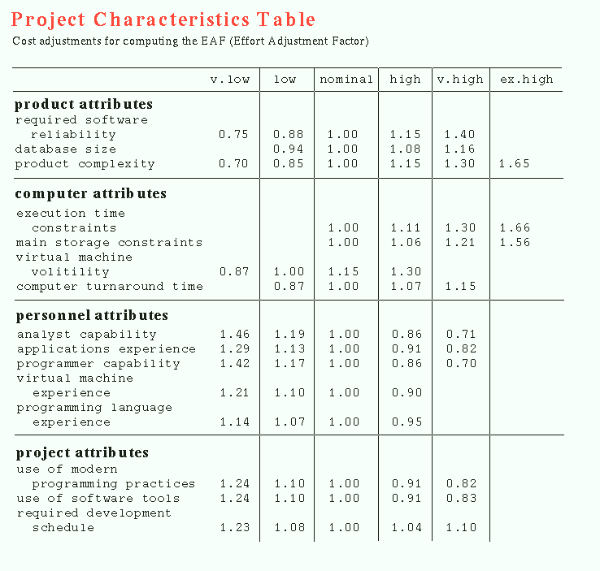

Slide 11
Numerical
A new project with 400 KLOC
has a choice of hiring from 2 pools of developers
1-very high capable (w.r.t application) but little experience in programming.
2-developers of low quality but a lot of programming experience.
Which is better choice.
CASE I
E=a(KLOC) ^{b} x EAF
EAF=0.82x1.14
=0.93
E=2.8(400)^{1.20} x 0.934
E=3470 PM (person months)
CASE II
E=a(KLOC)^{b} x EAF
EAF=1.29x0.95
  =1.22
  E=3412 x 1.22
  E=4528 PM

Slide 12
Detailed COCOMO
In detailed COCOMO , the whole software is divided into different modules and then we apply COCOMO in different modules to estimate effort and then sum the effort.
The effort is calculated as a function of program size and a set of cost drivers are given according to each phase of the software life cycle.

Slide 13
The phases of detailed COCOMO
planning and requirements
system design
detailed design
module code and test
integration and test

Slide 14
COCOMO II model
It was also developed by Barry Boehm
In detailed COCOMO, the whole software is divided into different modules and then we apply COCOMO in different modules to estimate effort and then sum the effort.
COCOMO II has 3 stages.
Application Composition Estimation
Early Design Estimation
Post Architecture Estimation

Slide 15
Application composition estimation
Focus on those application which can be
  Quickly developed using interoperated components
  E.g. GUI , Database manger
  Size is estimated using objects points
  Screens
  Reports
  3GL components

Slide 16
Application composition estimation
Steps for effort estimation
Access objects counts
  Estimate the numbers of screens , reports and 3GL components
  Classify complexity levels of each object.
  Classify each point into Simple , medium and difficult.
  screens are classify on the base of views and sources.
  Reports are classify on the base of Section + sources

Slide 17
Screen Classification
NO of Views | 2-3 Screens servers | <8 screens | 8+ screens Servers
<3 | Simple | Simple | Medium
3-7 | Simple | Medium | Difficult
>8 | Medium | Difficult | Difficult

Slide 18
Reports classification
NO of Views | 2-3 Screens servers | <8 screens | 8+ screens Servers
0-1 | Simple | Simple | Medium
2 or 3 | Simple | Medium | Difficult
4+ | Medium | Difficult | Difficult

Slide 19
COCOMO II Phases
The Six phases of detailed COCOMO are:-
planning and requirements
system design
detailed design
module code and test
integration and test
Cost Constructive model

