Slide 1
Smart Ordering For Vacation Rentals

Slide 2
Mashape Details
Endpoints
/smartordering/sort
This will sort the products based on both Walk Score and Amenities
/smartordering/sort/{type}
If the type is Amenity then the products will be sorted based on Amenities.
If the type is Walkscore then the products will be sorted based on Walkscore.
Mashape headers
X-Mashape-Key - q4ymM1vrtpmshz2GJbp5jAndqsowp15ZdHajsnc12JWnKD9cv7
Content-Type - application/json; charset=utf-8

Slide 3
URL, Request and Response
Base URL : https://shasureshkumar-smart-ordering-v1.p.mashape.com/
Request: {"products": [{"productId": “1", "productName": “Test Product", "latitude": 12.34, "longitude": -56.78, "address": “Product Address", "countryCode": “IN", "amenities": ["RST151", "RMA59", "RMA167"]},……….]}
Response : {"products": [ {"productId": “1", "productName": " Test Product ", "score": 17.23},…….]}

Slide 4
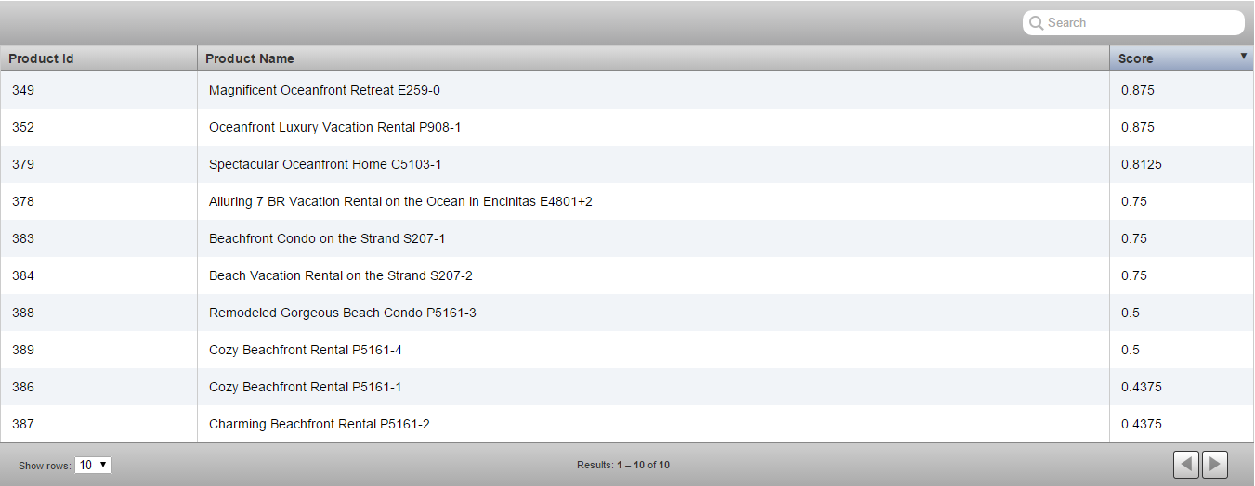
Amenities

Slide 5
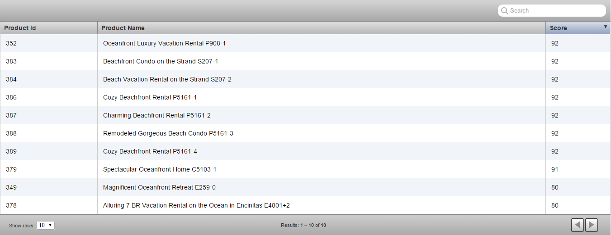
Walk Score

Slide 6
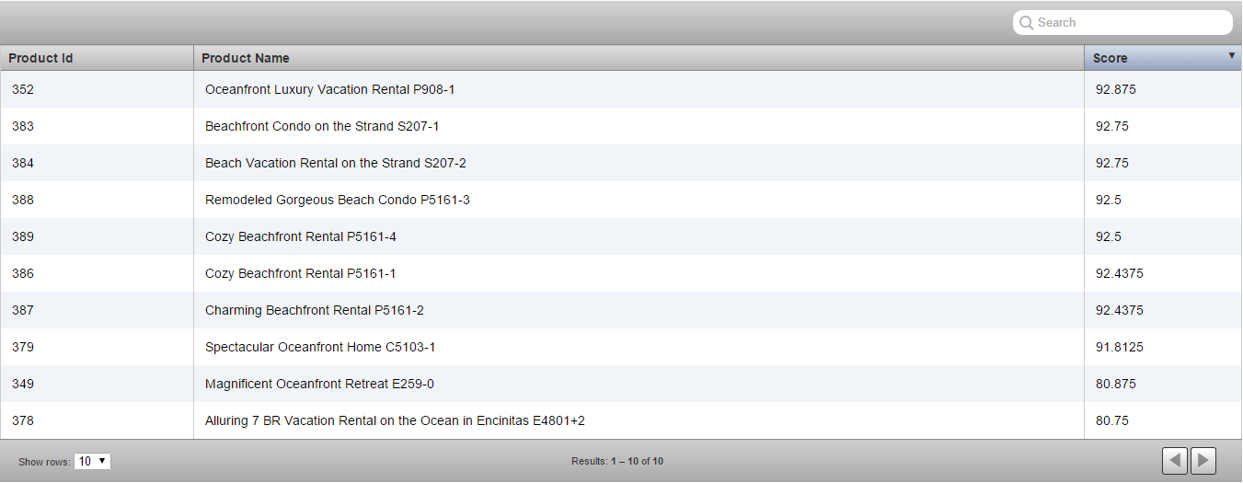
Both

