Slide 1


Nibodha Technologies
Preferred Vacation Rental Technology Partner
- SMART ORDERING API

Slide 2

SMART ORDERING API:
It is indeed a “Smart-API” to display the property details of vacation rentals sorted based on some unique parameters.
How is this different from the peers?
Contemporary API ‘s can list down the property details , either by the boring alphabetical order or by traditional price based order.
Our “Smart-API” intelligently displays the property details, by sorting them based on the amenities in the products and the Walk score.

Slide 3


How it does………
Smart-API calculates Amenity score for the product, based on the amenities like Refrigerator, Barbeque Facility, Microwave Oven, LCD TV, Blue-Ray Player etc. and list the products accordingly.
Also it leverages the walk score to decide the listing order.
Isn’t SMART ????

Slide 4





https://nibodha-smart-ordering-v1.p.mashape.com/vr-pms/smartorder/Amenity
Sorts based on both Amenity score & Walk score
https://nibodha-smart-ordering-v1.p.mashape.com/vr-pms/smartorder
https://nibodha-smart-ordering-v1.p.mashape.com/vr-pms/smartorder/walkscore

Slide 5

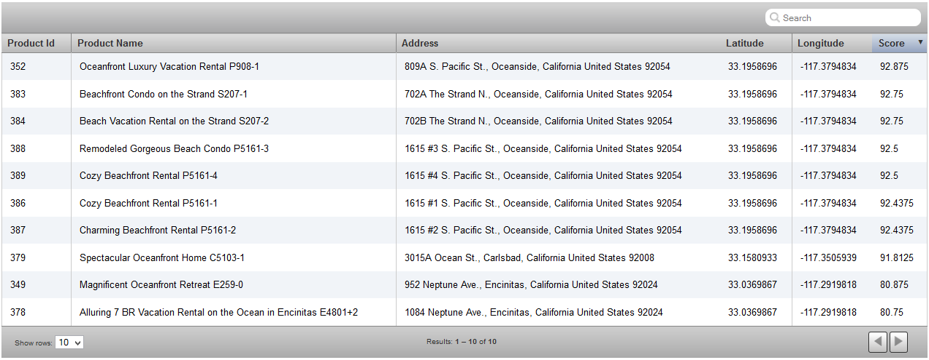
Products listed based on the calculated score

Slide 6


Thank you Varrsha Manokaran

