Slide 1
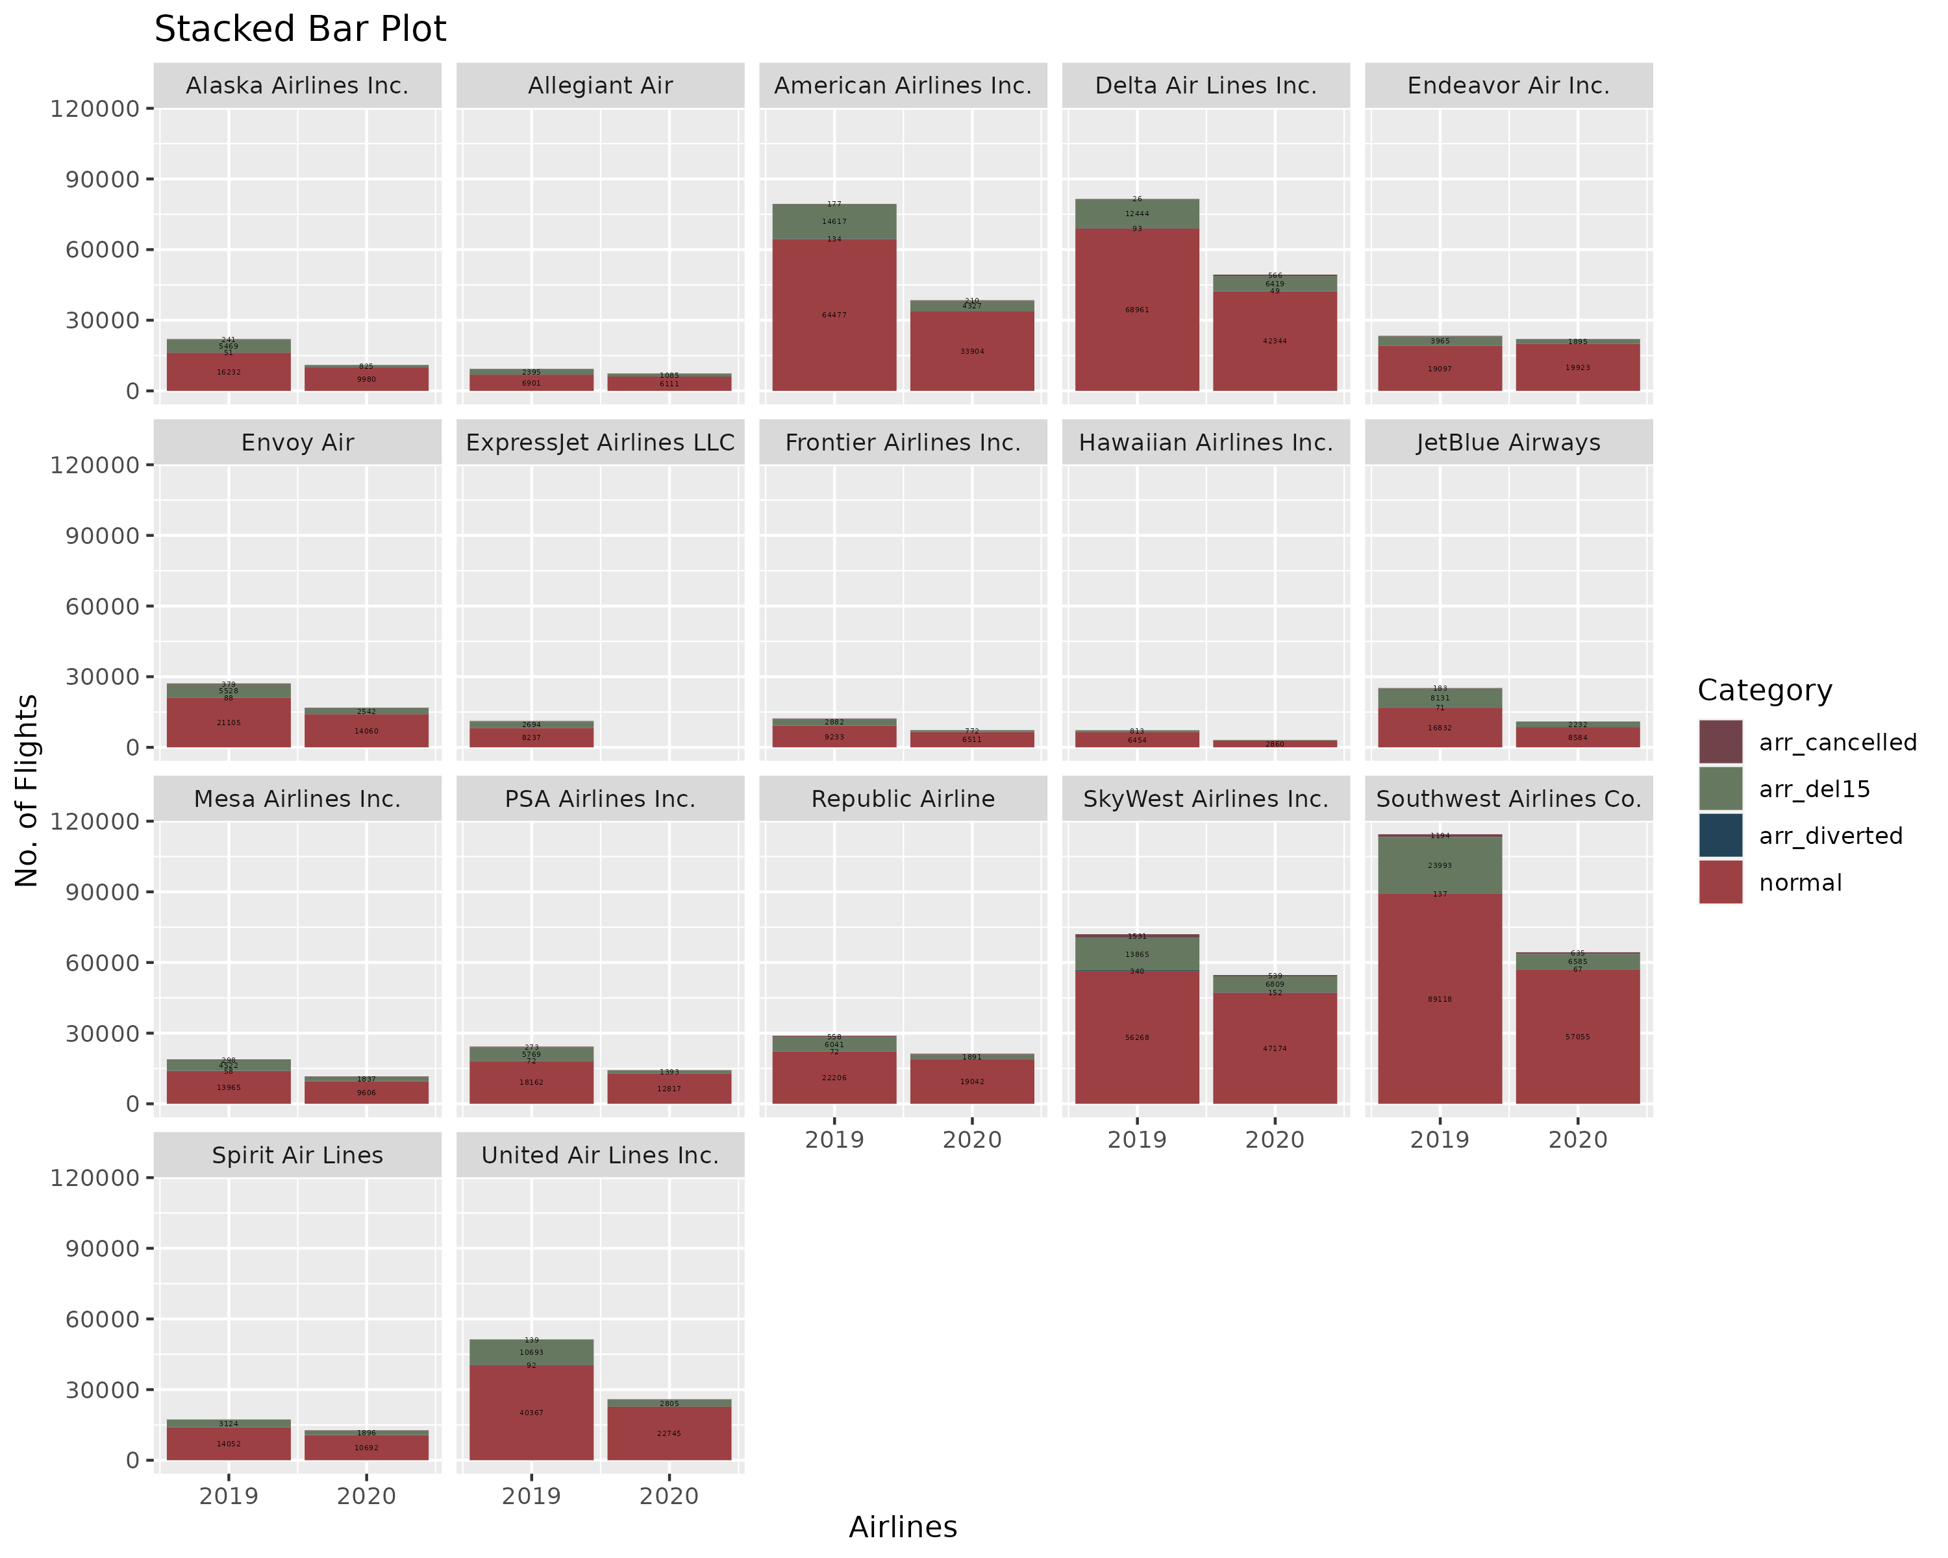
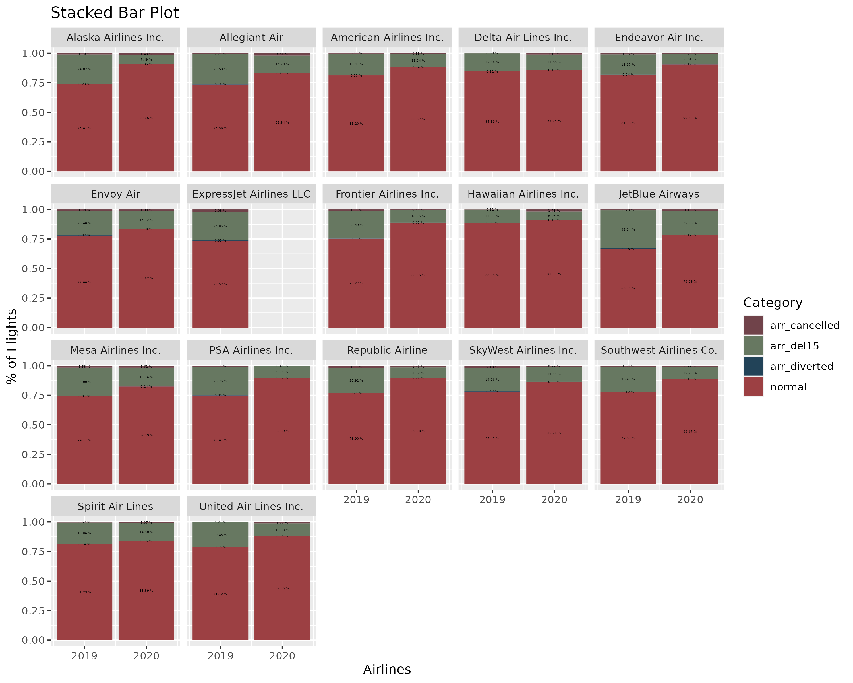
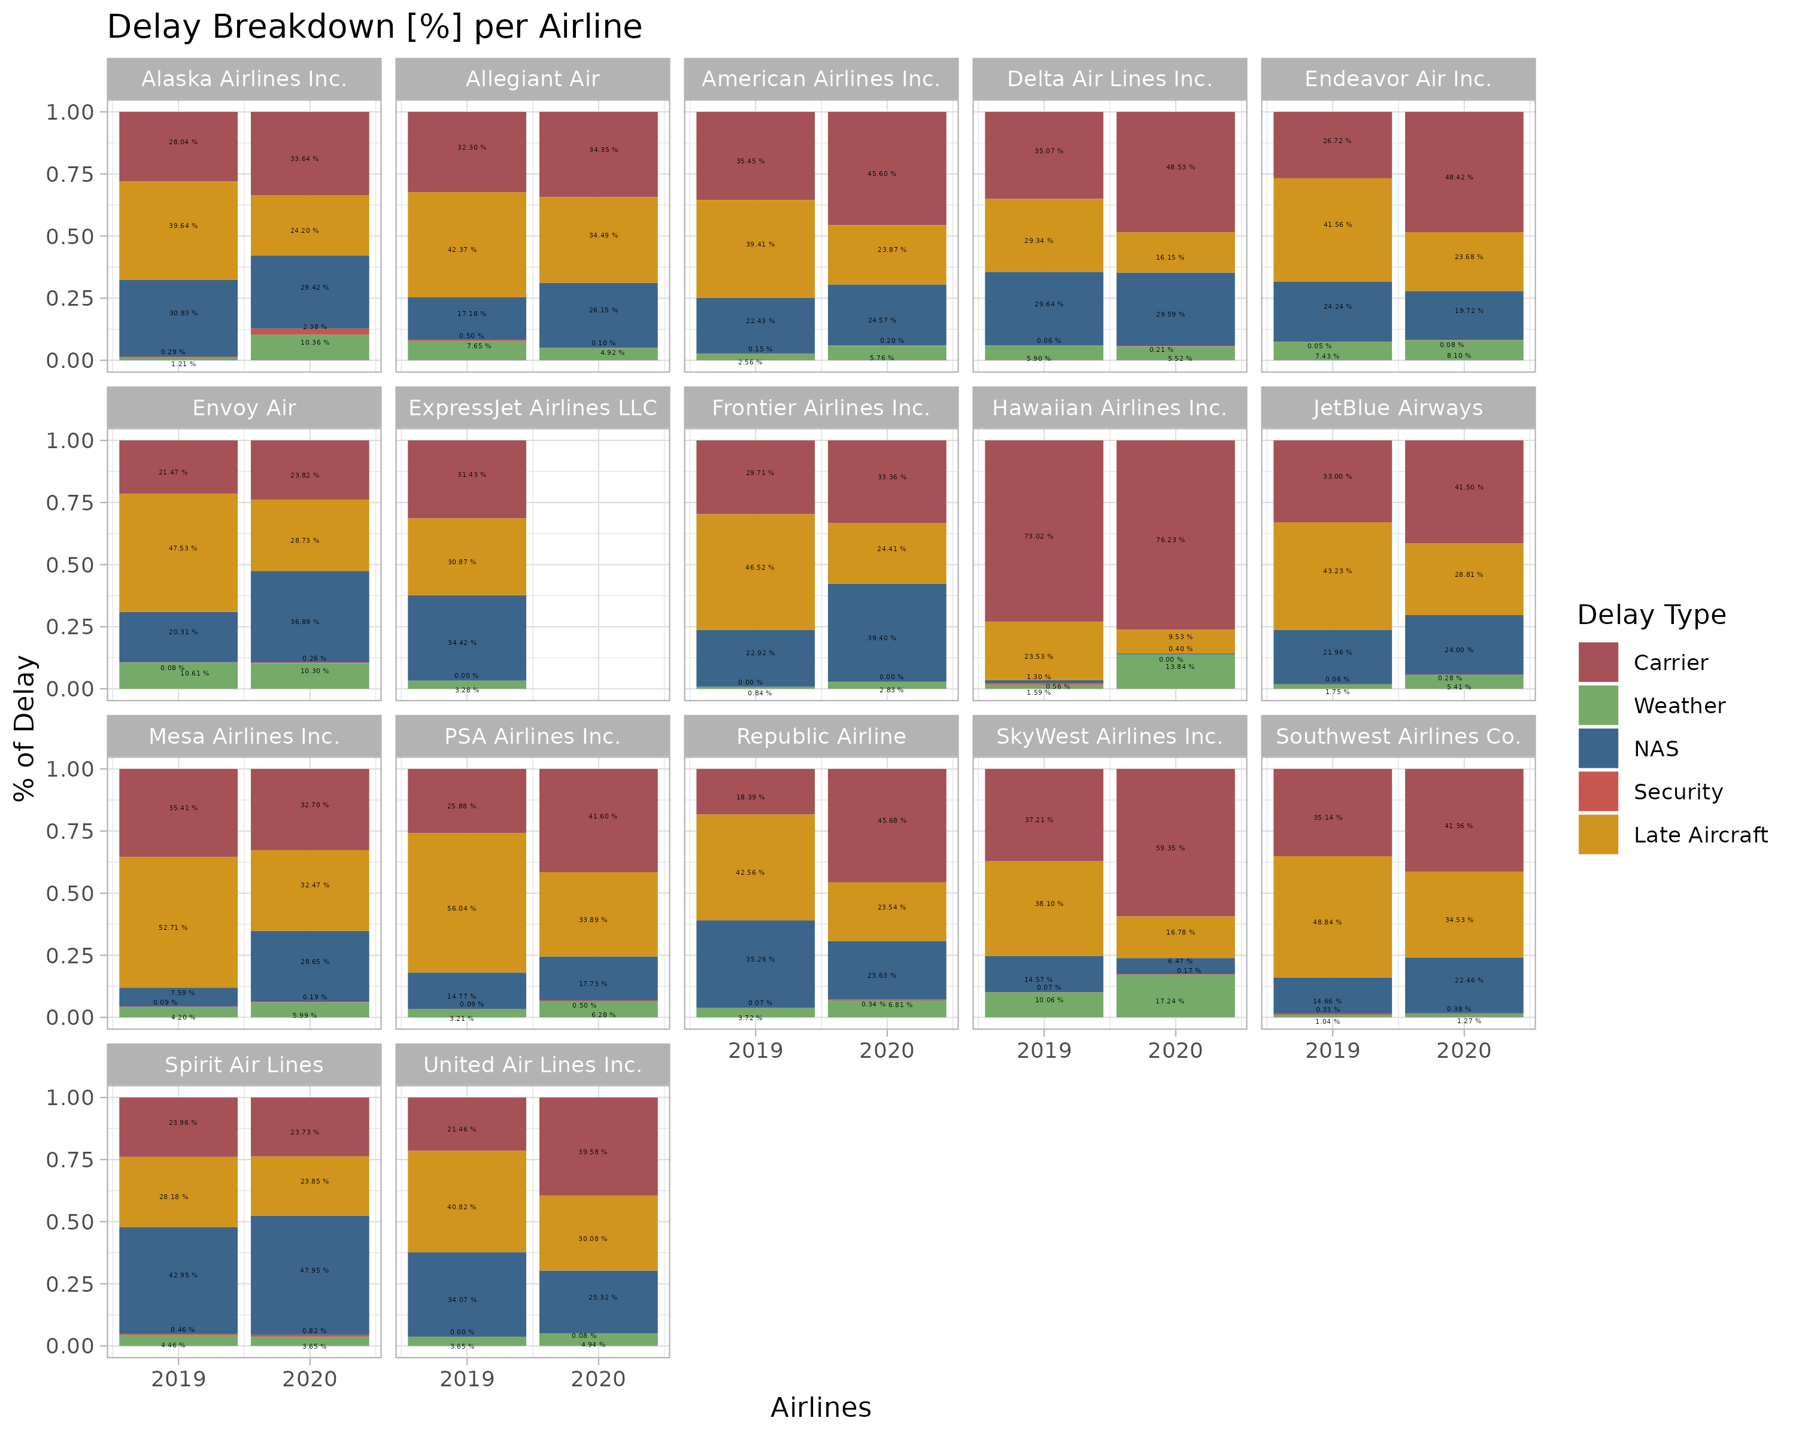
Overview:
Date & Airline & Airport
Arrival Type [# of Flights]:
All, Delayed, Cancelled, Diverted
Delay Type [# of Flights] & [Minutes]
Carrier, Weather, NAS, Security, Late Aircraft
Year on Year Comparison per Airline:
Year | Entries | Flights | Airports | Airlines
2019 | 1’812 | 625’763 | 350 | 17
2020 | 1’539 | 371’357 | 349 | 16
Total | 3351 | 997’120 | 360 | 17
Arrivals Breakdown [abs] per Airline
Arrivals Breakdown [%] per Airline
Delay Breakdown [%] per Airline
Cancelled
Delayed
Diverted
Normal
Cancelled
Delayed
Diverted
Normal
Year
Year
Year
Notes:
#Several airlines, although independent, operate for the big three, these are:## AA:# Envoy Air# PSA Airlines Inc.# Republic Airline*# UA:# ExpressJet# Mesa# Republic Airline*# DL:# Endeavor Air# Republic Airline*
Overall drop in flights and delayed #in absolute, as well as in relative % of delayed flight #
As for the Delay itself, it too has dropped significantly, even more, than

Slide 2
Arriving Flight # Development from 2019 to 2020:
Delay Development from 2019 to 2020:
Arrivals [#] | Total | Normal | Cancelled | Diverted | Delayed
Abs | -254’406 | -168’259.00 | -1’943.00 | -791.00 | -83’413.00
% | -40.66% | -34.22% | -33.54% | -58.25% | -65.71%
Delay [#] | Total | Carrier | Weather | NAS | Security | Late Aircraft
[Abs] | -83’413.00 | -19269.68 | -1’497.89 | -23’202.61 | -95.52 | -39’347.27
% | -65.71% | -52.81% | -47.38% | -60.03% | -34.45% | -81.35%
Delay [min] | Total | Carrier | Weather | NAS | Security | Late Aircraft
[Abs] | -6’023’719 | -1’542’685 | -185’000 | -1’338’452 | -4’107 | -295’3475
% | -70.17% | -57.46% | -47.52% | -69.63% | -37.06% | -82.57%
Notes:
# Overall drop of flights,
Flights dropped by 40%, delay

Slide 3
