Slide 1


AI-Driven Dashboard
Turning Data Centers’ raw data into a meaningful intelligence

Slide 2
Existing problems
Data centres require a very specific and complex microclimate ecosystem
The lack of a preventive fire control
Enormous amount of money on cooling
Downtime is expensive - single data centre outage costs $500K to $5M per hour

Slide 3
Statistics
In 2021 alone, it’s estimated that
Amazon lost $34 million in revenue,
Facebook lost $100 million in revenue
Alibaba lost $1 billion in revenue
All due to data center outages
As of March 2024, there were approximately 11,800 data centers worldwide, it is only going to increase!
Data center fire detection & suppression is growing 7.8% CAGR through 2029

Slide 4
Goals
Data Safety: Reacting is too late, prevent
Cost reduction: Data-Driven cooling optimisation
Downtime prevention: AI insights to take best care of the hardware
Carbon footprint reduction: Through optimised energy consumption

Slide 5





Our solution

Slide 6

Keep your data cool

Slide 7
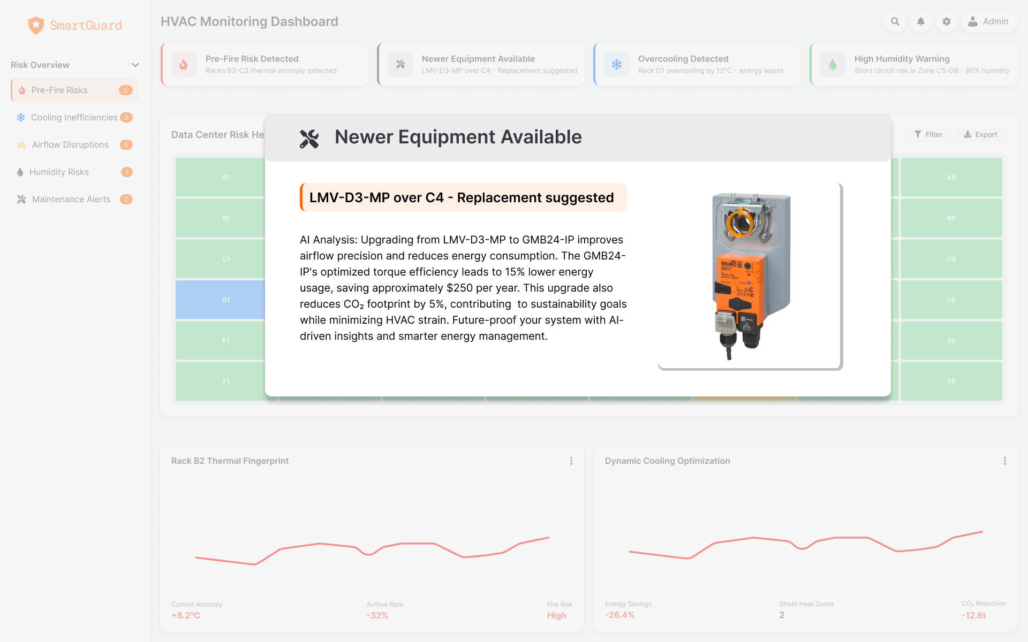
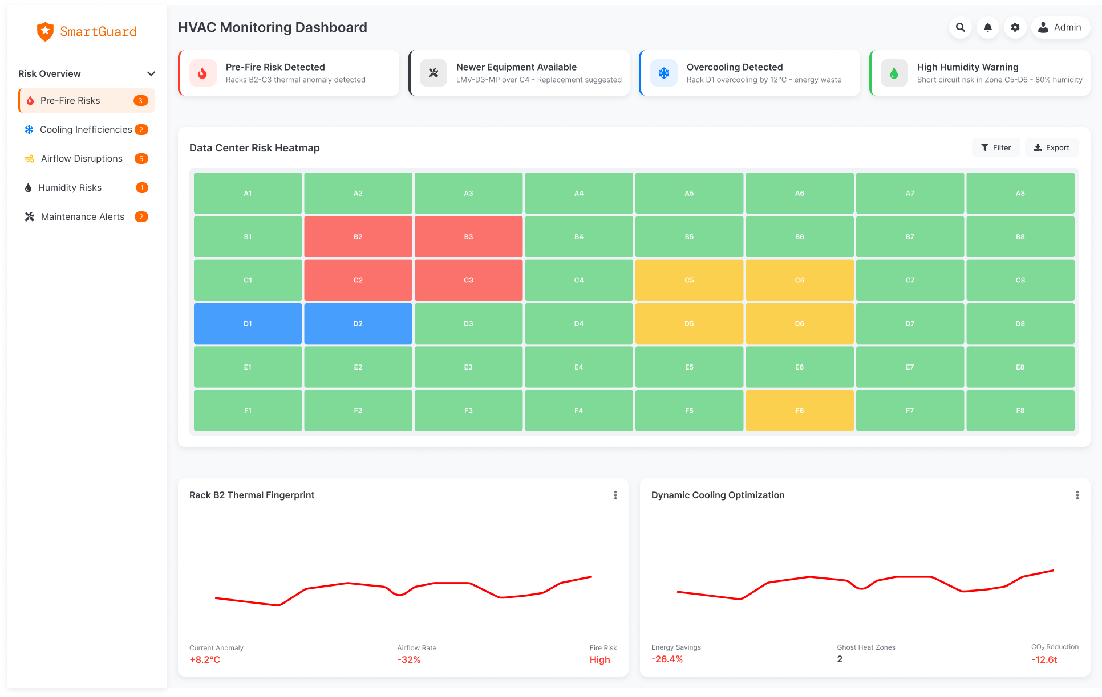

Slide 8
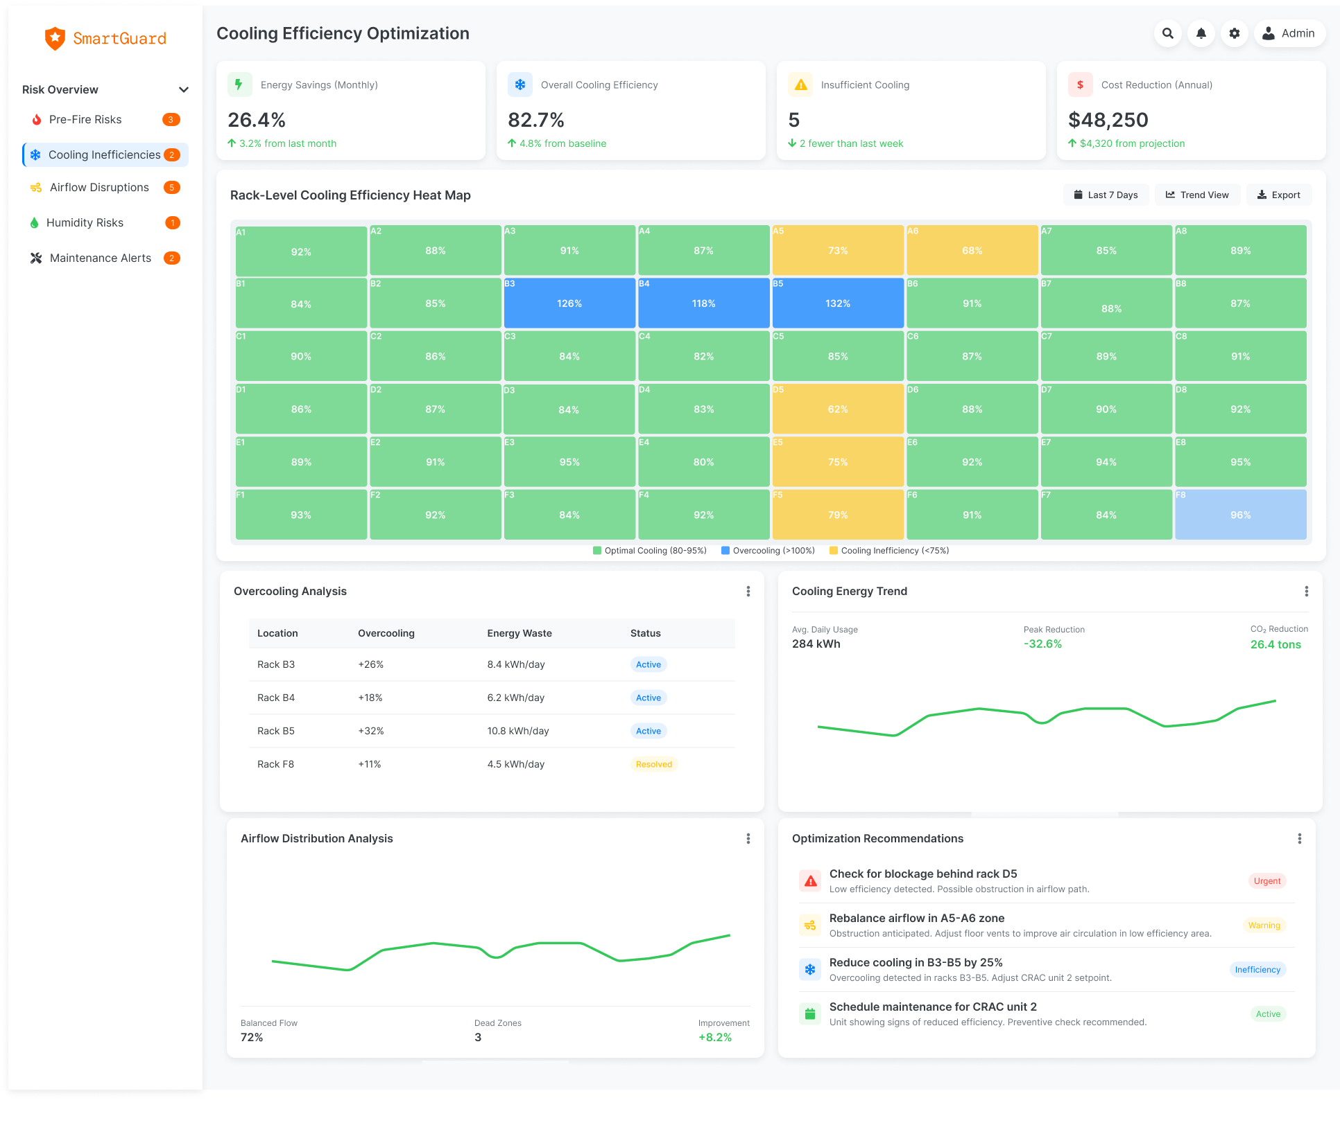

Slide 9
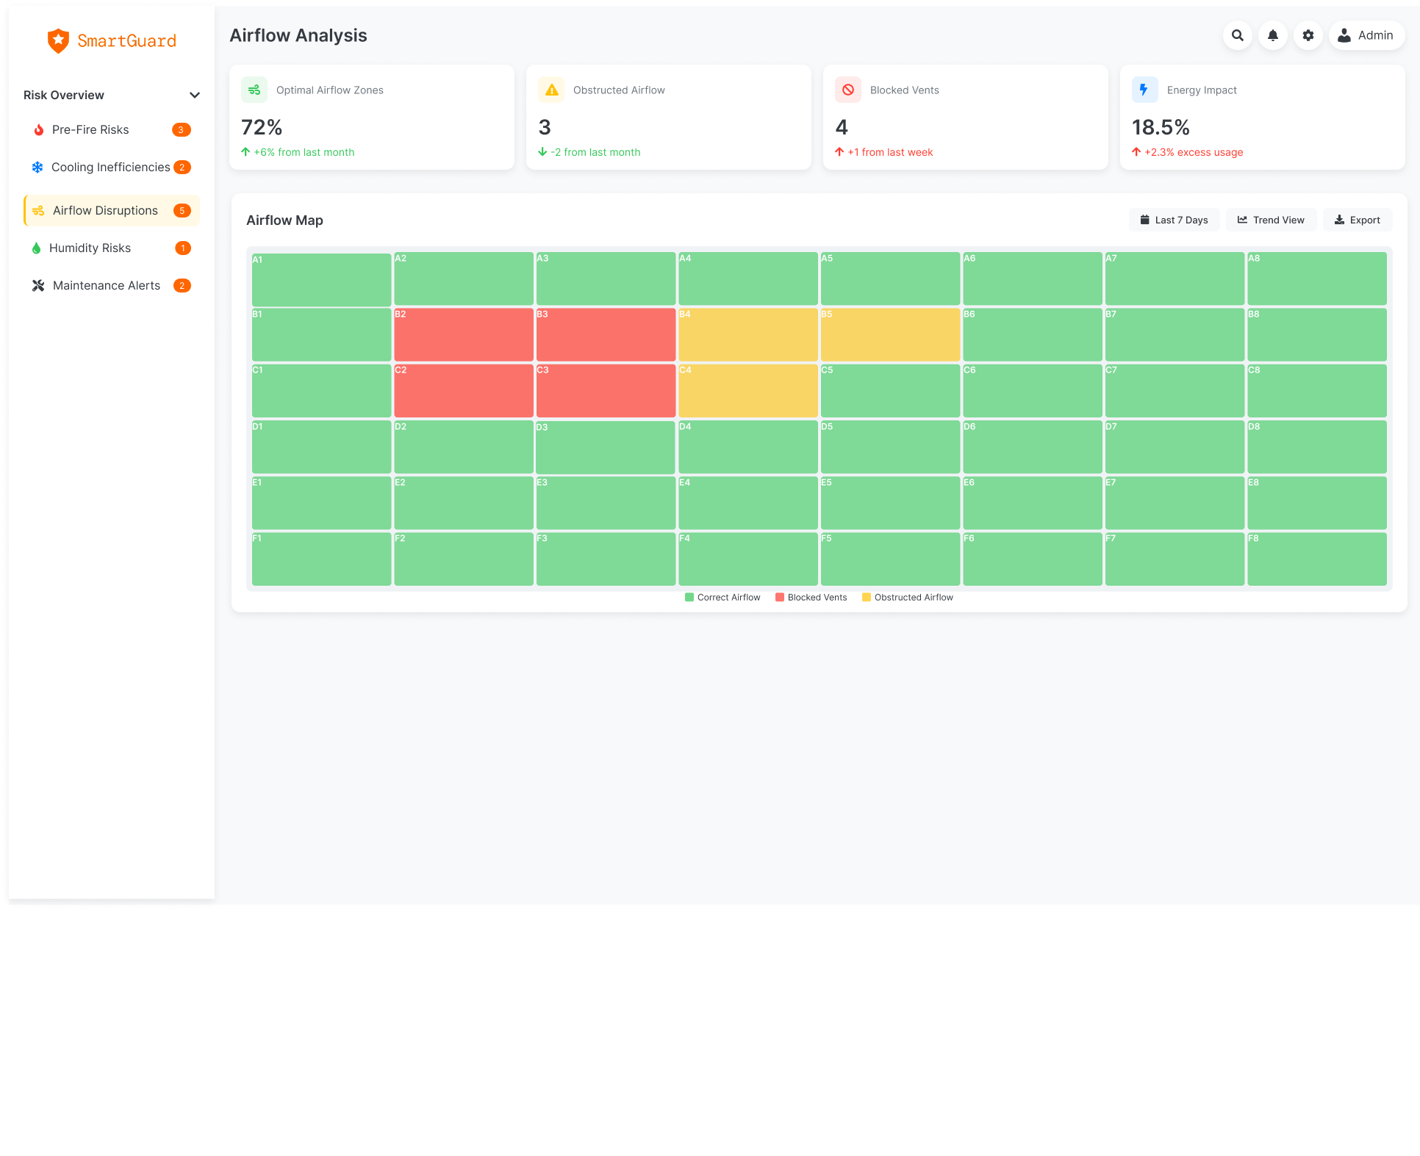

Slide 10
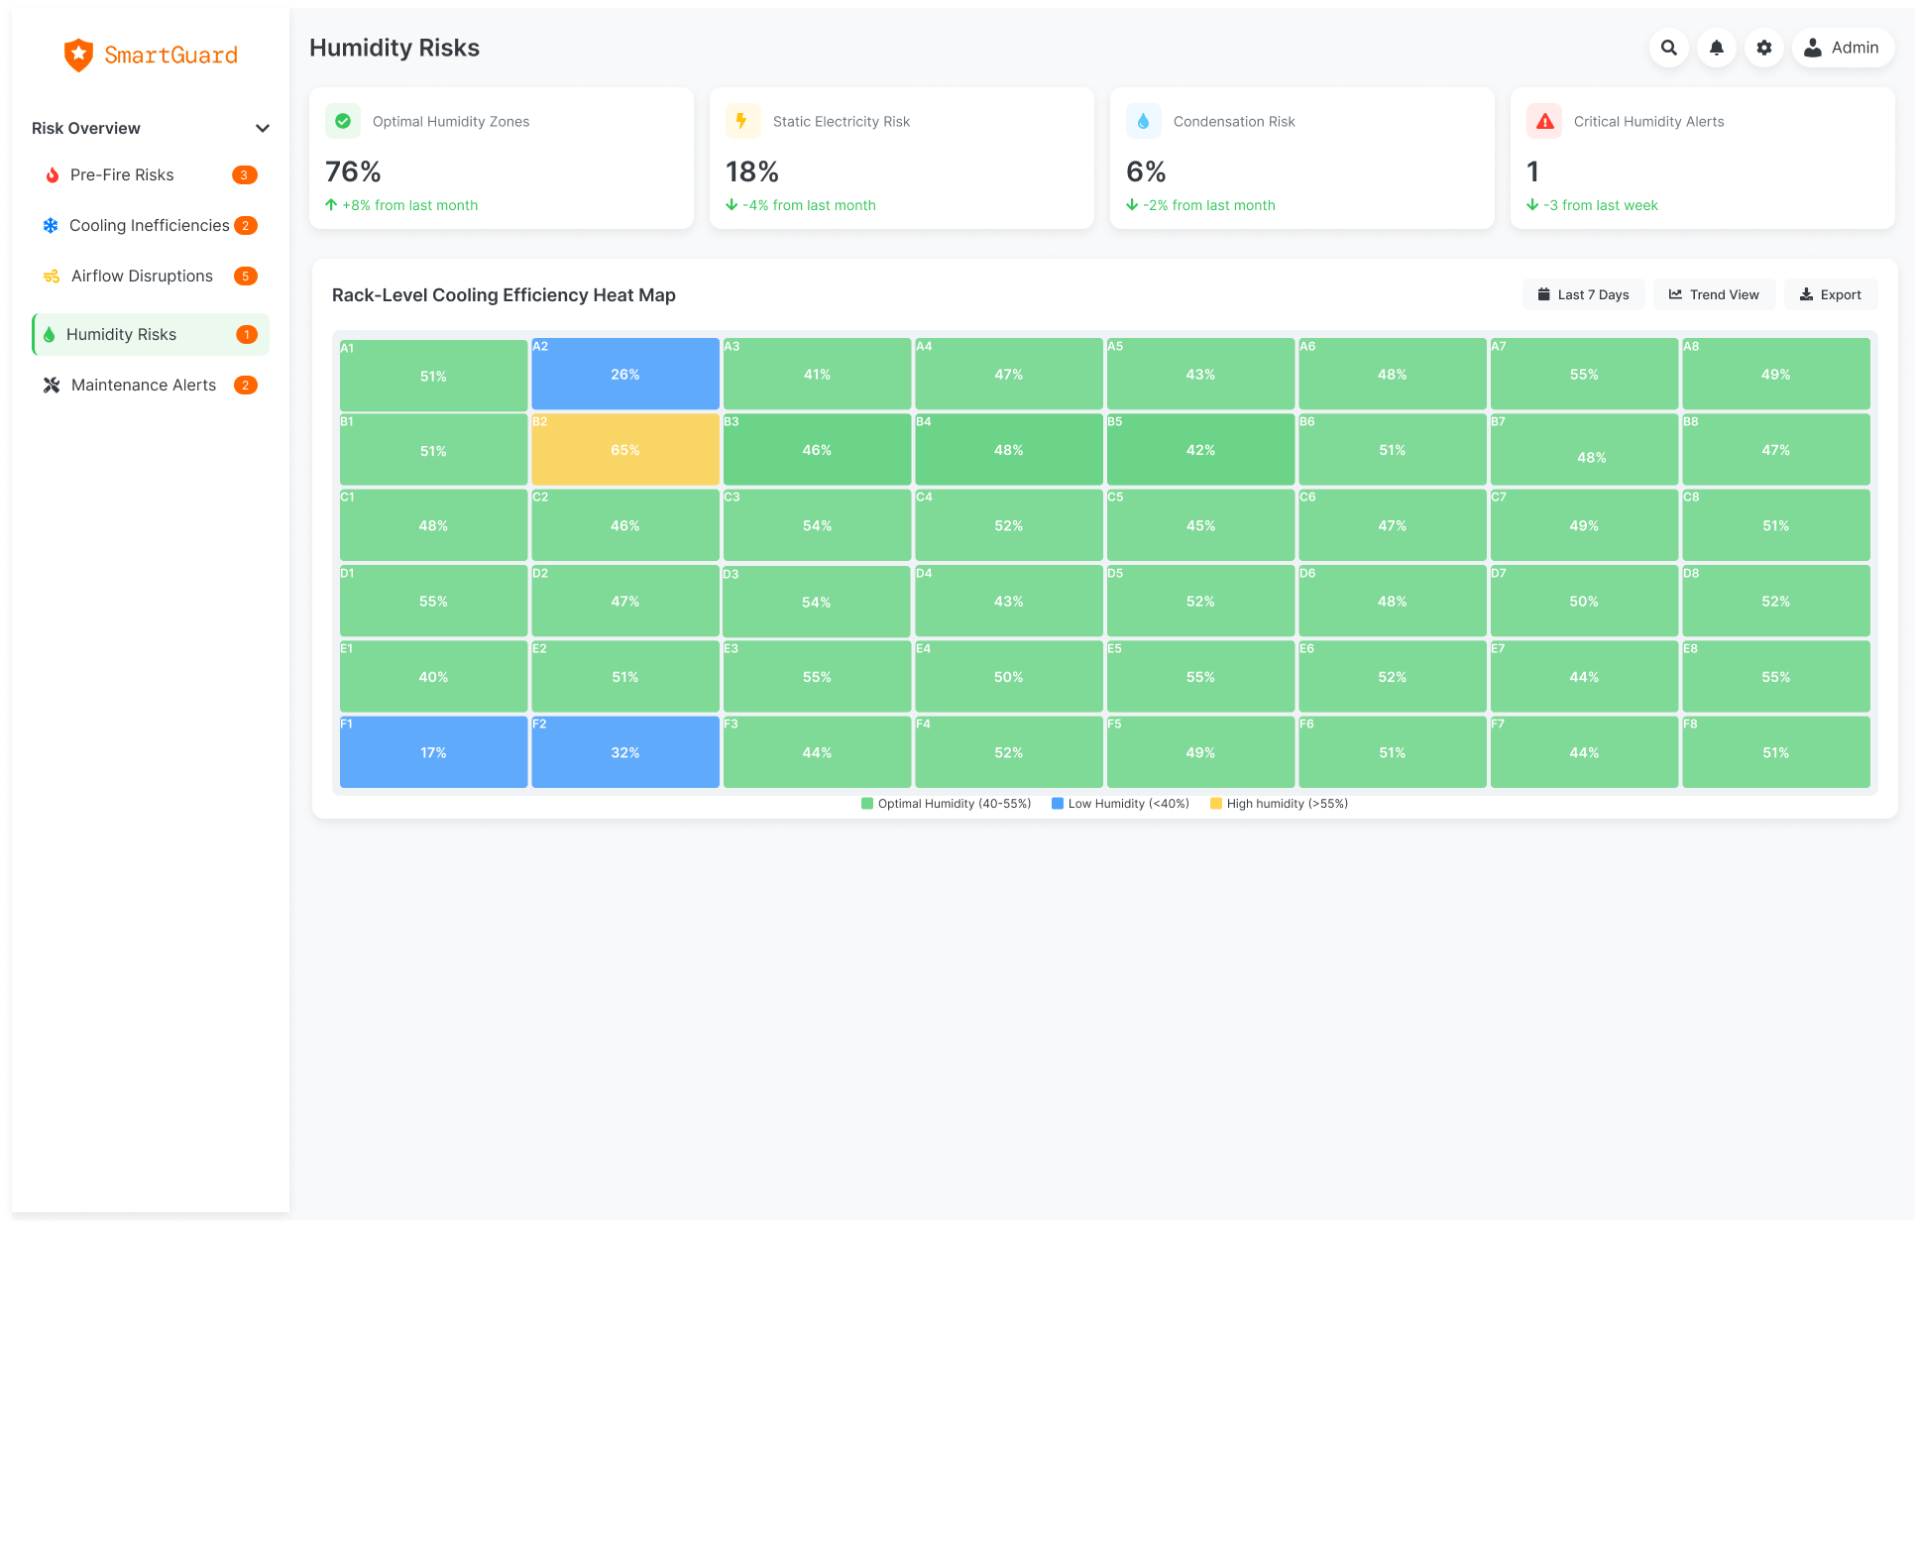

Slide 11
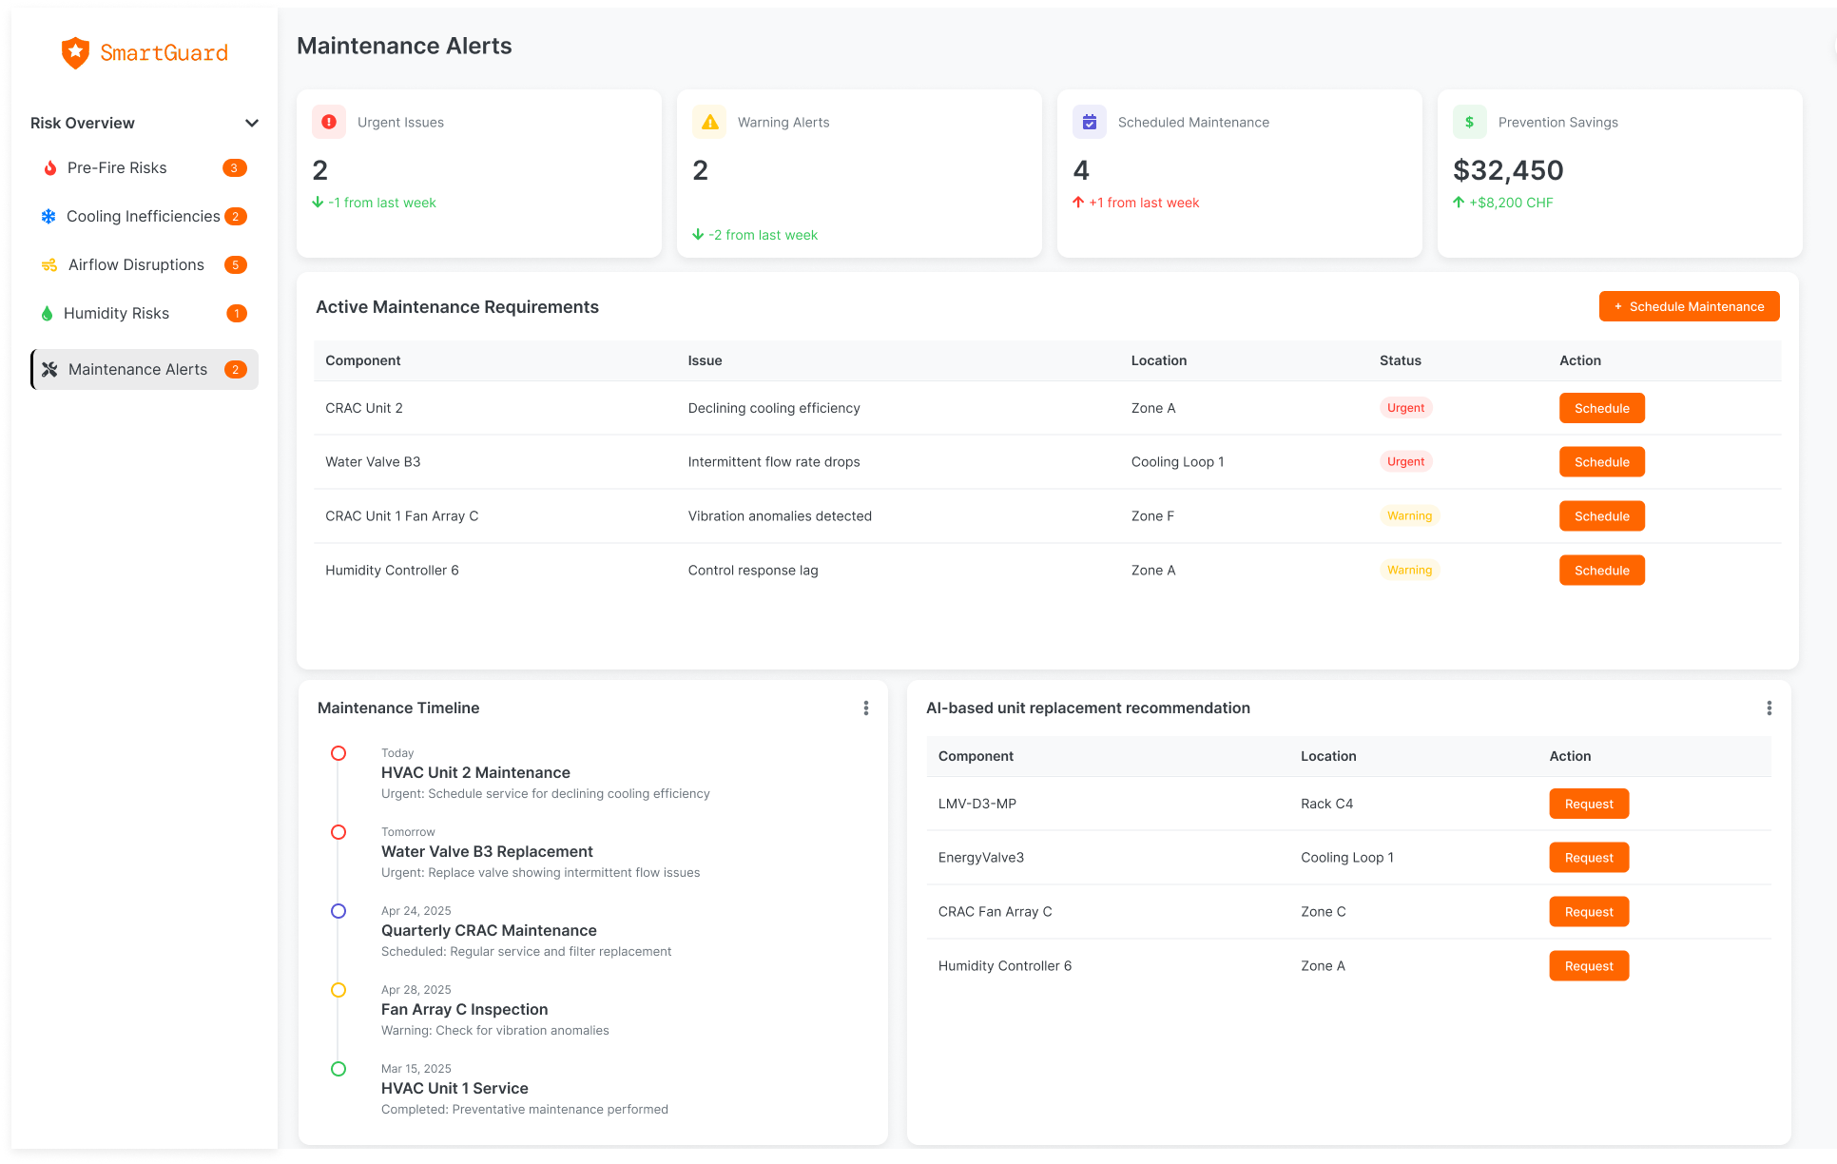

Slide 12
Future!

Slide 13
Thank you for your attention!

