Slide 1
CIPS Training
Xavier PERROT, CIS Product Owner (PO)
Toulouse, August 2024
Part 05 – CIPS-LAB

Slide 2





CIPS - Training sessions
You were here
CIPS-DC
CIPS-DS
CIPS-DE
CIPS-LAB
CIPS-TC

Slide 3


CIPS - Training sessions
CIPS-DC
CIPS-DS
CIPS-DE
CIPS-LAB
CIPS-TC
You are now here
My data are in CIPS-DS … what can I do with it?

Slide 4
SUMMARY
General presentation
What? Why? Who? How?
Web interface
Architecture, authentication, administration
Practical work
CIPS-DS file repository
Conda environment
Satellite files processing
VSCode setup

Slide 5
General presentation
What?
Why?
Who?
How?

Slide 6

General presentation - What?
What is CIPS-LAB ?
Central Information & Processing System - LABORATORY
It is
A module of CIPS solution developed by MFI (Meteo France International)
Integrated to offer an interactive development environment
Explore + develop + run

Slide 7
General presentation
What?
Why?
Who?
How?

Slide 8
General presentation - Why?
Why using CIPS-LAB ?
Remote access
Close to data → access and computation performances
Web access → centralized environment
Multiple users → common methods and tools
Python notebooks
User friendly → easy documentation
Python environment management → easy to install / deploy
Integrated into CIPS solution
CIPS-DS file repository access → data exploration
Computation nodes → powerful infrastructure

Slide 9
General presentation
What?
Why?
Who?
How?

Slide 10



General presentation - Who?
Who uses CIPS-LAB ?
Humans, not third-party systems
Data scientists
Climatologists
Meteorologists
Researchers with coding skills
Developers
Python developers
CIPS-TC task developer

Slide 11
General presentation
What?
Why?
Who?
How?

Slide 12
General presentation - How?
CIPS-LAB is JupyterHub
Open-source COTS
Authentication
Web interface for Notebooks, console, scripts, …
User friendly
CIPS-LAB is integrated in CIPS solution
Preconfigured Python environments with CIPS libraries
Connected to CIPS-DS archives (NFS mount)
Gitlab compatible (SSL certificates)
Access to computation resources (through SLURM)
SSH remote access for advanced users (SSH client, Visual Studio Code, ..)

Slide 13
Web interface
Architecture
Authentication
Administration

Slide 14
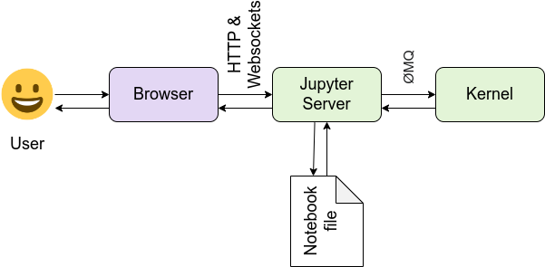

Web interface - Architecture
CIPS-LAB = JupyterHub = Multiple users Notebook server
= communication hub between
Web browser
Notebook file on disk
Ipython Kernel
Components
IPython Terminal
Wrapper of Python execution
Read-Eval-Print-Loop (REPL) →
IPython kernel
Provides computation & communication with frontend interfaces (e.g. Notebooks, IPython console, etc.)
Jupyter Notebook
JSON structure representing code, metadata, content and structure

Slide 15
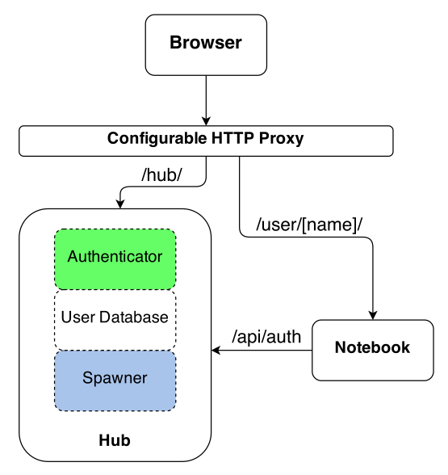
Web interface - Architecture
CIPS-LAB = JupyterHub = Multiple users Notebook server
Multi-user Hub that spawns and manages single-user Notebook server
Structure
Hub
Manages user accounts, authentication and how to spawn notebooks
Proxy
Route requests between Hub and Single-user notebooks
Single-user Notebook Server

Slide 16
Web interface
Architecture
Authentication
Administration

Slide 17
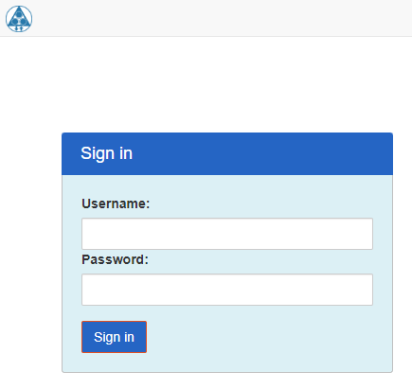
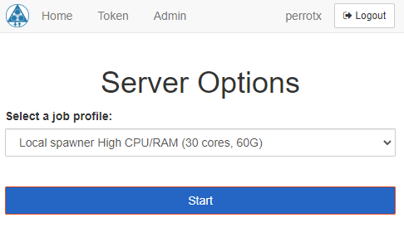
Web interface - Authentication
CIPS-LAB portal = JupyterHub Portal
Connect to CIPS welcome page
CIPS → http://cefsuj01.bmkg.suj:8080/cips_prod/#/
Click on “CIPS-LAB”
Enter directly CIPS-LAB URL
https://labtlp01.mfi.inte/hub/login
Authentication
Based on PAM (Pluggable Authentication Modules)
FreeIPA for MFI
Choose your “spawner”
Aka the execution environment
Local → on CIPS-LAB VM
SLURM → on computation infrastructure
Don’t be too greedy!

Slide 18
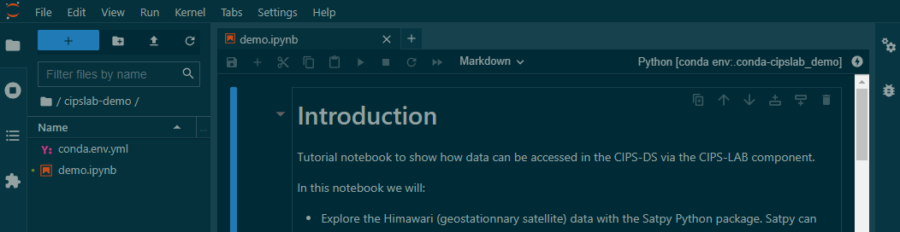
Web interface - Authentication
The spawner restore your previously used environment → Need to create new one if expired
Opened files
Python environments
…
Current Python venv (click to change)
Opened files
New file
Current path
(default /home)
Files of the current path

Slide 19
Web interface
Architecture
Authentication
Administration

Slide 20
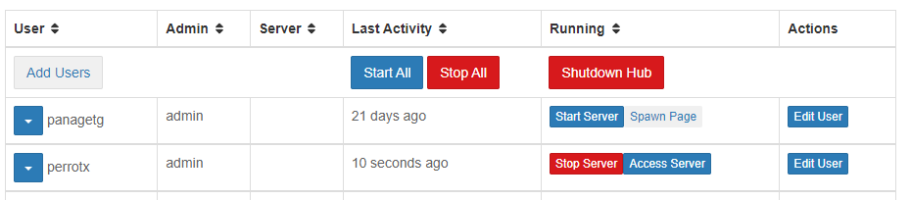
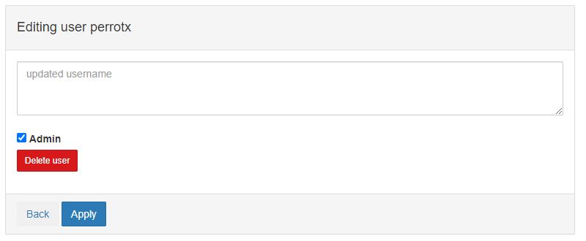
Web interface - Administration
Administration is available through “admin” menu in the header bar
It is dedicated to users and servers management
It is available for “admin” users
Stop CIPS-LAB
DO NOT CLICK IT
Start/stop
Users server
Choose spawner
User extra info
Admin ?
View user server
Delete user

Slide 21
Web interface - Administration
Server-side administration
File system
/shared NFS partition to store:
home directory in /shared/cipslab/home (symlink on /)
Conda (mamba) installation in /shared/cipslab/mambaforge
Mounted also on dedicated on workers
/scratch NFS partition:
Partition to store voluminous data
Mounted also on workers
CIPS-DS storage partition
Partition of CIPS-DS archive file repository (read only)
Mounted also on dedicated on workers

Slide 22
Web interface - Administration
Server-side administration
Configuration: centralized in a configuration file
/etc/jupyterhub/jupyterhub_config.py
JupyterHub service
Systemd service called “jupyterhub”
To start:
/etc/jupyterhub/start.sh
Spawner services
Spawner: SystemdSpawner to spawn notebook on CIPS-LAB VM
BatchSpawner: to spawn notebook on SLURM partition ‘datascience’
For both cases, cgroups to control resources & JupyterLab interface
Single-user Notebook server cleaner
Inactive notebook servers are killed after 3600s
Environment is saved but servers must be re-created (re-spawn)

Slide 23
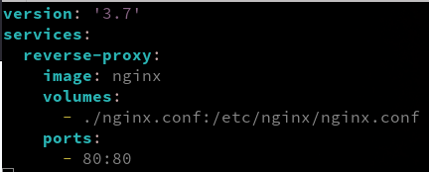
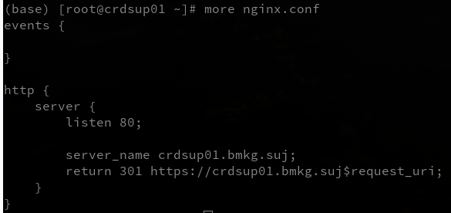
Web interface - Administration
Server-side administration
Web server NGINX
Docker container to route HTTP (80) connections to HTTPS (443)
Config in
/root/docker-compose.yaml →
NGINX config file →

Slide 24
Practical work
CIPS-DS file repository
Conda environment
Satellite files processing
VSCode setup

Slide 25
Practical work - CIPS-DS file repository
Practical work
Create a shortcut from your home to CIPS-DS archive
Open a “terminal”
Check the mounted storages
[xx@xx xx]$ df –h
Filesystem Size Used Avail Use% Mounted on
xx.xx.xx.xx:/xx xxT xxT xxT xx% /archive_cips
Create a symbolic link in your home directory
[xx@xx xx]$ df –h
ln -s /archive_cips/archive ~/cips
Refresh CIPS-LAB interface
Browse CIPS-DS files

Slide 26
Practical work
CIPS-DS file repository
Conda environment
Satellite files processing
VSCode setup

Slide 27
Practical work - Conda environment
Practical work
Prepare conda
Open a “terminal”
Add conda to your path, to be done the first time
[xx@xx xx]$ conda init bash && source ~/.bashrc
Install Python package to be able to open a notebook directly with the kernel of your choice
[xx@xx xx]$ conda install -c conda-forge nb_conda_kernels ipykernel
Create your conda environement
Create a file “conda.env.yml” in your home
[xx@xx xx]$ touch ~/conda.env.yml
Edit the file:
name: cipslab_demo
dependencies:
- pandas=1.5.3
Create the env
[xx@xx xx]$ conda env create -f conda.env.yml
Refresh CIPS-LAB interface and check Python environments
Update the environment
Update the file to add a new dependency
Update the env
[xx@xx xx]$ conda env update -f conda.env.yml
Refresh CIPS-LAB interface and check Python environments

Slide 28
Practical work
CIPS-DS file repository
Conda environment
Satellite files processing
VSCode setup

Slide 29
Practical work - Satellite files processing
Practical work
Adapt the satellite processing tutorial notebook !

Slide 30
Practical work
CIPS-DS file repository
Conda environment
Satellite files processing
VSCode setup

Slide 31
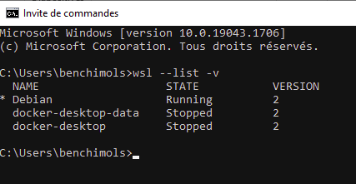
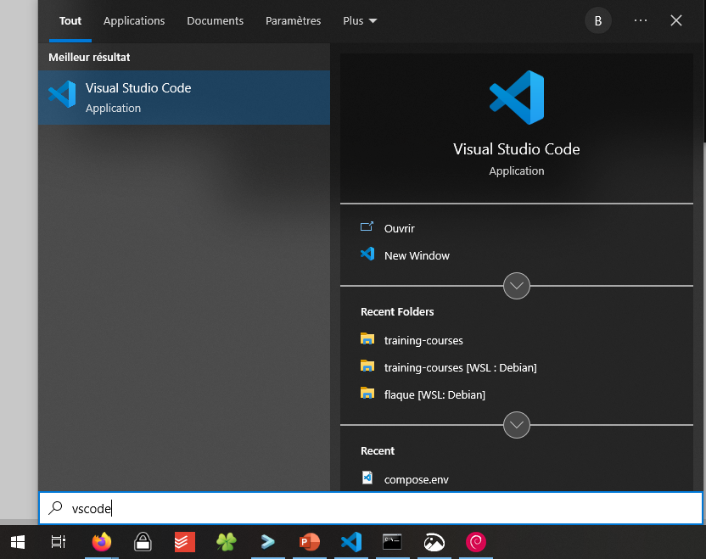
Practical work - VSCode setup
VSCode is a popular code editor edited by Microsoft.
Windows Subsystem Linux (WSL)
Open a Windows Command Line with CMD+”cmd.exe”
Check installed Linux distributions with “wsl –list -v”
Ensure WSL2 is activated
VSCode
Download it from https://code.visualstudio.com/
Execute the installer and click "Next"
Launch VSCode with CMD + VSCode
Extension configuration
Remote extension pack, to allows remote edition from WSL and SSH
Python, allowing full-featured Python edition, including Jupyter Notebook

Slide 32
Questions?

Slide 33
CIPS - Training sessions
CIPS-DC
CIPS-DS
CIPS-DE
CIPS-LAB
CIPS-TC
You are now here
CIPS-LAB in the satellite use case
Explore raw input files
Code and test algorithms
Run manually

Slide 34
Thanks for your attention!

