Slide 1
GitHub
Roberto Anic Banic – ISTE.120 - 2016

Slide 2
What is GitHub?
GitHub is a web-based Git repository hosting service. It offers all of the distributed version control and source code management (SCM) functionality of Git as well as adding its own features. It provides access control and several collaboration features such as bug tracking, feature requests, task management, and wikis for every project.

Slide 3
What is Git?
Git is a version control system (VCS) that is used for software development and other version control tasks. As a distributed revision control system it is aimed at speed, data integrity, and support for distributed, non-linear workflows.
Git was created by Linus Torvalds in 2005 for development of the Linux kernel, with other kernel developers contributing to its initial development. Its current maintainer is Junio Hamano.

Slide 4
capabilities
Strong support for non-linear development
Distributed development
Compatibility with extant systems and protocols
Efficient handling of large projects Torvalds has described Git as being very fast and scalable, and performance tests done by Mozilla showed it was an order of magnitude faster than some version control systems, and fetching version history from a locally stored repository can be one hundred times faster than fetching it from the remote server.
Cryptographic authentication of history
Garbage accumulates until collected

Slide 5
Some Git Commands
New Repository – git init
Clone a repository – git clone https…
Add files to the index – git add <filename> (one) / * (all)
Commit – git commit –m „Commit message”
Push to remote – git push
Pull from remote – git pull
See changed files – git status
Add remote – git remote add origin https://github.com/user/repo.git
Verify remote – git remote –v
Remove remote – git remote rm destination

Slide 6
Git Education Pack
FREE STUFF!!

Slide 7
Using Branches
A branch represents an independent line of development.
The git branch command lets you create, list, rename, and delete branches. It doesn’t let you switch between branches or put a forked history back together again. For this reason, git branch is tightly integrated with the git checkout and git merge commands.

Slide 8
Usage
git branch
List all of the branches in your repository.
git branch <branch>
Create a new branch called <branch>. This does not check out the new branch.
git branch -d <branch>
Delete the specified branch. This is a “safe” operation in that Git prevents you from deleting the branch if it has unmerged changes.
git branch -D <branch>
Force delete the specified branch, even if it has unmerged changes. This is the command to use if you want to permanently throw away all of the commits associated with a particular line of development.
git branch -m <branch>
Rename the current branch to <branch>.

Slide 9
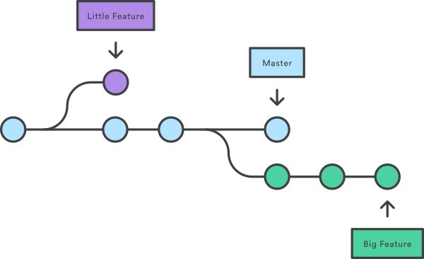
Branches

