Slide 1

SKY WAR

Slide 2
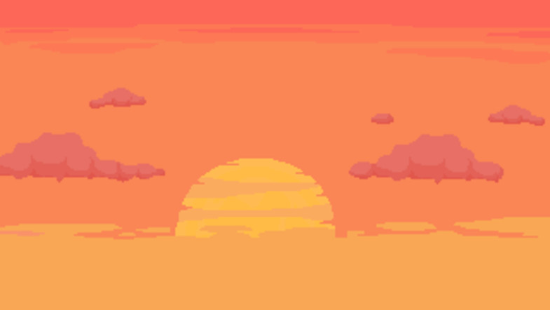

Process
Brainstorming
Inform ourselves
Development
Improvements

Slide 3


Division of work
Groups of 2
Focus on design or functionality

Slide 4

The result (documentation)

Slide 5
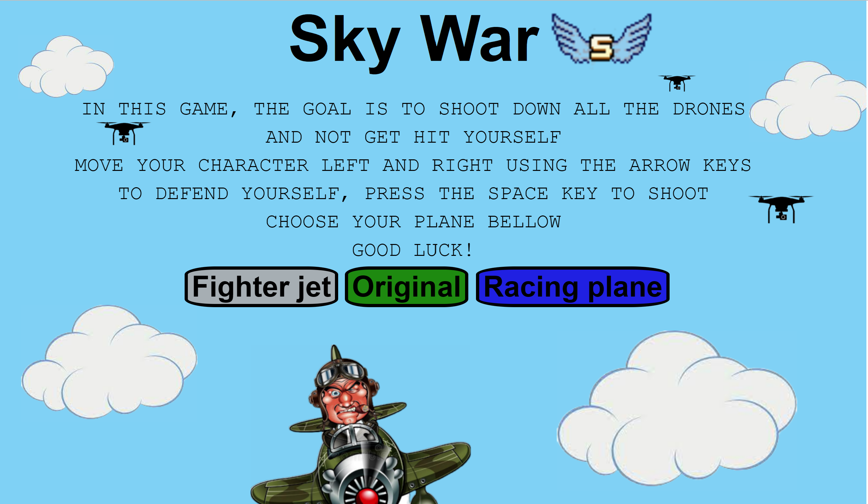
scene("game", () => {
// todo.. add scene code here
})
;scene("gameOver", (score) => {
// todo.. add scene code here
});

Slide 6
GAME OVER
Thanks for your attention

