Slide 1

Housing Price Analysis: Clustering and Prediction
A Machine Learning Approach to Real Estate Insights

Slide 2
Introduction
Objectives:
Conduct an exploratory data analysis (EDA) to uncover trends and key insights in the housing dataset.
Apply clustering techniques to identify distinct patterns and groupings within the data.
Develop and evaluate predictive models to accurately forecast house prices using various machine learning methods.
Problem Statement:
What are the key factors influencing house prices, and how can we quantify their impact?
How can clustering techniques reveal hidden patterns in the housing market?
How accurate can predictive models be in forecasting house prices, and which approach performs best?

Slide 3
Overview of the Dataset
longitude | latitude | housing_median_age | total_rooms | total_bedrooms | population | households | median_income | median_house_value | ocean_proximity
-122.23 | 37.88 | 41.0 | 880.0 | 129.0 | 322.0 | 126.0 | 8.3252 | 452600.0 | NEAR BAY
-122.22 | 37.86 | 21.0 | 7099.0 | 1106.0 | 2401.0 | 1138.0 | 8.3014 | 358500.0 | NEAR BAY
-122.24 | 37.85 | 52.0 | 1467.0 | 190.0 | 496.0 | 177.0 | 7.2574 | 352100.0 | NEAR BAY
-122.25 | 37.85 | 52.0 | 1274.0 | 235.0 | 558.0 | 219.0 | 5.6431 | 341300.0 | NEAR BAY
-122.25 | 37.85 | 52.0 | 1627.0 | 280.0 | 565.0 | 259.0 | 3.8462 | 342200.0 | NEAR BAY
1. longitude: How far west a house is. 2. latitude: How far north a house is. 3. housingMedianAge: Median age of a house within a block. 4. totalRooms: Total number of rooms within a block. 5. totalBedrooms: Total number of bedrooms within a block.
6. population: Total population within a block. 7. households: Total households within a block. 8. medianIncome: Median income for households. 9. medianHouseValue: Median house value for households. 10. oceanProximity: Proximity of the house to the ocean (categorical).

Slide 4
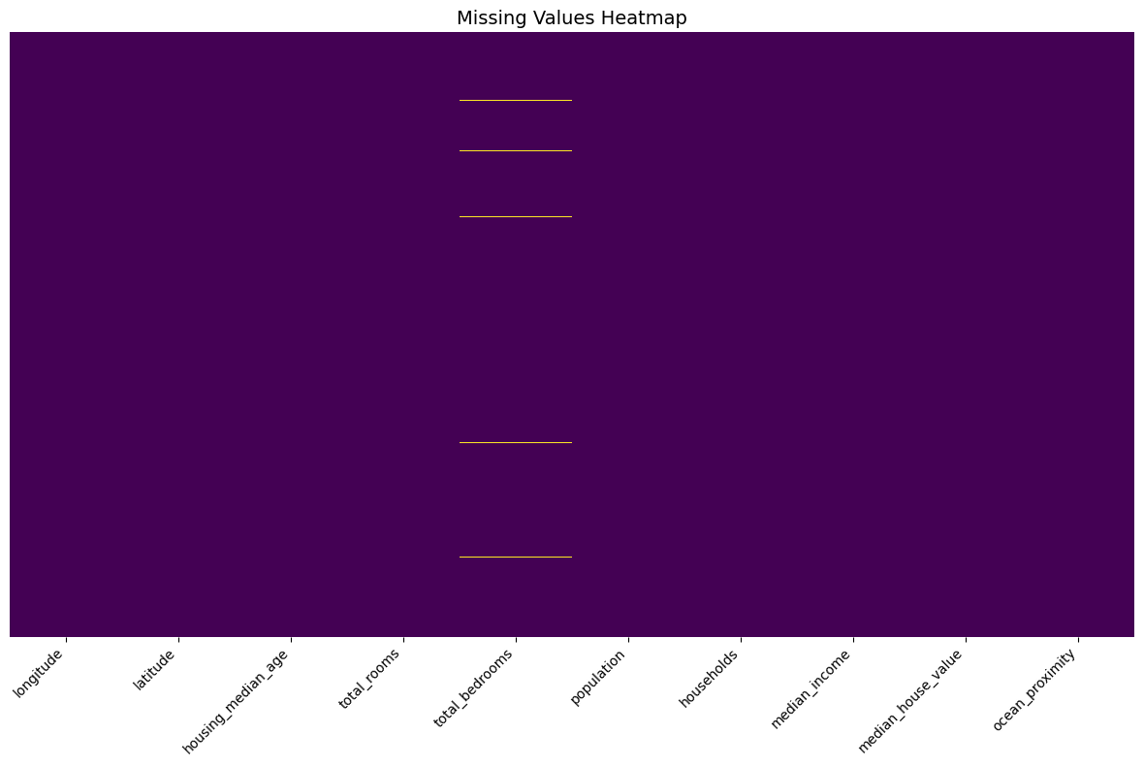
Missing Values in the Dataset
207 missing entries in “total_bedrooms” column out of 20.640 rows.
Rows with missing values were dropped to ensure data quality

Slide 5
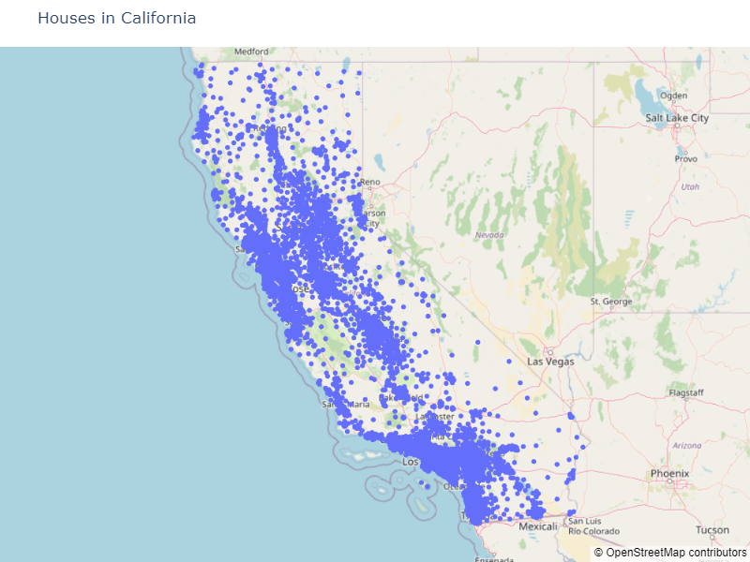
Map of Houses in the Dataset

Slide 6
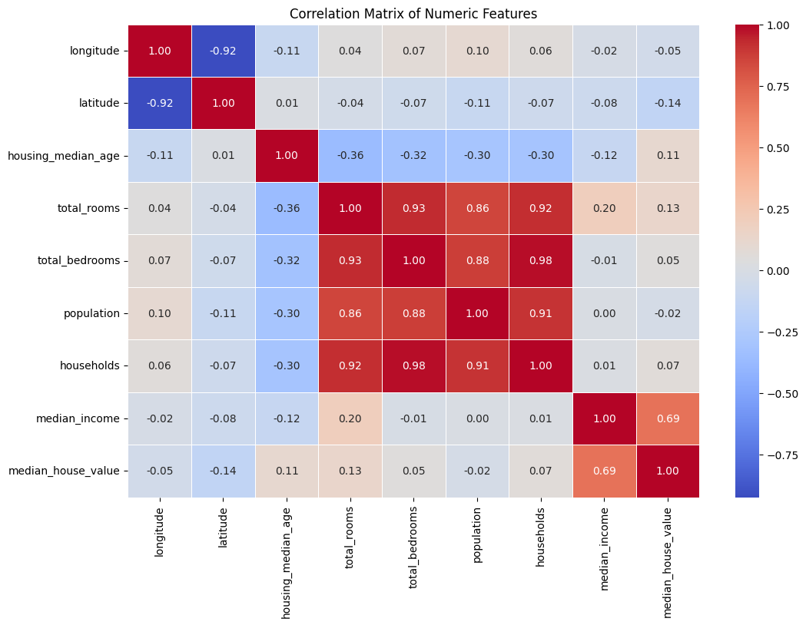
Correlation Matrix of Numeric Features

Slide 7
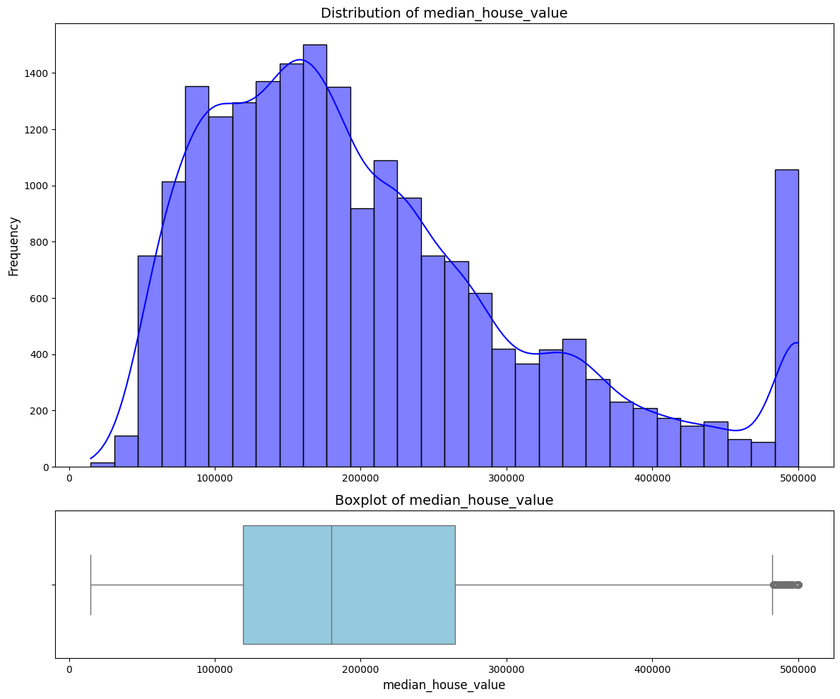
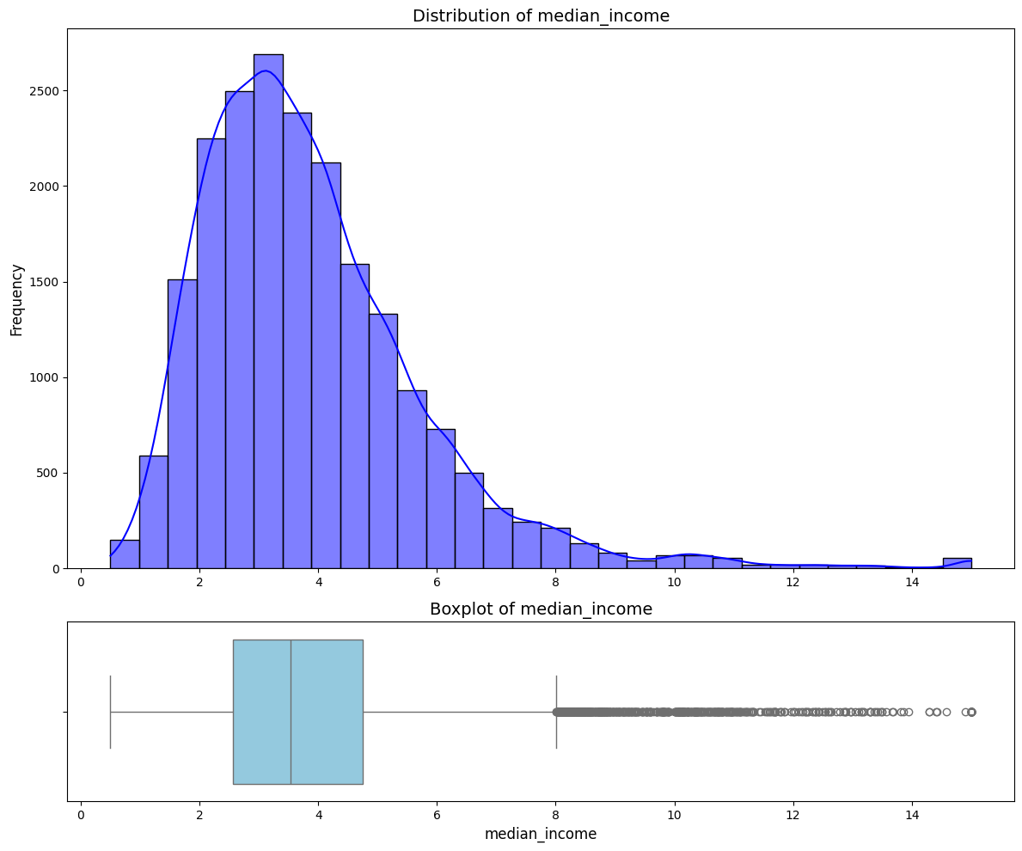
Distributions and Boxplots of Key Features
The histograms and boxplots below provide insights into the distributions of key features: - `median_house_value`: Shows skewness and a cap at 500,000. - `median_income`: Indicates the range and presence of outliers.

Slide 8
Unsupervised Analysis
In the Unsupervised Analysis, our objective is to explore patterns and groupings within the housing data.
Techniques used: • Principal Component Analysis (PCA) for dimensionality reduction • KMeans Clustering for identifying distinct housing groups

Slide 9
Principal Component Analysis (PCA)
Non-numeric data converted to numeric.
Kaiser Rule: 3 components retained (eigenvalues > 1).
PC1: 43.48%, PC2: 21.36%, PC3: 18.86%.
Total Variance Explained: 83.7%.
Feature | PC1 | PC2 | PC3
longitude | 0.0762 | -0.6620 | -0.2480
latitude | -0.0759 | 0.6905 | 0.1278
housing_median_age | -0.2164 | 0.0009 | 0.0496
total_rooms | 0.4844 | 0.0607 | 0.0850
total_bedrooms | 0.4895 | 0.0721 | -0.0412
population | 0.4701 | 0.0461 | -0.0780
households | 0.4910 | 0.0718 | -0.0265
median_income | 0.0558 | -0.1783 | 0.6711
median_house_value | 0.0452 | -0.1922 | 0.6735

Slide 10
Principal Component Analysis (PCA)
Non-numeric data converted to numeric.
Kaiser Rule: 3 components retained (eigenvalues > 1).
PC1: 43.48%, PC2: 21.36%, PC3: 18.86%.
Total Variance Explained: 83.7%.
Feature | PC1 | PC2 | PC3
longitude | 0.0762 | -0.6620 | -0.2480
latitude | -0.0759 | 0.6905 | 0.1278
housing_median_age | -0.2164 | 0.0009 | 0.0496
total_rooms | 0.4844 | 0.0607 | 0.0850
total_bedrooms | 0.4895 | 0.0721 | -0.0412
population | 0.4701 | 0.0461 | -0.0780
households | 0.4910 | 0.0718 | -0.0265
median_income | 0.0558 | -0.1783 | 0.6711
median_house_value | 0.0452 | -0.1922 | 0.6735

Slide 11
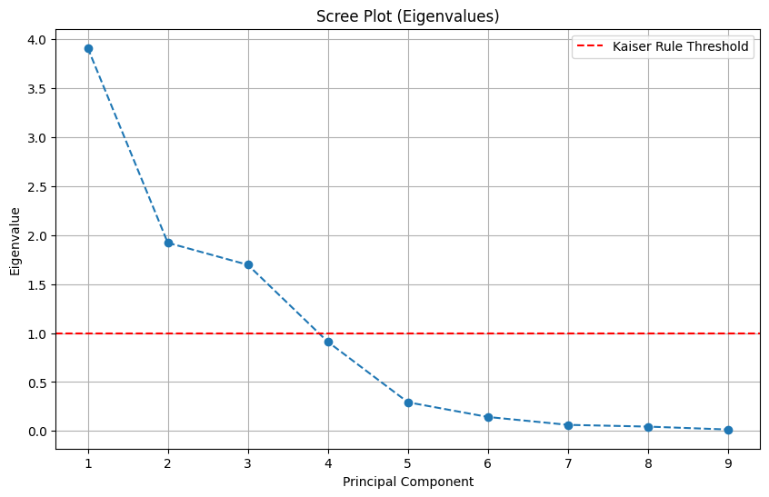
Scree Plot (Eigenvalues)
The scree plot shows the eigenvalues of the principal components. Using the Kaiser Rule (eigenvalue > 1), we retain 3 components that capture the majority of the dataset's variance. This helps reduce dimensionality while maintaining important information.

Slide 12
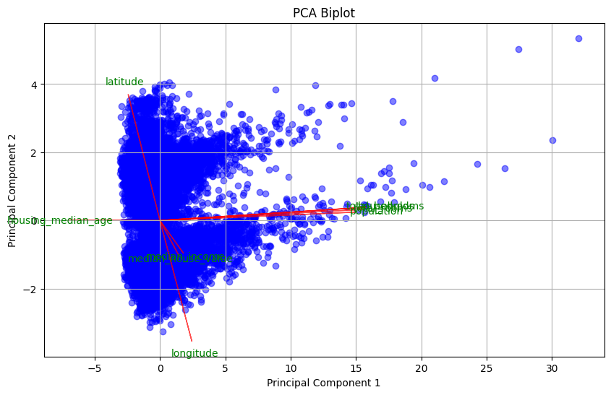
PCA Biplot
The PCA Biplot visualizes the dataset in the space of the first two principal components. It also shows the direction and magnitude of each original feature's contribution to these components. This helps to understand the influence of variables on the reduced dimensions.

Slide 13
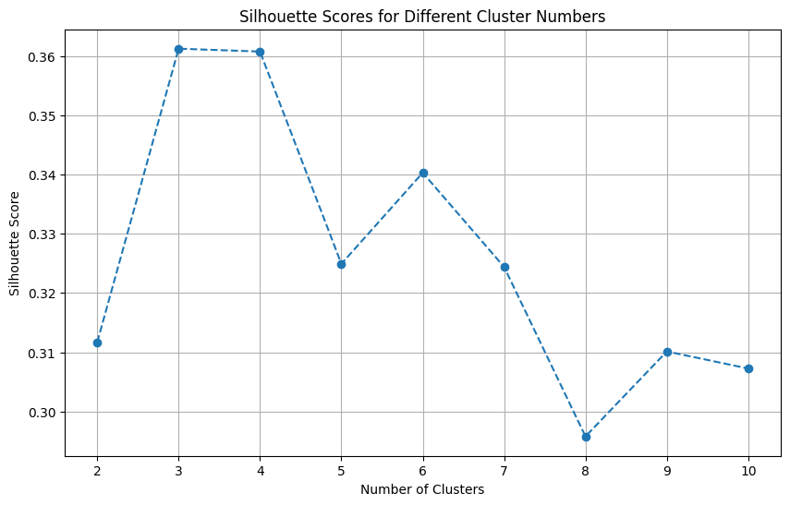
Clustering Analysis Introduction
We used KMeans clustering, determining the optimal number of clusters via Silhouette Scores. The plot below shows how scores vary with cluster numbers, guiding the best choice.

Slide 14
Clustering Analysis
The table below highlights the average values of key features across the identified clusters, providing insights into their distinct characteristics
Feature | Cluster 0 | Cluster 1 | Cluster 2
Longitude | -121.700 | -119.165 | -118.013
Latitude | 37.951 | 35.252 | 33.929
Housing Median Age | 0.093 | -0.953 | 0.079
Total Rooms | -0.207 | 2.370 | -0.214
Total Bedrooms | -0.243 | 2.437 | -0.197
Population | -0.281 | 2.250 | -0.139
Households | -0.249 | 2.430 | -0.192
Median Income | -0.063 | 0.195 | 0.017
Median House Value | 194,23 | 223,578 | 213,86

Slide 15
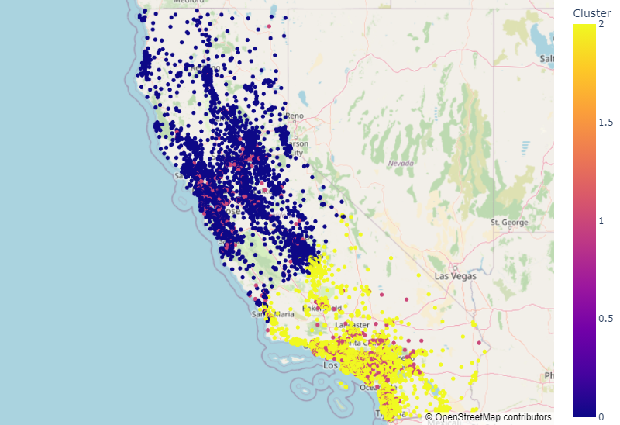
Map of Houses with Clusters
The map visualizes the clusters identified by KMeans in the context of their geographical locations. Each house is color-coded according to its cluster. Geographic patterns in clustering can provide insights into regional trends.

Slide 16
Supervised Analysis
In the Supervised Analysis, we aim to predict housing prices based on the features in the dataset. Techniques used: • Linear Regression • Random Forest • Neural Network (TensorFlow) • XGBoost

Slide 17
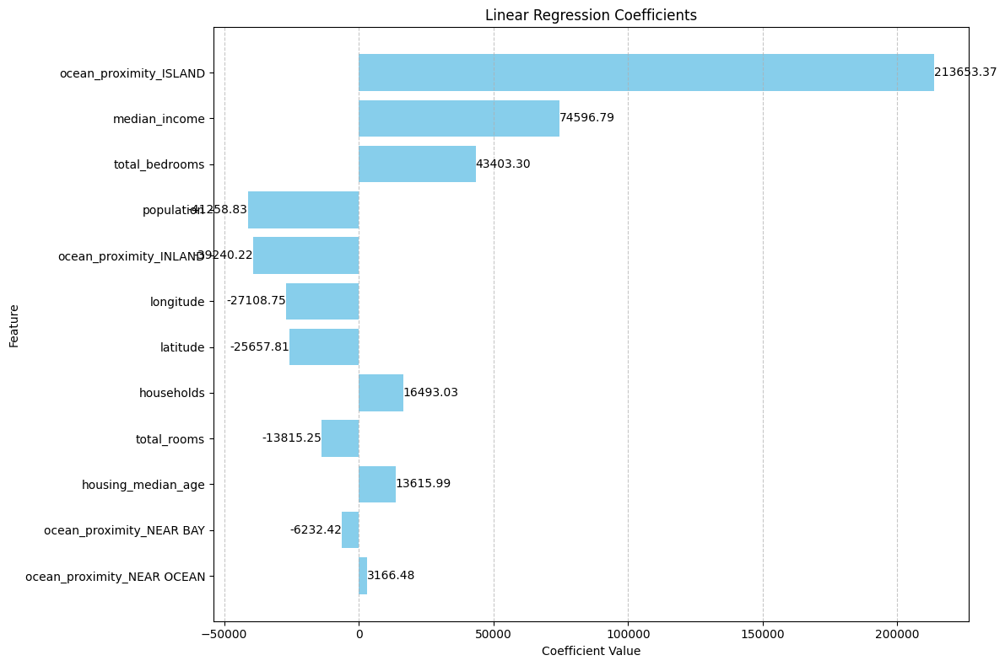
Linear Regression
• Mean Absolute Error (MAE): 50,413.43 • Mean Squared Error (MSE): 4,802,173,538.60 • Root Mean Squared Error (RMSE): 69,297.72 • R-squared (R²): 0.6488 • Adjusted R-squared: 0.6478

Slide 18
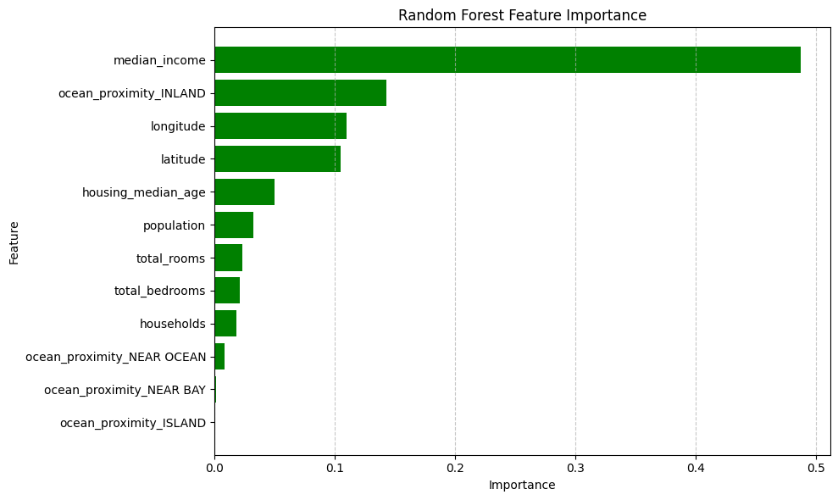
Random Forest
• Best Parameters: {'max_depth': 20, 'min_samples_split': 2, 'n_estimators': 500} • Mean Absolute Error (MAE): 31,641.57 • Mean Squared Error (MSE): 2,375,466,293.68 • Root Mean Squared Error (RMSE): 48,738.76 • R-squared (R²): 0.8263 • Adjusted R-squared: 0.8258

Slide 19
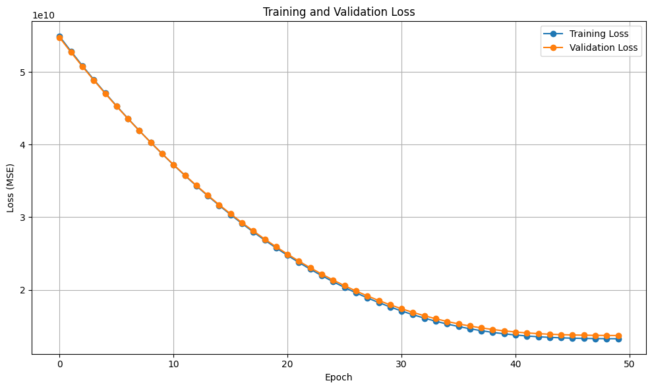
Neural Network
• Mean Absolute Error (MAE): 43,290.98 • Mean Squared Error (MSE): 3,882,304,308.67 • Root Mean Squared Error (RMSE): 62,308.14 • R-squared (R²): 0.7161 • Adjusted R-squared: 0.7153

Slide 20
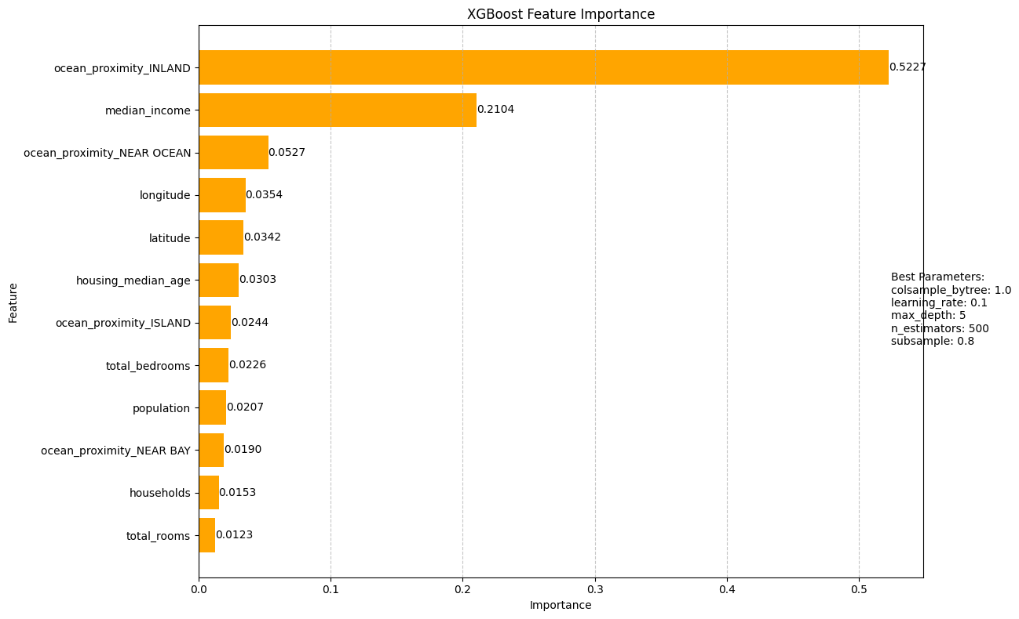
XGBoost
• Mean Absolute Error (MAE): 30,660.61 • Mean Squared Error (MSE): 2,204,422,834.38 • Root Mean Squared Error (RMSE): 46,951.28 • R-squared (R²): 0.8388 • Adjusted R-squared: 0.8383

Slide 21
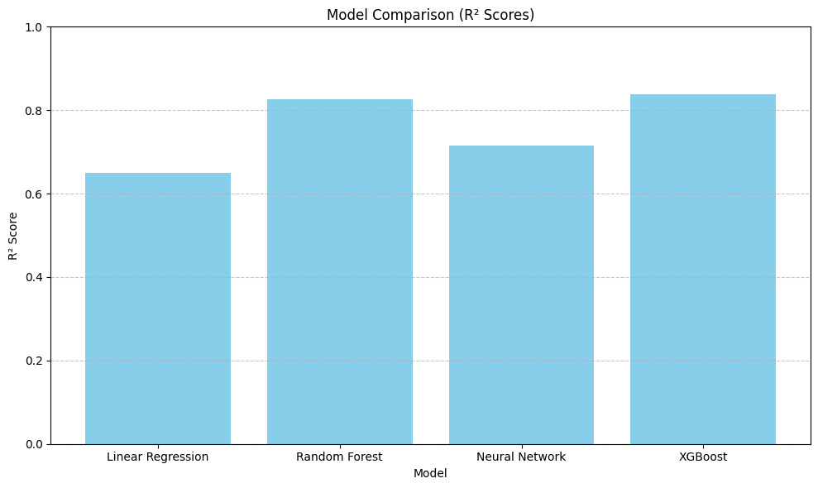
Model Evaluation Summary

Slide 22
Conclusion
Unsupervised Analysis:
PCA reduced dimensionality, capturing 83.6% of variance with 3 components.
KMeans identified 3 clusters with moderate silhouette scores (~0.36).
Clustering revealed regional and economic patterns aiding decision-making.
• Supervised Analysis:
XGBoost excelled with R² = 0.8388 and MAE = 30,661.
Random Forest also performed well (R² = 0.8263), highlighting key features.
Linear Regression was interpretable but less accurate due to simplicity.
Neural Network required careful tuning but delivered reasonable results.
Key features like 'median_income' and 'ocean_proximity' were consistently impactful.
Conclusion:
Clustering provides exploratory insights, while supervised models ensure predictive accuracy.
Together, they offer a comprehensive understanding and support better decisions.

Slide 23
Questions?
Thank you for your attention! Feel free to ask any questions or share your thoughts.

