Slide 1

Statistical Learning Techniques forCredit Loan Approval
A Comprehensive Analysis and PredictiveModeling Approach

Slide 2

Techniques Used: Unsupervised and Supervised Learning
Phase 1: Unsupervised Learning
Multicollinearity Check: Remove highly correlated features.
PCA: Dimensionality reduction (retain variance).
Hierarchical Clustering: Uncover natural groupings.
t-SNE & UMAP: Visualize high-dimensional data in 2D
Phase 2: Supervised Learning
Logistic Regression (Elastic Net): Feature selection + robust modeling
Random Forest: Capture non-linear relationships, evaluate feature importance
XGBoost: Boosting for high-dimensional performance
Neural Network: Deep learning with cross-validation.

Slide 3
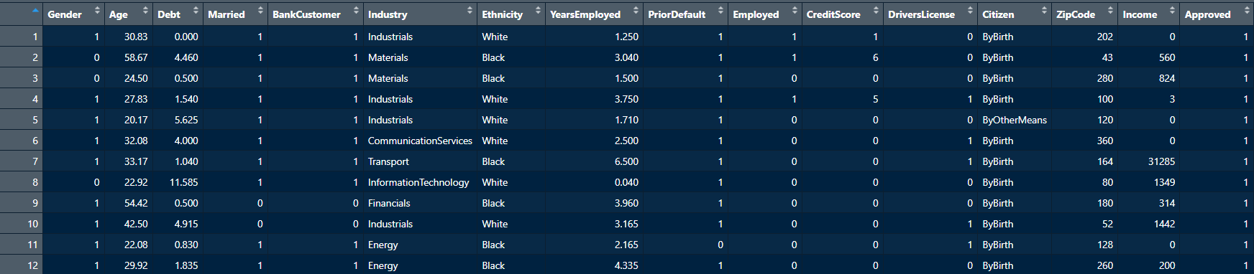
Original Dataset

Slide 4

Data Preprocessing Overview
One-Hot Encoding: Transformed categorical variables into numerical format.
Multicollinearity Check:
Removed: Married, BankCustomer.
Highly Correlated Features:
Removed: Industry.Healthcare, Citizen.ByBirth.
Aliased Variables:
Removed: Industry.Utilities, Ethnicity.White, Citizen.Temporary.
VIF Analysis (VIF>5 ):
Removed: Industry.Energy.
Feature Selection: Retained key features:
Gender, Age, Debt, YearsEmployed, PriorDefault, Employed, CreditScore, Income, Approved, Citizen.ByOtherMeans.

Slide 5

Unsupervized Analysis

Slide 6
Pincipal Components Analysis
Component | Standard Deviation | Proportion of Variance | Cumulative Proportion
PC1 | 1.5950 | 0.2827 | 0.2827
PC2 | 1.1243 | 0.1404 | 0.4231
PC3 | 1.0061 | 0.1125 | 0.5356
PC4 | 0.9810 | 0.1069 | 0.6425
PC5 | 0.9416 | 0.0985 | 0.7410
PC6 | 0.8699 | 0.0841 | 0.8251
PC7 | 0.7964 | 0.0705 | 0.8956
PC8 | 0.7417 | 0.0611 | 0.9567
PC9 | 0.6242 | 0.0433 | 1.0000
Using the Kaiser rule, we selected the first three principal components (PCs), which together explain 53.56% of the total variance in the dataset.

Slide 7
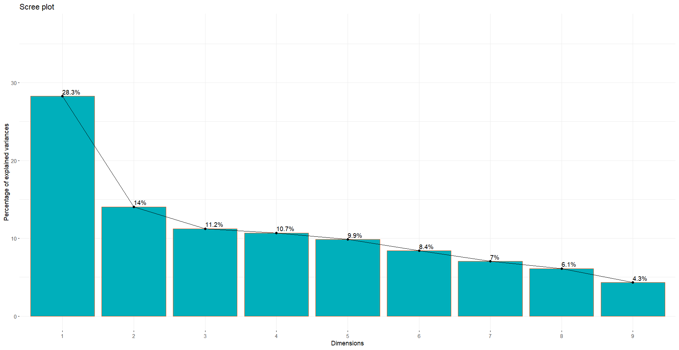
Scree Plot

Slide 8
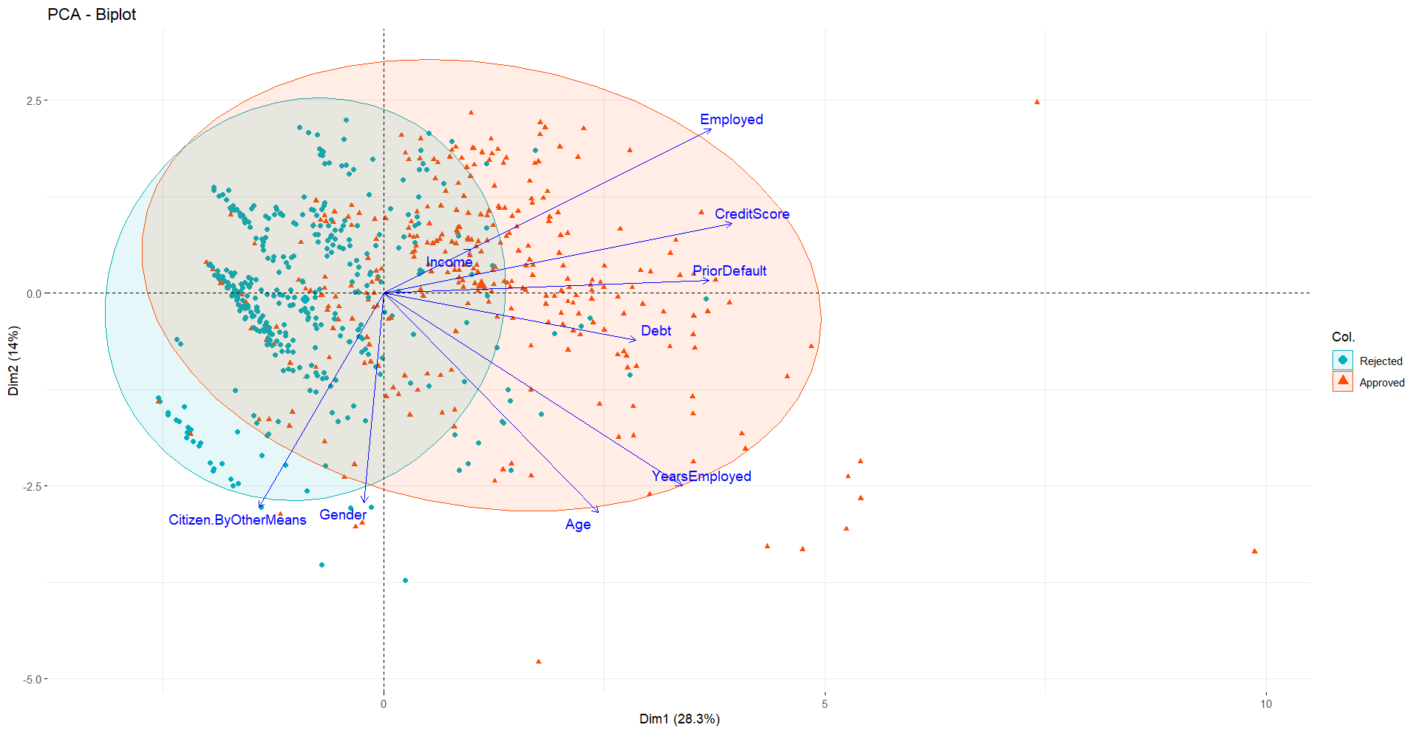
PCA Biplot

Slide 9
PCA Loadings
Variable | PC1 | PC2 | PC3
Gender | -0.026 | -0.456 | 0.067
Age | 0.287 | -0.478 | -0.053
Debt | 0.338 | -0.103 | -0.354
YearsEmployed | 0.400 | -0.420 | 0.004
PriorDefault | 0.436 | 0.027 | 0.114
Employed | 0.439 | 0.357 | 0.246
CreditScore | 0.467 | 0.151 | 0.221
Income | 0.117 | 0.094 | -0.848
Citizen.ByOtherMeans | -0.167 | -0.466 | 0.159
PC1 captures a dimension of financial stability and employment status, PC2 primarily captures a demographic dimension, PC3 primarily captures variability related to income levels

Slide 10
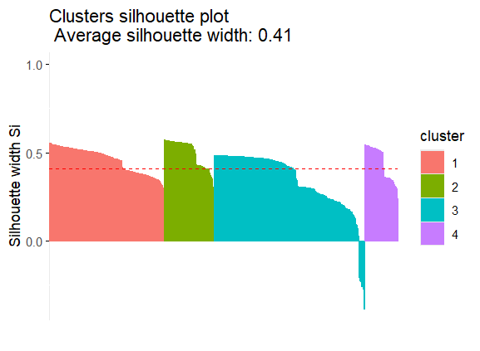
Hierarchical Clustering
Cluster 1: 0.46
Cluster 2: 0.50
Cluster 3: 0.34
Cluster 4: 0.44

Slide 11
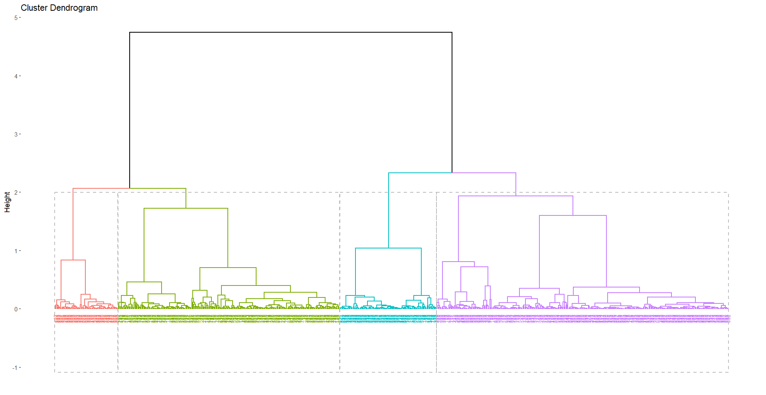
Hierarchical Clustering

Slide 12
Hierarchical Clustering
Cluster 1: Slightly above-average age, high debt, moderate employment years, and high credit scores with notable variation. Predominantly male, employed, with prior defaults, and not part of minority groups.
Cluster 2: Younger individuals, low debt, minimal employment years, and low credit scores with no variation. Predominantly female, unemployed, less likely to have prior defaults, and not part of minority groups.
Cluster 3: Younger individuals, low debt, fewer employment years, and low credit scores with minimal variation. Predominantly male, unemployed, unlikely to have prior defaults, and not part of minority groups.
Cluster 4: Relatively younger, low debt, minimal employment years, and credit scores near average with moderate variation. Predominantly male, employed, unlikely to have prior defaults, and not part of minority groups.

Slide 13
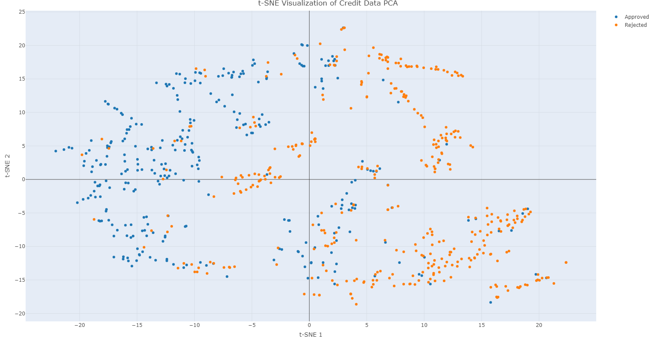
t-SNE

Slide 14
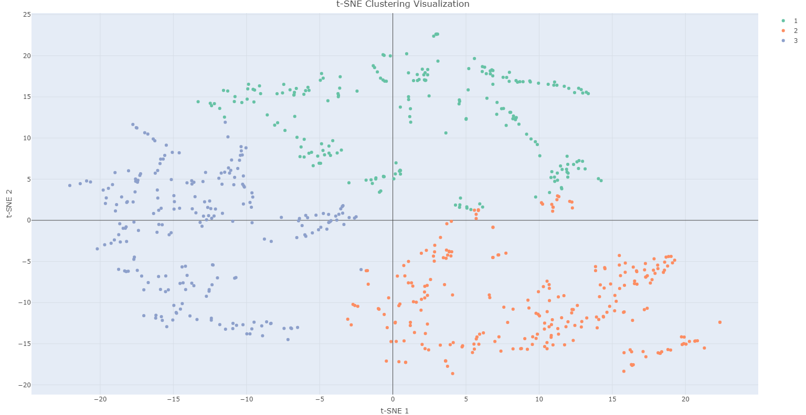
t-SNE Clustering
Cluster 1: Young individuals with moderate debt, limited work experience, and slightly below-average credit scores.
Cluster 2: Predominantly male, low debt, poor credit scores, and minimal work experience.
Cluster 3: Older, financially stable individuals with low debt, high credit scores, and significant work experience.

Slide 15
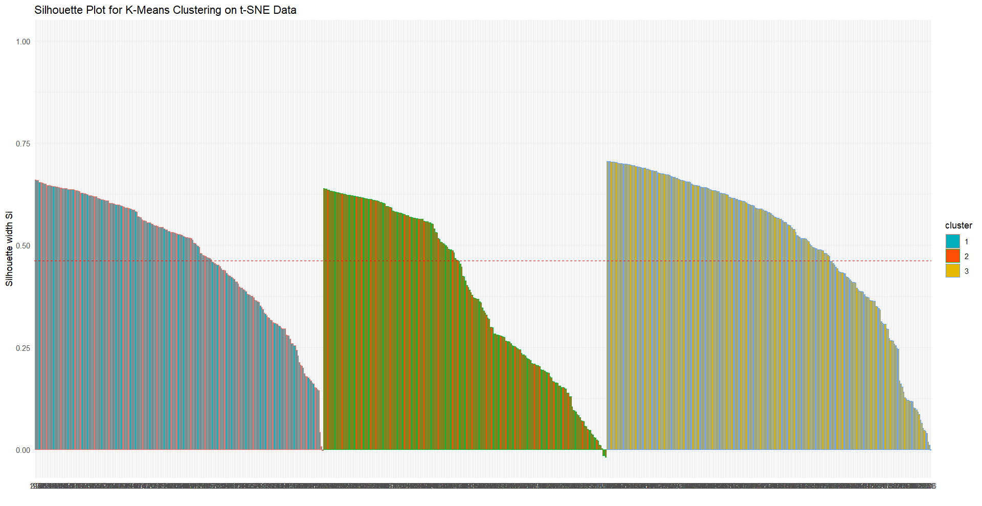
t-SNE Silhouette Score
Cluster 1: 0.38924
Cluster 2: 0.509
Cluster 3: 0.481

Slide 16
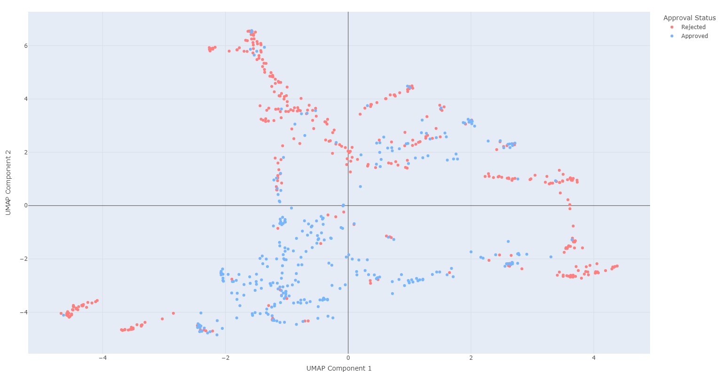
UMAP
Clear clusters of approved (blue) and rejected (light red) applications observed.
Overlap between groups suggests features do not fully separate the two categories.

Slide 17
Supervized Analysis

Slide 18
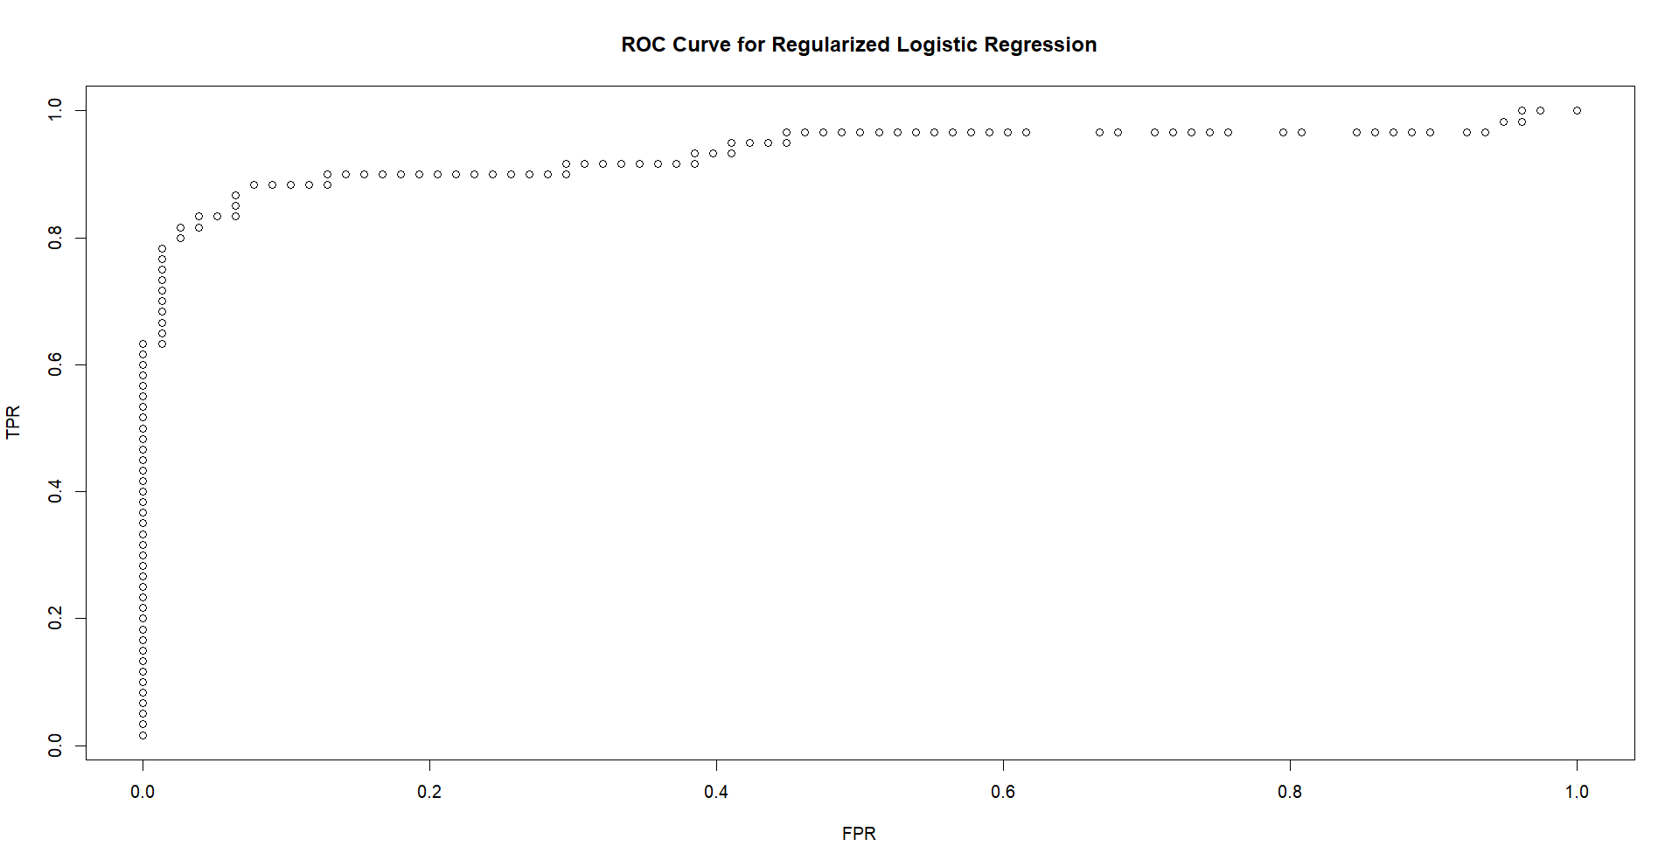
Logistic Regression with Elastic Net Regularization
Predicted \True | Rejected (0) | Approved (1) | Total
Rejected (0) | 68 | 7 | 75
Approved (1) | 10 | 53 | 63
Total | 78 | 60 | 138
Binomial Deviance: 0.758
Misclassification Error: 0.1232
AUC (Area Under the ROC Curve): 0.933
Mean-Squared Error (MSE): 0.2180
Mean Absolute Error (MAE): 0.5584

Slide 19
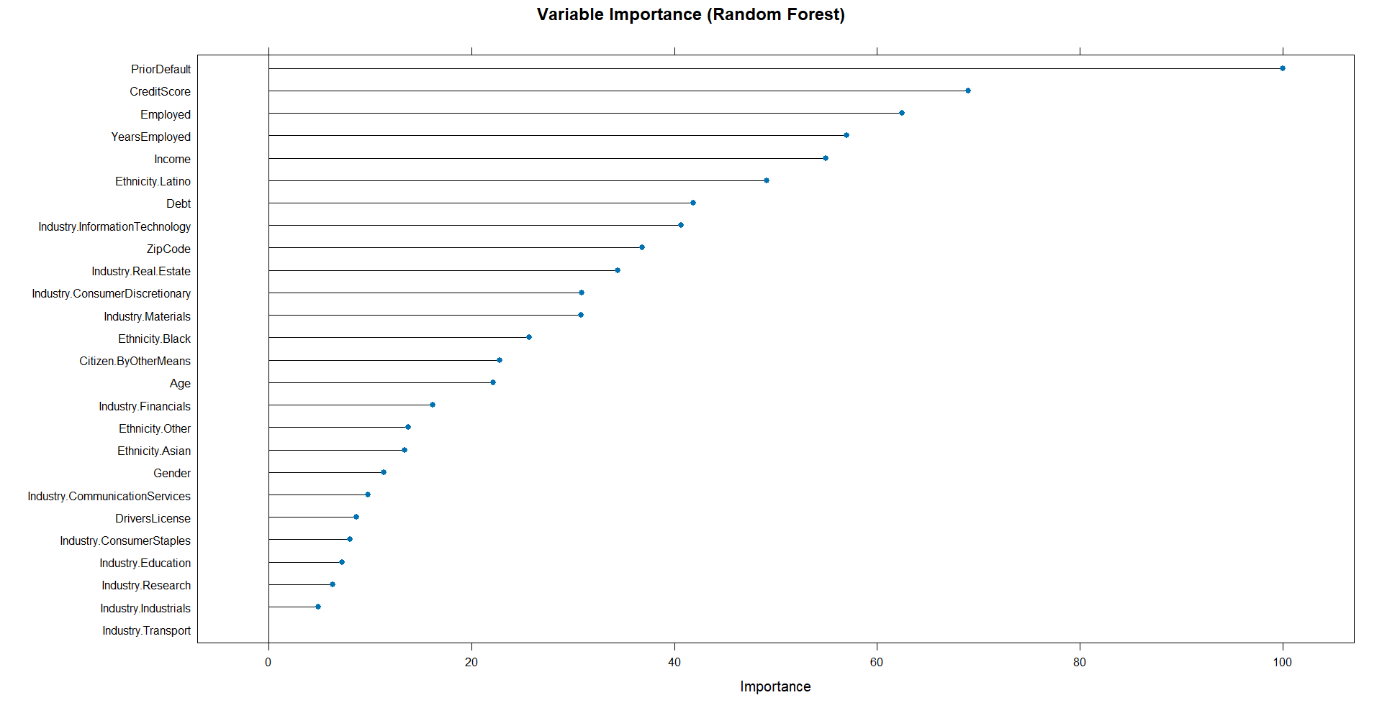
Random Forest
Predicted \True | Rejected (0) | Approved (1) | Total
Rejected (0) | 46 | 4 | 50
Approved (1) | 15 | 72 | 87
Total | 61 | 76 | 137
Accuracy: 86.13%
Precision (Positive Predictive Value): 92.00%
Recall (Sensitivity): 75.41%
Specificity: 94.74%
F1-Score: 82.88%

Slide 20
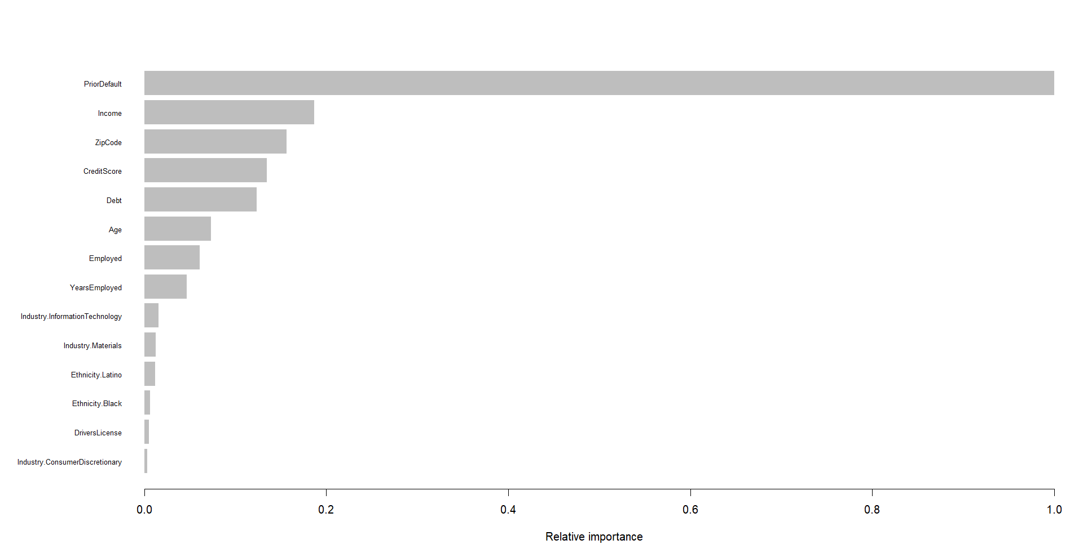
XGBoost
Predicted \True | Rejected (0) | Approved (1) | Total
Rejected (0) | 45 | 3 | 48
Approved (1) | 15 | 75 | 90
Total | 60 | 78 | 138
Accuracy: 86.96%
Precision: 83.33% (Positive Predictive Value)
Recall: 96.15% (Sensitivity)
Specificity: 75.00%
F1-Score: 89.29%

Slide 21
Neural Network
Predicted \True | Rejected (0) | Approved (1) | Total
Rejected (0) | 72 | 10 | 82
Approved (1) | 6 | 50 | 56
Total | 78 | 60 | 138
Accuracy: 0.8841
Precision: 0.8780
Recall: 0.923140
Specificity: 0.8333
F1-Score: 0.8929
Kappa: 0.7623

Slide 22
Conclusion

Slide 23
Unsupervized Analysis
PCA: Reduced dimensionality, revealing financial stability, demographics, and income as key drivers of variance.
Hierarchical Clustering: Identified 4 distinct clusters based on financial and demographic characteristics.
t-SNE with k-means:Highlighted fine-grained clusters, showing distinct groups such as:
Young individuals with moderate debt.
Low-credit males.
Financially stable older individuals.
UMAP (approved/rejected):
Visualized the global structure of approved and rejected applications.
Revealed overlaps and transitional areas between these groups.

Slide 24
Supervized Analysis
Logistic Regression (Elastic Net):
Selected key features: Prior Default, Credit Score, Income.
Strong interpretability; achieved an AUC of 0.9339.
Random Forest:
Highlighted variable importance with top predictors: Prior Default, Income, Credit Score.
Accuracy: 86.13%.
XGBoost:
Captured complex relationships with hyperparameter tuning.
Accuracy: 86.96%.
Neural Network:
Achieved the highest accuracy (88.41%) with a simple architecture (single hidden layer).
Key Insights:
Logistic regression and random forest excel in interpretability and feature selection.
XGBoost and neural networks deliver superior performance with competitive accuracy.

Slide 25

Thank you for your attention! Questions?

