Slide 1
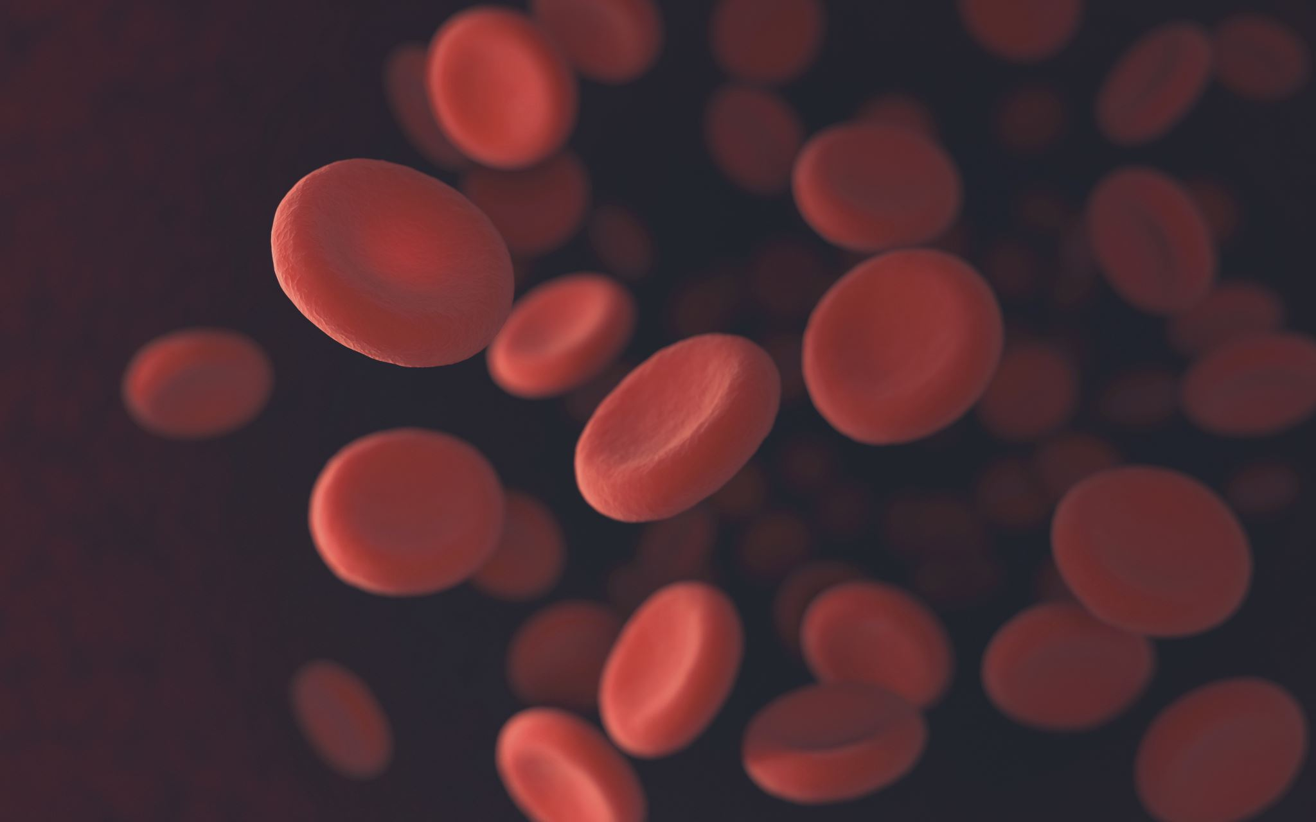
White Blood Cells Classification and Segmentation
Computer Vision Project
Niccolò Siciliano (1958541)

Slide 2
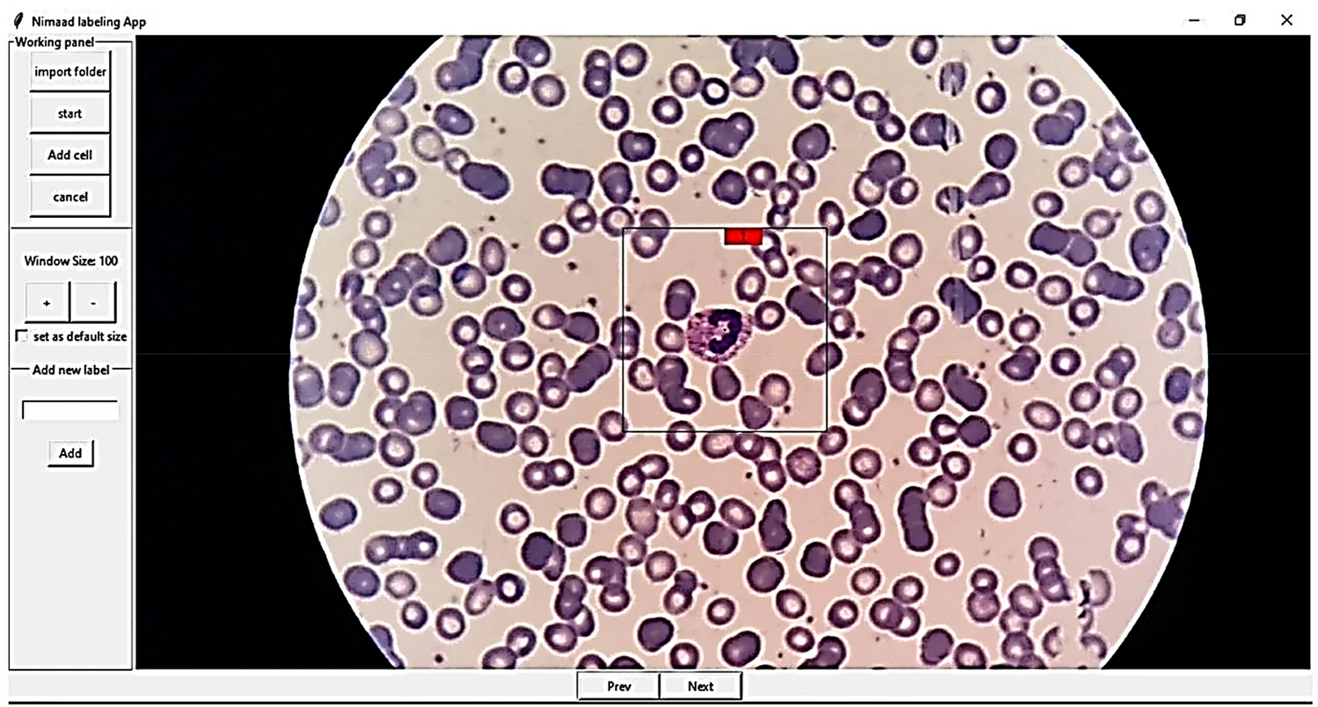
Abstract
Accurate and early detection of anomalies in peripheral white blood cells plays a crucial role in the evaluation of well-being in individuals and the diagnosis and prognosis of hematologic diseases.

Slide 3
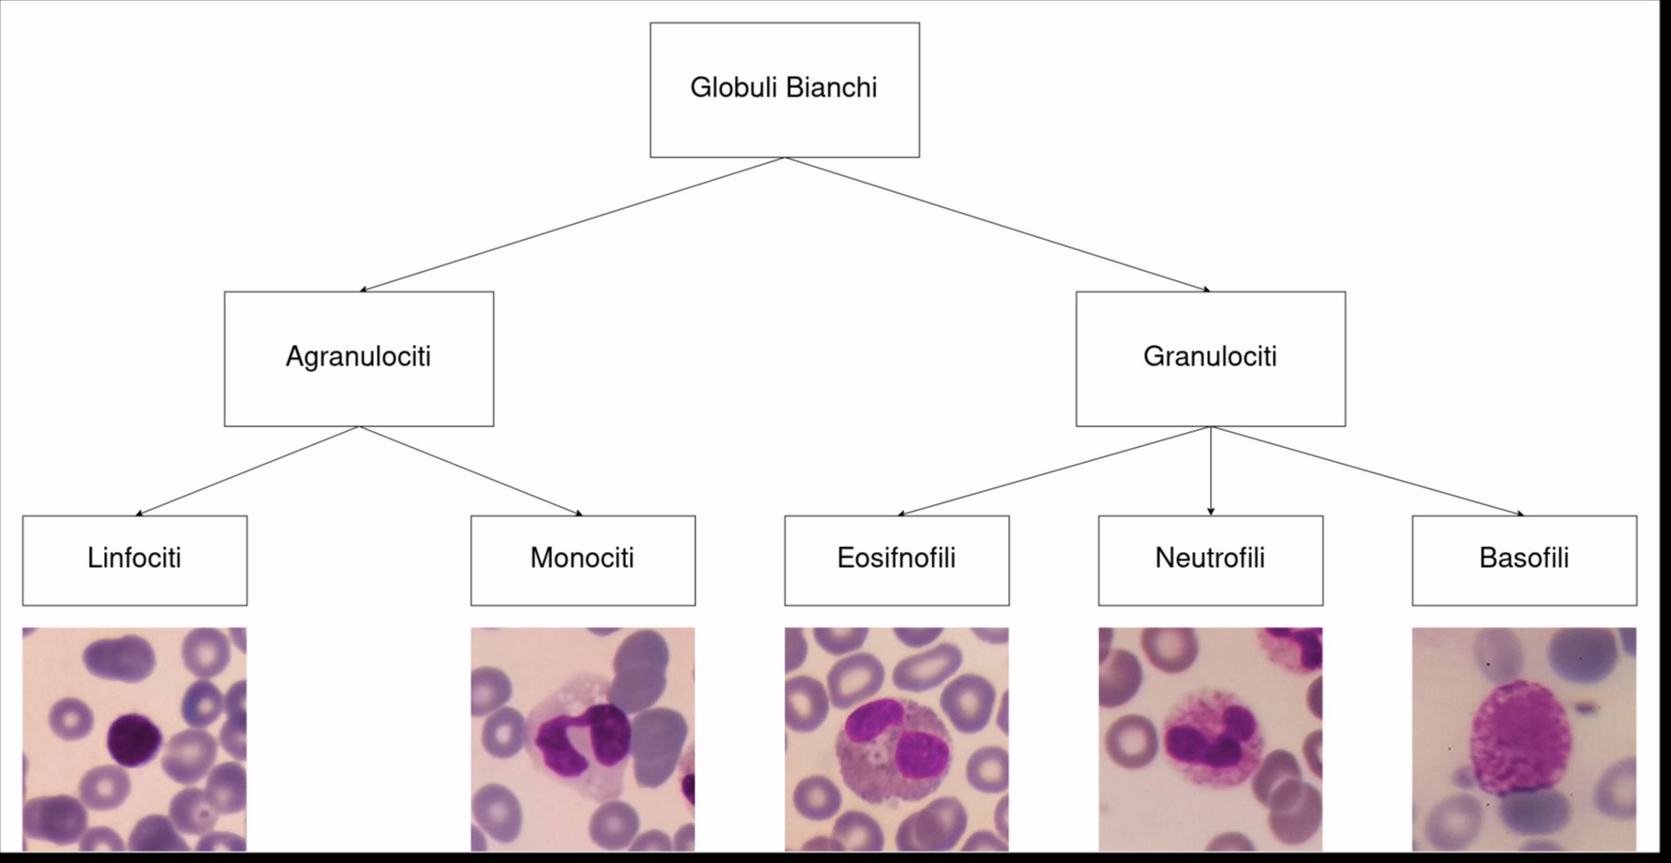
Task
White Blood Cells calssify into 5 classes:
Lymphocyte;
Neutrophil;
Monocyte;
Basophil;
Eosinophil;
Each class of cells is different by color, structure of cell membrane and shape of nucleus.

Slide 4
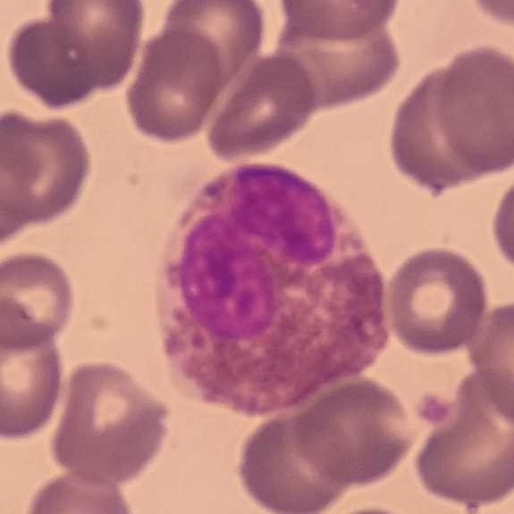
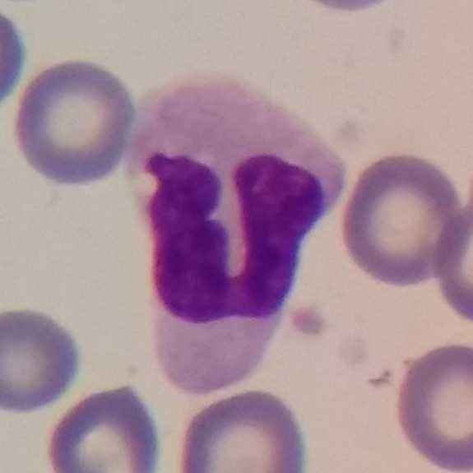
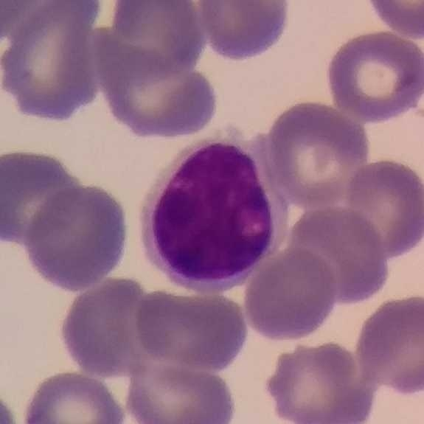
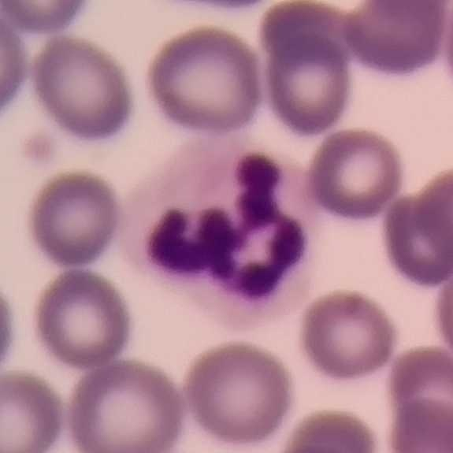
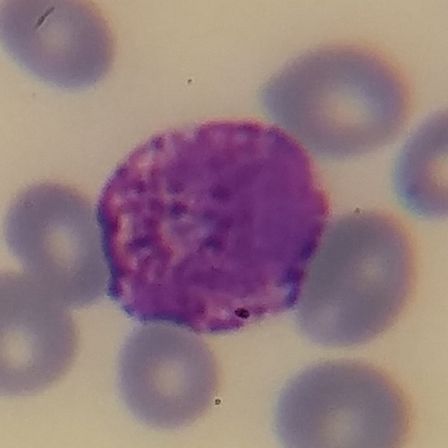
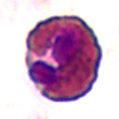
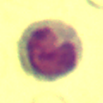
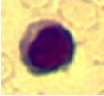
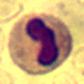
Datasets
Dataset1: images 512 x 512, 1145 individual WBC images (242 neutrophil, 201 eosinophil, 242 monocyte,242 lymphocyte, 218 basophil)
Dataset2: images 120 x 120, 300 individual WBC images (176 neutrophil, 22 eosinophils,48 monocyte, and 53 lymphocyte)

Slide 5
Proposed methods for segmentation
Reduced Unet
Two Model Architecture
Double Decoder Architecture

Slide 6
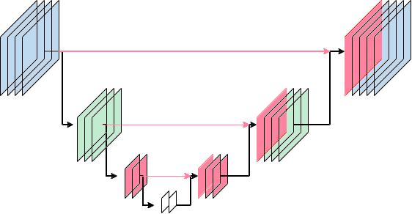
Reduced Unet
Network inspired by Unet architecture. 4 level instead of 5. Take image as input and return an image where each pixel as label 0(background), 1(nucleus), 2(wall).
Number of trainable paramters:
2,040,707

Slide 7
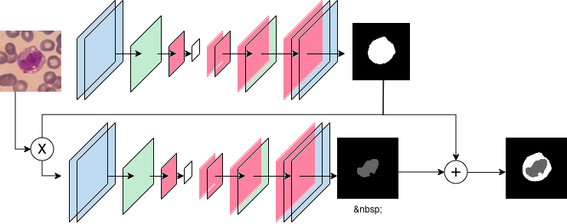
Two Net Architecture
Two specilized network to extract cell wall and nucleus of the cell. The first network take an image as input and return cell mask.
The second network try to extract nucleus mask from the region of image where the cell is located , obtained combining original image and cell mask extracted from the first network.
Number of trainable paramters:
1,981,252

Slide 8
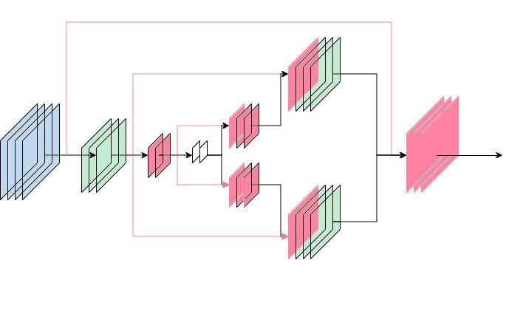
Double Decoder Model
Reduced Unet with two decoder to help the network to extract different features.
Number of trainable paramters: 2,843,363

Slide 9
Performances
Dataset1 | Accuracy per pixel | mIoU | Dice Coefficient
Reduced Unet | 0.948 | 0.956 | 0.928
Two Net Arch | 0.941 | 0.921 | 0.902
Double Decoder Arch | 0.955 | 0.965 | 0.937
Dataset2 | Accuracy per pixel | mIoU | Dice Coefficient
Reduced Unet | 0.935 | 0.953 | 0.92
Two Net Arch | 0.939 | 0.953 | 0.901
Double Decoder Arch | 0.943 | 0.955 | 0.92

Slide 10
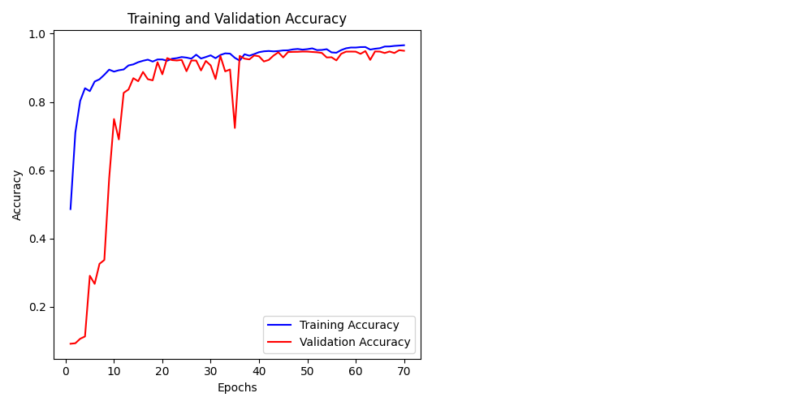
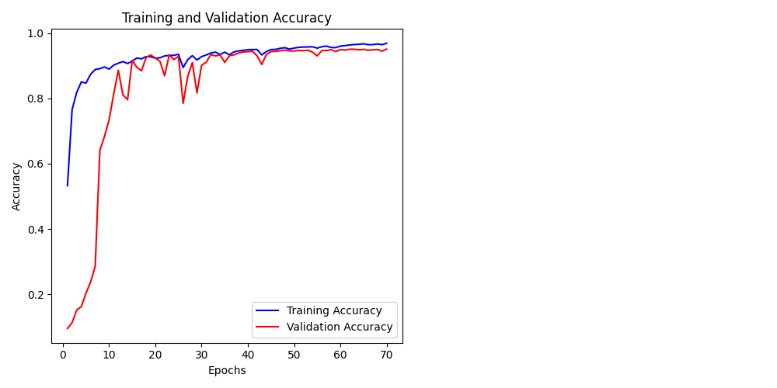
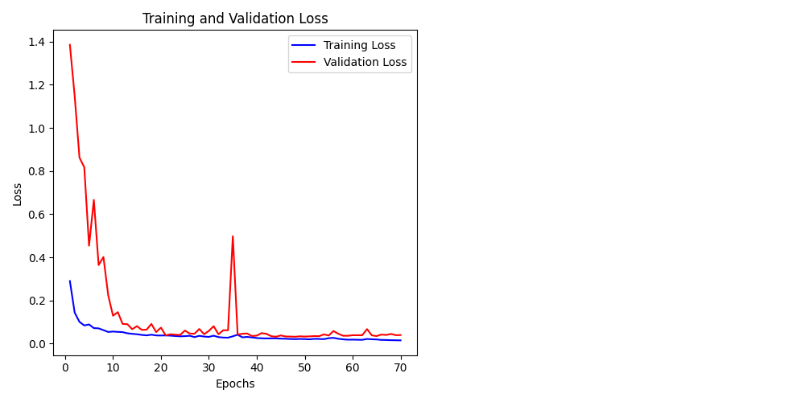
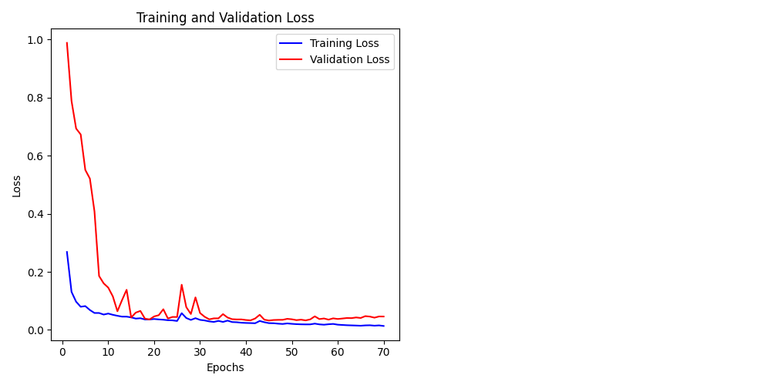
Performances
Reduced Unet and Double Decoder Net accuracy
Reduced Unet and Double Decoder Net loss

Slide 11
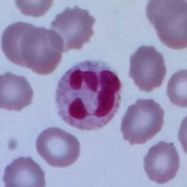
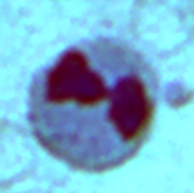








Results
Input dataset1:
Input dataset1:
Ground Truth
Reduced Unet
Double Decoder Arch
Two Net Architecture

Slide 12
Proposed method for classification
Classification on all image
Classification on segmented image

Slide 13
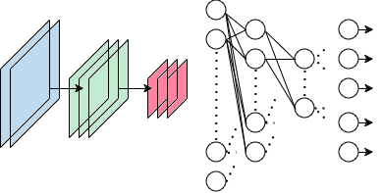
Classification Architecture
The network is divided into two parts: one where feature are extracted from original image through convolution and second where this features are processed with dense layers.

Slide 14
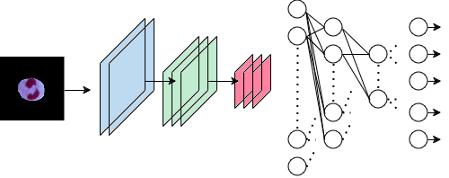
Classification Architecture
In this network the input image is only the cell image, obtained combining original image and cell mask

Slide 15
Performances
Dataset 1 | Accuracy | Precision | Recall | F1 score
Whole image net | 0.948 | 0.951 | 0.948 | 0.948
Segmented img net | 0.923 | 0.943 | 0.934 | 0.923
Dataset 2 | Accuracy | Precision | Recall | F1 score
Whole image net | 0.923 | 0.915 | 0.911 | 0.911
Segmented img net | 0.921 | 0.913 | 0.902 | 0.902

Slide 16
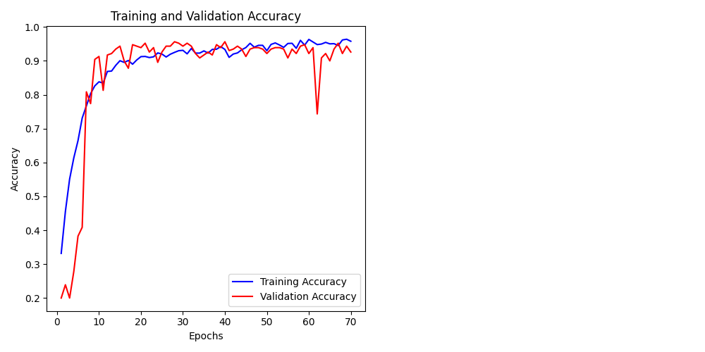
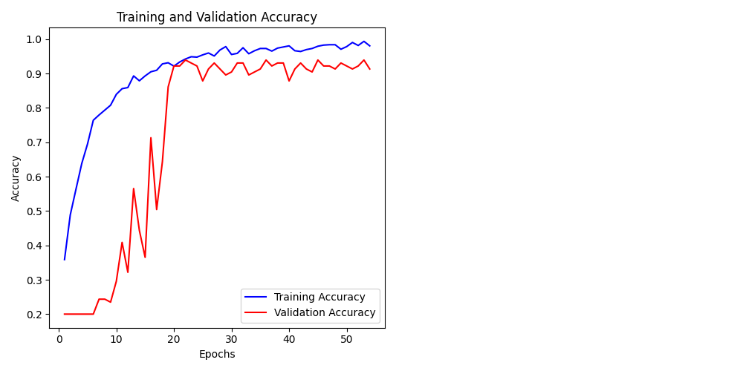
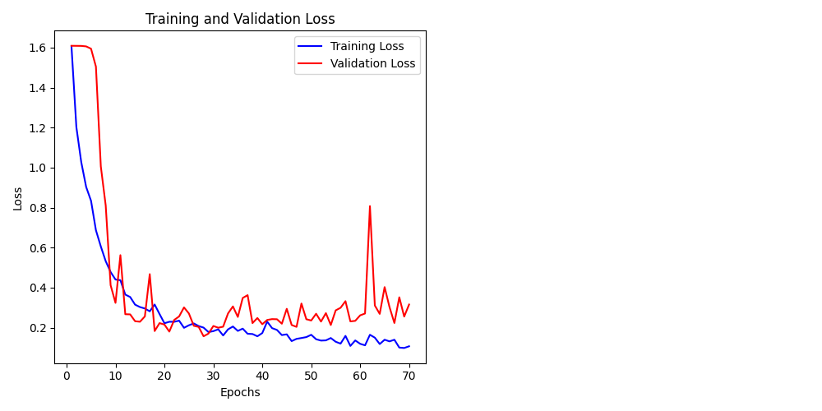
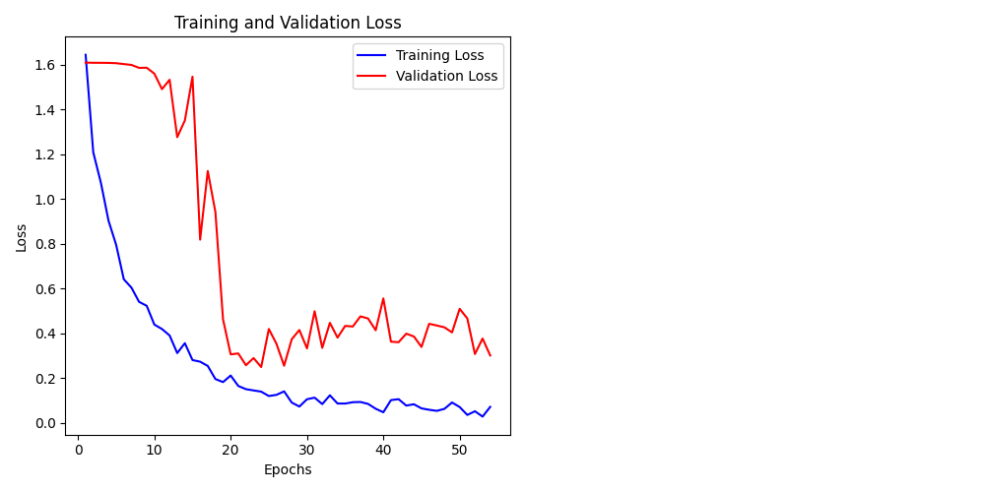
Performances
Whole image net and Segmented image net accuracy
Whole image net and Segmented image net loss

Slide 17
Thank for your attention
Niccolò Siciliano (1958541)

