Slide 1
DATA SCIENCE CAPSTONE · FINAL REPORT
Spotify Song Popularity
Erik Babb · May 2026

Slide 2
Agenda
01
02
03
Problem Statement
Data & Wrangling
Exploratory Analysis
Business context & success criteria
32,833 tracks → 24,531 clean records
Genre trends, feature distributions
04
05
Modeling Results
Recommendations
Ridge, Random Forest, XGBoost
Playlist presence, recency, vocal production
2 / 10

Slide 3
Problem Statement
“How can record labels increase popularity in their songs as of October 2019?"
Context
Spotify popularity (0–100) reflects recent streaming activity
High popularity drives playlist placement and further streams
Record labels need data-driven guidance for production decisions
Data comes from Kaggle
Criteria for Success
Identify audio features most predictive of popularity
Provide 3 concrete, analysis-backed recommendations
Build a model explaining meaningful variance in popularity
3 / 10

Slide 4
Data & Wrangling
32,833
−4,476
−2,126
−1,694
24,531
Raw Tracks
Duplicate IDs
Feature / Name Dups
Remixes Removed
Final Clean Tracks
Missing Values
5 records with nulls and zeroes only
Deduplication
Three rounds: track ID, track name + audio features combination, and track name + artist combination
Remix Removal
1,694 remix tracks removed (similar features but inconsistent popularity)
Date Normalization
Incomplete dates (year-only or year-month) filled with plausible random values
Feature Engineering
Created track_occurences, top_genre, and top_subgenre from the original data
4 / 10

Slide 5
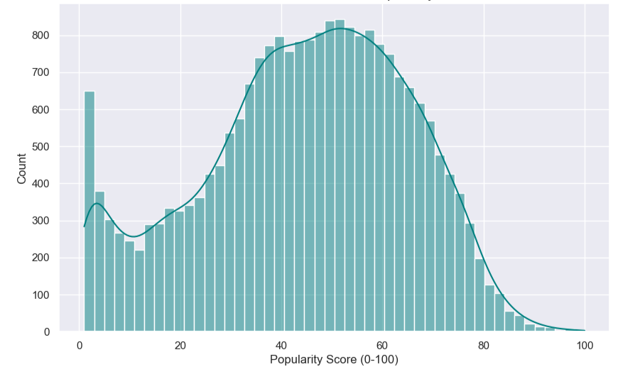
Exploratory Analysis — Popularity Overview
Distribution with zeroes removed
Key Observations
Mean popularity = 41
8.5% of tracks scored exactly 0 and were removed before modeling
Only one track scored 100: "Dance Monkey" by Tones and I
Top 1% threshold: popularity ≥ 83 (263 tracks)
5 / 10

Slide 6
Exploratory Analysis — Genre & Audio Features
Where Top 1% Tracks Fall (ECDF)
Acousticness
Higher — 70th percentile
vs. all tracks in dataset
Speechiness
Higher — 75th percentile
vs. all tracks in dataset
Danceability
Higher — 60th percentile
vs. all tracks in dataset
Liveness
Higher — 60th percentile
vs. all tracks in dataset
Energy
Lower — 30th percentile
vs. all tracks in dataset
6 / 10

Slide 7
Modeling — Approach & Results
Baseline
Selected Model
Runner-up
Ridge Regression
Random Forest
XGBoost
alpha=0.1 · solver=auto
n_est=500 · depth=20
max_feat=None · split=5
lr=0.1 · depth=5
n_est=200 · sub=1.0
14.71
0.196
13.95
0.263
13.95
0.262
MAE
R²
MAE
R²
MAE
R²
Linear, fast but limited
Best overall performance
Virtually tied with RF
7 / 10
All models tuned with 5-fold GridSearchCV · 80/20 train-test split · Features standardized with StandardScaler

Slide 8
Feature Importance — Random Forest
Key Takeaways
#1
track_occurences
Most important feature — songs on more playlists score higher
#2
days_since_release
Newer songs score higher — Spotify favors recent tracks
#3
instrumentalness
Low instrumentalness (vocal tracks) correlates with popularity
#4
duration_sec
Track length has moderate predictive value
#5
loudness
Higher loudness associated with greater popularity
#6
tempo
Tempo contributes modestly to popularity prediction
8 / 10

Slide 9
Recommendations for Record Labels
01
Focus on Playlist Placement
Track occurrences, the number of playlists a song appears on, was the single most important predictor of popularity. Labels should invest in editorial and algorithmic playlist pitching, as broader playlist presence directly correlates with higher popularity scores.
02
Release New Music Consistently
Days since release was the second most important feature. Spotify's algorithm strongly favors recent tracks. Record labels should prioritize frequent, timely releases to maintain catalog recency and algorithmic visibility.
03
Prioritize Vocal Tracks Over Instrumentals
Instrumentalness was the third most important feature, with low instrumentalness (songs with vocals) correlating with higher popularity. Labels should favor vocal-led productions over purely instrumental releases.
9 / 10

Slide 10
Conclusion
Model Performance Summary
Key Takeaway
Final Model: Random Forest (MAE = 13.95, R² = 0.263)
Explains ~26% of popularity variance using features available and derived from this dataset
Limitation: marketing, artist recognition, and lyrics not captured
Songs placed across many playlists, released recently, and featuring vocals over instrumentals have the highest predicted popularity on Spotify.
Ideas for Further Research
Add lyric-based NLP features (sentiment, theme, vocabulary)
Include marketing spend, editorial placement, and social following
Build genre-specific sub-models for higher accuracy
10 / 10

