Slide 1
NBA
NBA Player Salaries and Market Value
Predicting player pay and finding who is over and underpaid
Data Science Capstone · Final Presentation
Erik Babb · July 2026
Notes:
Title slide. Project predicts NBA salary from production and identifies over and underpaid players.

Slide 2
Agenda
01
Problem & Context
02
Data & Approach
03
Data Wrangling
04
Exploratory Analysis
05
Player Archetypes
06
Modeling
07
Feature Importance & Value
08
Recommendations
2

Slide 3
Problem & Context
How well can an NBA player’s salary be predicted from measurable production, and which players fall furthest from their predicted value?
Context
Success metric
Teams operate under a hard salary cap, so every dollar spent on one player is unavailable for another
A model that predicts log salary well and surfaces clear over and underpaid players
Stakeholders
Constraints
NBA front offices and general managers
2025-26 season only, box score stats, and salaries structured by the CBA
3

Slide 4
Data & Approach
Season stats and physicals from nba_api, salaries from Basketball-Reference, and CBA salary tiers, merged into one record per player.
582
3
18
log(salary)
players merged
data sources
model features
prediction target
Formulated as a regression problem
Target: natural log of salary, chosen because raw salary is heavily right skewed
Predictors: per 36 minute production rates, shooting percentages, minutes per game, games played, experience, and age
Physical measurements were reserved for clustering rather than the salary model
4

Slide 5
Data Wrangling
→
→
582
379
363
players merged
(stats + salaries + bio)
after 500 minute cutoff
with salary
used for the model
Missing weights
Missing salaries
Median weight imputed for 6 players, mostly two way and G League contracts
113 players had no salary on record. Excluded from the model but kept for clustering
5

Slide 6
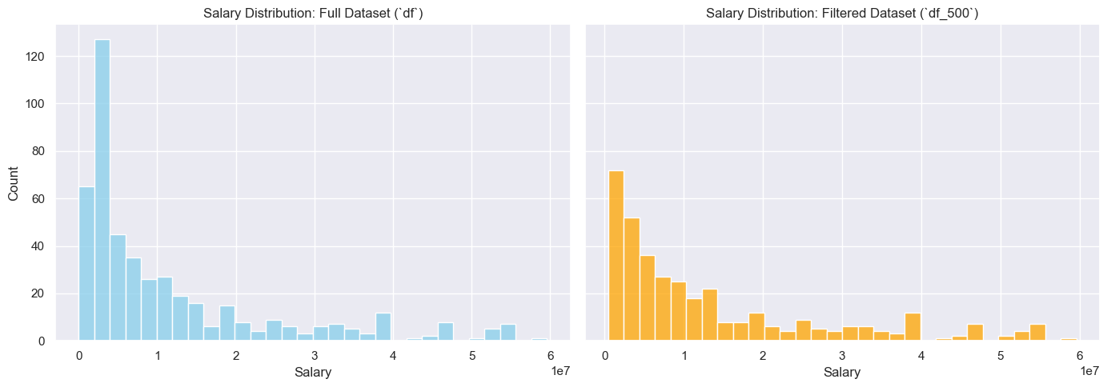
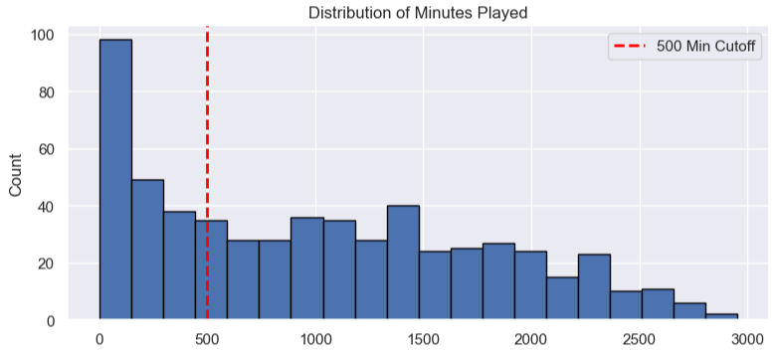
Exploratory Analysis
Key Findings
Salary is heavily right skewed, so the log of salary was used as the target
Offensive volume stats such as points, field goal attempts, and free throw attempts relate most strongly to pay
Defensive stats like rebounds, blocks, and steals relate less to pay
Players under 500 minutes were removed to cut small sample noise
6

Slide 7
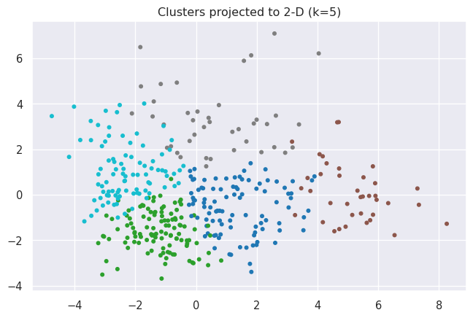
Player Archetypes
k-means grouped players into five archetypes. The color swatches match the scatter at left.
Elite Superstar Frontcourt
41 players
$36.1M avg
Elite Scoring Guards & Playmakers
91 players
$17.7M avg
Traditional Centers & Paint Anchors
38 players
$11.8M avg
Versatile Forwards & Dynamic Bigs
97 players
$7.8M avg
Complementary Wings & Shooting Guards
112 players
$7.6M avg
7

Slide 8
Modeling
Three models were compared. Random Forest was selected on cross validated R squared and carried into the analysis.
BASELINE
FINAL MODEL
TREE MODEL
Linear Regression
Random Forest
XGBoost
R² 0.618
R² 0.625
R² 0.624
MAE 0.565
MAE 0.581
MAE 0.580
SELECTED
Random Forest was tuned with GridSearchCV (500 trees, max depth 10). Metrics are on the log salary scale, where an R squared near 0.62 means the model explains about 62% of salary variance. The models are close on the small test set, so the more stable cross validated score guided the choice
8

Slide 9
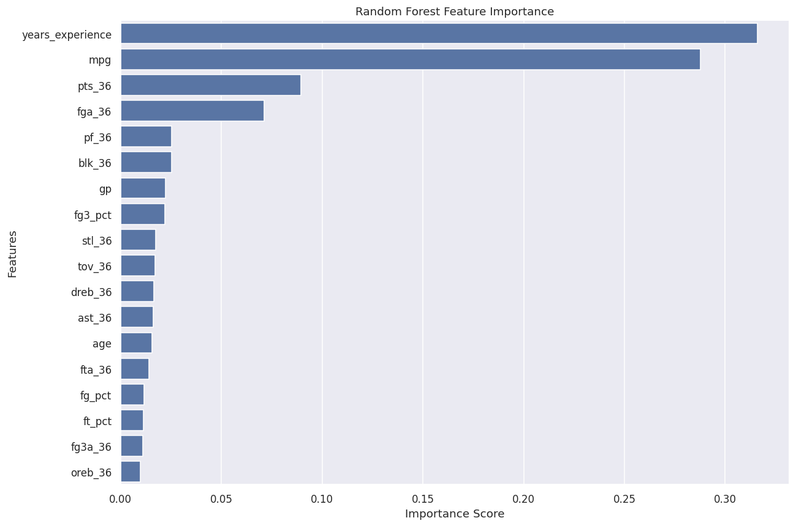
Feature Importance
#1
years_experience
Tenure sets contract eligibility and the maximum salary tier.
#2
mpg
Minutes per game reflect role and carry the volume that per 36 stats remove.
The market prices seniority and role more visibly than per minute production.
9

Slide 10
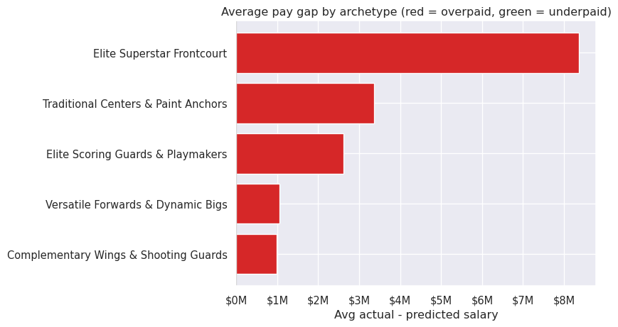
Overpaid and Underpaid Players
Most overpaid
Jimmy Butler +$30.9M
Kevin Durant +$27.5M
Giannis Antetokounmpo +$27.4M
Paul George +$27.0M
Most underpaid
Deni Avdija -$22.7M
Russell Westbrook -$20.9M
Austin Reaves -$19.8M
Saddiq Bey -$18.4M
Overpayment rises with the tier of the group
10

Slide 11
Recommendations
01
Target productive players on cheap contracts
Rookie scale and bargain veteran deals hold the most surplus value. Reaves, Avdija, and Alexander-Walker are examples of production the market has not repriced.
02
Be disciplined paying for experience and minutes
The most overpaid players are veterans whose pay reflects seniority more than current production. Weigh long max extensions for aging stars carefully.
03
Benchmark contracts within archetypes
Compare pay to peers in the same archetype rather than the whole league. Superstar frontcourt carries the biggest premium, role players are priced efficiently.
11

Slide 12
Conclusion & Future Work
Final model: Random Forest predicting log salary, test R squared about 0.62.
Salary is driven mainly by experience and minutes, well ahead of per minute production. The model surfaces the most over and underpaid players and shows superstar archetypes carry the largest premium.
Future work
Add contract context such as years remaining, contract type, and injury history
Model several seasons together to improve stability and separate role from pay
Apply a smearing correction so the log to dollar value gaps are more accurate
Add advanced metrics beyond box score rates, such as efficiency and on court impact
12

