Slide 1
Introduction to AI Group 6
Natural language processing
classify YouTube comments as spam

Slide 2
Table of Contents
01
02
03
04
The Goal of this project
Model Training
Model Evaluation
Visualizing Results
Conclusion
05

Slide 3
The goal of this project
The goal of this project is to identify spam comments in YouTube videos
Notes:
The goal of this project is to identify spam comments in YouTube videos. We will use datasets containing comments from Katy Perry and LMFAO videos. Our approach involves using a Multinomial Naive Bayes Classifier, a popular algorithm for text classification tasks.

Slide 4
Naive Bayes Classifier
Model Training
We train a Naive Bayes Classifier on the training set. We assume simplifies the computation and often works well in practice, especially for text classification tasks.
Notes:
We train a Naive Bayes Classifier on the training set. The Naive Bayes algorithm is based on Bayes' theorem and assumes that the features are conditionally independent given the class. This assumption simplifies the computation and often works well in practice, especially for text classification tasks.

Slide 5
Model Evaluation
Mean accuracy: 0.8970972423802615
Cross-validation
Accuracy: 0.9431818181818182
Testing on Data
Accuracy: 0.8264840182648402
Testing on Data with new comments

Slide 6
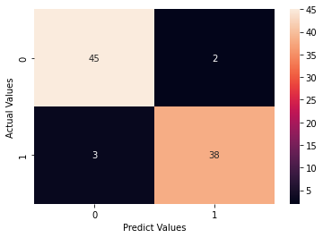
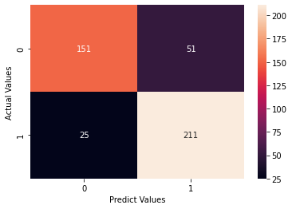
Visualizing Results
Testing on Data
Testing on Data with new comments
Notes:
To better understand the classifier's performance, we visualize the confusion matrix using the seaborn library. The confusion matrix provides insight into the number of true positives, true negatives, false positives, and false negatives for each class, allowing us to assess the model's strengths and weaknesses.

Slide 7
Conclusion
Notes:
In conclusion, our Naive Bayes Classifier performed reasonably well in classifying YouTube comments as spam or not spam.

