Slide 1
Introduction to AI Group 6
Natural language processing
classify YouTube comments as spam

Slide 2
Table of Contents
01
02
03
04
The Goal of this project
Model Training
Model Evaluation
Visualizing Results
Conclusion
05

Slide 3
The goal of this project
The goal of this project is to identify spam comments in YouTube videos
Notes:
The goal of this project is to identify spam comments in YouTube videos. We will use datasets containing comments from Katy Perry and LMFAO videos. Our approach involves using a Multinomial Naive Bayes Classifier, a popular algorithm for text classification tasks.

Slide 4
Naive Bayes Classifier
Version 1&2
For the version1 We train a Naive Bayes Classifier on the training set and we using the Stopwords method in NL toolkit to filter the word and for the and version2, We just change the 1 test file to more dataset
Notes:
The concept of our group is do it on individual version and We chosen the best accuracy result version. For the version1 we do the import train and test data only one file and using the Stopwords method

Slide 5
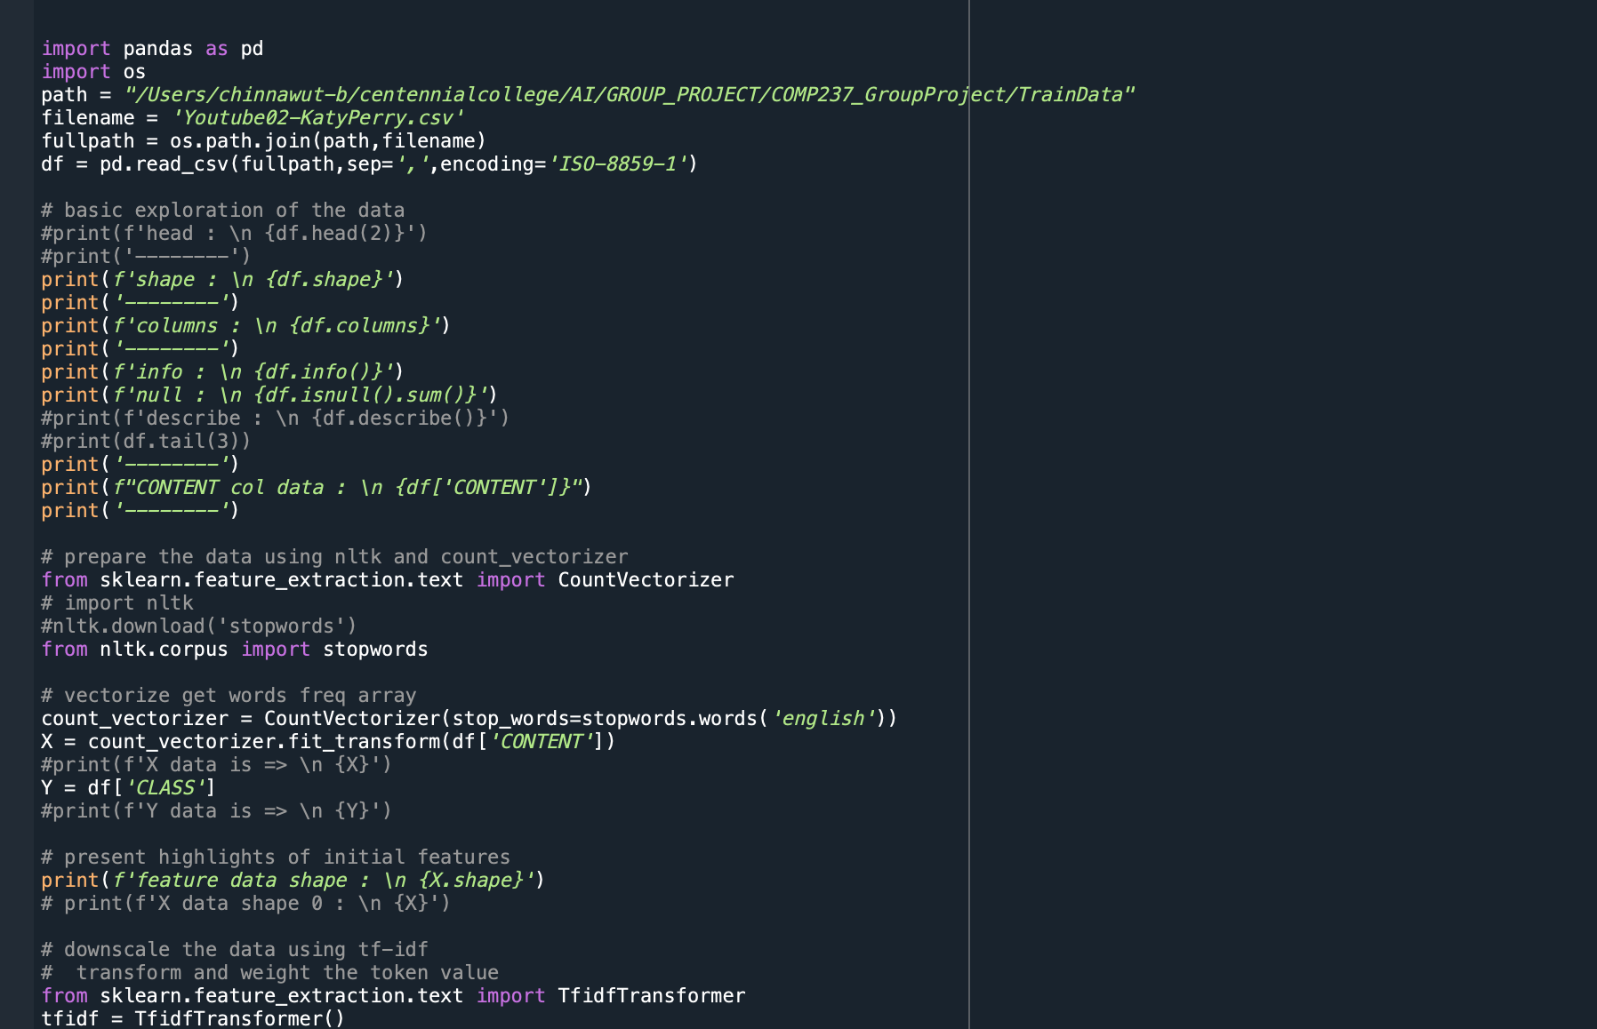
Code review version1
Notes:
The goal of this project is to identify spam comments in YouTube videos. We will use datasets containing comments from Katy Perry and LMFAO videos. Our approach involves using a Multinomial Naive Bayes Classifier, a popular algorithm for text classification tasks.

Slide 6
Model Evaluation
Mean accuracy: 0.8970972423802615
Cross-validation
Accuracy: 0.9431818181818182
Testing on Data
Accuracy: 0.8264840182648402
Testing on Data with new comments

Slide 7
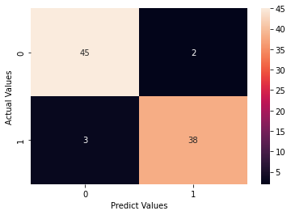
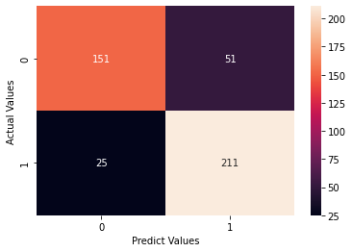
Visualizing Results
Testing on Data
Testing on Data with new comments
Notes:
.

Slide 8
Naive Bayes Classifier
Version 3
For the version3, this script for the NLP classification with different stemmer for comparison.
Notes:
The concept of our group is do it on individual version and We chosen the best accuracy result version. For the version1 we do the import train and test data only one file and using the Stopwords method

Slide 9
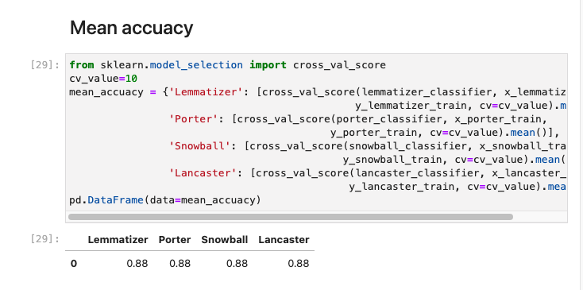
Model Evaluation

Slide 10
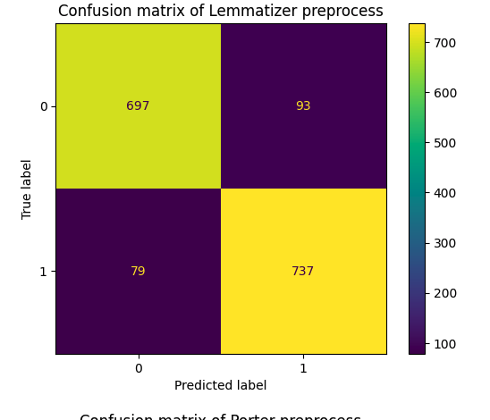
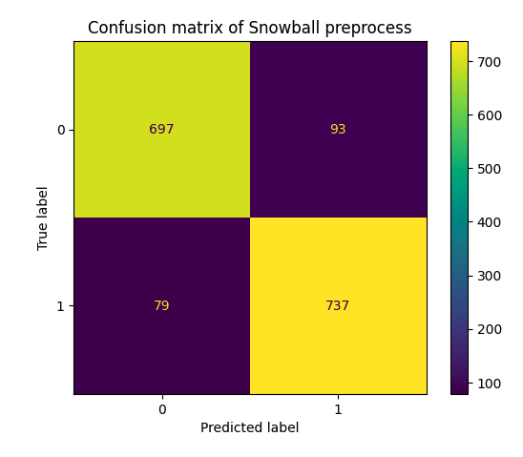
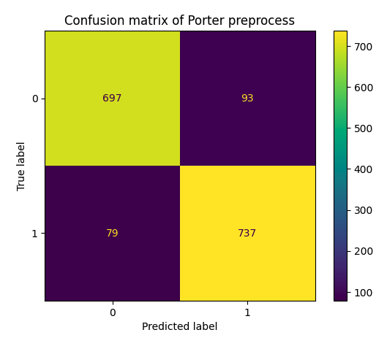
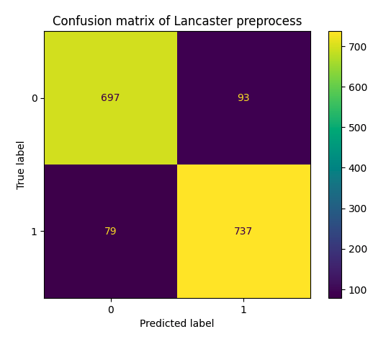
Visualizing Results
Notes:
.

