Slide 1
Final Project: Love Connected <3
第11組
B05902021 李澤諺 B05902019 蔡青邑 B05902070 翁肇陽

Slide 2
Love Connected <3
Boy\Girl | 0 | 1 | 2 | 3 | 4 | 5 | 6 | … | 100
0 | V
1 |  |  | V
2 |  | V
3 |  |  |  | V
4 |  |  |  |  |  | V
5 |  |  |  |  | V
6 |  |  |  |  |  |  | V
… |  |  |  |  |  |  |  |  | V
100 |  |  |  |  |  |  |  | V

Slide 3
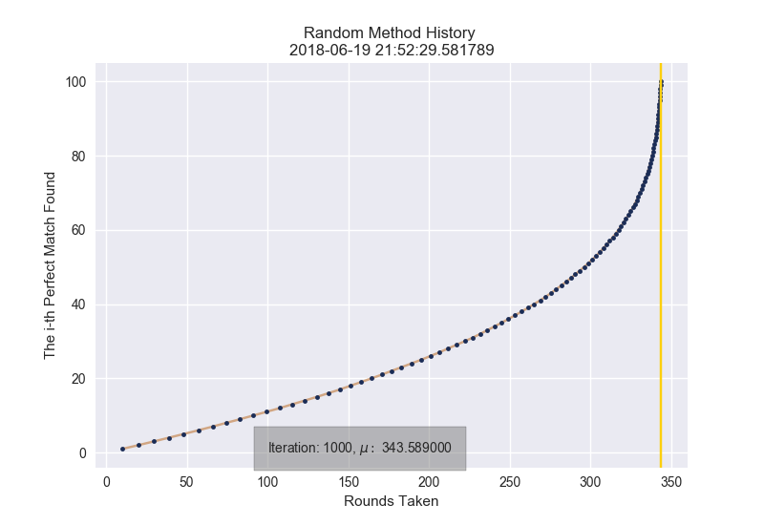
Naïve Random: Randomly Generate Our Query

Slide 4
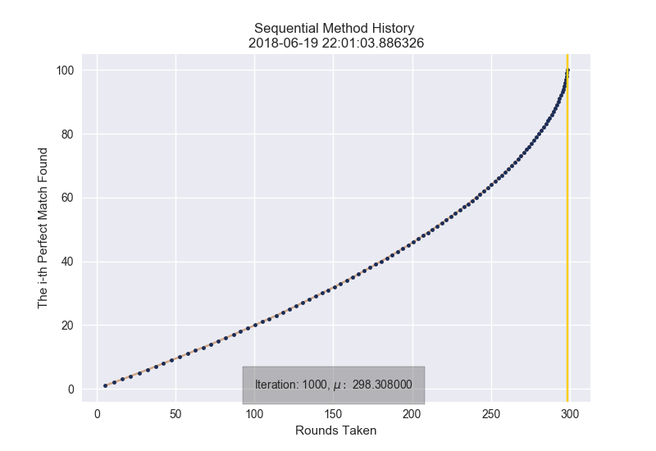
Sequential Method: 由左至右由上至下挑

Slide 5
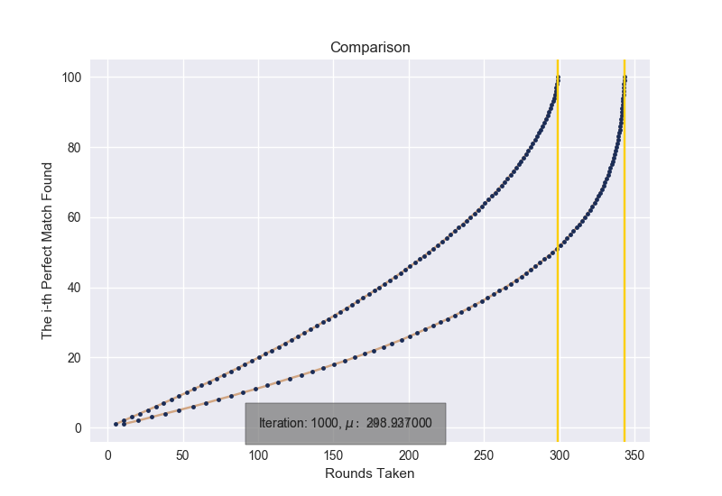
Why is sequential better than random?

Slide 6

Do you remember Monty Hall Problem?

Slide 7
If (0, 0) is not a perfect match…
Boy\Girl | 0 | 1 | 2 | 3 | 4 | 5 | 6 | … | 100
0 | 1/100 | 1/100 | 1/100 | 1/100 | 1/100 | 1/100 | 1/100 | 1/100 | 1/100
1 | 1/100 | 1/100 | 1/100 | 1/100 | 1/100 | 1/100 | 1/100 | 1/100 | 1/100
2 | 1/100 | 1/100 | 1/100 | 1/100 | 1/100 | 1/100 | 1/100 | 1/100 | 1/100
3 | 1/100 | 1/100 | 1/100 | 1/100 | 1/100 | 1/100 | 1/100 | 1/100 | 1/100
4 | 1/100 | 1/100 | 1/100 | 1/100 | 1/100 | 1/100 | 1/100 | 1/100 | 1/100
5 | 1/100 | 1/100 | 1/100 | 1/100 | 1/100 | 1/100 | 1/100 | 1/100 | 1/100
6 | 1/100 | 1/100 | 1/100 | 1/100 | 1/100 | 1/100 | 1/100 | 1/100 | 1/100
… | 1/100 | 1/100 | 1/100 | 1/100 | 1/100 | 1/100 | 1/100 | 1/100 | 1/100
100 | 1/100 | 1/100 | 1/100 | 1/100 | 1/100 | 1/100 | 1/100 | 1/100 | 1/100

Slide 8
If (0, 0) is not a perfect match…
Boy\Girl | 0 | 1 | 2 | 3 | 4 | 5 | 6 | … | 100
0 | X | 1/99 | 1/99 | 1/99 | 1/99 | 1/99 | 1/99 | 1/99 | 1/99
1 | 1/99 | 1/100 | 1/100 | 1/100 | 1/100 | 1/100 | 1/100 | 1/100 | 1/100
2 | 1/99 | 1/100 | 1/100 | 1/100 | 1/100 | 1/100 | 1/100 | 1/100 | 1/100
3 | 1/99 | 1/100 | 1/100 | 1/100 | 1/100 | 1/100 | 1/100 | 1/100 | 1/100
4 | 1/99 | 1/100 | 1/100 | 1/100 | 1/100 | 1/100 | 1/100 | 1/100 | 1/100
5 | 1/99 | 1/100 | 1/100 | 1/100 | 1/100 | 1/100 | 1/100 | 1/100 | 1/100
6 | 1/99 | 1/100 | 1/100 | 1/100 | 1/100 | 1/100 | 1/100 | 1/100 | 1/100
… | 1/99 | 1/100 | 1/100 | 1/100 | 1/100 | 1/100 | 1/100 | 1/100 | 1/100
100 | 1/99 | 1/100 | 1/100 | 1/100 | 1/100 | 1/100 | 1/100 | 1/100 | 1/100

Slide 9
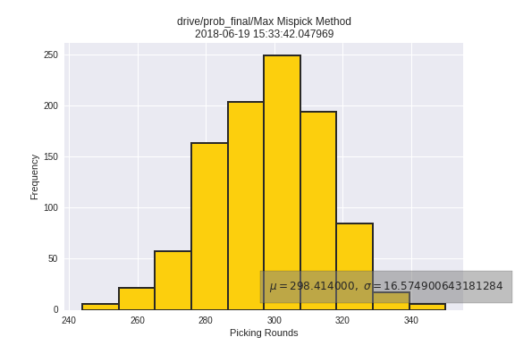
Mispick Method

Slide 10
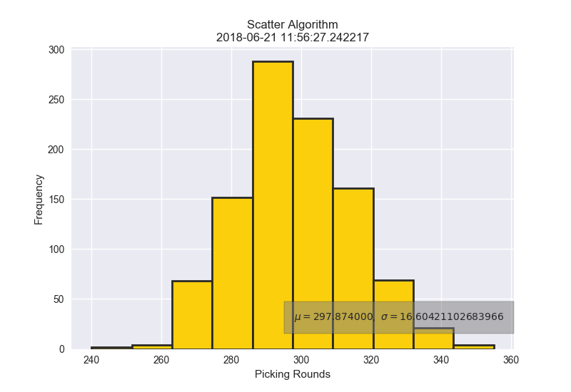
Scatter Method

Slide 11

Love Connected <3
Boy\Girl | 0 | 1 | 2 | 3 | 4 | 5 | 6 | … | 100
0 | X | 1/99 | 1/99 | 1/99 | 1/99 | 1/99 | 1/99 | 1/99 | 1/99
1 | 1/99 | 1/100 | 1/100 | 1/100 | 1/100 | 1/100 | 1/100 | 1/100 | 1/100
2 | 1/99 | 1/100 | 1/100 | 1/100 | 1/100 | 1/100 | 1/100 | 1/100 | 1/100
3 | 1/99 | 1/100 | 1/100 | 1/100 | 1/100 | 1/100 | 1/100 | 1/100 | 1/100
4 | 1/99 | 1/100 | 1/100 | 1/100 | 1/100 | 1/100 | 1/100 | 1/100 | 1/100
5 | 1/99 | 1/100 | 1/100 | 1/100 | 1/100 | 1/100 | 1/100 | 1/100 | 1/100
6 | 1/99 | 1/100 | 1/100 | 1/100 | 1/100 | 1/100 | 1/100 | 1/100 | 1/100
… | 1/99 | 1/100 | 1/100 | 1/100 | 1/100 | 1/100 | 1/100 | 1/100 | 1/100
100 | 1/99 | 1/100 | 1/100 | 1/100 | 1/100 | 1/100 | 1/100 | 1/100 | 1/100

Slide 12
How do we get the probability

Slide 13
Conditional probability of simple version
1st Round：pick (X1 , Y4) & (X2 , Y3)
 | X1 | X2 | X3 | X4 | X5
Y1
Y2
Y3 |  | 0
Y4 | 0
Y5

Slide 14
Conditional probability of simple version
1st Round：pick (X1 , Y4) & (X2 , Y3)
 | X1 | X2 | X3 | X4 | X5
Y1
Y2
Y3 | 4/13 | 0
Y4 | 0 | 4/13
Y5
$$\frac{P(!\left(X1 , Y4\right) and !\left(X2 , Y3\right) and (X1 , Y3))}{P(!\left(X1 , Y4\right) and !(X2 , Y3))}=\frac{P((X1 , Y3))}{P(!\left(X1 , Y4\right) and !(X2 , Y3))}=\frac{4! }{5!−2×4!+3! }=\frac{4}{13}$$

Slide 15
Conditional probability of simple version
1st Round：pick (X1 , Y4) & (X2 , Y3)
 | X1 | X2 | X3 | X4 | X5
Y1 | 3/13 | 3/13
Y2 | 3/13 | 3/13
Y3 | 4/13 | 0 | 3/13 | 3/13 | 3/13
Y4 | 0 | 4/13 | 3/13 | 3/13 | 3/13
Y5 | 3/13 | 3/13

Slide 16
Conditional probability of simple version
1st Round：pick (X1 , Y4) & (X2 , Y3)
 | X1 | X2 | X3 | X4 | X5
Y1 | 3/13 | 3/13 | 7/39 | 7/39 | 7/39
Y2 | 3/13 | 3/13 | 7/39 | 7/39 | 7/39
Y3 | 4/13 | 0 | 3/13 | 3/13 | 3/13
Y4 | 0 | 4/13 | 3/13 | 3/13 | 3/13
Y5 | 3/13 | 3/13 | 7/39 | 7/39 | 7/39

Slide 17
Conditional probability of simple version
Principle of inclusion and exclusion is needed!
(When a person can be picked more than once in a round, then the rook polynomial is needed!)

Slide 18
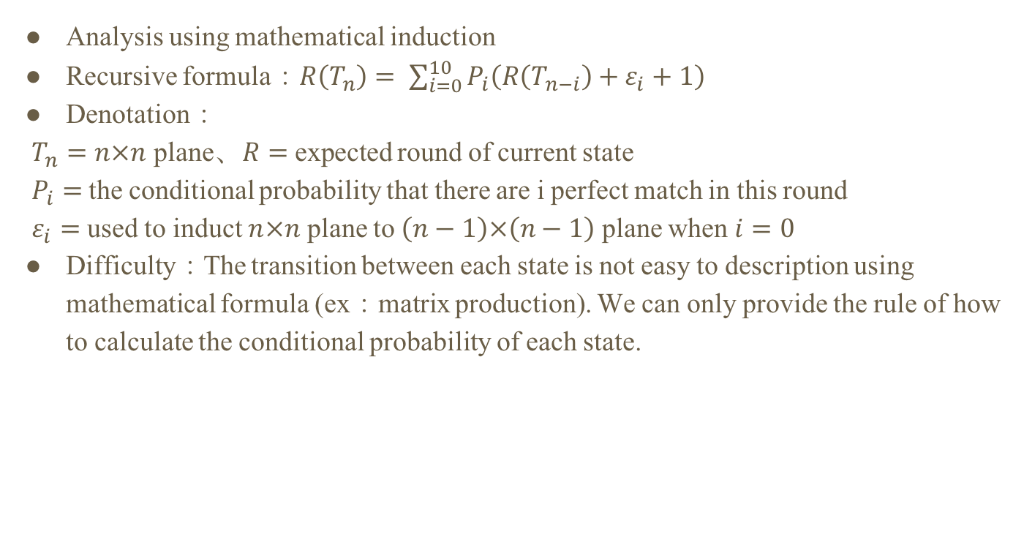
Conditional probability of simple version
Analysis using mathematical induction
Recursive formula：$R\left(T_{n}\right)= \sum_{i=0}^{10}{P_{i}\left(R\left(T_{n−i}\right)+ε_{i}+1\right)}$
Denotation：
$T_{n}=n×n$ plane、$R=$expected round of current state
$P_{i}=$the conditional probability that there are i perfect match in this round
$ε_{i}=$used to induct $n×n$ plane to $\left(n−1\right)×\left(n−1\right)$ plane when $i=0$
Difficulty：The transition between each state is not easy to description using mathematical formula (ex：matrix production). We can only provide the rule of how to calculate the conditional probability of each state.

Slide 19
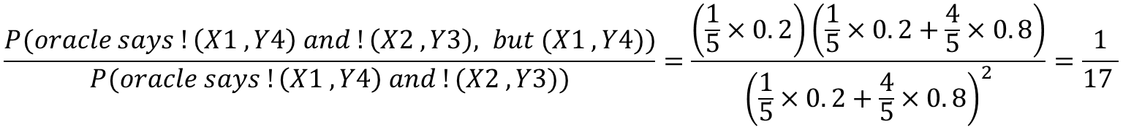
Conditional probability of difficult version
1st Round：pick (X1 , Y4) & (X2 , Y3), and oracle says both of them are mismatch
 | X1 | X2 | X3 | X4 | X5
Y1
Y2
Y3 |  | 1/17
Y4 | 1/17
Y5
$$\frac{P(oracle says !\left(X1 , Y4\right) and !\left(X2 , Y3\right), but (X1 , Y4))}{P(oracle says !\left(X1 , Y4\right) and !(X2 , Y3))}=\frac{\left(\frac{1}{5}×0. 2\right)\left(\frac{1}{5}×0. 2+\frac{4}{5}×0. 8\right)}{{\left(\frac{1}{5}×0. 2+\frac{4}{5}×0. 8\right)}^{2}}=\frac{1}{17 }$$

Slide 20
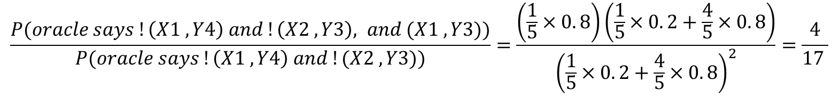
Conditional probability of difficult version
1st Round：pick (X1 , Y4) & (X2 , Y3), and oracle says both of them are mismatch
 | X1 | X2 | X3 | X4 | X5
Y1
Y2
Y3 | 4/17 | 1/17
Y4 | 1/17 | 4/17
Y5
$$\frac{P(oracle says !\left(X1 , Y4\right) and !\left(X2 , Y3\right), and (X1 , Y3))}{P(oracle says !\left(X1 , Y4\right) and !(X2 , Y3))}=\frac{\left(\frac{1}{5}×0. 8\right)\left(\frac{1}{5}×0. 2+\frac{4}{5}×0. 8\right)}{{\left(\frac{1}{5}×0. 2+\frac{4}{5}×0. 8\right)}^{2}}=\frac{4}{17 }$$

Slide 21
Conditional probability of difficult version
1st Round：pick (X1 , Y4) & (X2 , Y3), and oracle says both of them are mismatch
 | X1 | X2 | X3 | X4 | X5
Y1 | 4/17 | 4/17
Y2 | 4/17 | 4/17
Y3 | 4/17 | 1/17 | 4/17 | 4/17 | 4/17
Y4 | 1/17 | 4/17 | 4/17 | 4/17 | 4/17
Y5 | 4/17 | 4/17

Slide 22
Conditional probability of difficult version
1st Round：pick (X1 , Y4) & (X2 , Y3), and oracle says both of them are mismatch
 | X1 | X2 | X3 | X4 | X5
Y1 | 4/17 | 4/17 | 3/17 | 3/17 | 3/17
Y2 | 4/17 | 4/17 | 3/17 | 3/17 | 3/17
Y3 | 4/17 | 1/17 | 4/17 | 4/17 | 4/17
Y4 | 1/17 | 4/17 | 4/17 | 4/17 | 4/17
Y5 | 4/17 | 4/17 | 3/17 | 3/17 | 3/17

Slide 23
Conditional probability of difficult version
The analysis is the same as simple version.
Using mathematical induction.
But the calculation of conditional probability is more difficult.

Slide 24
Brute Force Solution
DFS

Slide 25
DFS (3x3, 1 query per time)
x | ? | ?
? | x | ?
? | ? | ?
E(Rounds) = 1 * 1/3 + 1 * 2/3 = 1
x | 2/3 | 1/3
2/3 | x | 1/3
1/3 | 1/3 | 1/3
E(Rounds) = 1 * 1/3 + 2 * 1/3 = 5/3
x
? | x
x
 | x | ?
P = 1/3
P = 2/3
P = 2/3
P = 1/3
x
x | x
x
v | x
x
 | x | x
x
 | x | v
P = 1
x
 | x | x
Use different p for simple/difficult version !

Slide 26
Thank you
Our github repo is at https://github.com/Nicetiesniceties/2018_Probability_Final_Project.git

