Slide 1
Thinning Operator
2018/11/20

Slide 2

Homework 7
Threshold: 128
1, if pixel > 127
0, if pixel < 128
Downsample image to 64 x 64 pixels
Do thinning operator (4 connected)

Slide 3
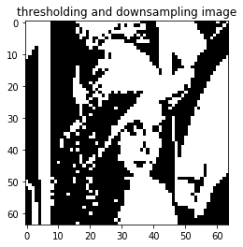
Homework 7 - Result

Slide 4
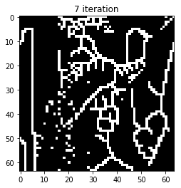
Homework 7 - Result

Slide 5
Thinning Operator
Create marked image
Yokoi Operator
Pair Relationship Operator
Connected Shrink Operator
Compare the shrink result with marked image

Slide 6
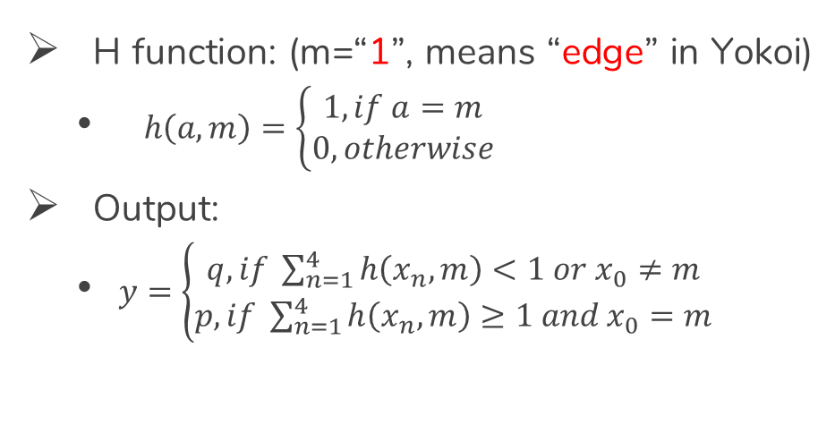
Pair Relationship Operator
H function: (m=“1”, means “edge” in Yokoi)
$h\left(a, m\right)=\left\{\begin{matrix}1, if a=m \\ 0, otherwise\end{matrix}\right.$
Output:
$y=\left\{\begin{matrix}q, if \sum_{n=1}^{4}{h\left(x_{n}, m\right)<1 or x_{0}≠m} \\ p, if \sum_{n=1}^{4}{h\left(x_{n}, m\right)≥1 and x_{0}=m}\end{matrix}\right.$

Slide 7
Pair Relationship Operator
original image
Yokoi result
* | *
 | * | *
 |  | * | *
 |  | * | *
 |  | * | *
1 | 2
 | 2 | 2
 |  | 2 | 1
 |  | 1 | 1
 |  | 1 | 1

Slide 8
Pair Relationship Operator
 | 1 | 2
 |  | 2 | 2
 |  |  | 2 | 1
 |  |  | 1 | 1
 |  |  | 1 | 1
 | q

Slide 9
Pair Relationship Operator
 | 1 | 2
 |  | 2 | 2
 |  |  | 2 | 1
 |  |  | 1 | 1
 |  |  | 1 | 1
 | q | q

Slide 10
Pair Relationship Operator
 | 1 | 2
 |  | 2 | 2
 |  |  | 2 | 1
 |  |  | 1 | 1
 |  |  | 1 | 1
 | q | q
 |  | q | q
 |  |  | q | p

Slide 11
Pair Relationship Operator
 | 1 | 2
 |  | 2 | 2
 |  |  | 2 | 1
 |  |  | 1 | 1
 |  |  | 1 | 1
 | q | q
 |  | q | q
 |  |  | q | p
 |  |  | p

Slide 12
Pair Relationship Operator
 | 1 | 2
 |  | 2 | 2
 |  |  | 2 | 1
 |  |  | 1 | 1
 |  |  | 1 | 1
 | q | q
 |  | q | q
 |  |  | q | p
 |  |  | p | p

Slide 13
Pair Relationship Operator
 | 1 | 2
 |  | 2 | 2
 |  |  | 2 | 1
 |  |  | 1 | 1
 |  |  | 1 | 1
 | q | q
 |  | q | q
 |  |  | q | p
 |  |  | p | p
 |  |  | p

Slide 14
Pair Relationship Operator
 | 1 | 2
 |  | 2 | 2
 |  |  | 2 | 1
 |  |  | 1 | 1
 |  |  | 1 | 1
 | q | q
 |  | q | q
 |  |  | q | p
 |  |  | p | p
 |  |  | p | p

Slide 15
Pair Relationship Operator
marked image
original image
q | q
 | q | q
 |  | q | p
 |  | p | p
 |  | p | p
* | *
 | * | *
 |  | * | *
 |  | * | *
 |  | * | *

Slide 16
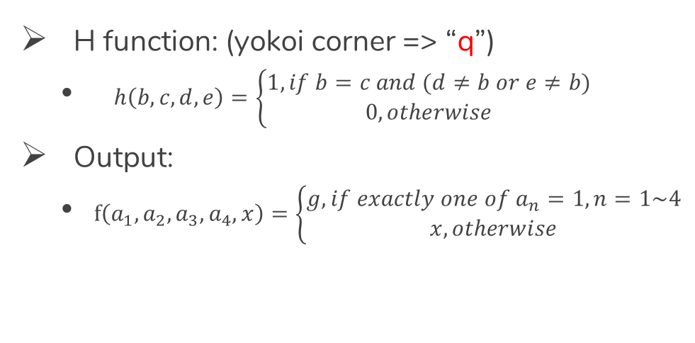
Connected Shrink Operator
H function: (yokoi corner => “q”)
$h\left(b, c, d, e\right)=\left\{\begin{matrix}1, if b=c and (d≠b or e≠b) \\ 0, otherwise\end{matrix}\right.$
Output:
$f\left(a_{1},a_{2},a_{3},a_{4}, x\right)=\left\{\begin{matrix}g, if exactly one of a_{n}=1, n=1\sim 4 \\ x, otherwise\end{matrix}\right.$

Slide 17
Thinning Operator
marked image
original image
q | q
 | q | q
 |  | q | p
 |  | p | p
 |  | p | p
* | *
 | * | *
 |  | * | *
 |  | * | *
 |  | * | *

Slide 18
Thinning Operator
q | q
 | q | q
 |  | q | p
 |  | p | p
 |  | p | p
* | *
 | * | *
 |  | * | *
 |  | * | *
 |  | * | *
* | *
 | * | *
 |  | *
 |  | * | *
 |  | * | *

Slide 19
Thinning Operator
q | q
 | q | q
 |  | q | p
 |  | p | p
 |  | p | p
* | *
 | * | *
 |  | *
 |  | * | *
 |  | * | *
* | *
 | * | *
 |  | *
 |  | * | *
 |  | * | *

Slide 20
Thinning Operator
q | q
 | q | q
 |  | q | p
 |  | p | p
 |  | p | p
* | *
 | * | *
 |  | *
 |  | * | *
 |  | * | *
* | *
 | * | *
 |  | *
 |  | *
 |  | * | *

Slide 21
Thinning Operator
q | q
 | q | q
 |  | q | p
 |  | p | p
 |  | p | p
* | *
 | * | *
 |  | *
 |  | *
 |  | * | *
* | *
 | * | *
 |  | *
 |  | *
 |  | * | *

Slide 22
Thinning Operator
q | q
 | q | q
 |  | q | p
 |  | p | p
 |  | p | p
* | *
 | * | *
 |  | *
 |  | *
 |  | * | *
* | *
 | * | *
 |  | *
 |  | *
 |  | *

