Slide 1
Skin Cancer Detection
Using BLIP and LLM

Slide 2
TEAM MEMBERS
Prof : Dr.HariKishan Kondaveeti
KAKUMANU NICHAL HAAS – 22BCE9651
B KEERTHAN - 22BCE8216
RUDRAPAATI YASHASWINI - 22BCE20469
DEVANSH CHHIBBER - 22BCE7919

Slide 3
Vision & Goal
Vision:
To build an AI-assisted system that can help dermatologists and healthcare professionals in early detection of skin cancer.
Combine Vision-Language Models (BLIP) with Large Language Models (LLM) to provide explainable diagnosis (caption + reasoning).
Enable accessible and affordable diagnostic support for patients worldwide.
Goal:
Use BLIP to generate descriptive captions from dermoscopy images.
Leverage an LLM (Flan-T5) to classify captions into one of 9 cancer types with reasoning.
Train, validate, and test the pipeline on the ISIC Skin Cancer Dataset.
Achieve high accuracy while ensuring explainability and interpretability of predictions.

Slide 4
Core Objectives
Automated Captioning: Use BLIP to convert dermoscopy images into meaningful captions.
Disease Classification: Employ an LLM (Flan-T5) to classify captions into 9 skin cancer categories.
Explainability: Provide reasoning behind each prediction for transparent medical AI.
Performance Evaluation: Measure accuracy, precision, and recall to validate effectiveness.
Scalability: Design a pipeline that can be extended to other medical imaging domains.

Slide 5
Key Components
Dataset: ISIC Skin Cancer (9 classes)
Image Captioning: BLIP model for generating captions
LLM Classification: Flan-T5 for mapping captions to cancer types
Pipeline: Image → Caption → Diagnosis Label + Rationale
Evaluation: Accuracy and reasoning-based assessment

Slide 6
Tools and Technologies
Python – Core programming language
PyTorch – Deep learning framework
Transformers (Hugging Face) – BLIP & Flan-T5 models
Pandas, NumPy, Scikit-learn – Data handling & evaluation
PIL (Pillow) – Image processing
Kaggle – Dataset source (ISIC Skin Cancer)

Slide 7
DataSet
Source: Kaggle – Skin Cancer ISIC: The International Skin Imaging Collaboration
Classes: 9 types of skin conditions
Actinic Keratosis
Basal Cell Carcinoma
Dermatofibroma
Melanoma
Nevus
Seborrheic Keratosis
Squamous Cell Carcinoma
Vascular Lesion
Normal
Format: Images (.jpg / .png) organized by class folders
Scale: Thousands of labeled images for training & testing
Link: https://www.kaggle.com/datasets/nodoubttome/skin-cancer9-classesisic

Slide 8
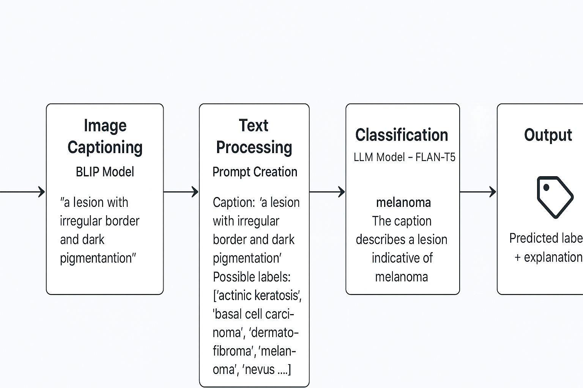
Workflow
Image → Caption (BLIP) → Prompt → LLM → Prediction​
Input Image → Skin cancer image provided to the system
Image Captioning (BLIP Model) → Generates descriptive text (caption) for the input image
Text Processing (Prompt Creation) → Caption + possible cancer types structured into a prompt
Classification (LLM Model – FLAN-T5) → Predicts most likely skin cancer type with reasoning
Output → Predicted cancer label + explanation

Slide 9
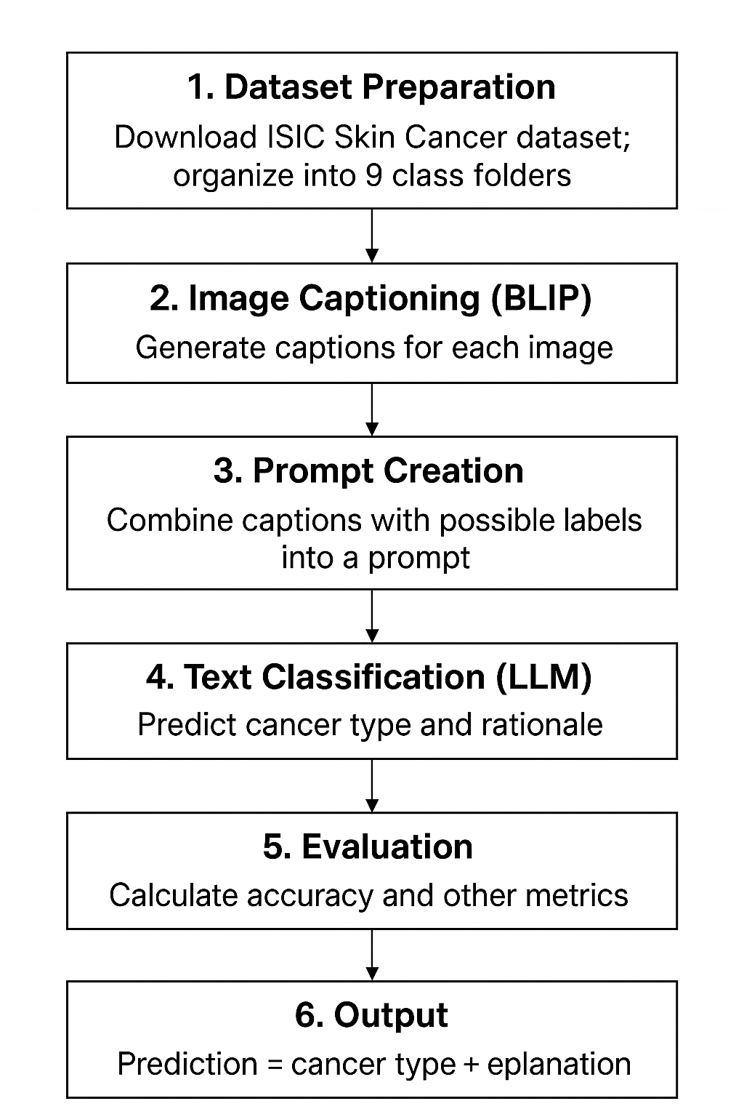
Procedure
Code:https://colab.research.google.com/drive/199NG6zWJH1D4oxNjidC-nCs5ZOSrizzq?usp=sharing​
Dataset Preparation
Download ISIC Skin Cancer dataset from Kaggle.
Organize images into 9 folders (one per class).
Create a DataFrame linking each image path with its label.
Image Captioning (BLIP)
Load BLIP model (Salesforce/blip-image-captioning-base).
Pass each image through BLIP to generate a descriptive caption.
Save captions alongside image paths and labels in a CSV file.
Prompt Creation
Define a set of possible skin cancer labels.
Construct a structured prompt combining:
Generated caption
List of possible labels
Instruction for LLM to classify and explain

Slide 10
Text Classification (LLM)
Use a free Hugging Face LLM (e.g., google/flan-t5-large).
Feed the structured prompt into the LLM.
Collect predicted label + rationale for each caption.
Evaluation
Compare LLM predictions with true dataset labels.
Calculate accuracy, precision, recall, and F1-score.
Generate a confusion matrix to visualize class-wise performance.
Output
Final result = Predicted skin cancer type + reasoning (explanation).
Save predictions and evaluation metrics for reporting.

Slide 11
Future Enhancements
Fine-Tuning the Model
Currently, BLIP generates captions and the LLM classifies based on text.
By fine-tuning BLIP and the LLM on the skin cancer dataset, the models will learn domain-specific features.
This improves caption quality and classification accuracy since the model adapts directly to medical images.
Improving Accuracy with Better Resources
Use premium GPUs in Colab (e.g., A100, V100) for faster training and handling larger batch sizes.
This enables fine-tuning on the entire dataset instead of small subsets.
More GPU power allows you to use larger models (e.g., BLIP-2, Mistral-7B, or LLaMA-2) for richer predictions.
Adopting Advanced Paid LLMs (e.g., Grok AI, GPT-4)
Paid LLMs have stronger reasoning and understanding.
They can provide more accurate classifications and medical-style rationales.
Integration with Grok AI (X’s premium model) or GPT-4 ensures high-quality outputs, especially in complex edge cases.

Slide 12
References
BLIP: Bootstrapping Language-Image Pre-training – Salesforce Research – Model: Salesforce/blip-image-captioning-base – https://huggingface.co/Salesforce/blip-image-captioning-base
FLAN-T5 (Instruction-Tuned Language Model) – Google Research – Model: google/flan-t5-large – https://huggingface.co/google/flan-t5-large
Skin Cancer ISIC Dataset (9 Classes) – Kaggle: Skin cancer ISIC The International Skin Imaging Collaboration – https://www.kaggle.com/datasets/nodoubttome/skin-cancer9-classesisic
Hugging Face Transformers Library – https://huggingface.co/transformers
PyTorch (Deep Learning Framework) – https://pytorch.org/

