Slide 1
Neural Network Zoo:
Why the Wolf Spider Represents a GNN
Graph Neural Networks • Animal Metaphor • Message Passing

Slide 2
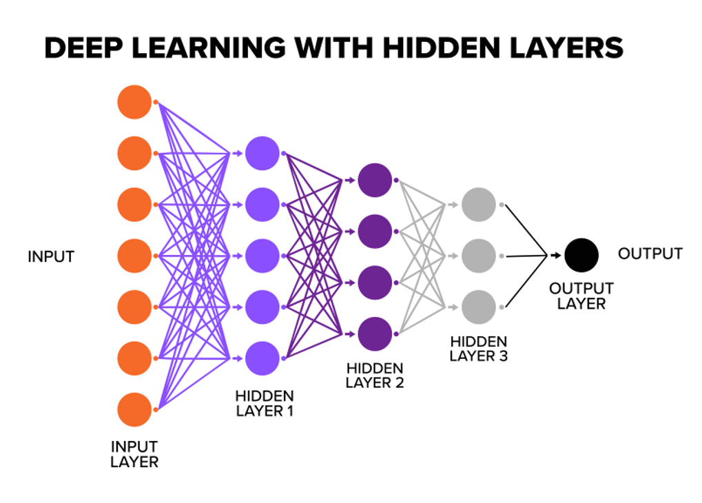
What is Deep Learning and Neural Networks?
What Is Deep Learning?
It is a branch of artificial intelligence that uses multi-layer neural networks to learn complex patterns from data. For example, a network can learn to recognize features in an image. This ability allows Deep Learning to be used in different areas of artificial intelligence.
Important concepts:
  Uses artificial neural networks.
  Features multiple processing layers.
  Learn complex patterns from data.
  Used for images, audio, text, and video.

Slide 3
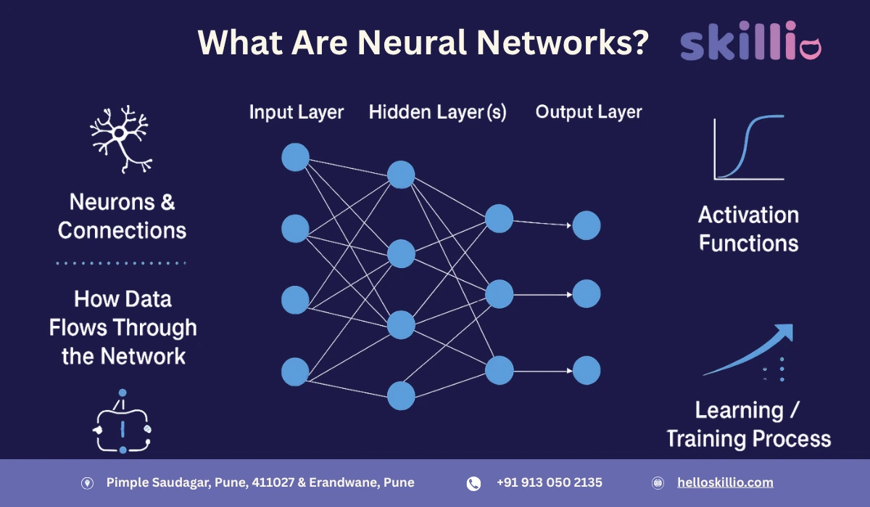
What Is a Neural Network?
Neural networks are made of artificial neurons connected to each other, but each neuron receives information, processes it, and produces an output.
Neurons are organized into layers: an input layer, hidden layers, and an output layer. This organization allows the network to process information and learn patterns.
Neurons Organization:
Input Layer → Hidden Layers → Output Layer

Slide 4
How Does a Neural Network Learn?
Neural networks learn through a training process because it receives data and produces predictions. Then, it compares that prediction with the expected result and adjusts its weights to reduce the error. When repeating this process with many examples, the network learns patterns that help make better predictions.
Process:
Data → Prediction → Comparison → Weight Adjustment → Better Prediction
The Neural Network Zoo:
Just as animals have unique capabilities for survival, different neural network architectures specialize in distinct tasks. Our team explores this concept through our chosen model and animal analogy.

Slide 5
Where Does a GNN Fit?
Deep learning expands neural networks by stacking many layers.
Different architectures are designed for different kinds of data:
  Images → Convolutional Neural Networks (CNNs)
  Sequences → Recurrent/Transformer-based models
  Graphs → Graph Neural Networks (GNNs)
A GNN is specialized for data where relationships between things are important.

Slide 6
The Basic Idea of a Graph
A graph is a way to represent entities and the relationships between them.
Nodes = the entities or objects.
Edges = the relationships or connections.
Examples: people connected by friendships, cities connected by roads, or atoms connected by chemical bonds.
B
A
C
D
E

Slide 7
How Does a GNN Learn? — Message Passing
1. Each node receives information from its neighboring nodes.
2. It combines the neighbors’ information with its own features.
3. It updates its internal representation.
4. After several rounds, each node captures information about its local neighborhood and the larger graph.
B
A
C
D
E

Slide 8
Why Are GNNs Useful?
GNNs are useful when relationships are as important as the individual data points.
Molecules → predict properties and behavior
Fraud detection → identify suspicious relationship patterns
Social networks → analyze communities and connections
Recommendation systems → connect users, products, and interactions
Traffic and route optimization → model roads, intersections, and routes

Slide 9
Choosing the Animal: Three Candidates
Our challenge: choose an animal that communicates the most important GNN ideas.
🐺 Wolf — teamwork and communication
🕷️ Spider — webs, connections, and signals
🕷️🐺 Wolf spider — combines the strengths of both metaphors
Key question: Which animal best represents connectivity + information flow?

Slide 10
Candidate #1 — Wolf
Pros
  Wolves operate in packs, loosely resembling nodes interacting.
  They communicate and coordinate, suggesting message passing.
Cons
  A wolf pack is not a structured network of nodes and edges.
  Pack relationships are more social/hierarchical than graph-like.
  The wolf does not naturally communicate network topology.
Conclusion: The wolf represents teamwork, but it is the weakest fit for GNN structure.

Slide 11
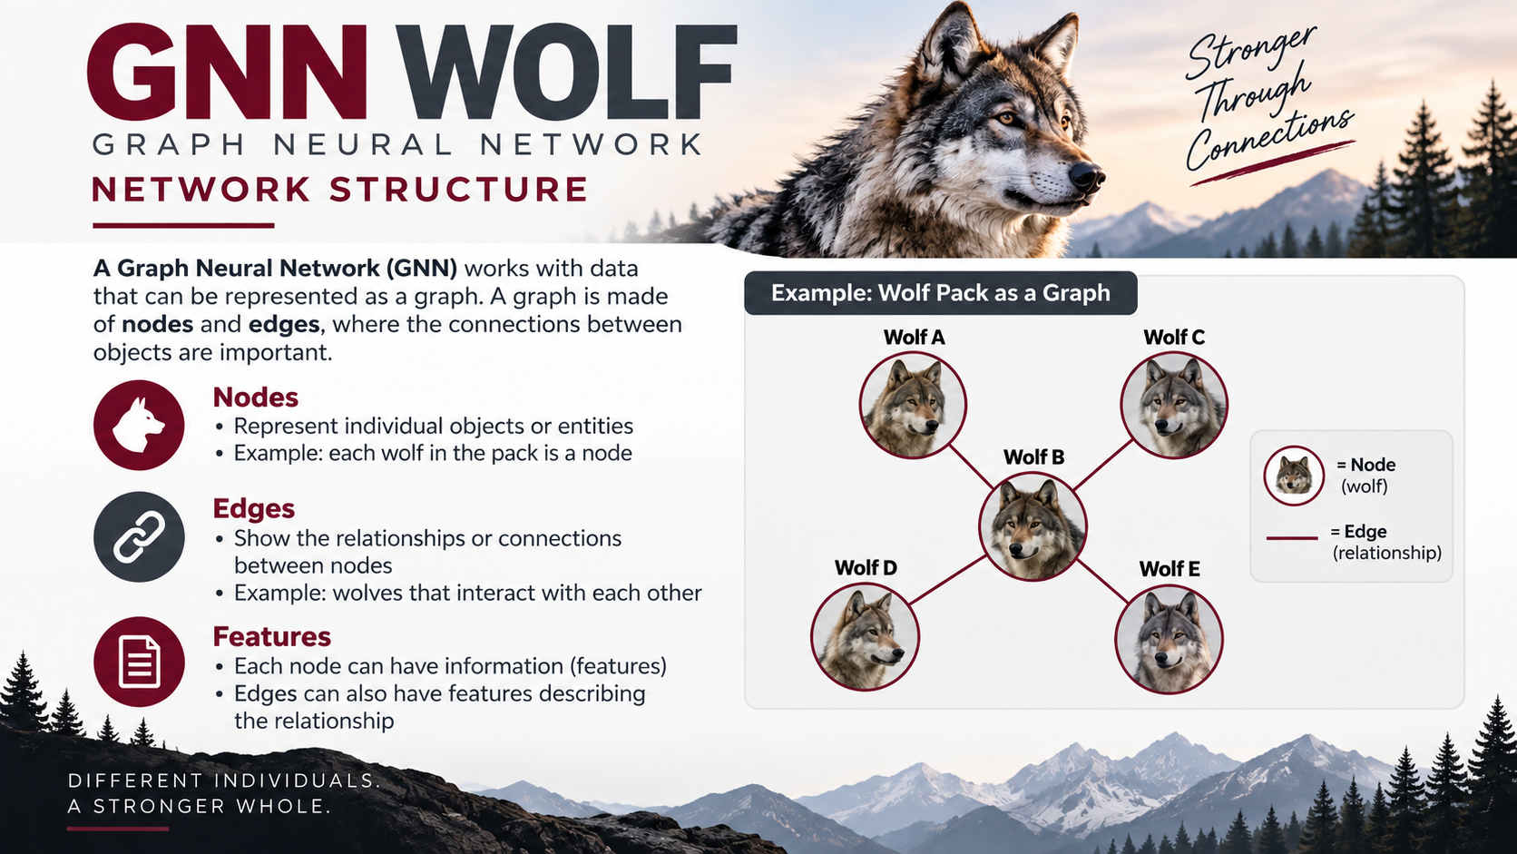


Slide 12
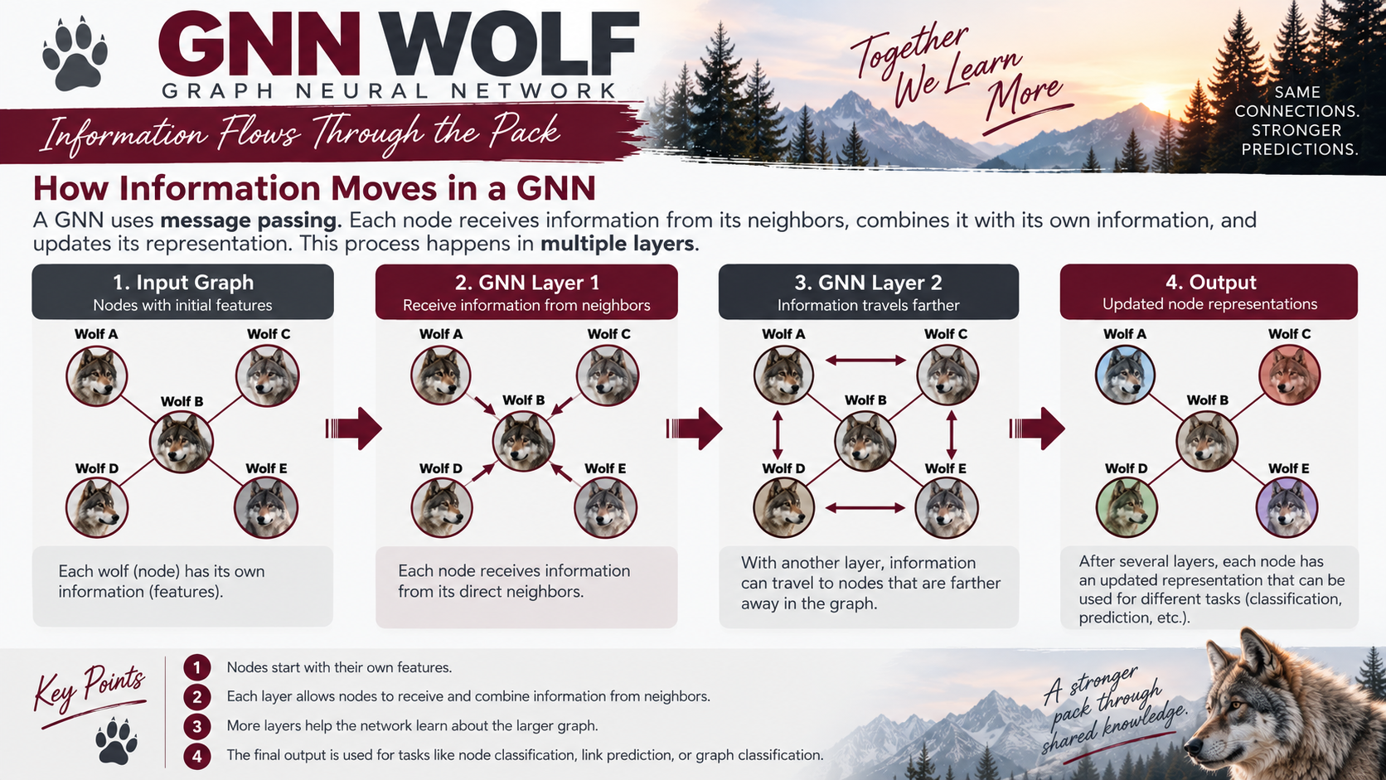

Slide 13
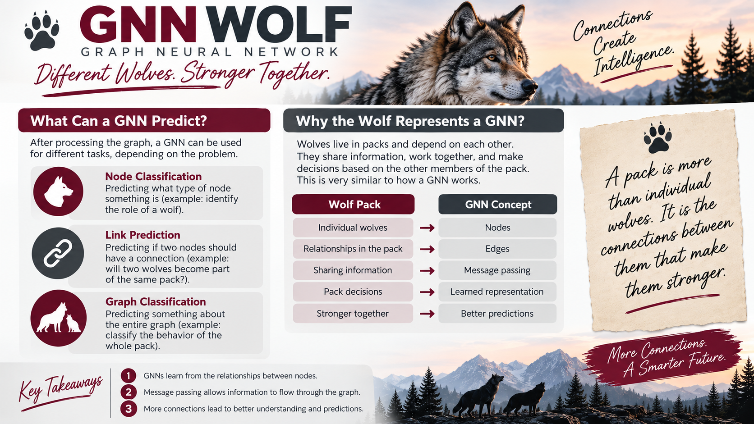

Slide 14
Candidate #2 — Spider
Pros
  A spider web is a literal network of connected points and pathways.
  The web visually resembles nodes and edges.
  A spider can detect vibrations traveling through the web — a useful analogy for information flow.
Cons
  The basic spider metaphor can feel generic.
  Not all spiders build capture webs.
Conclusion: The spider is much closer to GNNs, especially for connectivity and message passing.

Slide 15
Candidate #3 — Wolf Spider: The Final Choice
The wolf spider combines the strengths of the two metaphors.
🐺 Wolf → individual awareness and active interaction with the environment.
🕷️ Spider → sensing signals and navigating a connected environment.
The hybrid name mirrors the hybrid nature of a GNN: node features + relational structure.
Important clarification: wolf spiders do not build capture webs. The “web” is conceptual — the GNN’s network is a structure of nodes and edges.
The metaphor focuses on information propagation, not literal web construction.

Slide 16
Why the Wolf Spider Wins
Nodes → sensory points / individual processing units
Edges → pathways through which signals or information can be related
Message passing → information from the surrounding connected structure influences a node
Graph structure → the interconnected environment being analyzed
Most importantly: the analogy makes an abstract GNN easier to explain visually.
Final argument: The spider represents the graph; the wolf represents active interaction; the wolf spider brings the ideas together.

Slide 17
Why GNNs Matter in the Real World
GNNs are especially useful when the relationships between data points matter as much as the points themselves
Fraud Detection:
Transactions can be modeled as a graph of customers, accounts, merchants, and transfers. GNNs can detect suspicious relationship patterns that traditional methods may miss because they analyze the network structure itself.
Bank accounts + transactions → suspicious network patterns → fraud alert
Recommendation Systems:
Users, products, clicks, purchases, and ratings naturally form interconnected graphs. GNNs can learn from these relationships to improve recommendations rather than treating users or products as isolated records.
Users + products → interaction patterns → recommendation
Molecular & Biological Modeling:
Atoms can be represented as nodes and chemical bonds as edges, which makes molecular data inherently graph-structured. GNNs are widely used in biology and molecular analysis because the relationships among components are central to prediction.
Atoms + bonds → molecular relationships → property prediction

Slide 18
References and Contributions:
Slides 2-4: What are Neural Networks and Deep Learning (Cesar Noriega)
Slides 11 - 13: GNN Wolf (Luiz Paludo)
Slide 17: Why GNNs Matter in the Real World (Nichelle Graf)
    Motie, S., & Raahemi, B. (2024). Financial fraud detection using graph neural networks: A systematic review. Expert Systems with Applications, 240, 122156.
  Wu, S., Sun, F., Zhang, W., Xie, X., & Cui, B. (2022). “Graph Neural Networks in Recommender Systems: A Survey.” ACM Computing Surveys, 55(5).
  DOI: 10.1145/3535101.
  Corso, G., Stark, H., Jegelka, S., Jaakkola, T., & Barzilay, R. (2024). “Graph Neural Networks.” Nature Reviews Methods Primers, 4, Article 17.
  DOI: 10.1038/s43586-024-00294-7.
  Chen, J., & Yang, Y. (2026). “Real-time Dynamic Graph Learning with Temporal Attention for Financial Fraud Detection.” Frontiers in Artificial
  Intelligence, 9, 1774013. DOI: 10.3389/frai.2026.1774013.
All other Slides: MaryAnn Mastri

