Slide 1

COURSE PORTFOLIO
Natural Language
Processing
Nichelle Graf
AI Focus: Bridging the gap between humans and machine
Applied Artificial Intelligence & Robotics
Houston City College
ITAI 2373 – NLP | Spring 2026
Professor Anna Devarakonda
https://github.com/Nichelleg/AI-Portfolio-Nichelle-Graf

Slide 2

Learning Journey
https://github.com/Nichelleg/AI-Portfolio-Nichelle-Graf
Foundation: Trade Tools, Toolkits & Text Processing
GitHub · Jupyter · VS Code · Python · NLTK · spaCy · Pandas
Core NLP: Text Representation / POS / Semantic Analysis
BoW · TF-IDF · N-Grams · Scikit-Learn · Matplotlib
Machine Learning: Sentiment & Emotion / Text Classification
VADER · TextBlob · DataFrames · Seaborn
Advanced Techniques: LLMs / Machine Translation / Topic Modeling LDA · NMF · NER · Conversational AI
Final Project: NewsBot Intelligence System 2.0
Kaggle · Production-Ready Platform · Multi-Pipeline NLP

Slide 3
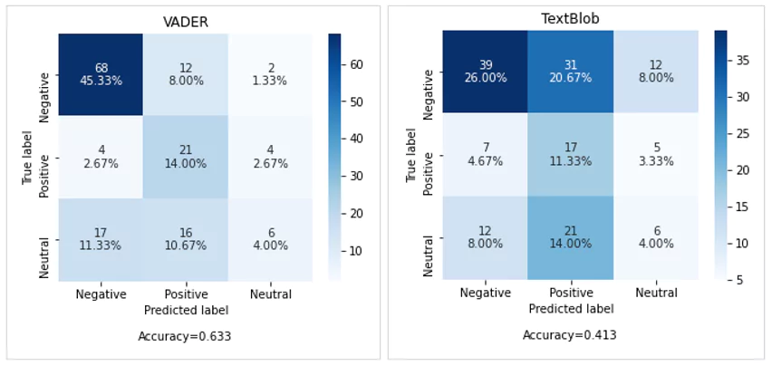
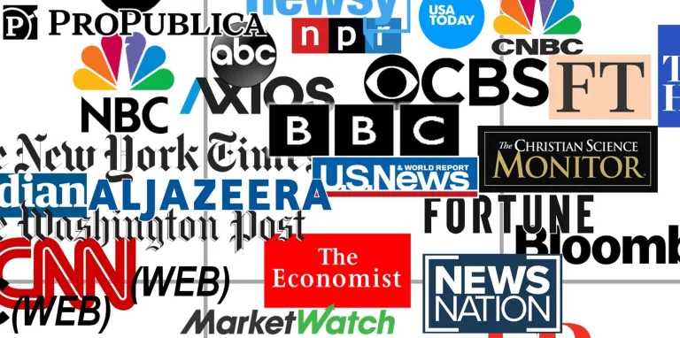
Featured Projects
https://github.com/Nichelleg/AI-Portfolio-Nichelle-Graf
Sentiment & Emotion
Analysis Lab
1
Multi-library pipeline comparing VADER and TextBlob across social media, reviews, and news datasets.
Pandas · Seaborn · DataFrames
NewsBot Intelligence System
(Development) Midterm Project
2
3
NewsBot 2.0 Enhancement
(Production Platform) Final Project
Advanced News Content Analysis:
Topic modelling > Multi-class
classification > Querying > Interpretable outputs.
TF-IDF · LDA · NMF · NER · Kaggle

Slide 4
Skills & Competencies
https://github.com/Nichelleg/AI-Portfolio-Nichelle-Graf
NLP CORE
TEXT REPRESENTATION
ML PIPELINE
Tokenization & POS Tagging
Named Entity Recognition (NER)
Stemming & Lemmatization
Sentiment & Emotion Analysis
Bag of Words (BoW)
TF-IDF Vectorization
N-Grams & Word Embeddings
Topic Modeling: LDA / NMF
Text Classification
Train/Test Evaluation
Preprocessing Pipelines
Bias & Ethics Awareness
TOOLS & LIBRARIES USED THIS SEMESTER
Python
NLTK
spaCy
Pandas
Scikit-Learn
VADER
TextBlob
Seaborn
Jupyter

Slide 5
Reflection & Next Steps
KEY INSIGHTS
NEXT STEPS
→ Preprocessing decisions are as critical as model choice — the same technique can help or hurt depending on context. → Word embeddings changed how I think about meaning: semantic relationships are directions in vector space, not labels. → Every NLP pipeline involves trade-offs between speed, accuracy, and information loss — there is no universal solution. → Ethics isn't a footnote — bias encoded in training data becomes bias encoded in decisions.
01 Explore transformer architectures (BERT, GPT) and fine-tuning for domain-specific NLP tasks.
02 Integrate NewsBot 2.0 with live news APIs for real-time querying and summarization. 03 Apply NLP skills to cybersecurity use cases — log analysis, threat intelligence extraction. 04 Publish annotated Jupyter notebooks to GitHub as a public learning resource for other students.
https://github.com/Nichelleg/AI-Portfolio-Nichelle-Graf

