Slide 1
5 : 3

Slide 2

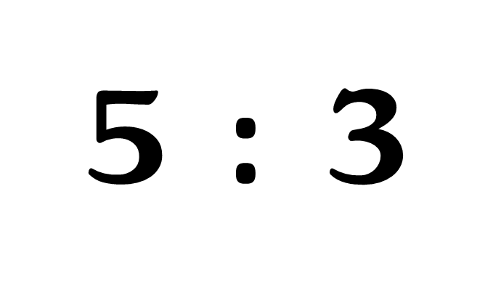
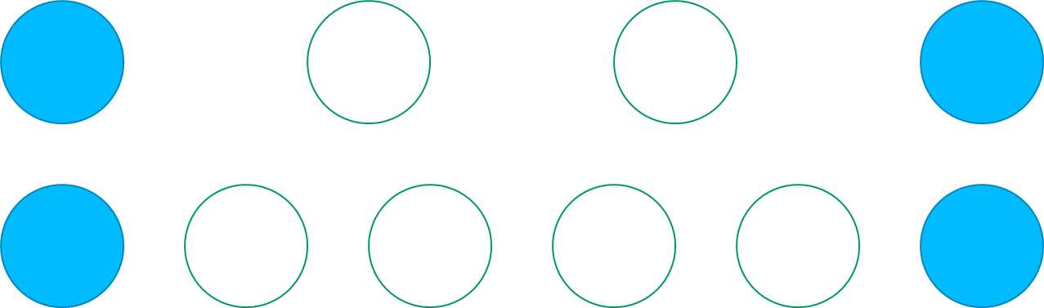

Slide 3

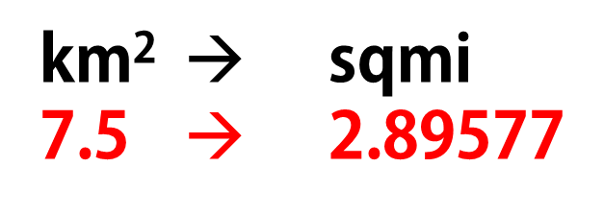
⇌
km² → sqmi
7.5 → 2.89577

Slide 4
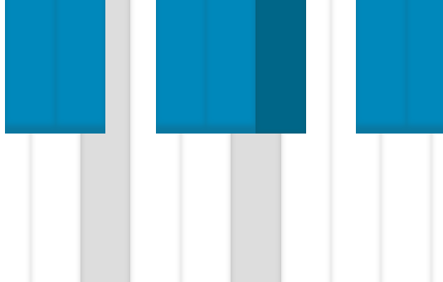
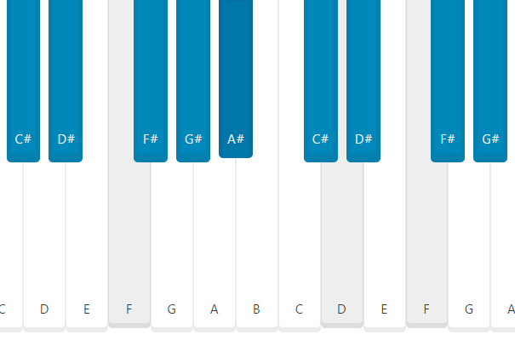

Slide 5
3
4
4
4
5
4
6
8
7
8

Slide 8
WIP :)

