Slide 1
Health Information System
CEMA Internship – Software Engineering Task
Built with FastAPI, PostgreSQL, and Render

Slide 2
Problem Statement
Health institutions need efficient tools to manage clients and programs.
Manual methods are error-prone and inefficient.
A digital, API-first solution helps streamline health program management.

Slide 3
Project Objectives
Allow doctors to register clients and create health programs.
Enable enrollment of clients in one or more programs.
Provide a searchable client directory and detailed profiles.
Expose client data via API for integration with other systems.

Slide 4
Technology Stack
Backend Framework: FastAPI
Database: PostgreSQL
ORM: SQLAlchemy + Alembic
Testing: Pytest
Deployment: Render
Version Control: Git + GitHub

Slide 5
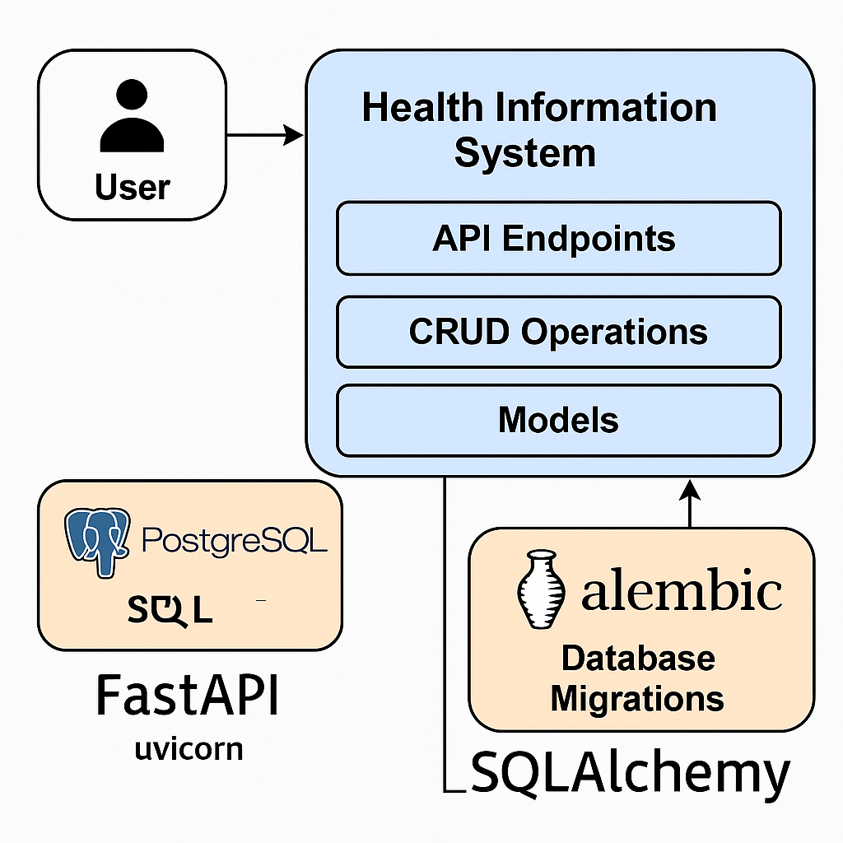
System Design

Slide 6
System Architecture
FastAPI handles all HTTP requests and routing.
SQLAlchemy defines models and interacts with PostgreSQL.
Alembic handles database migrations.
Client and Program tables are relationally linked.
Deployed to cloud via Render.

Slide 7
Core Features
Create, view, and manage health programs (e.g., TB, HIV, Malaria).
Register new clients and enroll them into programs.
View detailed client profiles and program history.
Search clients by name or ID.
Access documentation via Swagger UI.

Slide 8
Live Demo Screenshots
• Root welcome endpoint (GET /)
• Create and retrieve programs (POST/GET /programs)
• Register clients (POST /clients)
• Enroll clients (POST /enrollments)
• Full API docs available at /docs

Slide 9
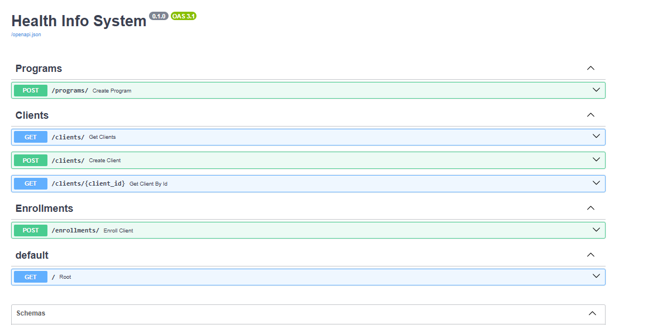

Slide 10
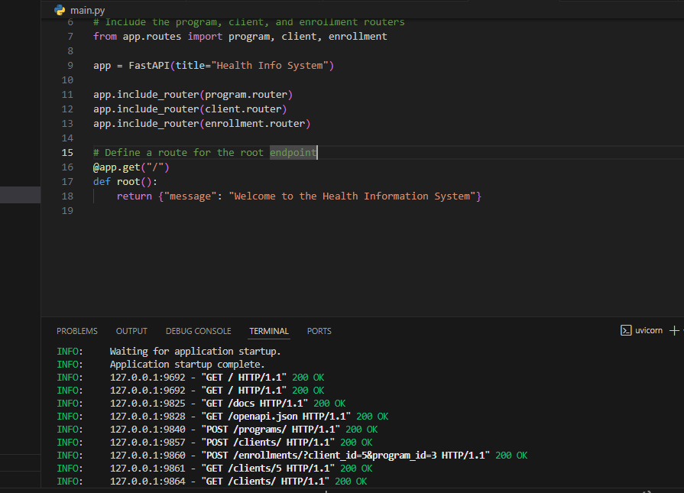

Slide 11
Testing & Deployment
Tested root endpoint using Pytest and FastAPI TestClient.
Deployment automated via Render build and deploy pipeline.
Render runs migrations on start and serves app on public URL.

Slide 12
Security & Best Practices
.env used to manage secrets (DATABASE_URL).
Avoided hardcoding passwords or keys in code.
Clean, modular code with comments and docstrings.
Followed Git best practices (clear commits, .gitignore, env management).

Slide 13
Links & Next Steps
GitHub Repo: https://github.com/Nicholas-Bett/Health-info-system.git
Live API: https://health-info-system-zimv.onrender.com/docs
Next steps: Add authentication, improve testing, add frontend UI.

