Slide 1
Team Power Ranger
CE2006 : Software Engineering
Koh Ji Peng
Mcvie Chua
Wong Wei Jun
Gerrard Hoo
Chew Zhi Jie
Liu Zhiwei

Slide 2

Walkera

Slide 3

Background
People want to stay healthy
Insufficient time to exercise
Lack of guidance
Unable to integrate exercise to daily life

Slide 4

Walkera
Helps with integrating exercise into daily life
Guide you to reach daily step quota
Takes BMI, age, height, weight into consideration

Slide 5
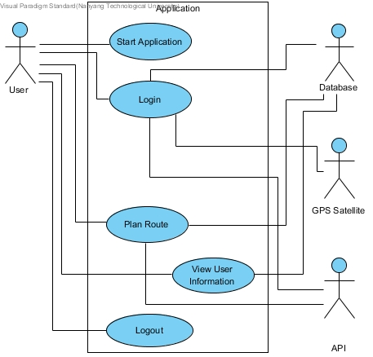
Functionality
Plan Route : Plan based on current/selected location and step quota
View User Information : Able to view recent walking trend
Target : Smartphone Users who want to integrate fitness into daily life.

Slide 6
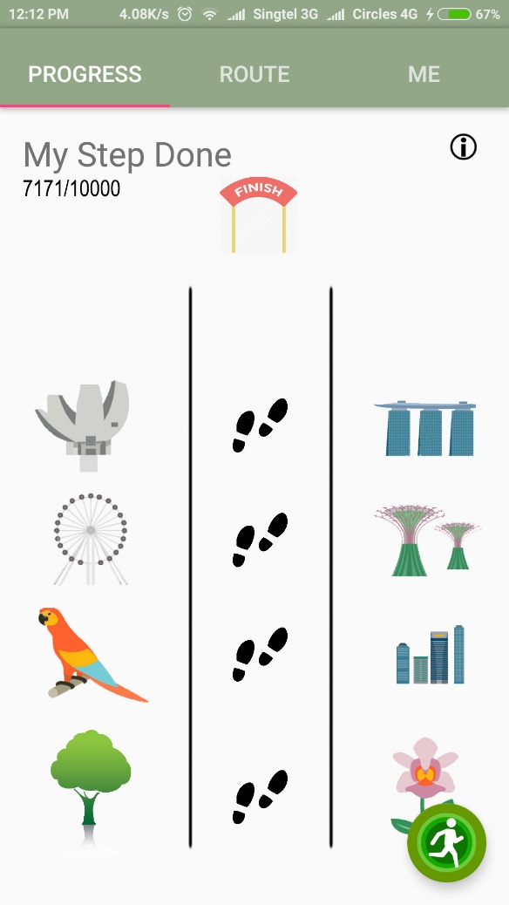
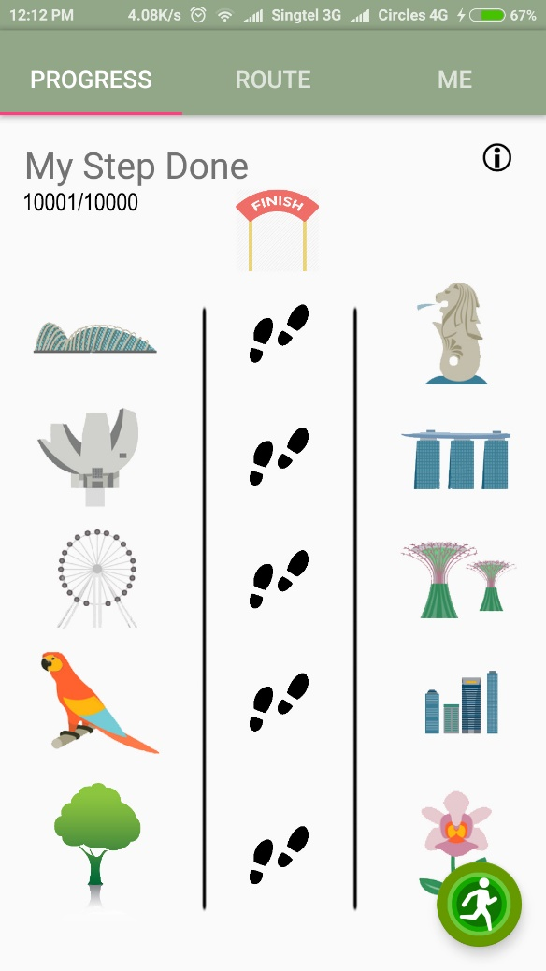
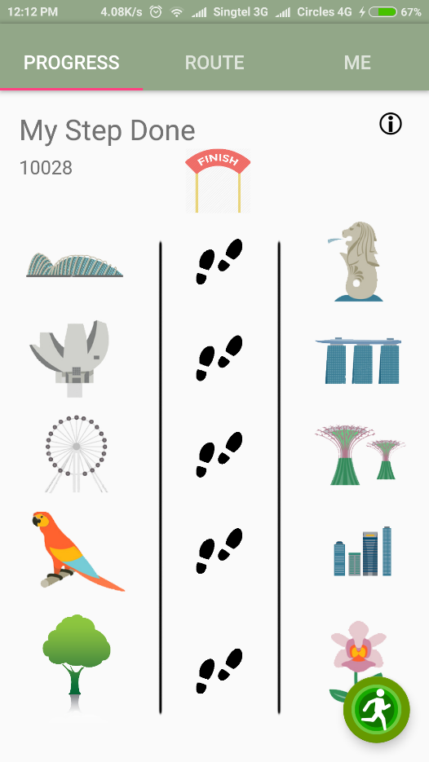
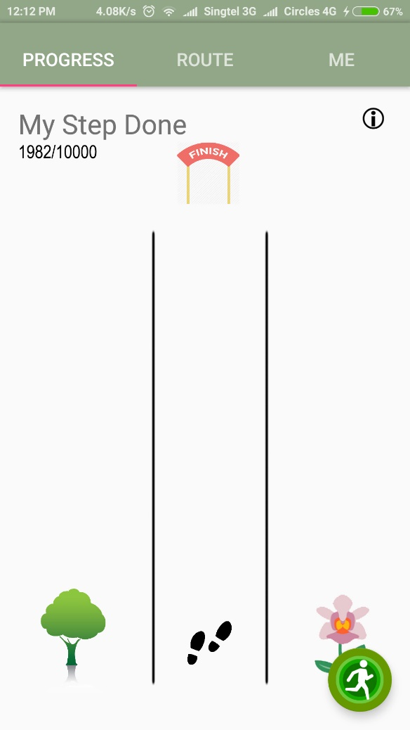
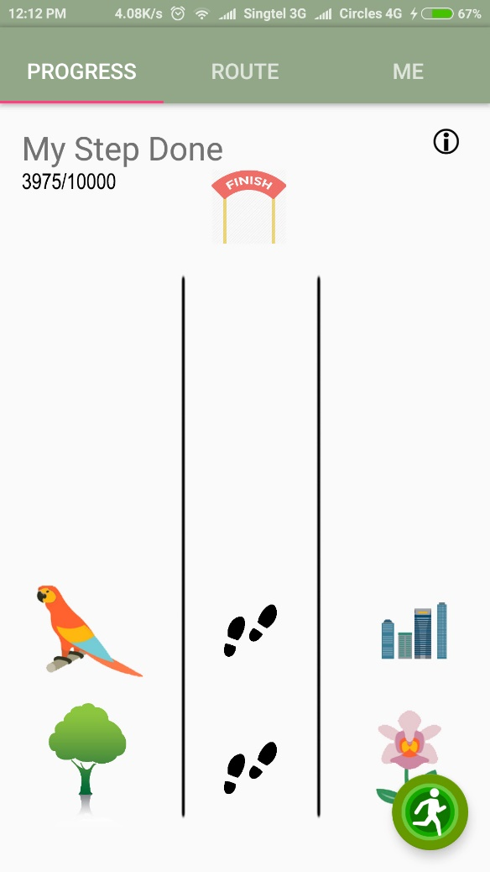
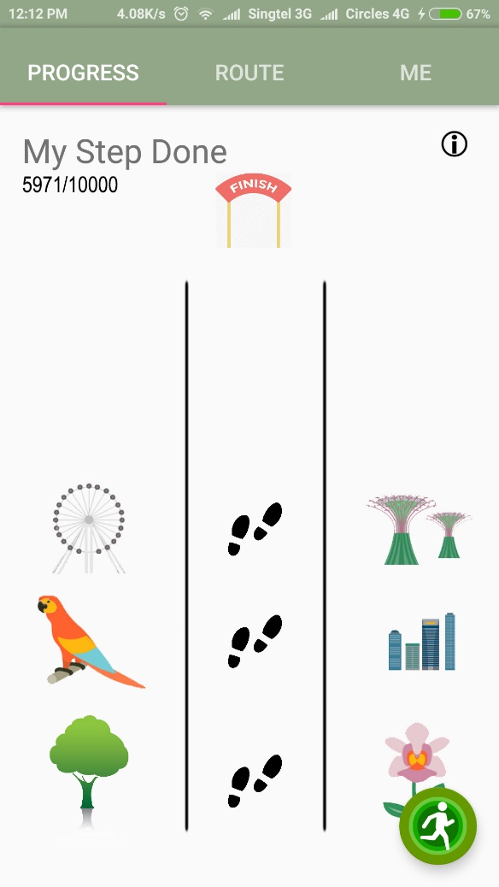
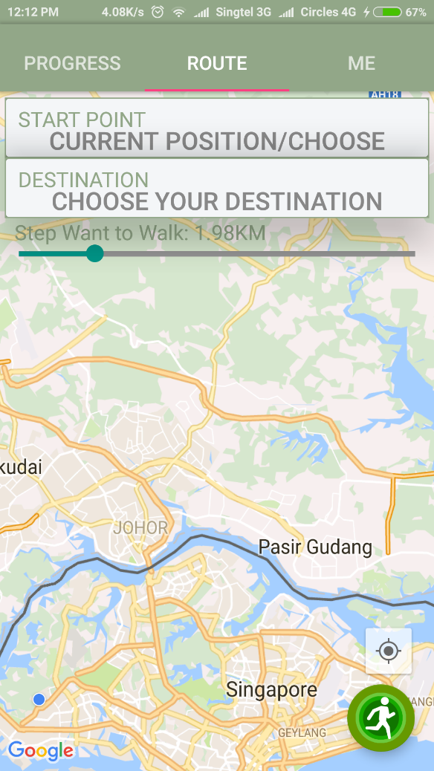
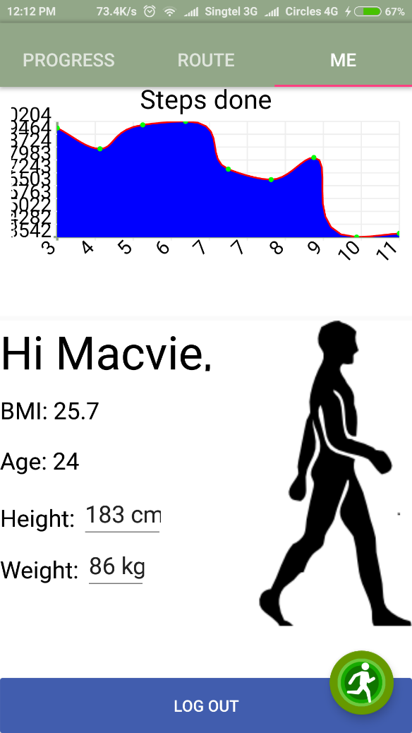
Walkera Features

Slide 7
Live Demonstration

Slide 8
VIDEO

Slide 9



Full-Stack Architecture

Slide 10
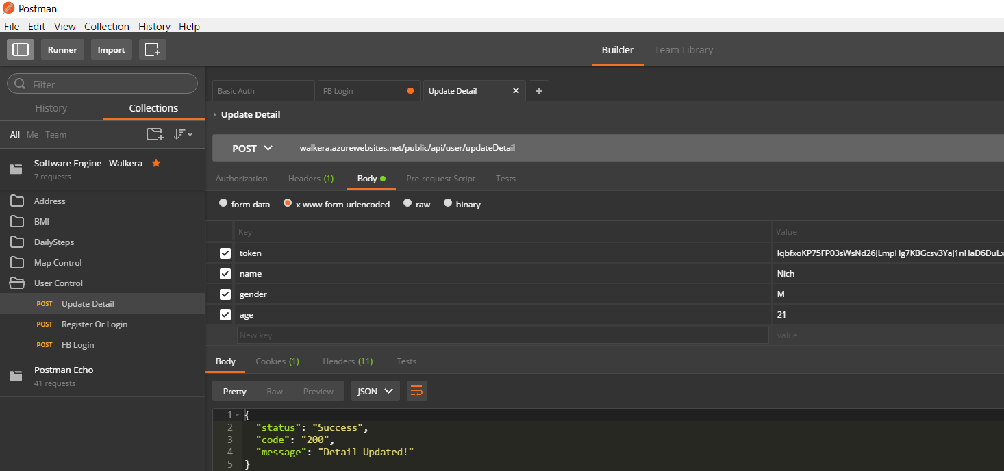
Laravel 5 RESTful API

Slide 11




Government API Used

Slide 12



Good Practices we Use

Slide 13
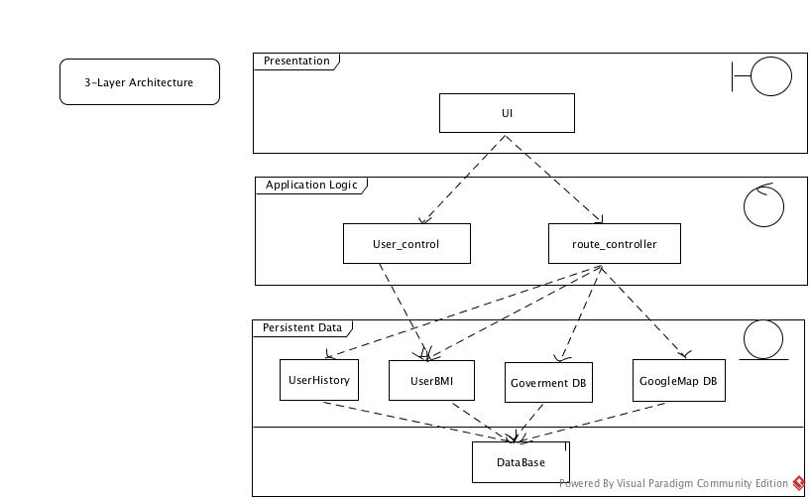
System Design

Slide 14
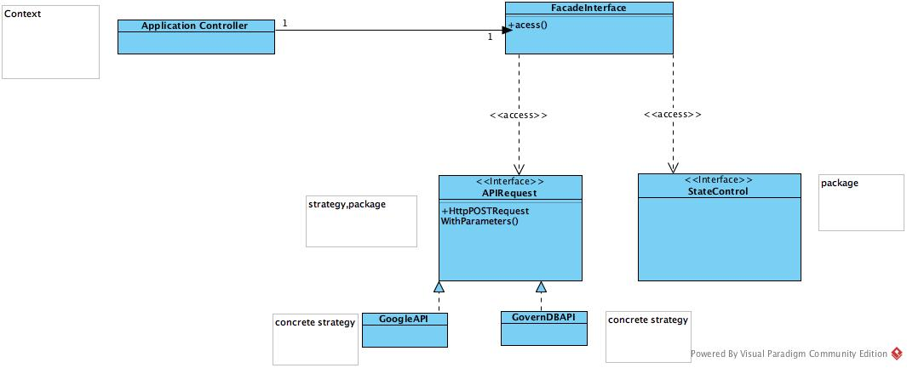
System Design

Slide 15
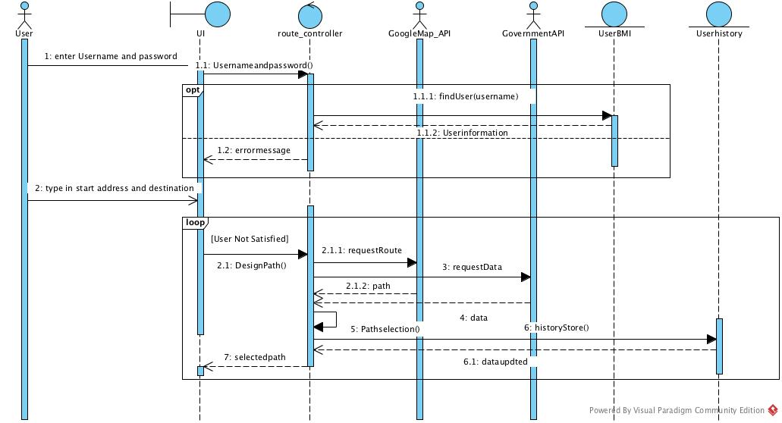
Sequence Diagram

Slide 16
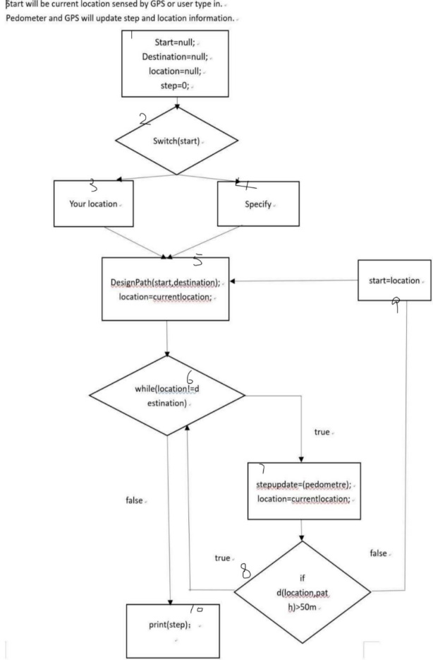
Test Case

Slide 17
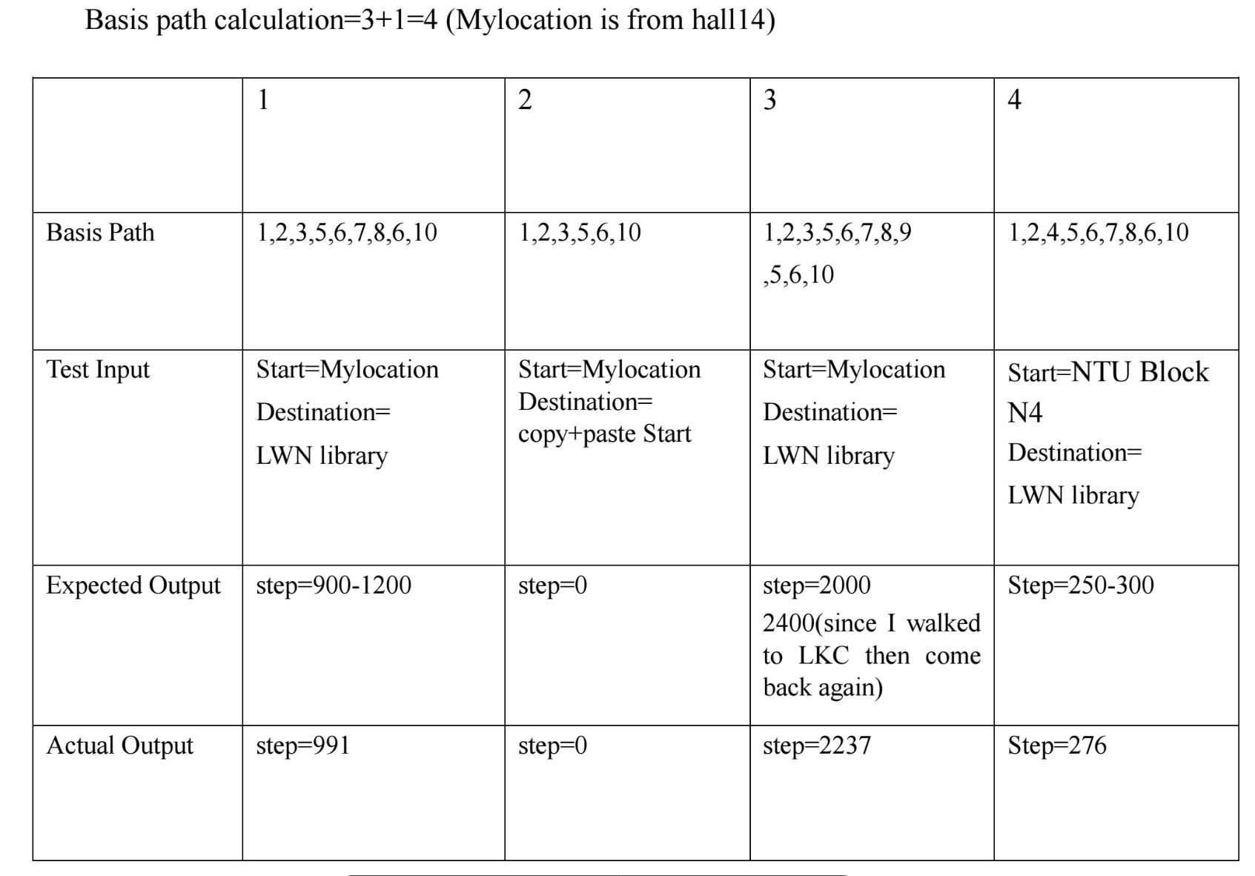
Test Case

Slide 18
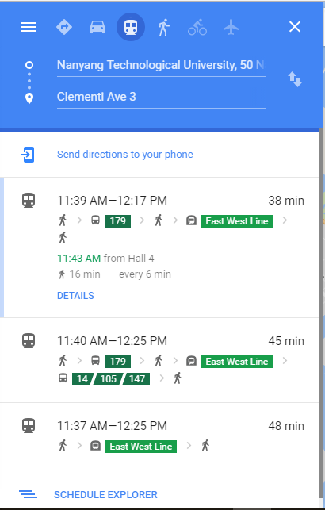

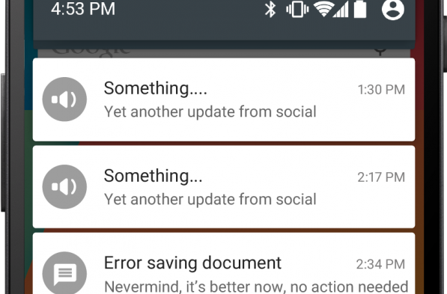
Future Works
Multiple routes for user to select
Includes estimate time taken
Integrate with various applications
Samsung Health
Apple Health
Health Promotion Board step challenge
Notifications
Insufficient steps
Daily Summary

Slide 19

Future Works
Save Favourite route
Plan ahead
Set depart by, arrive at
Integrate with various smart products
Xiao Mi smart shoe
nike+ tracking
Adidas miCoach

Slide 20
Thank You! Q & A

