Slide 1

Sandlot
The Sandbox League Management Platform
1/13
Notes:
Introduce all team members at beginning
Introduce your problem/project
Include slide number/total on each slide
Include “roadmap” at beginning

Slide 2

"The McMaster GSA softball league’s current software platform is outdated and fragile, struggling to efficiently manage up to 1,000 participants. While paid-for services are available, the league needs a personalized, cost-effective solution."
~ Dr. Jake Nease
2/13
Notes:
McMaster Graduate Student Association hosts Annual Softball league operates over the summer (first week May - last week August)
More than 30 teams enrolled in the league with a hundred games played each month; a system that is robust and reliable desperately needed
The current platform created over 30 years ago built primarily from PHP, maintained by 1 person, makes it difficult for constant support
Many league management platforms available, but require payment or usage of constant ads

Slide 3
What?
Why?
Why now?
Difficult user interface
Lack of technical support
Inefficient league management
Save time and resources
Reduce negative user engagement
Scale & adapt for expansion
Seamless integration
Continued growth without expensive, ad-supported alternatives.
Few inexpensive, customizable platforms
3/13
Notes:
What is the problem:
Problem is that the Website operated now difficult to use and not intuitive for users (poor navigation; hard to find certain information standings, contact information)
Broken architecture (missing pages, faulty links, code logic displayed on actual website, statistics arent accurately tracked; games played incorrect to team’s record)
Outdated management processes (creating accounts information provided as ASCII in email)
Why are we solving it:
Reason to save time performing actions (external platforms using waivers) or resources (providing an updated free league and scheduling platform)
Reduce amount of negative user interactions with system (website crashing from clicking on a link, or unable to complete an action or find a page)
Scale and adapt for expanding the league if more teams and players join, will system be able to handle it
Why solve it now: - hard to find platform that is easy to pickup and create own league with how you want to configure
Able to use with dozens of players without system breaking that you dont have to pay for or be bombarded by ads from sites like IM leagues

Slide 4



Our Solution
Advanced Scheduling Algorithm
Enhanced Season Configurations
Customizable Waiver Management
4/13
Notes:
What we would provide: - Own scheduling algorithm satisfying both hard and soft constraints (never schedule one of your own teams game on top of each other, no team should play one more game per day, and soft constraints avoid offday, avoid timeslots not preferred, avoid fridays, avoid latest timeslot unless desired)
Multiple configuration options for a season in the league you create, with customizable fields, timeslots, dates and divisions
Customizable waivers that can be enabled and modified to match your league needs

Slide 5
Live Demo
5/13

Slide 6
Scheduling
Reschedule Requests
Other platforms generate schedules… But do they prioritize flexibility and fairness?
Our scheduling system ensures balanced matchups, minimizes conflicts, and adapts to league-specific needs.
Designed to handle growing participation while keeping the process seamless for both commissioners and teams.
Other platforms allow commissioners to reschedule games… But what about the teams themselves?
Reschedule requests allow teams to reschedule games between one another with no involvement from the commissioner.
Helpful in smaller leagues where the commissioner may not always be available.
5/14

Slide 7
Custom Waivers
Other platforms might only allow embedding waivers… But what about a platform native customizable waiver?
Custom waivers allow the system’s waivers to change dynamically as you need them to. No more external waiver management!
Platform native waivers means signatures are automatically stored when signed and can be retrieved on demand.
6/14

Slide 8






Tech Stack
Database
Maintainability and generalization were key focuses for our project.
We made it a point to use common, well documented software, frameworks, and languages.
Using an ORM allowed our queries to be database agnostic.
Queries
Backend
HTTPS Requests
Frontend
6/13

Slide 9
Usability Testing
Usability Testing is important when users are potentially not technically inclined.
Performed 2 types of tests 1. Surveys 2. Walkthroughs
For both tests, the test group had large variance in technical knowledge.
We found that while surveys provided good metrics, they don’t provide enough specific feedback
7/13

Slide 10
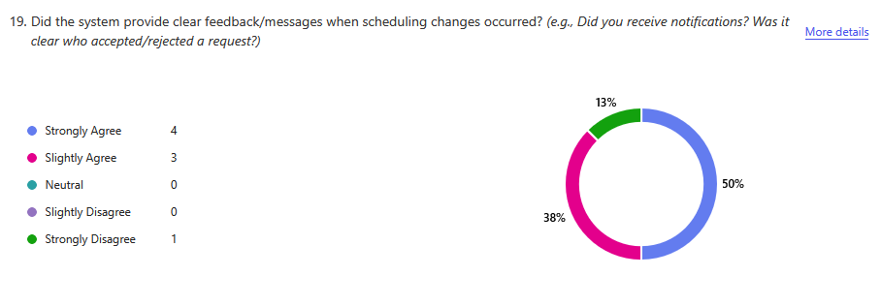
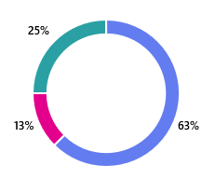
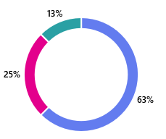
Surveys
System Performance
Scheduling Feedback
Strongly Agree
Slightly Agree
Neutral
Slightly Disagree
Ease of Use
Reschedule Requesting
Strongly Disagree
Metrics look good… but what about specific changes from feedback?
8/13

Slide 11
Walkthroughs
A 1 on 1 session with a user where they walk us through their thought process navigating and using the website.
Allowed us to get feedback that would be more difficult to get from a survey.
Easier for tester to vocalize their ideas and feedback.
Communication is much quicker, more likely to get more out of a test. Big Takeaways:
Any question they had about the functionality of the website was an opportunity for improvement of communication.
No stupid questions!
9/13

Slide 12
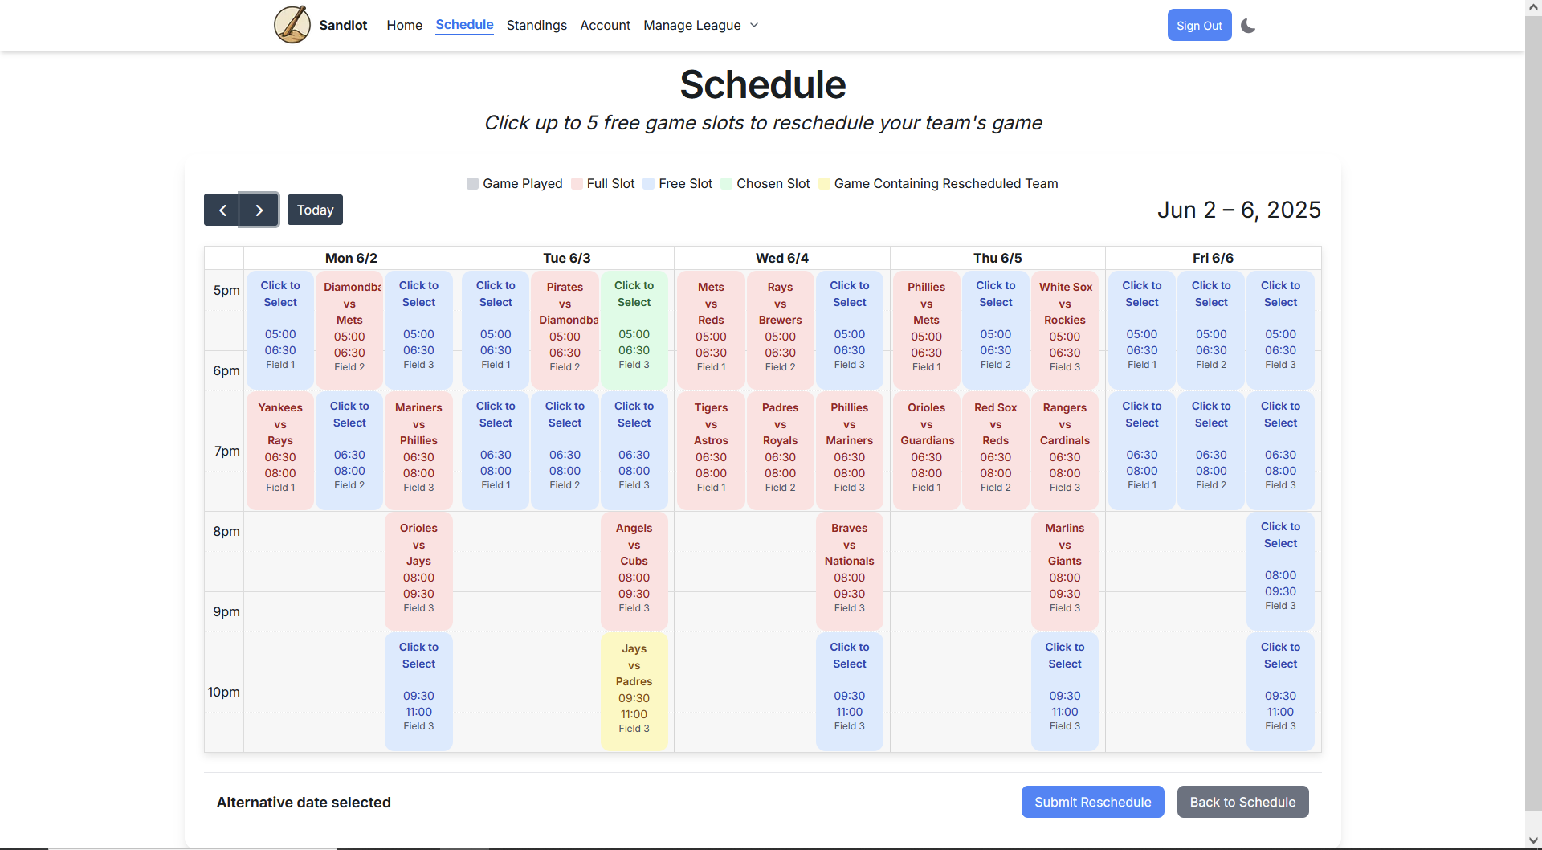
Specific Feedback
10/13

Slide 13
~60%
Less feedback on the second set of walkthroughs
11/13

Slide 14
Overview
12/13

Slide 15
Q & A
13/13

