Slide 1
Covid-19 Big Data Analysis
Nicholas Fryer
Ariel Rubio-Perez
Armand Wilson

Slide 2
Technologies Used
Spark
Hadoop
Git

Slide 3
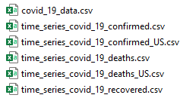
INPUT FILES

Slide 4
Top 10 Currently Infected Countries
Notes:
Active Cases = confirmed - deaths – recovered
US removed because the data for recovered was incomplete

Slide 5
Least 10 Currently Infected Countries

Slide 6
Worldwide Recovery Offset

Slide 7
Death rate in the United States
Notes:
Death rate = #ofDeaths/#ofConfirmed
Oklahoma Spike error
https://okcfox.com/news/local/reporting-error-leads-to-spike-in-covid-cases-reported

Slide 8
THANK YOU

