Slide 1
Bone Abnormality Detection
Nicholas Kastanos (nk569)
Notes:
Greet
Bone abnormality in upper limb radiographs

Slide 2
Motivation
Detecting bone abnormalities is the first task for triage units.
Essential in determining severity level.
Requires expert knowledge to accomplish reliably.
Not all emergency staff may have this knowledge.
Notes:
The human body contains 207 bones, each with their specific role.
It is not surprising that one of the most common emergency department visits is related to musculoskeletal injuries.
When a patient arrives at the ER, the first task is to locate and diagnose the injury accurately and quickly.
This allows the on-call staff to make informed decisions about the severity and treatment required for the patient.
In the case of musculoskeletal injuries, radiographs (or x-rays) of the affected region must be captured and examined.
While the radiographs themselves can be taken by trained radiographers, and the radiographers are trained in anatomy, their knowledge is more general than that of a specialist surgeon. This can result in missed or incorrect diagnoses, which can result in life-long discomfort for the patient.

Slide 3
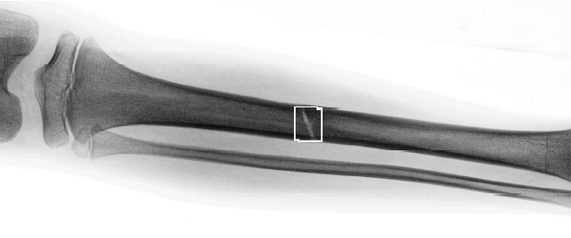
The solution
Develop a model which can reliably detect musculoskeletal abnormalities.
Image from:
Martin Donnelley, Greg Knowles, "Automated bone fracture detection," Proc. SPIE 5747, Medical Imaging 2005: Image Processing, (29 April 2005); doi:10.1117/12.594449
Notes:
One of the possible solutions to this issue is the development of an image classification model which can detect bone abnormalities.
These range from fractures to deformations, displacements, and soft-tissue detachments.

Slide 4
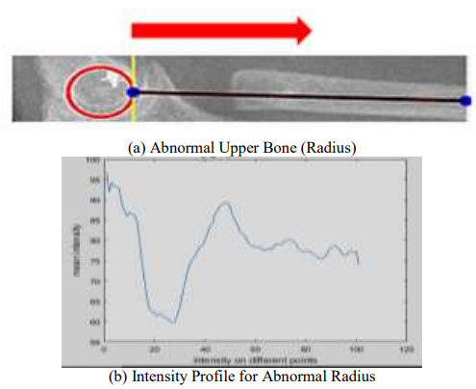
Previous Work
Most other work uses Deep Learning
This requires large datasets and intensive training processes
Other existing classical computer vision methods are specialised to one type of X-ray location
This is to allow the use of specialised features for the region
Image from:
Afzal, Mashal & Moazzam, M. & Badar, Rizwan & Narejo, Sanam. (2020). Automatic Detection of Elbow Abnormalities in X-ray Imagery. International Journal of Advanced Computer Science and Applications. 11. 10.14569/IJACSA.2020.0111248.
Notes:
Much of the previous work in this field makes use of deep learning image classification techniques.
Rajpurkar et al. developed a 169-layer DenseNet CNN which can provide binary abnormality classification, and the abnormality location can be inferred from class activation mappings. While effective, the understandability of the model is limited. The requirements for developing such a model are intensive and the authors needed to resort to transfer learning to reach the desired accuracies.
Other methods such as the one on screen make use of specialised features designed for the targeted bone structure. In this case, the capitellum is located using Hough circle detection and the radius and ulnar bones are approximated as lines. The intensity of the radiograph as seen in figure b is used to profile the bone shape. This limits the techniques developed to one type of x-ray, and new features must be developed for other regions such as wrists, hands and fingers.

Slide 5
What I want to do
Create a set of features which are not specific to the X-ray type to classify bone abnormality.
No targeted joint/bone detection
One set of calculations
Notes:
What I want to create is a set of universal features which can be used to develop models of different bones. Ideally, I would like to avoid detecting specific bone structures, however circle and line detection would be acceptable if it can be used on different types of radiographs.

Slide 6
Musculoskeletal Radiographs (MURA) dataset.
Developed by the Stanford ML Group
Contains radiographs of multiple upper-arm locations (Elbow, Finger, Hand, Forearm, etc.)
Binary classification, on a ‘study’ basis, detecting abnormalities.
Studies can have any number of radiographs.
Notes:
In order to develop these features, I am using MURA, a radiograph dataset for upper limbs.
This dataset contains many different radiograph types, which are labelled to indicate normal or abnormal bone structure.
The dataset creators determined that normal labels are attributed to healthy bone structure, and anything else is considered an abnormality. This means that healed bone structures with surgical implants are also considered abnormalities.
The main difficulty for this dataset is that each study is attributed a label, and each study can have any number of images. This means that some of the images in the study may show normal bone structure while the study as a whole is abnormal.
Therefore, the entire study must be considered, and the images must be combined into a single input.

Slide 7
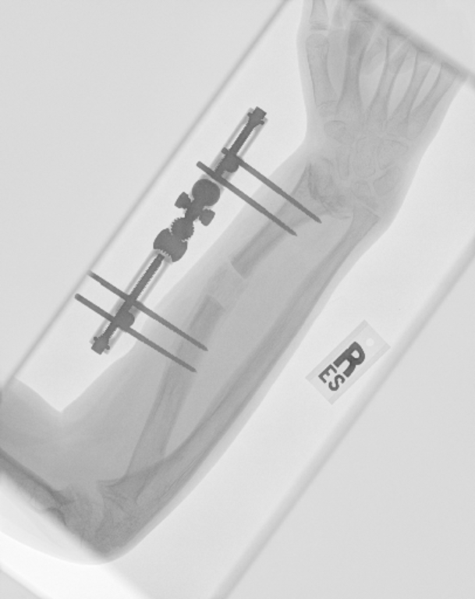
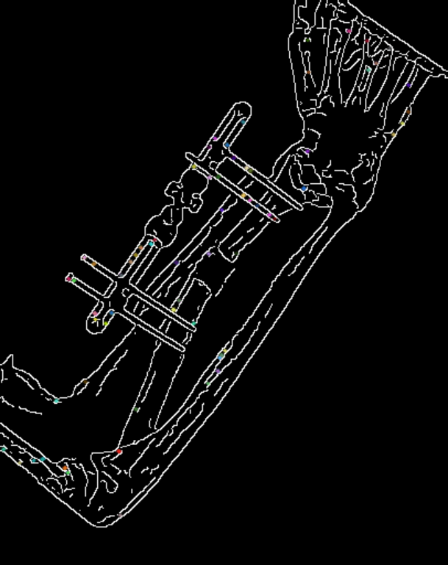
Current progress:
Features:
100 SIFT keypoint features
Colour inversion: white background, black lines
Gaussian Blur and Greyscale Morphology
Background removal
Canny Edge detection
PCA dimension reduction
Notes:
In order to develop a full set of features for the study, features are extracted for each image, and combined into a single vector. For studies with less images than the maximum number of images in a study, the vector is padded with zero inputs.
Since the mean images per study is much less than the maximum, the features at the end of the vector are commonly zero, and the learning algorithms will learn to ignore those inputs. To combat this, the image orders are randomised within the zero padded vector, but the internal order of features is maintained.
Currently, I am using 100 SIFT key points per image to develop these feature vectors, and PCA is completed on the final feature vector to reduce the dimensionality.

Slide 8
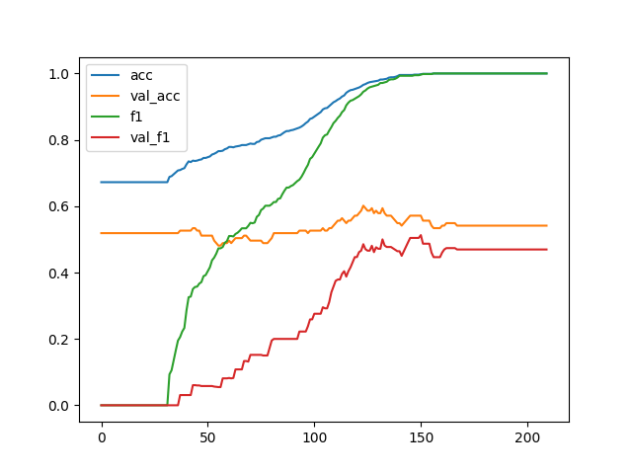
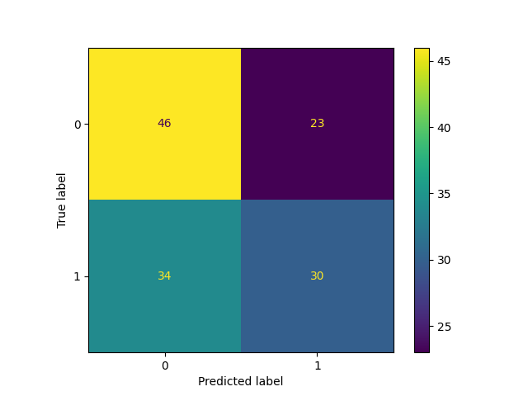
Current progress:
Classifiers:
Forearm RBF-kernel SVM, Top-50 PCA components, C= 654.4
Validation F1 score: 0,51
Notes:
Currently, I have developed a SVM classifier which has an F1 score of approximated 50 percent. While this seems like the model is not learning, this is not the case.
The dataset contains more normal labels than abnormal ones. If the model was unable to learn the features, it would get the best accuracy by predicting only the most common class.
While this performance is not high enough to be reliably used, it shows proof of concept, and that it is most likely possible to develop a more accurate model.

Slide 9
Planned Classifiers
MLP
Random Forest
Ensemble Statistical classifiers
CNN (if time permits)
Notes:
Going forward I want to try and implement additional classifiers, to see if these features can be learned better by different methods.
Should time permit, would like to use a CNN neural network, however the resources required for such a training process may be beyond the time I have remaining.
In addition to further classifiers, I would like to apply circle and line detection to the processing stage to attempt to increase the information captured by the features. Should time permit, I may use Bayesian optimisation to determine optimal kernel filter sizes, number of SIFT features, and other parameters.

Slide 10
Thanks!
Questions?

