Slide 1
Przewidywanie oceny filmu na podstawie grających aktorów

Slide 2
Cross-Validation score for actors
Najniższy: 0.439
Najwyższy: 0.465
Średnie: 0.45

Slide 3
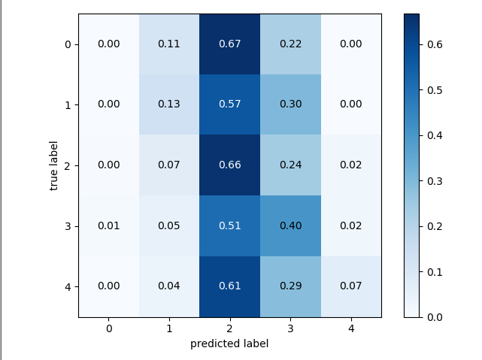
3. kNN
0.39%
K = 5
Iłość klas = 5
And a lot of users
Accuracy

Slide 4
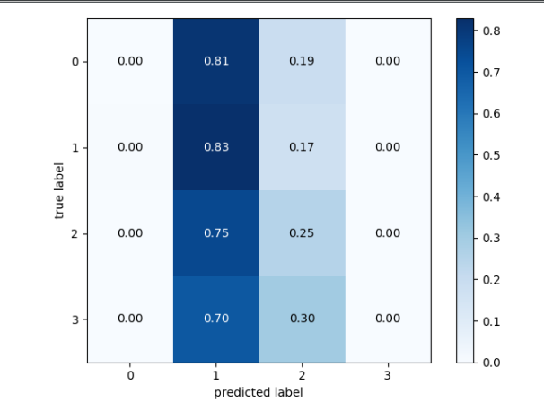
3. kNN
0.45%
Iłość klas = 4
K = 25
And a lot of users
Accuracy

Slide 5
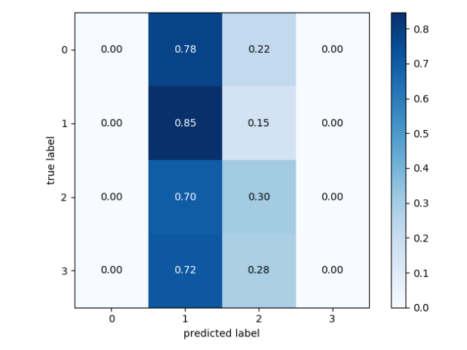
3. kNN
0.51%
Iłość klas = 4
K = 95
And a lot of users
Accuracy

Slide 6
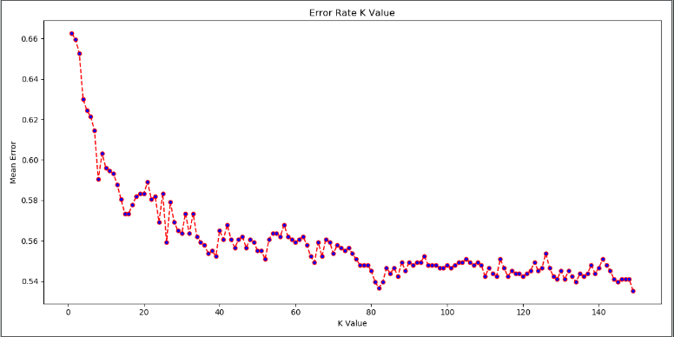
3. kNN
And a lot of users

Slide 7
SVM
Support Vector Classification
SVM Accuracy: 0.448
GridSearch 0.475

Slide 8
Przewidywanie jakości wina

Slide 9
Cross-Validation score for wines
Średnie: 0.53

Slide 10
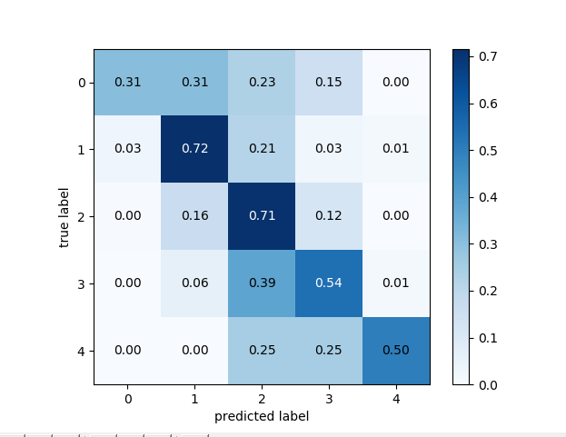
3. kNN
0.67%
K = 1
Iłość klas = 5
And a lot of users
Accuracy

Slide 11
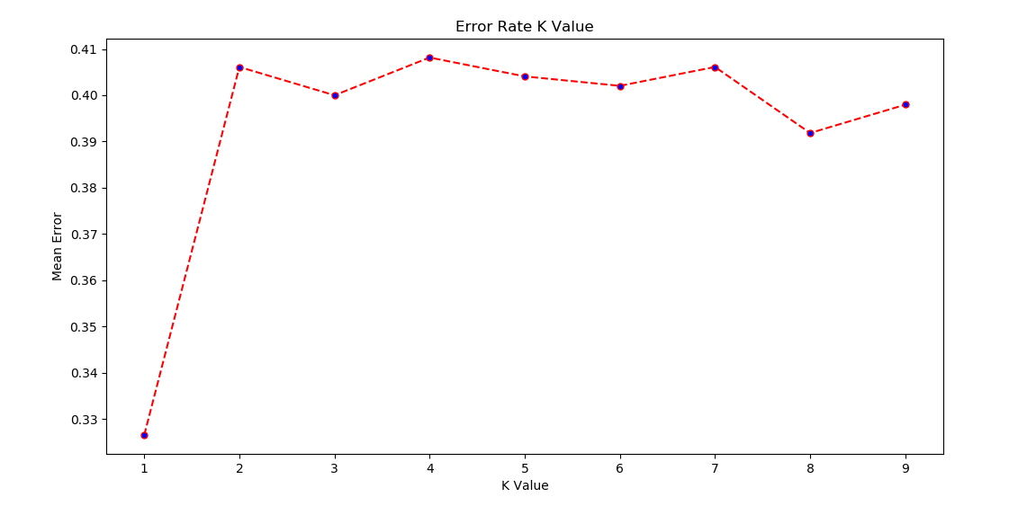
3. kNN
And a lot of users

Slide 12
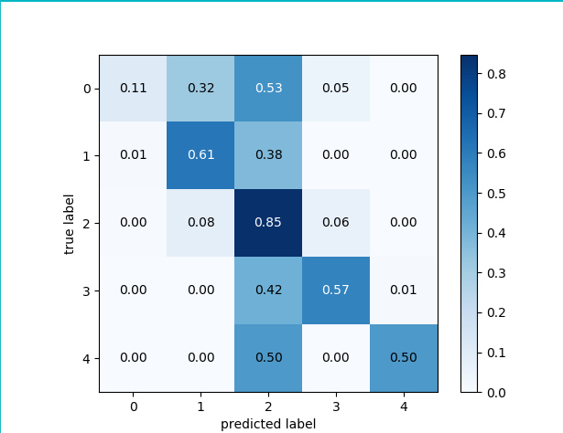
SVM

Slide 13
SVM
Support Vector Classification
SVM Accuracy: 0.64-0.68
GridSearch 0.72

Slide 14
Thanks!
Any questions?

Slide 15
Credits
Special thanks to all the people who made and released these awesome resources for free:
Presentation template by SlidesCarnival
Backgrounds by Pixeden
Diagram featured by http://slidemodel.com

