Slide 1
SCIENCE, IDEOLOGY, THEORY Systemic Racism: Myths and Realities (SOC 373) Patricia Fernández-Kelly September 11, 2025
Patricia Fernández-Kelly Princeton University Department of Sociology

Slide 2
Science vs Ideology

Slide 3
Dominant or hegemonic ideologies are narratives that explain natural or social phenomena while justifying existing orders of inequality. Resistance ideologies put forth narratives that counter hegemonic ideologies. In both cases, the emphasis is on collective belief regarding ethical principles rather than the concerted investigation of empirical realities.

Slide 4
Ideological red flags: GOD NATURE

Slide 5
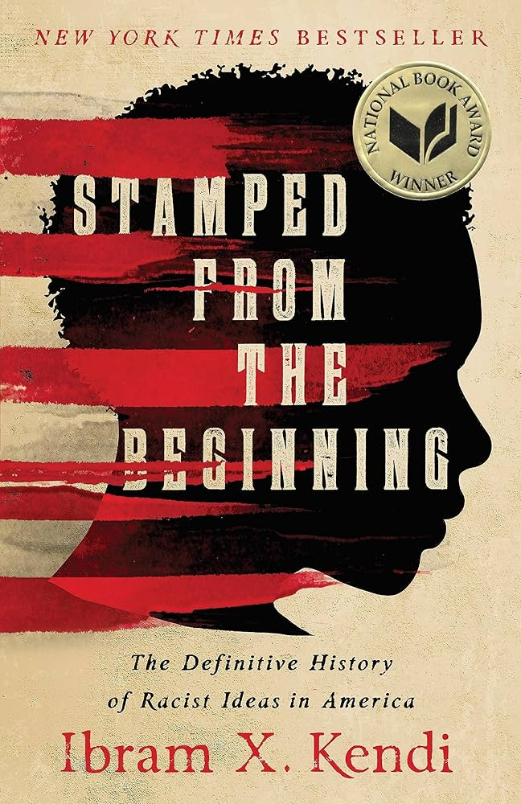


Slide 6
Ibram X. Kendi → Director of the Howard Institute of Advanced Study → Author of How to Be an Anti-Racist (2019) → MacArthur Genius Grant recipient → National Book Award for Stamped from the Beginning (2016). Kendi, a historian, provides a detailed, fascinating account of the people and situations that produced and perpetuated racist ideas.

Slide 7
Kendi focuses on the origins of racism in America proposing a linear relationship between economic and political interests and the rise of racist ideas. He rejects the idea that hatred led to racism

Slide 8
In the early capitalist period, Portuguese explorers were the first to hold Africans in bondage. Later on, English traders generated large profits through the sale of Africans. They became “capital.”

Slide 9
Kendi also investigates various ideological narratives explaining and justifying racial inequality Climate “theory” links a population's physical and intellectual traits to the climate of their geographic location. It is a form of environmental determinism, arguing that tropical, temperate, and cold climates created distinct, inherent physical, moral, and intellectual differences between human groups. Curse “theory” The "Curse of Ham" was based on a passage from the Book of Genesis, in which Noah curses Ham's son, Canaan, to be a "servant of servants." From the 15th century onward, this passage was misused to justify the enslavement of people of African descent

Slide 10
Kendi identifies three competing positions on race: Segregationist: overtly racist, attributes racial disparities on inherent Black inferiority Assimilationist: Attributes disparities on cultural differences and promotes incorporation into White mores and behaviors Antiracist: Promotes racial equality

Slide 11
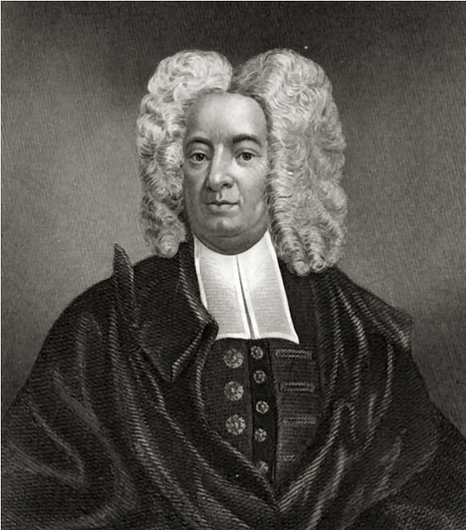
COTTON MATHER (1663 – 1728) Major theologian, a Puritan clergyman who wrote extensively on theological, historical, and scientific subjects. He was associated with the Salem witch trials of 1692- 1693. Like most of his peers, Richard Mather and his son, Cotton Mather, like his father, Richard Mather, another notable theologian, saw slavery as consistent with a Christian outlook. God, they believed, put enslaved people under the authority of White Christian masters. This was a divinely sanctioned way to convert "heathens" In The Negro Christianized (1706) he advocated for a humane treatment of enslaved people to promote their salvation.

Slide 12
THE POWER OF IDEOLOGY Kendi gives attention to the ideological justifications of slavery: By focusing on the idea of “saving souls” at the expense of liberating bodies, preachers normalized the horrors of bondage. Paradoxically, the acknowledgement that enslaved people had souls, gave those in bondage the tools to resist.

Slide 13
Interrogating Critical Race Theory. Let us begin by defining theory, shall we?

Slide 14
A working definition of theory: A collection of logically related propositions whose purpose is to describe, explain, and sometimes forecast phenomena and events. Theories make use of concepts to illuminate empirical realities.

Slide 15
Critical Race Theory (CRT) is a framework that examines how race and racism have shaped U.S. laws, social structures, and institutions. CRT was developed by legal scholars and activists in the 1970s and 1980s, CRT holds that racism is not merely the result of individual prejudice but woven into the fabric of American society. Key Concepts: 1. Race as a social construction. 2. Intersectonality.

Slide 16
Critiques of Critical Race Theory : → Rejection of objectivity and meritocracy . → Focus on storytelling over data → Anti-liberal thrust, regarding individual potential → Objection to the idea of racism as a feature of American history and social constitution. → Divisiveness and identity politics. → Anti-White bias.

Slide 17

Kimbeerle Crenshaw (1991). “Mapping the Margins: Intersectionality, Identity Politics, and Violence against Women of Color.” Stanford Law Review 43: 1241-1299.

Slide 18

Crenshaw is celebrated for her emphasis on intersectionality, that is, an integrative approach that exposes the problematic use of single categories to define identity. Intersectionality has gained great currency but it is often misused and misinterpreted. Crenshaw’s original intent was to use the concept to deepen understandings about the relationship between individuals/groups and the law.

Slide 19
Intersectionality is an analytical framework for understanding how aspects of a person's social and political identities combine to create different modes of discrimination and privilege. Intersectionality identifies multiple factors of advantage and disadvantage.
Examples:
gender, caste, sex, race, ethnicity, class, sexuality,
religion, disability, weight, and physical appearance.
These intersecting and overlapping social identities may be both empowering and oppressing

Slide 20
Crenshaw puts forth a Black feminist critique that reveals the problematic consequences of treating race and gender as mutually exclusive categories of experience and analysis .
In race discrimination cases, discrimination tends to be viewed in terms of sex-or class-privileged Blacks; in sex discrimination cases, the focus is on race-and class-privileged women. This focus on otherwise-privileged group members creates a distorted analysis of racism and sexism because the operative conceptions of race and sex become grounded in experiences that actually represent only a subset of a much more complex phenomenon.

Slide 21
In DeGraffenreid v. General Motors (1976), Emma DeGraffenreid and four other black female auto workers alleged compound employment discrimination against black women because of General Motors’ seniority-based system of layoffs.
The courts weighed the allegations of race and gender discrimination separately, finding that the employment of African-American male factory workers disproved racial discrimination, and the employment of white female office workers disproved gender discrimination.
The court declined to consider compound discrimination and dismissed the case. Crenshaw argued that in cases such as this, the courts have tended to ignore black women's unique experiences by treating them as only women or only black

Slide 22
The intersectional experience is greater than the sum of racism and sexism, any analysis that does not take intersectionality into account cannot sufficiently address the particular manner in which Black women are subordinated. Refusal of the courts to recognized Black women as a protected class: “The prospect of the creation of new classes of protected minorities, governed only by the mathematical principles of permutation and combination, clearly raises the prospect of opening the hackneyed Pandora’s box.” (DeGraffenreid vs General Motors)

Slide 23
Moore v Hughes Helicopters, Inc. 1983 This case concerns the proper use of the "disparate impact" model of proof in employment discrimination cases. Tommie Moore is a black female employee of Hughes Helicopters, Inc. ("Hughes"), a manufacturer of commercial and military helicopters. Moore, suing on behalf of a class of black female Hughes employees, alleges that Hughes has discriminated against black females in violation of Title VII of the Civil Rights Act of 1964, as amended, 42 U.S.C. § 2000e, et seq. The alleged discrimination occurred in the selection of employees for supervisory and upper-level craft positions from 1975 through 1979. The case went to trial before Judge Robert J. Kelleher in October 1980. At the conclusion of Moore's case, Hughes moved for an involuntary dismissal . . . Moore's complaint alleged intentional discrimination against Moore personally, but no evidence supporting this claim was presented at trial. . . Moore appeals the dismissal of her case, the denial of her earlier motion for summary judgment, the limited scope of the class certification, and the award of court costs to Hughes. We affirm the district court.

Slide 24
In sum, several courts have proved unable to deal with intersectionality, although for contrasting reasons. In DeGraffenreid, the court refused to recognize the possibility of compound discrimination against Black women and analyzed their claim using the employment of white women as the historical base.

Slide 25
As a consequence, the employment experiences of white women obscured the distinct discrimination that Black women experienced. Conversely, in Moore, the court held that a Black woman could not use statistics reflecting the overall sex disparity in supervisory and upper-level labor jobs because she had not claimed discrimination as a woman, but “only” as a Black woman. The court would not entertain the notion that discrimination experienced by Black women is indeed sex discrimination.

Slide 26
Revisiting the question: Is Critical Race Theory a theory?

