Slide 1

SYSTEMIC RACISM: MYTHS AND REALITIES SOC 373 Patricia Fernández-Kelly Princeton University Department of Sociology
September 4, 2025

Slide 2
Defining Systemic Racism. Systemic racism designates persistent racial inequalities resulting from the operation of entrenched social, economic, and political orders across time and space. By contrast to prejudice or bigotry, which materialize in personal attitudes and beliefs, systemic racism is embedded in laws, policies, and practices that antecede individuals. Examples include residential segregation, unfair lending practices, barriers to home ownership, processes resulting in the differential accumulation of wealth, schools’ dependence on property taxes, voter suppression policies, etc.

Slide 3
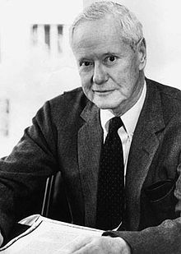
Robert K. Merton (1949). “Discrimination and the American Creed”

Slide 4
This celebrated paper, first published in 1948, illustrates a way to organize knowledge and “do” science through logical reasoning and the application of rigorous methodologies. Merton notes a difference between research with direct implications for social problems and research that is remote from these problems. Of equal importance is his distinction between norms/values and behavior.

Slide 5

But Merton was not the first to note that discrepancy. It was Harriet Martineau, a follower of Auguste Comte who first drew attention to that distinction.

Slide 6
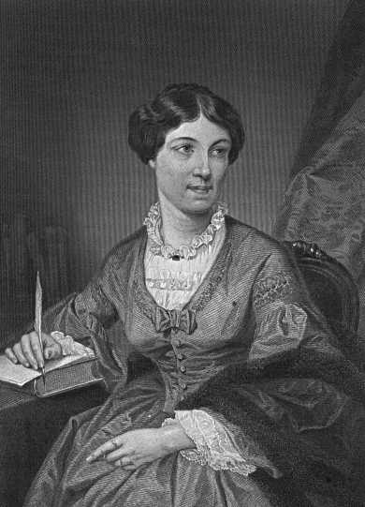
Harriet Martineau: How to Observe Morals and Manners (1838)

Slide 7
Merton first considers our nation’s foundational creed set forth in the Declaration of Independence, the preamble of the Constitution, and the Bill of Rights. He discards simplistic interpretations, noting that the American creed does NOT proclaim universal equality of innate intellectual or physical endowment. He further notes the gap between the national creed and conduct. He observes that the gap is not just about ideals versus practices or true belief versus hypocrisy.

Slide 8
Here are two fragments of the national creed:

Slide 9

“We the People of the United States, in Order to form a more perfect Union, establish justice, insure domestic Tranquility, provide for the common defense, promote the general Welfare, and secure the Blessings of Liberty to ourselves and our Posterity do ordain and establish this Constitution for the United States of America.” — Preamble to the Constitution, 1787

Slide 10
“We hold these truths to be self-evident, that all men are created equal, that they are endowed by their Creator with certain unalienable Rights, that among these are Life, Liberty and the pursuit of Happiness . . .” —Declaration of Independence, 1776

Slide 11
Merton is clearly thinking about the gulf between ideals such as those inscribed in our master narrative and phenomena like slavery and Jim Crow laws.

Slide 12
It’s not equality of individual endowments that the creed affirms but: “the indefeasible principle of the human right to full equity: the right to equitable access to justice, freedom, and opportunity, irrespective of race or religion or ethnic origin. . . dignity of the individual irrespective of group membership. And it goes on to say that although individuals differ in innate endowment, they do so as individuals, not by virtue of their group memberships.”

Slide 13
The creed is NOT a fixed and static cultural constant, unmodified in the course of time. . . It is, moreover, unevenly distributed throughout the society.

Slide 14
Nor does the creed exert the same measure of control over behavior in diverse times and places. Insofar as it is a “sacred” part of American culture . . . it is largely immune to direct attack THE CREED, THOUGH INVULNERABLE TO DIRECT ATTACK, IS NOT BINDING ON PRACTICE.

Slide 15
The relationship, however, is not between two variables (ideals and individual behaviors) but between three variables: The cultural creed honored by tradition and partly enacted into law, The beliefs and attitudes of individuals regarding the principles of the creed, and The actual practices of individuals with reference to it

Slide 16
In other words, for analytical purposes, Merton is unpacking the phenomenon of discrimination into three distinct variables that may combine in various ways.

Slide 17

Once we substitute these three variables of cultural ideal, belief, and actual practice, the entire formulation of the problem changes.
We escape from the virtuous but ineffectual impasse of deploring the alleged hypocrisy of many Americans into the more difficult but potentially effectual realm of analyzing the problem actually in hand. Conduct may or may not conform with individual’s own beliefs concerning the moral claims of all people to equal opportunity.

Slide 18
Merton’s Typology: Type I: The Unprejudiced Non-Discriminator or All-Weather Liberal - The individual who adheres to the creed in both belief and practice. Type II: The Unprejudiced Discriminator or Fair-Weather Liberal. An expedient individual who supports discriminatory practices in the interest of profit, even though such behavior may contradict his beliefs in the American creed. Type III: The Prejudiced Non-Discriminator or Fair-Weather Illiberal The prejudiced individual who, in a liberal environment, reluctantly conforms to the creed in practice (but not in belief) out of fear of sanctions and repercussions. Type IV: The Prejudiced Discriminator or All-Weather Illiberal The prejudiced individual who holds discriminatory beliefs in all circumstances, even in the face of sanctions and repercussions.

Slide 19
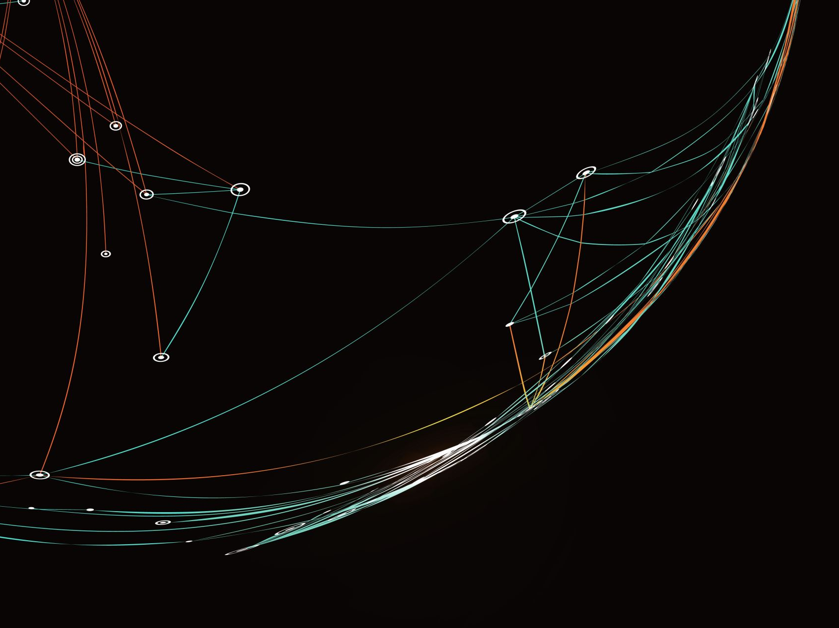
As a template for analysis, that typology has critical consequences for theory (as a necessary part of science) but also for social policy. You are welcome, SPIA students.

Slide 20
Why? Because the typology identifies social sectors more or less susceptible to behavioral modification through changes in the rewards/incentives system. Type I: The Unprejudiced Non-Discriminator is (in this schema) a potent group advancing the correspondence between the national creed and actual conduct. Type IV: The Prejudiced Illiberal represents the group most resistant to change.

Slide 21
On the other hand, Types II and III: The Unprejudiced Discriminator and the Prejudiced Non-Discriminator are of greatest interest to policy because of their higher propensity towards behavioral modification in correspondence to changes in the incentives system.

Slide 22
That was the intent and the effect of Affirmative Action Programs! (Before they were recently dismantled by the Supremes)

Slide 23
With his ideas, Merton was anticipating measures to combat systemic racism in the 1940s! And he was doing that through logical reasoning and the application of scientific approaches. (Loud applause)

Slide 24
Yet Merton also lavishes criticism upon “all weather liberals.” Fallacy of group soliloquies. Ethnic liberals are busily engaged in talking to themselves. Fallacy of unanimity. Continued association with like-minded individuals tends to produce the illusion that a large measure of consensus has been achieved in the community at large. Fallacy of privatized solutions to the problem. He essays a private solution to a social problem. Such fallacies invite social inaction.

Slide 25
Liberals (as well as conservatives) often fail to recognize that privatized solutions cannot be the solution for problems that are essentially social in nature.

Slide 26
Take Home Points: 1. A primary function of sociology is to account for the determinants and consequences of diverse forms of social behavior. 2. The “creed” does not exert the same level of control over all groups. 3. Attitudes and overt behavior vary independently. 4. PREJUDICIAL ATTITUDES DO NOT HAVE TO RESULT IN DISCRIMINATORY BEHAVIOR.

Slide 27
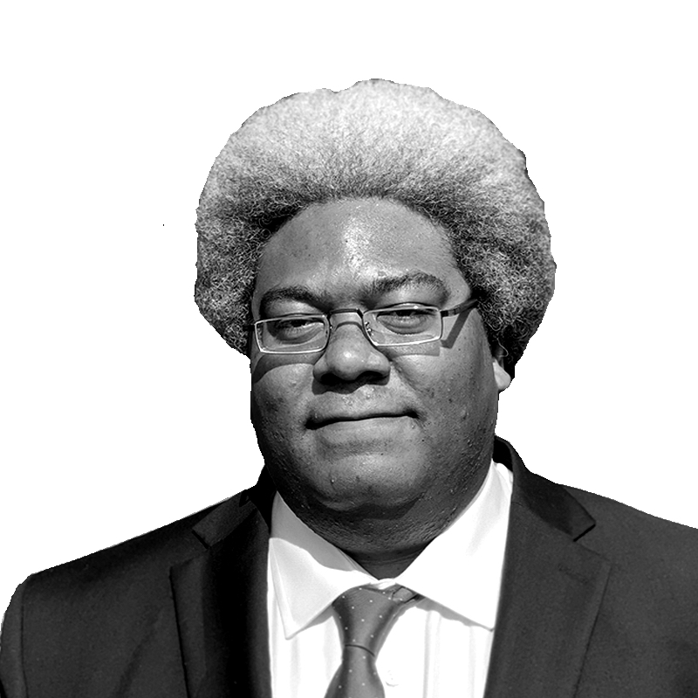
Elie Mystal (2022). Allow me to Retort: A Black guy’s Guide to the Constitution.

Slide 28
Mystal is the Justice correspondent for The Nation and, in my estimation, one of the most brilliant and piercing voices commenting on our legal system. He notes something that should not be controversial: the crafters of the constitution owned enslaved people. (Anyone disputing that fact?)

Slide 29
As a result, Mystal argues, the U.S. Constitution would be useless, were it not for the Bill of Rights, that is without the Reconstruction Amendments. He is thus a fierce critic of “Originalists” who argue that the Constitution should be interpreted only within the parameters of the time when it was written. His tone is loud and filled with outrage, but Mystal like Merton, aims to salvage and honor the Constitution as an evolving document representing the best possible aspects of the American character.

Slide 30

THE END (FOR THE TIME BEING)

