Slide 1
Pseudocode
From algorithms to pseudocode
Pseudocode: a set of human-readable statements for delineating the steps of an algorithm
Pseudocode is not a program you can run, but provides more detail than an algorithm, easing the transition from idea to program code
Used to help brainstorm before you code
Easy to write and help determine logic of a problem
Non-technical team members can understand
Pseudocode guidelines
Some keywords and style conventions are derived from programming languages
In pseudocode, you work with variables, which hold values that might change during program execution, and computations

Slide 2
Pseudocode Examples: Output
Python
print(“Game Over”)
Pseudocode
Display ‘Game Over’

Slide 3
Pseudocode Examples: Retrieve Information
Python
Name = input(“Enter name:”)
Pseudocode
Prompt for name
Or
Get name

Slide 4
Pseudocode Examples: Calculations
Python
avg = point / num_students
Pseudocode
DIVIDE num_students by points

Slide 5
Pseudocode Examples: Assigning Variables
Python
cart_items = 0
Pseudocode
SET cart_items to 0

Slide 6
Pseudocode Examples: IF Statements
Python
if attendance == True:
attendance_points += 1
Else:
print(“You missed class”)
Pseudocode
IF attendance is True THEN
Add 1 to attendance_points
Else
Display “You missed class”
EndIf

Slide 7
Pseudocode Examples: IF Statements
Python: Sample restaurant rating code
rating = int(input(“Enter rating:”))
if rating >= 7:
print(“Great Work!”)
else:
print(“Let’s try again”)

Slide 8
Pseudocode Examples: IF Statements
Pseudocode: Sample restaurant rating code
PROMPT for rating
Get the rating and make it a number
IF rating is greater than or equal to 7
Display “Great Work!”
Else
Display “Let’s try again”
EndiF

Slide 9
Pseudocode
Pseudocode guidelines (continued)
Steps for writing pseudocode:
Write down the algorithm
Identify and name variables
Write statements that declare and initialize variables
Work through each step of the algorithm, writing detailed pseudocode steps
Identify computations and write them as mathematical expressions, using variables
Identify decision structures and write them in if..then and otherwise format
Identify repetition structures and write them using repeat x times or repeat until
Use indents for multiline decision and repetition structures
Use blank lines as whitespace to set off decision and repetition structures

Slide 10
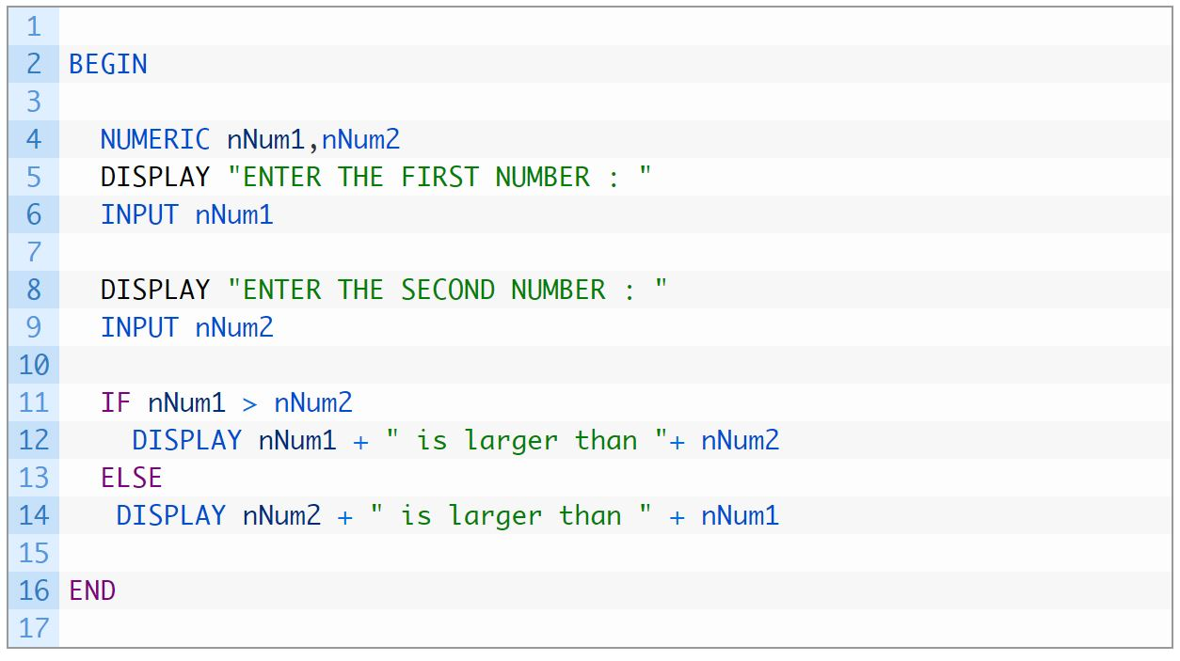
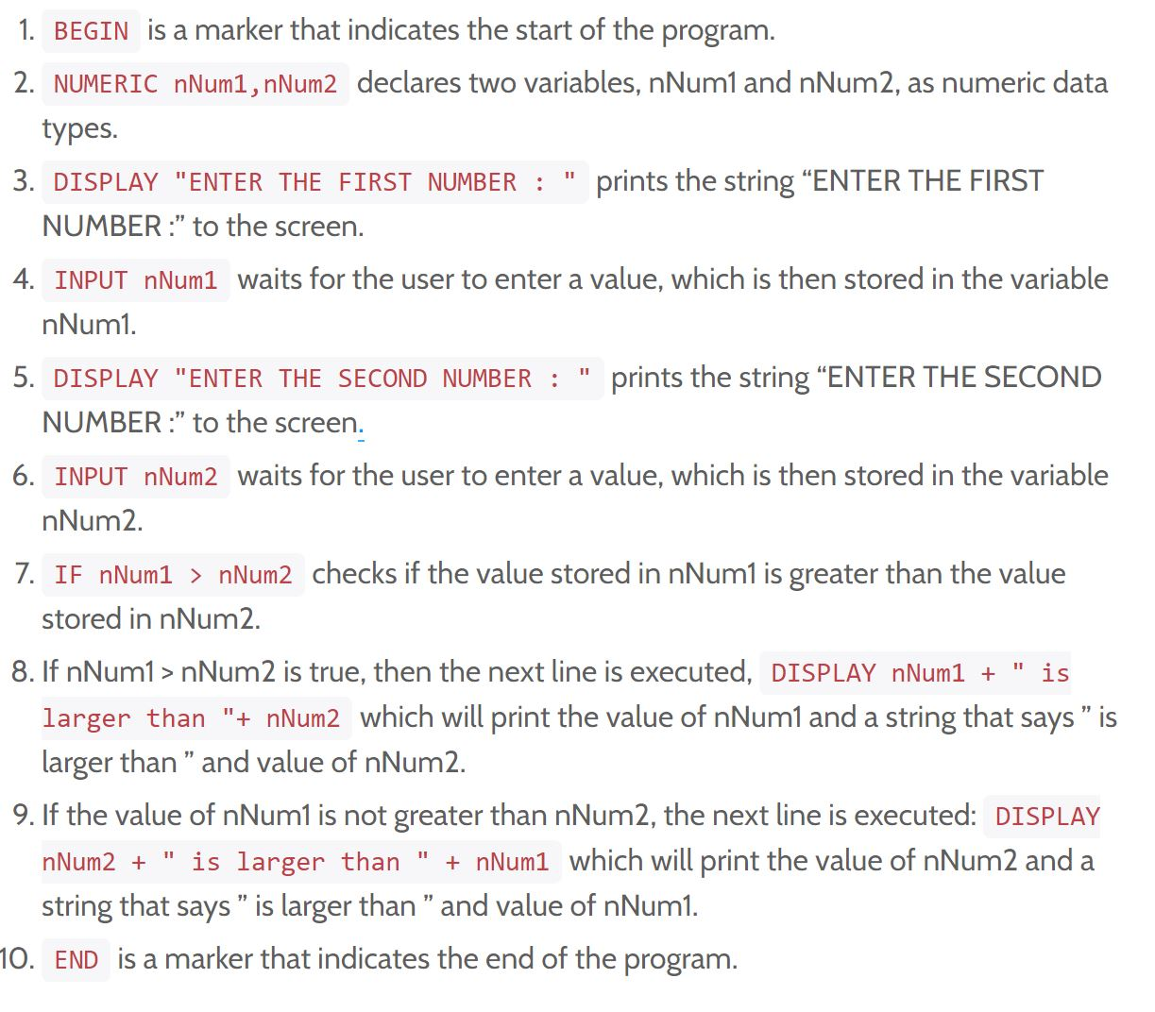
Pseudocode Example
NUMERIC nNum1,nNum2 declares two variables, nNum1 and nNum2, as numeric data types

Slide 11
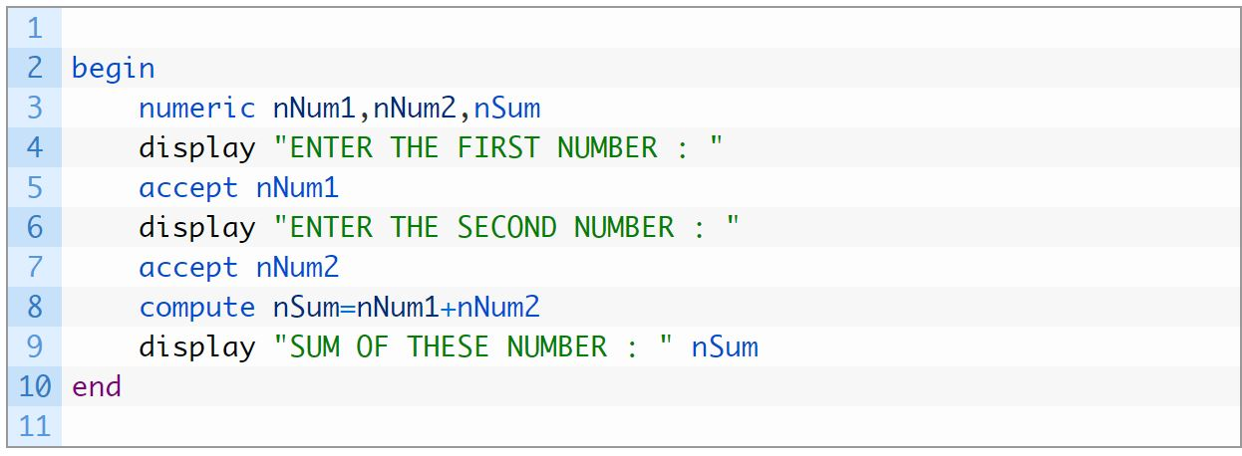
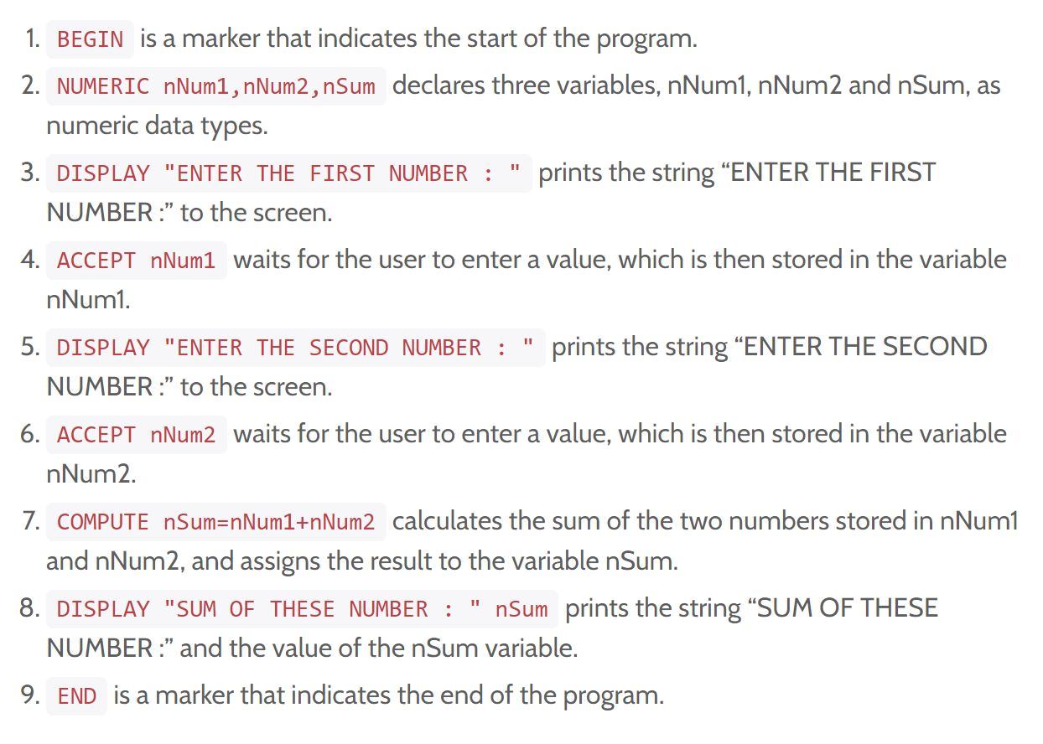
Pseudocode Example
NUMERIC nNum1,nNum2 declares two variables, nNum1 and nNum2, as numeric data types

Slide 12
Flowcharts
Flowchart basics
Flowchart: a diagram that represents the sequence and flow of steps in an algorithm
May be used instead of or along with pseudocode
Use a standard set of shapes that are connected by flowline arrows
Drawing flowcharts
Flowcharts begin and end with a terminator shape
The first shape contains the word “Start”
Additional shapes are stacked vertically to indicate sequential program flow
Decision control structures use a diamond shape and branching arrows for decisions
Repetition control structures are represented using arrows that point upward to an earlier point in the sequence

Slide 13
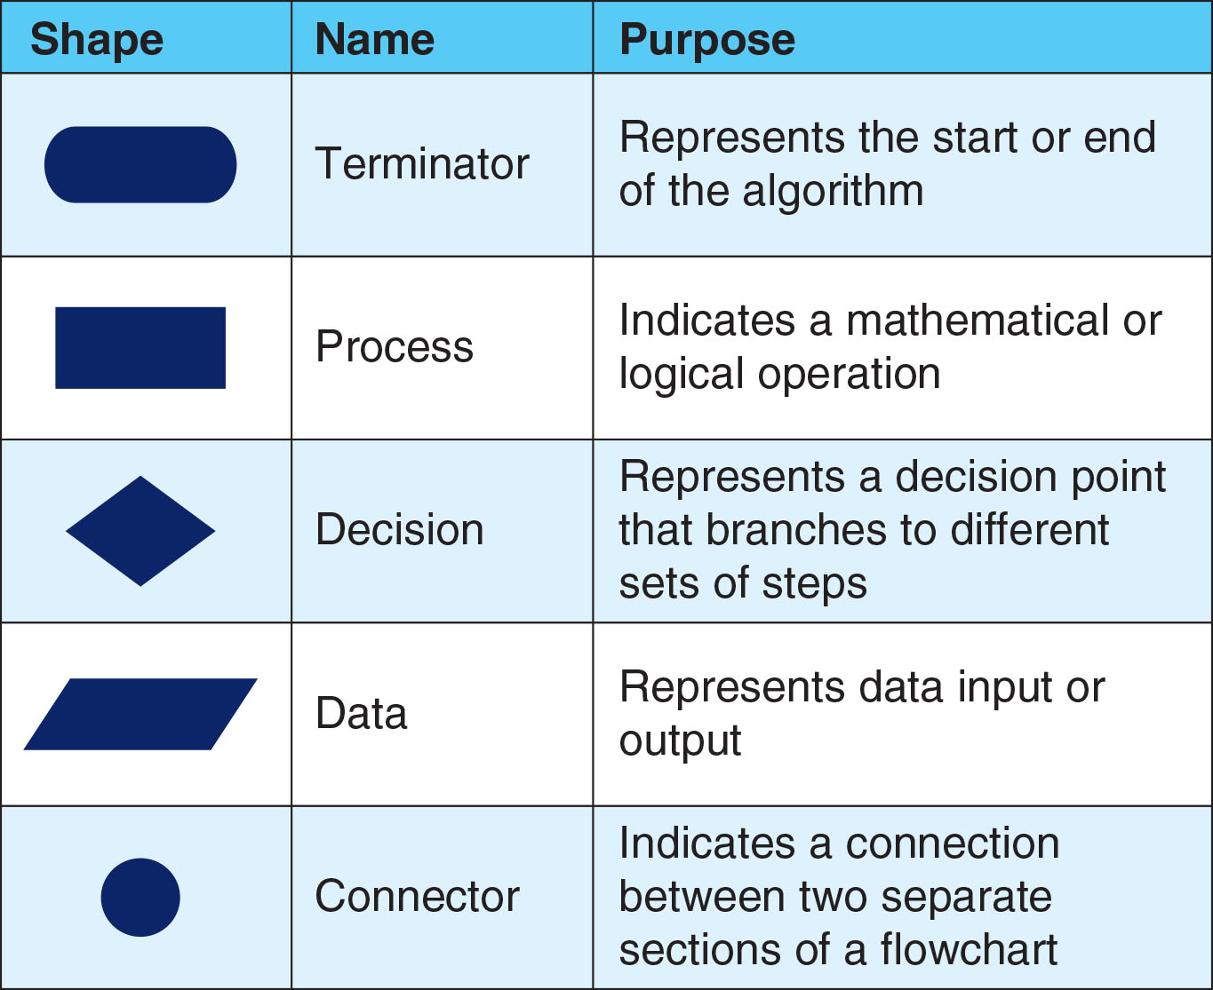
Flowcharts

Slide 14
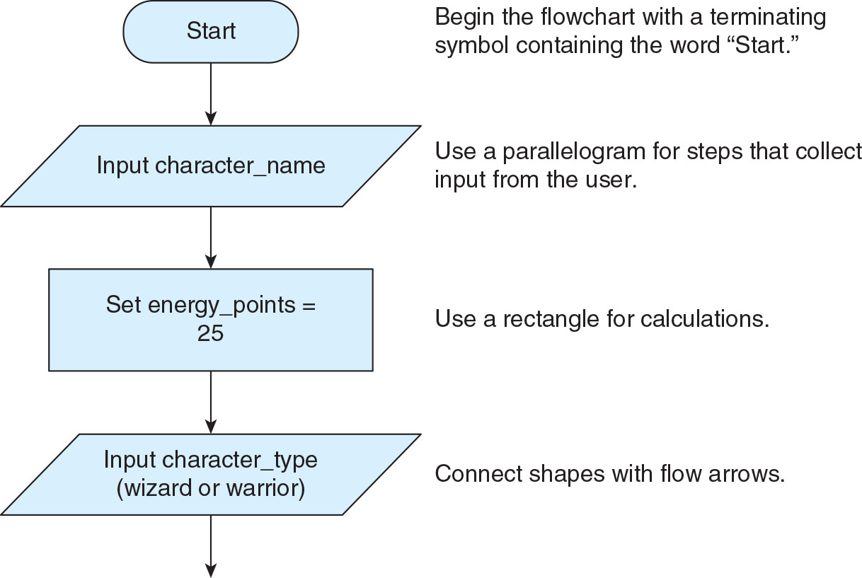
Flowcharts

Slide 15
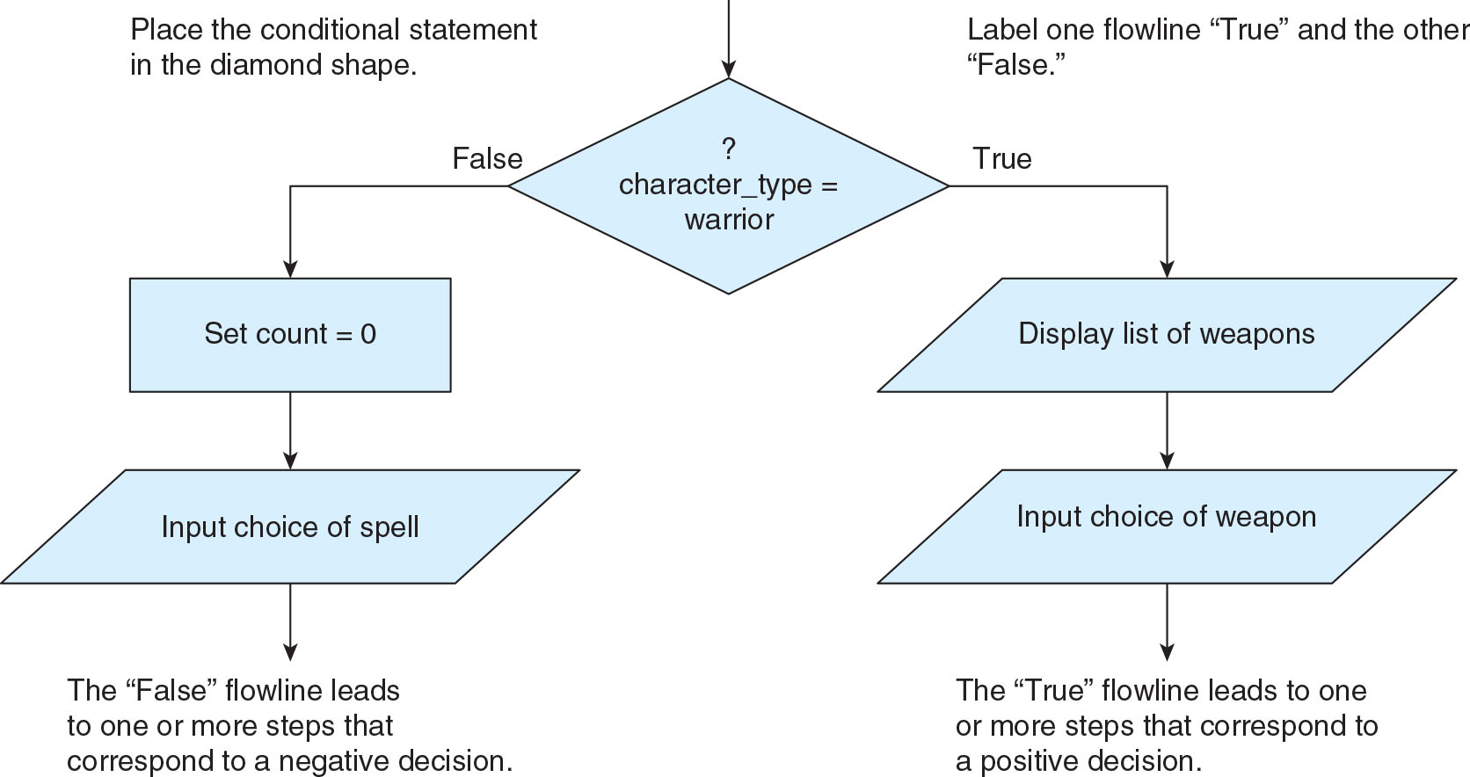
Flowcharts

Slide 16
Flowcharts
Flowchart tools
You can use diagramming software or an online diagramming app to create flowcharts
Apps allow you to drag and drop shapes, and typically to drag connecting arrows between shapes
Check your completed flowchart:
Each shape excluding the Start and End terminators should have at least one input and one output
All flow arrows should point in the correct direction to indicate the sequence of steps

Slide 17
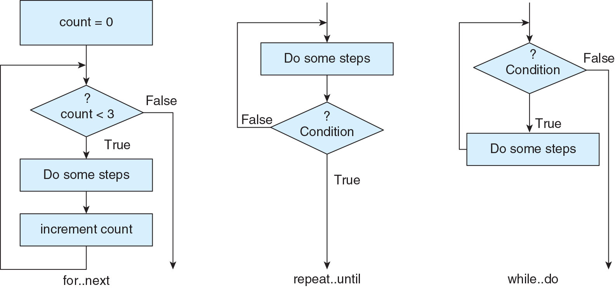
Flowcharts: repetition control structures

Slide 18
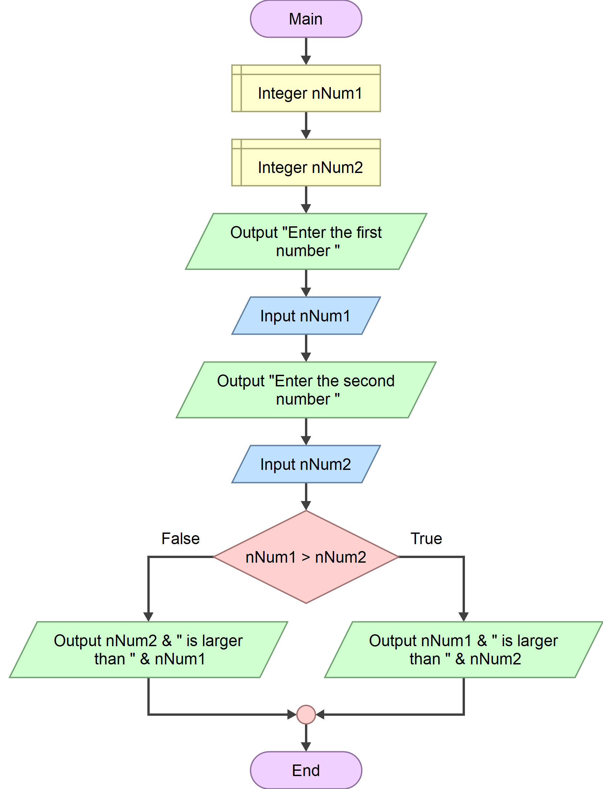
Pseudocode/Flowchart Example
NUMERIC nNum1,nNum2 declares two variables, nNum1 and nNum2, as numeric data types

Slide 19
Pseudocode/Flowchart Example
NUMERIC nNum1,nNum2 declares two variables, nNum1 and nNum2, as numeric data types

