Slide 1
Software Development Methodologies

Slide 2
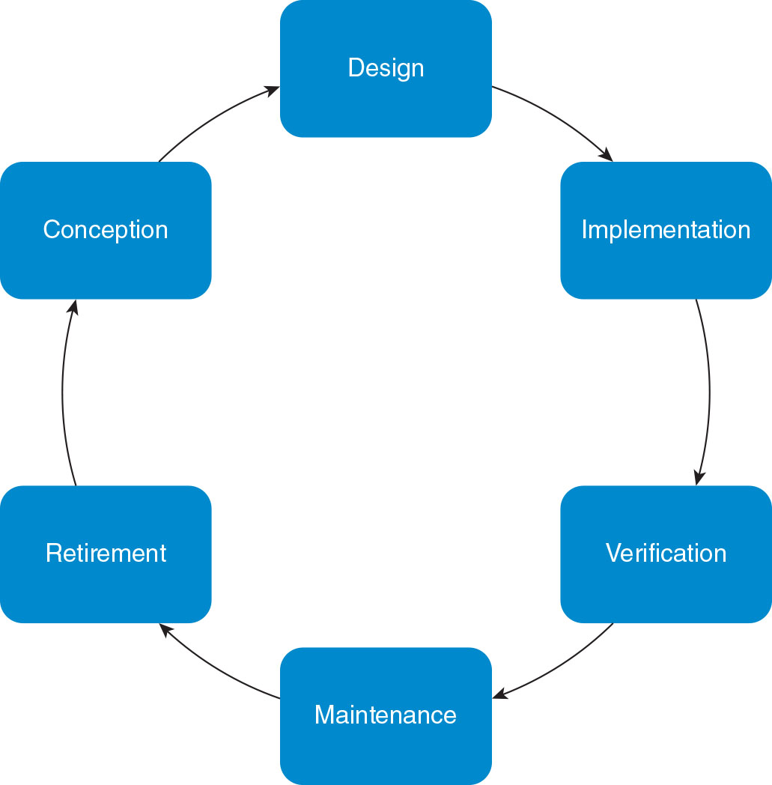
Software Development (1 of 4)

Slide 3
Software Development (2 of 4)
The software development life cycle
Software development life cycle: the phases of software development: conception/planning, design, implementation, verification, maintenance, and retirement
Key events occur during each phase
Conception and planning: requirements for what the software is expected to do are created by various stakeholders and combined into a plan
Design: developers formulate a model of the software using algorithms and data structures that specify how the software will meet the requirements
Implementation: code is written and data structures are populated
Verification: the software is tested, debugged, and optimized for deployment
Maintenance: the deployed software is incrementally improved
Retirement: support is discontinued
The cycle may begin again for a new edition of the software

Slide 4
Software Development (3 of 4)
The software development life cycle (continued)
Plan before you code, accounting for what the software should do and how
Testing is mandatory
Be prepared to revise and improve code with a long lifespan
Efficiency, quality, and security
Efficiency: combining a smaller hardware footprint with better response time
Security: protecting self, users, underlying hardware, and the communication system from unauthorized activities
Quality: correctness, reliability, ease of use, flexibility, testability, and maintainability

Slide 5
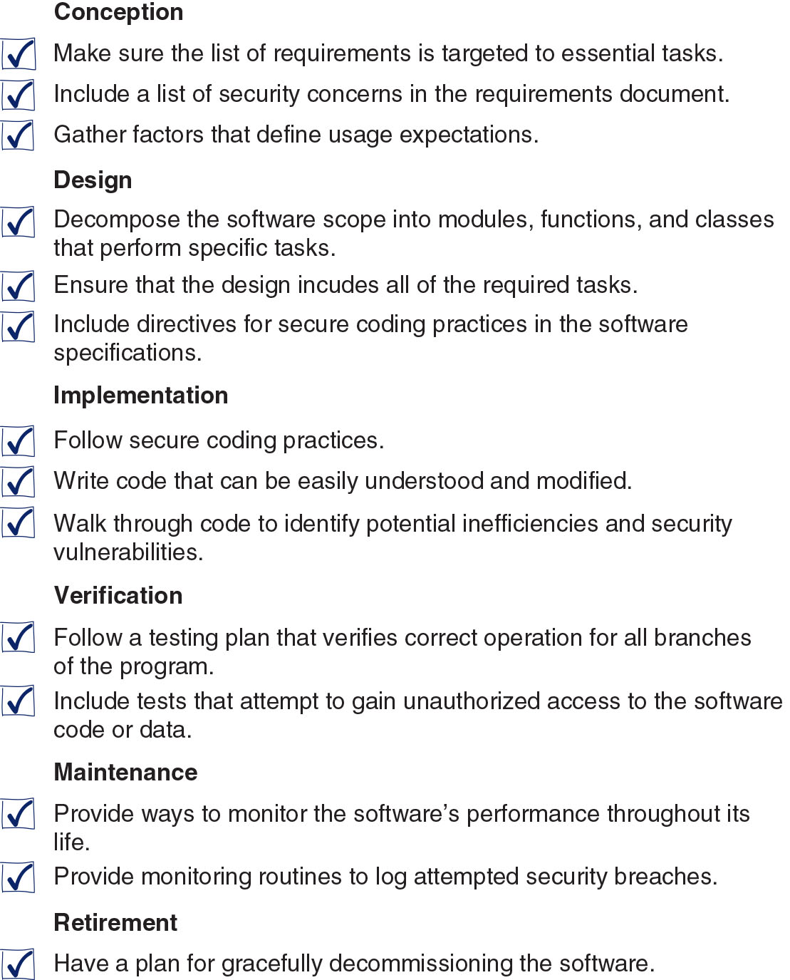
Software Development (4 of 4)

Slide 6
The Waterfall Model (1 of 3)
Structured analysis and design
Waterfall model: a model that divides software development into a series of cascading tasks that are performed one after the other
Waterfall advantages and disadvantages
Advantages:
Emphasis on planning during the analysis and design phases
Programmers have a clear mandate and don’t need to be concerned with last-minute change orders
Documentation created during the analysis and design phases needs only minor edits to become documentation for the final software product
The major criticism is lack of flexibility

Slide 7
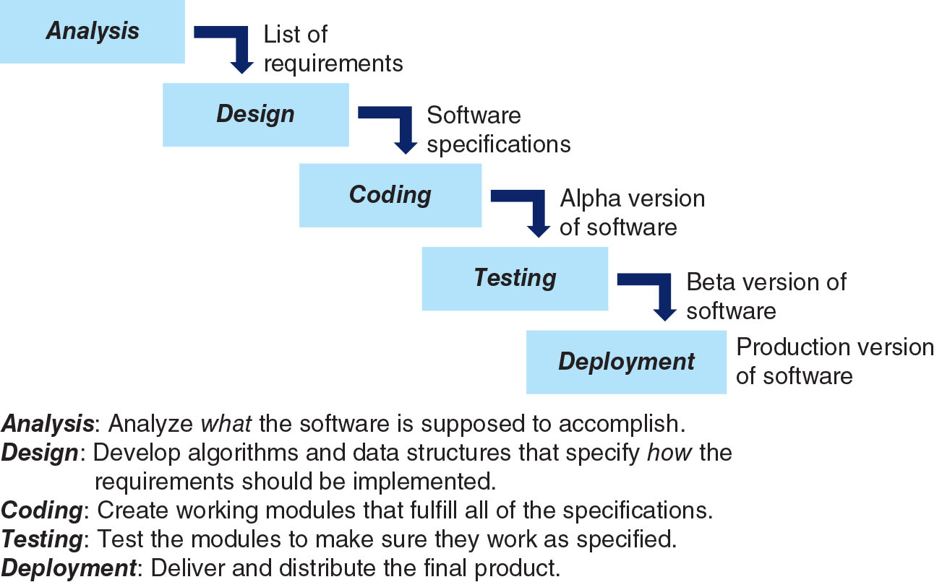
The Waterfall Model (2 of 3)

Slide 8
The Waterfall Model (3 of 3)
Waterfall advantages and disadvantages (continued)
Appropriate for development projects when:
Scope and size of the project are well defined
Requirements are clear at the beginning of the project
Underlying system and use cases are stable
Project has a defined completion period during which requirements are not likely to change

Slide 9
The Agile Model (1 of 5)
Incremental development
Incremental development model: model in which software is designed, coded, and tested in a succession of cycles
Each cycle produces a module that works and adds value to the project but is not necessarily feature complete
Agile methodologies
Agile developmental methodologies: methodologies based on incremental, iterative development (e.g., Scrum)
A Scrum Master is a professional who leads a team using Agile project management through the course of a project. A Scrum Master facilitates all the communication and collaboration between leadership and team players to ensure a successful outcome.

Slide 10
The Agile Model (2 of 5)
Four important principles of the Agile philosophy:
Interacting with users and team members rather than following a set process
Focusing on coding and testing rather than maintaining documentation
Getting feedback from users throughout the development process
Allowing specifications to change as developers respond to feedback

Slide 11
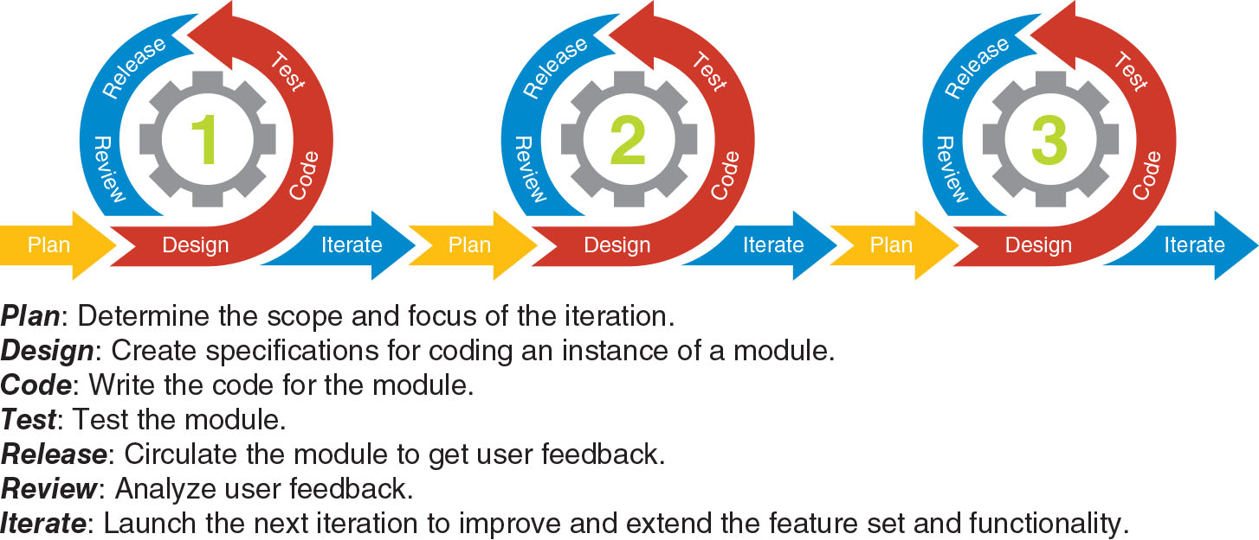
The Agile Model (3 of 5)

Slide 12
The Agile Model (4 of 5)
Agile advantages and disadvantages
Advantages:
More flexible
Functional software is released at the end of each iteration
Each release is thoroughly tested to ensure software quality
User interaction during multiple deployment and review phases provides developers with continuous feedback
Because of feedback during each iteration, the final product tends to satisfy user needs

Slide 13
The Agile Model (5 of 5)
Agile advantages and disadvantages (continued)
Disadvantages:
Measuring progress is difficult
Number of iterations that will be required for the final product is unknown
Developers can get sidetracked by requests to add features that are not essential to the software functionality
The lack of a comprehensive design plan tends to be reflected in haphazard documentation
Appropriate for projects where:
Requirements are not obvious when the project begins
It is acceptable for the design to emerge through prototyping
User involvement in the development process is important

